Slide 1
Physical Examination
Nose, Mouth and Throat
Assistant Lecturer
Alaa Hamza Hermis
Lecture -4-

Slide 2
Preparation
Nurse
Environment
Client
Equipment

Slide 3
(General Approach to assess ( Nose, Mouth, and Throat)
1. Greet the patient and explain the assessment techniques that using.
2. Use a quiet room that will be free from interruptions.
3. Ensured that the light in the room provides sufficient brightness adequate observation of the patient.
4. Place the patient in an upright sitting position or for patients who cannot tolerated he sitting position assess head so that it can be rotated from side to side
5. Visualize the underlying structures during the assessment allow adequate description of findings.
6. Always compare right and left ears, as well as right and left nose, sinuses, mouth, and throat ect..

Slide 4
Mouth & Oropharynx
Equipment Needed
1. Penlight
2. Tongue blade
3. Small gauze (2*2)
4. Clean gloves

Slide 5
Preparation:
1. Position the client sitting up straight with his \her head at your eye level.
2. Remove client's dentures if available
Subjective data:
I. Sores & Lesions
2.Sore Throat
3. Bleeding gum.
4. Toothache
5. Hoarseness
6. Dysphagia
7. Altered taste
8. Smoking, Alcohol
consumption
9. Self-care behaviors, dental care pattern, dentures or appliances

Slide 6
.
Inspection & palpation lips
Normal Findings
Color: in white skin Pink , in dark skin: may have bluish hue
or freckle like pigmentation.
Movement: symmetrical during smile , open and close . No lesions, swelling, drooping , its moist and smooth
Wearing gloves, inspect & palpate lips for the following:
The patient's teeth should be clean with no decay, appear white and shiny smooth surfaces and edges. Adults should have a total of 32 teeth with 16 teeth in each arch. Children by the age of 2 1/2 have a total of 20 teeth with 10 in each arch.
Abnormal findings
Missing teeth, loose or broken teeth and misaligned teeth
.

Slide 7
Wearing gloves, inspect & palpate buccal mucosa for the following:
Color: Pink (increased pigmentation often noted in dark- skinned client
Consistency : Smooth, moist, without lesions
Landmarks : Parotid duct openings are seen small papilla located near upper second molar
Retract client's lips to inspect & palpate gums for the following:
Color : pink
Consistency :Moist, free of lesion and ulcer ,pale or yellow defined in gingivitis

Slide 8
Inspect protruded tongue for the following:
Symmetry & texture and color moist; papillae present; symmetrical appearance; midline fissure present , pink ,smooth
Inspect ventral surface of the tongue & mouth floor for the following:
Color: pink slightly pale
Landmarks: Submandibular duct openings are located on both sides of the frenulum , tongue is free of lesions or increased redness; frenulum is centered.
Palpate inspected the site of tongue: pink , moist ,free of lesion and ulcer

Slide 9
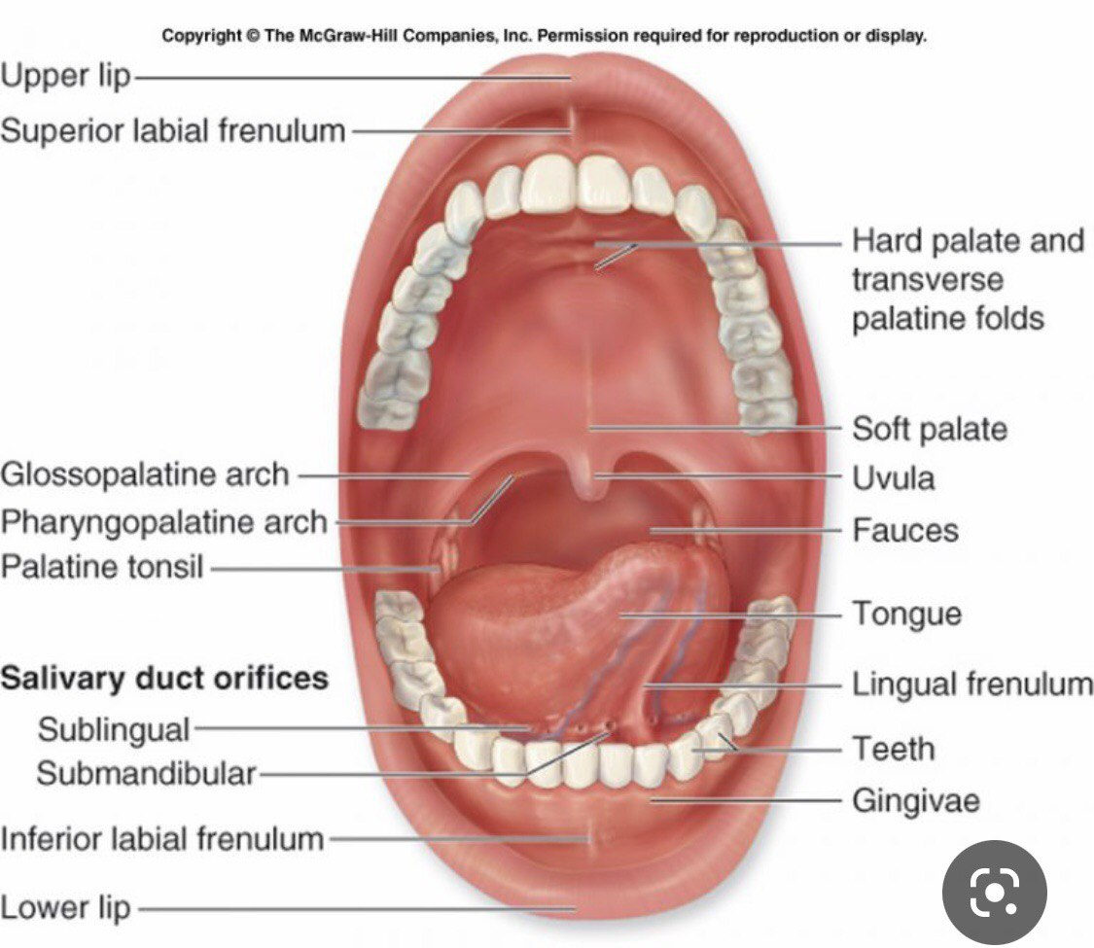

Slide 10
Inspect hard & soft palate for the following:
Color & consistency : hard palate is pale irregular while soft palate is pink and soft , spongy
Inspect oropharynx for the following:
Color : pink
Landmarks : Tonsillar pillars symmetrical;
tonsils present (unless surgically removed) &
without exudates; uvula at midline & rises on phonation.

Slide 11
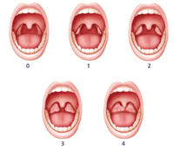
Grading of Tonsils :
0 : tonsils not visible
1+ tonsils are visible,
2 + tonsils are between the pillars and uvula
3 + tonsils are touching the uvula
4 + tonsils extend to the midline of the oropharynx.

Slide 12
Nasal airflow ( airway patency)
The common method via which to formally assess nasal airflow
1. Place thumb over the nostril not being assessed to occlude air flow.
2. Ask the patient to breath in through their nose and note the degree of airflow.
3. Repeat assessment on the other nostril, noting any difference in apparent airflow.

Slide 13
External
Look at the external surface of the nose noting:
Skin changes – e.g. skin lesions / erythema
Note any deviation in the nasal bones or cartilage
Internal
1. Ask the patient to look forwards, keeping their head in the neutral position.
2. Carefully elevate the tip of the nose with thumb, so that the nasal cavity becomes visible. Use a pen torch or otoscope as a light source to externally illuminate the cavity.
3. Inspect the nasal mucosa for any abnormalities (including the septum).
4. Inspect and compare the nasal cavities alignment (note any septal deviation).

Slide 14
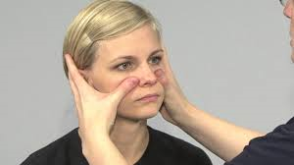
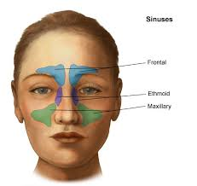
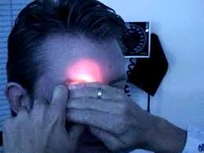
Sinuses

Slide 15
