Slide 1
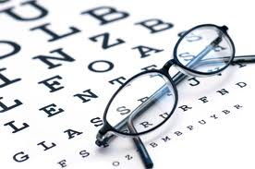
Eye Assessment
Assistant Lecturer
Alaa Hamza Hermis
Lecture -5-

Slide 2
Objectives:
students will be able to:
1. Demonstrate the ability to safely & accurately complete a comprehensive examination of the eye.
2. Demonstrate the ability to accurately document eye assessment data in organized manner.

Slide 3
Equipment Needed
1 . Snellen Chart
2. Near-vision chart
3. Cover card
4. Penlight
5. Ophthalmoscope
6. Ruler

Slide 4
Subjective data:
1. Vision difficulty (decrease acuity)
2. Redness, swelling
3. Glaucoma (blurring, blind spots)
4. Pain
5, Watering, discharge
6. Use of glasses or contact lenses
7. Strabismus, diplopia (Double Vision)
8. Past history of ocular problems
9. Self-care behaviors

Slide 5
External Eye Structures:
Eye brow: for shape, movement , hair distribution : normal finding revealed symmetrical in shape intact skin and evenly hair distribution , symmetrical movement
Eye lashes : evenly hair distribution ,curl directed outward
Eye lids : inspect for color ,lesion and movement : color same as the face no discoloration , free of lesion and discharge when lids closed it should be symmetrical complete , sclera not visible

Slide 6
Assess bulbar conjunctiva ( cover the eye ball and sclera : transparent ,sclera white or yellow. capillary appears free of lesion
( retract)
Assess palpebral conjunctiva line the eye lid normal finding pink to red ,shiny smooth free of discharge and lesion.

Slide 7
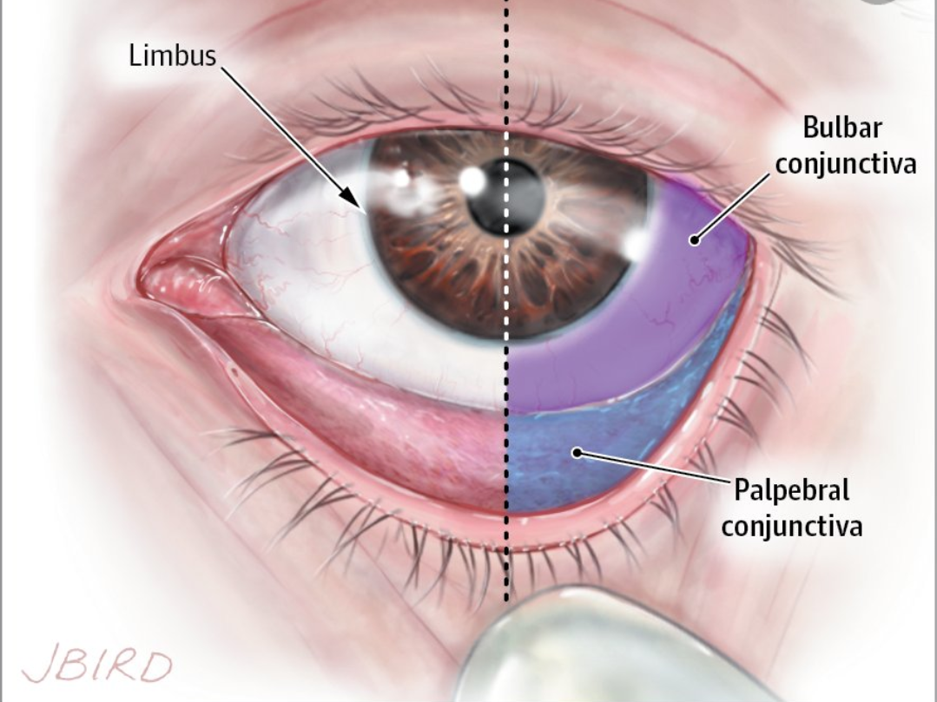

Slide 8
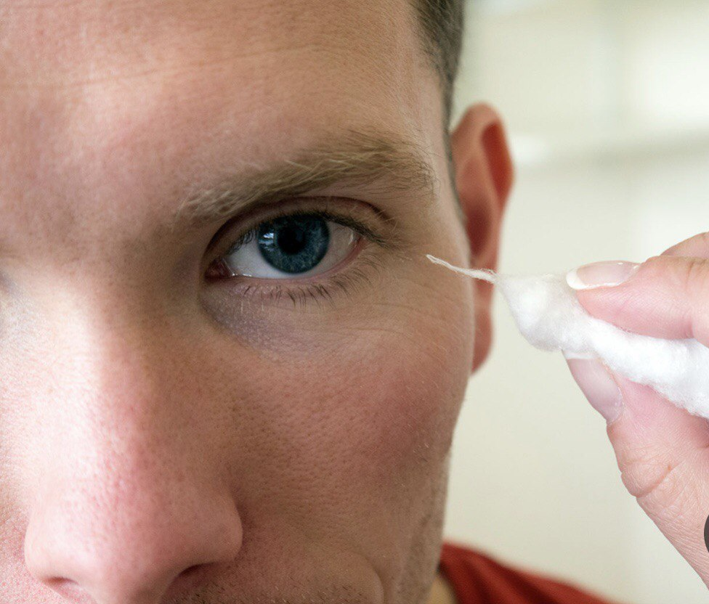
By using gauze or cotton touch the client cornea blinking indicate that the trigeminal (5th) nerve is intact

Slide 9
Inspect pupil : black in color , equal in size normally 3-7mm in diameter and round ,iris flat and rounded
Assess pupil for:
Direct reaction to light: pupil constrict
( penlight)
Reaction to Accommodation :
Penlight placed 10cm or 4 in near nose bridge , normal finding pupil constrict when looking on near object and dilated on far object.
Documentation: PERRLA (pupils equal round reacting to light and accommodation)

Slide 10
Assess Lacrimal Gland Sac and Nasolacrimal duct
Inspect and use index to palpate :
Free of edema ,no tenderness ,no excessive tearing
Lacrimal gland in outer eye canthus
Lacrimal sac and duct inner canthus of eye

Slide 11
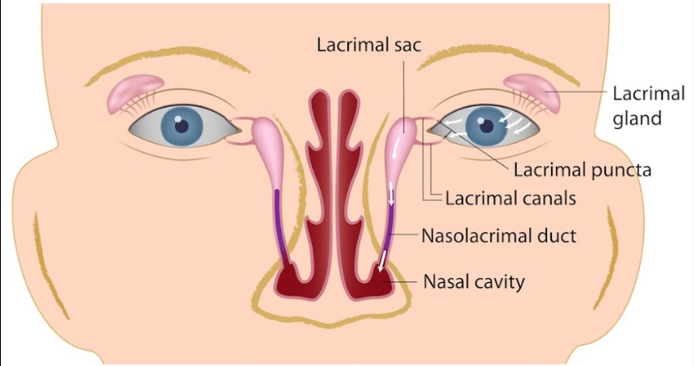

Slide 12
Exteraoccular Muscle Test
Stand direct in front of the client use penlight within 1ft distance (30 cm) ask the client to follow the object move toward 6 cardinal direction . Normal finding both eye coordinated movement
Abnormal: eye fail to follow the object squint and strabismus ( cross –eye)
Nystagmus : caused by nerve impairment

Slide 13
How is visual field testing done?
Visual field testing is performed on one eye at a time, with the opposite eye completely covered to avoid errors.
In all testing, the patient must look straight ahead at all times in order to avoid testing the central vision rather than the periphery.

Slide 14
The reasons for this test are the following :
* visual field testing is useful screening for glaucoma.
*testing patient with glaucoma for treatment response.
*screening and testing for lid droop or ptosis, particularly for insurance approval of lid lift surgical procedures.

Slide 15
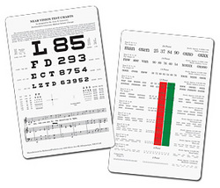
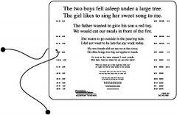
Visual acuity:
Near vision: within 30-36cm distance ask the client to read newspaper or magazine with keeping glass or lenses

Slide 16
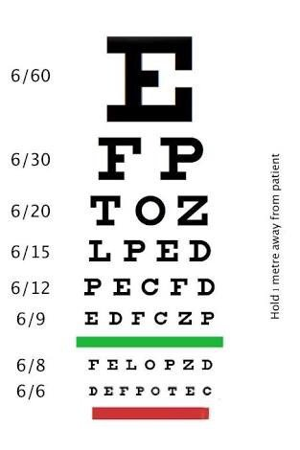
Snellen Chart

Slide 17
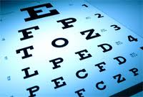
Distance vision test
within 20 feet or 6 meter by using snellen chart the client read the chart line from top to bottom .
First number 20 indicate the distance
Between the chart &client
Second number 20 indicate
The distance that normal
Eye can read
Glass and lenses kept

Slide 18
Distance from the chart
D (Distant) for the evaluation done at 20 feet (or 6 meters).
N (Near) for the evaluation done at 14 inches (or 36 cm).
Eye evaluated
  OD (Latin oculus dexter) for the right eye.
  OS (Latin oculus sinister) for the left eye.
  OU (Latin oculi uterque) for both eyes.
  CC (Latin cum correctors) with correctors.
  SC (Latin sine correctors) without correctors

Slide 19
Performing functional vision test
1- light perception: penlight from lateral than off ask client about light if he
recognize documentation : LP+
2- Hand movement within 30 cm 1 feet move hand back ,front than stop ask client when it stopped doc: H\M 1ft +
3- Counting finger within 30 cm or 1 ft ask the client number of finger doc: F\C+

Slide 20

Ophthalmoscope: A lighted instrument, one of the most important tools for examining the optic disc.
Normal orange to pink with vessel appearance
Abnormal pale red spot

