Slide 1
Heart & Neck Vessels Assessment
Hassanain Mohammed Kadhim
Lecture -8-

Slide 2
Objectives:
At the end of this lab, the students will be able to:
1. Demonstrate the ability to safely & accurately complete heart & neck vessels assessment.
2.Demonstrate the ability to accurately document heart & neck vessels assessment data in organized manner.

Slide 3
Equipment Needed
I . Marking Pen
2.Stethoscope with diaphragm & bell
3. Alcohol swab
4- Watch with second hand

Slide 4
Preparation
1. To evaluate the carotid arteries, the client can be sitting.
2. Stand on the client's right side.
3. The room should be warm.
4. Ensure the female's privacy by keeping her breasts draped.
5. Gently displace the breast upward, or ask the client to hold it out of the way.

Slide 5
Subjective data:
1. Cough
2. Nocturia (Excessive urination at night)
3. Dyspnea (Difficulty in Breathing)
4. Fatigue
5. Past cardiac history
6. Orothopnea (shortness of breathing when the patient lying flat ( supine position)
7. Cyanosis or pallor
8. Family cardiac history
9. Edema
10.Chest pain
11. Personal habits

Slide 6
The Neck Vessels
Palpate the carotid artery
Palpate each carotid artery
- Avoid excessive pressure on the carotid sinus area.
- Palpate gently.
Palpate only one carotid artery at a time.
- Feel the contour & amplitude of the pulse.
- Compromise finding to the other side.

Slide 7
Normal finding :
Contour is smooth
Strength is 2+ or moderate.
Findings should be same bilaterally

Slide 8
Assessment of Edema

Slide 9
Assessment of Pitting Edema According To 1-Deep 2- Location 3- Extension
0+ No edema
1+ Mild pitting edema ,2mm depression disappear rapidly.
2+Moderate pitting edema,4 mm disappear in10-15 sec
3+ Moderate severe pitting edema ,6mm depression disappear in more than 1 min
4+ Severe pitting edema , 8 mm depression that can disappear more than 2min

Slide 10
Palpate the Apical impulse: -
5th intercostal space at the left side of the chest
OR Left Midclavicular line under the nipple 2 cm
Note: apical impulse is not palpable in
obese or in clients with thick chest wall.

Slide 11
Palpation

Slide 12
Auscultation
clean the end pieces with alcohol swab.
- After you place the stethoscope, try closing your eyes briefly to get out any distraction.
- Begin with the diaphragm end piece & note the following:
Rate & rhythm
Identify S1 & S2
Listen for murmurs

Slide 13
1- S1 (Lub): produced by click of the atrioventricular Valve (Mitral & Tricuspid valve)
2- S2 (Dub) : produced by click of the semilunar valve
( Aortic & pulmonary valve)
Normal finding:
Rate range from 60-IOO bpm, &
the rhythm is regular.
Sl is louder than S2 at the apex,
& S2 is louder than S1 at the base.

Slide 14
Where to place your stethoscope
As with palpation of the heart, auscultation should proceed in a logical manner over 5 general areas on the anterior chest, beginning with the patient in the supine position. Examined with diaphragm, including:
1- Aortic region at the 2nd intercostal spaces at the right
2- Pulmonic region at the 2rd intercostal spaces at the left

Slide 15
3- Erb’s point at the 3th intercostal spaces (ICS)
4- Tricuspid region at the 4th Or 5th intercostal spaces at the left border of sternum
5- Mitral region (near the apex of the heard between the 5th intercostal spaces in the mid- clavicular line) (apex of the heart).

Slide 16
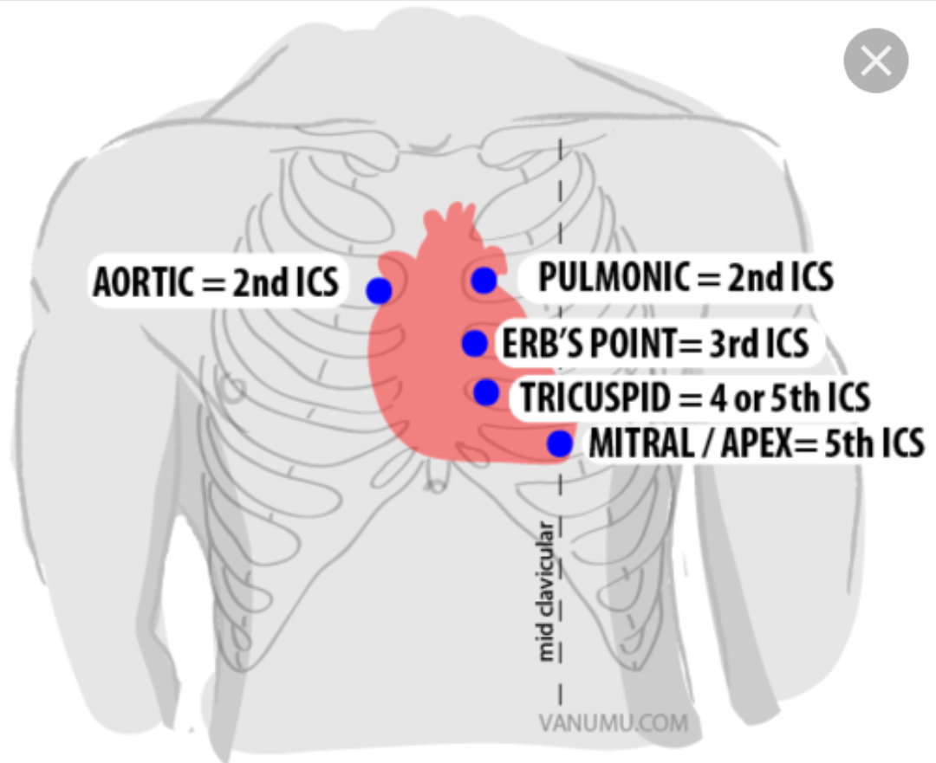
Auscultation

Slide 17
Auscultation

