Slide 1
Lecture #1
First semester
Nursing Process
:by
Professor
Dr. Fakhria Jaber
Al-Mustaqbal University College
Nursing Department
2nd Class
Adult Nursing

Slide 2
The nursing process
Is a deliberate problem-solving approach for meeting people’s health care and nursing needs.
Although the steps of the nursing process have been stated in various ways by different writers, the common components cited are assessment, diagnosis, planning, implementation, and evaluation (2017).

Slide 3
Characteristic of Nursing Process
Provide the framework for care.
It is client center.
Adapted of problem solving technique.
It has planned.
It is cyclic and dynamic.

Slide 4
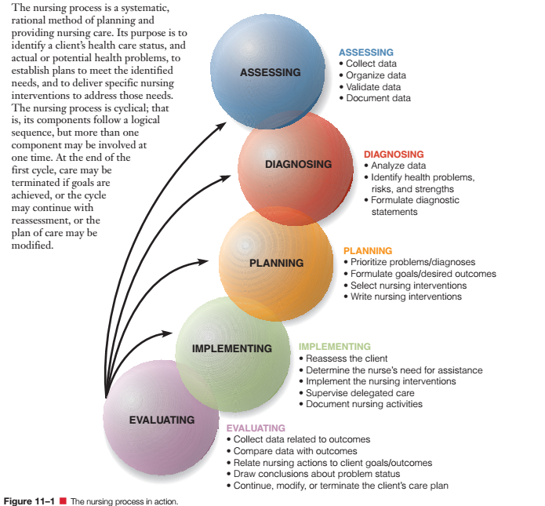

Slide 5
1- Assessment
The first step in the nursing process that include systematic collection of data through interview, observation, and examination to determine the patient’s health status as well as any actual or potential health problems

Slide 6
Types of assessment
Data base assessment –
comprehensive information you gather on initial contact with the person to assess all aspects of health status.
Focus assessment –
the data you gather to determine the status of a specific condition.
Emergency assessment:
the data you gather to determine the threatening status of a specific condition related to CAB system.
Ongoing assessment or (follow-up )
Data gathering extended to the client discharge to maintain his health condition

Slide 7
Data collection
Data collection Is the process of gathering information about client health status.
The collection of patient data is vital steps in nursing process because the remaining steps depend on these steps.
Characteristic of data:
Complete.
Accurate
Relevant.

Slide 8
Data collection
Sources of Data
Primary source: Client
Secondary source: Client’s family, reports, test results, information in current and past medical records.
Types of data
Subjective data: (symptoms, covert data), the client only client can be described. Such as itching, pain, feeling, I feel weak all over.
Objective data: referred to as (signs or overt data) are detectable by observe or can be measured, it can be seen, heard.
Example Blood pressure reading, pulse, redness, cyanosis.
Blood pressure: 90/ 50 mmHg.

Slide 9
Methods of Data Collection
Observation
  Notes the general appearance and behavior of the client
  Helps to determine the client’s status, both physical and mental
Interview
  Preparation
  Stages
    Introduction
    Working
    Closure
Notes:
Observation:
A- Vision (all appearance).
B- Smell (body or breathing odors)
C- Hearing (breathing, heart, bowel)
D- Touching (temperature, pulse rate)

Slide 10
Methods of Data Collection
Physical examination
Assessment techniques
  Inspection
  Palpation
  Percussion
  Auscultation
Laboratory and diagnostic data

Slide 11
Subjective Data
Biographical data (demographical data) (ID)
  Name
  Age
  Gender (male-or-female)
  Marital status (married, single, divorce)
  Educational level ( primary, secondary, diploma,….)
  Occupation (worker, officer, gainer(
  Religion (Muslimism, Jewish, Christian
  Birth date
  Birth place
  Phone number
  Phone number of significant person
  Address

Slide 12
Subjective Data
Past history
  Previous Illness or Diseases
  Previous Surgery
  Allergies —> (from food, drug)
  Accident and injury
  Immunization
  Medication
  Previous hospitalization
Present history (pain assessment)
  C: Characteristics
  O: Onset
  L: Location + Radiation
  D: Duration
  S: Severity (0-10 scale)
  0-4 mild\ 5-6 moderate\ 7-10 sever
  P: Pattern
  A: Association sign and symptom

Slide 13
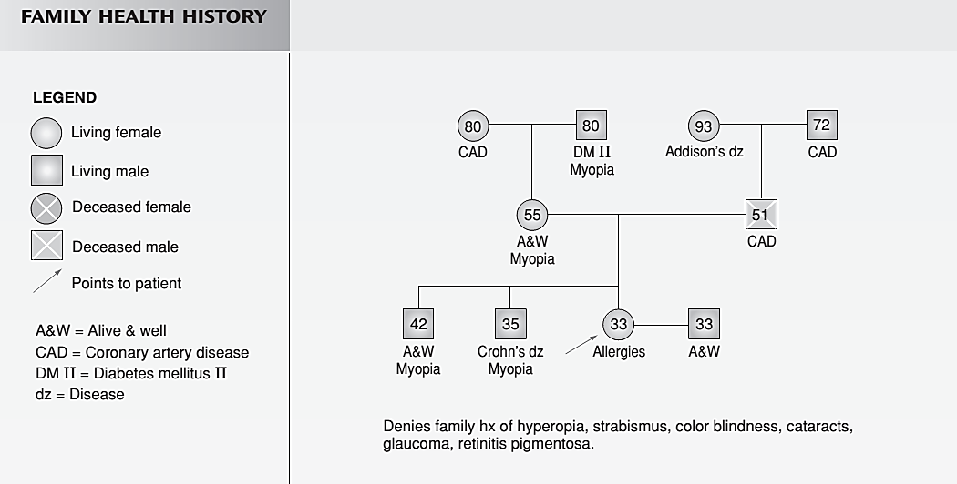
Subjective Data
Family History (genogram)
Diseased
Diseased
(continued)

Slide 14
Subjective Data
Social History
  Alcohol Use
  Tobacco Use
  Drug Use
  Sleep
  Diet
  Exercise
  Stress
  Stress Management
  Economic Status
  Hobbies and Leisure Activities
  Roles and Relationships

Slide 15
Subjective Data
Social History
  Characteristic Patterns of Daily Living
  Daly activities (dependent, independent, need assistant)
  Bathing
  Dressing
  Eating
  Toileting
  Grooming
  Drinking
  Ambulating

Slide 16
    2- Nursing Diagnosis:
Second step of the Nursing Process that describes clinical judgments about individual, family, or community responses to actual or potential health problems/life processes” that can be managed by independent nursing interventions
NANDA Definition: (North America Nursing Diagnosis Associate)
Nursing diagnosis is a clinical judgment about individual, family, or community responses to actual and potential health problems/life processes.

Slide 17
A nursing diagnosis (Nsg Dx) vs A medical diagnosis(MD Dx)
Within the scope of nursing practice
Identify responses to actual or potential health problems/life processes.
Can change from day to day
Within the scope of medical practice
determines a specific disease, condition or pathological state.
Stays the same as long as the disease is present

Slide 18
Types of Nursing Diagnoses
Actual: A problem exists
Imbalanced nutrition; less than body requirements RT chronic diarrhea, nausea, and pain AEB height 5’5” weight 105 lbs.
Risk: A problem does not yet exist
Risk for falls RT altered gait and generalized weakness.

Slide 19
Components of Nursing Diagnosis
It contains three parts:
Problem:
1) Identifies unhealthy response
2) Indicates what should change
Etiology:
1) Identifies causative or contributing factors
  suggests nursing interventions
Sign and symptom: redness, cyanosis, loss of appetite.
It called PES system.
Example:
problem
Etiology
Sign
Ex: Anxiety related to Fear of death manifested by patient verbalization.
Ex: Activity intolerance related to obesity manifested by body weight 140 KG.

Slide 20
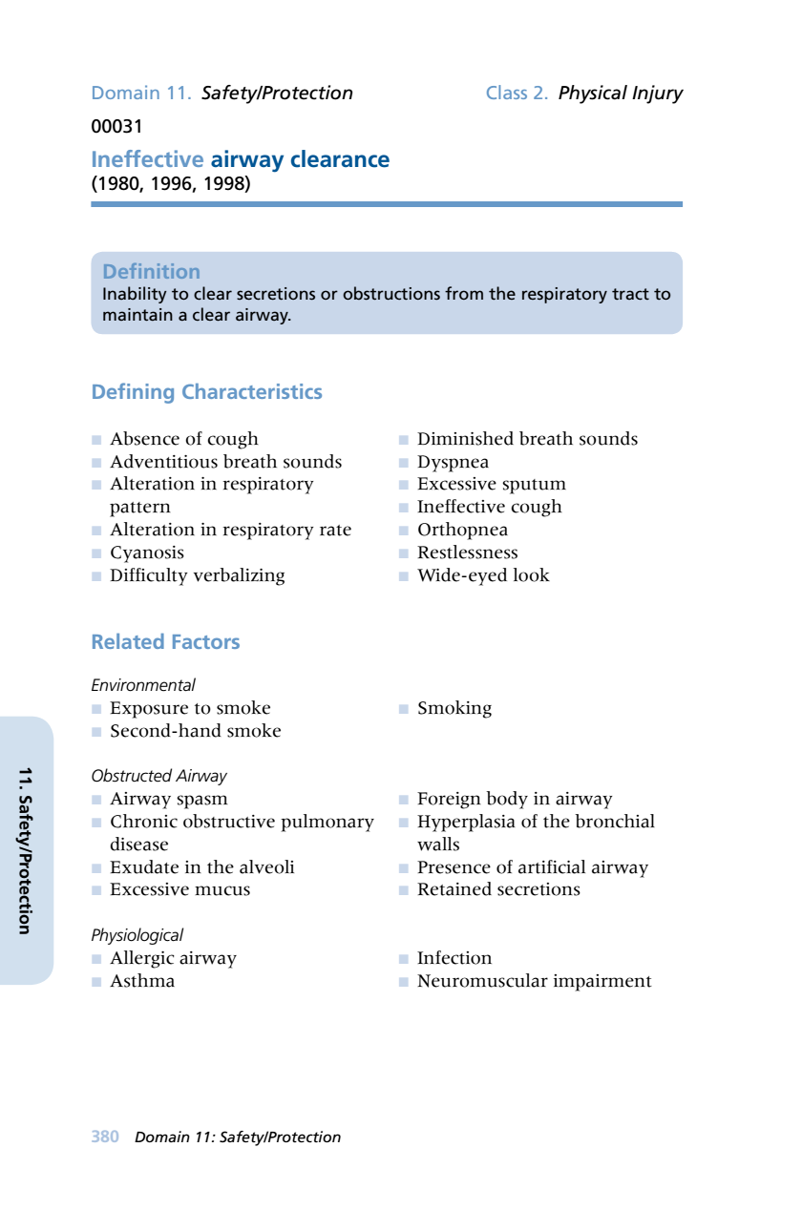
Writing Diagnostic Statements
Writing Diagnostic Statements
1
3
2

Slide 21
3- Planning
Third step of the Nursing Process;
That is development of measurable goals and outcomes as well as a plan
of care designed to assist the patient in resolving the diagnosed problems and achieving the identified goals and desired outcomes.
Planning process:
Prioritize problem.
Formulate goal.
Select nursing intervention.
Write nursing order.
Record and modify.

Slide 22
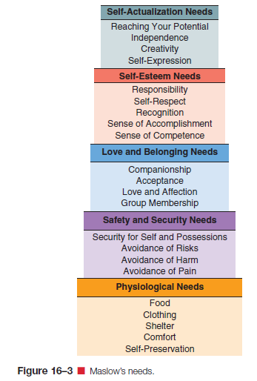
Setting Priorities
Determine problems that require immediate action
Maslow’s Hierarchy of Human Needs

Slide 23
  Goals
Short-Term Goals
Outcomes achievable in a few days or 1 week
Client-centered
Measurable
Realistic
Accompanied by a target date
Long-Term Goals
Desirable outcomes that take weeks or months to accomplish for client’s with chronic health problems

Slide 24
Components of Outcomes
Subject: who is the person expected to achieve the outcome?
Verb: what actions must the person take to achieve the outcome?
Condition: under what circumstances is the person to perform the actions?
Performance criteria: how well is the person to perform the actions?
Target time: by when is the person expected to be able to perform the actions?
The patient (1) will walk (2) with a walker (3) the length of the hall (4) by the end of the shift (5

Slide 25
Interventions – 3 types
Independent ( Nurse initiated )- any action the nurse can initiate without direct supervision
Dependent ( Physician initiated )-nursing actions requiring MD orders
Collaborative- nursing actions performed jointly with other health care team members

Slide 26
4- Implementation
forth step of nursing process,
The implementation phase of the nursing process involves carrying out the proposed plan of nursing care..
Process of implementation:
  Reassessing the client.
  Determine the nurse need for assistance.
  Implementing.
  Supervising.
  Document the action.

Slide 27
5- Evaluation
Final step of the Nursing Process that determine the client progress toward goals achievement and effectiveness of the nursing care plan.
A comparison of client behavior and/or response to the established outcome criteria
Continuous review of the nursing care plan
Examines if nursing interventions are working
Determines changes needed to help client reach stated goals

Slide 28
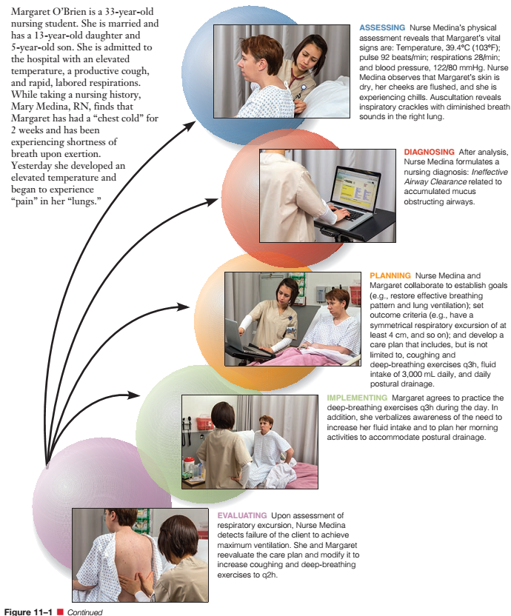

Slide 29
Case study:
Mrs. A 23 years old admitted to the hospital, married, the temperature is elevated, productive cough, rapid respiration with difficulty.
1) Assessment:
V/S are temperature 39.1C, pulse 92 b/m, respiration rate 28 b/m and blood pressure 122/80 mm/hg. nurse observe that Mrs. A is dry skin, her cheeks are flushed, she is experience of chill.
On chest, auscultation reveals respiratory crackles.

Slide 30
2) Diagnosis:
Ineffective breathing pattern related to accumulation of secretion as manifested by productive cough, rapid
respiration with difficulty.
3) Planning:
Goal:
The patient (S) will able to breath (V) normally (c) within 8 hours (T).
Restore effective breathing pattern.
Interventions: Deep breathing exercise. Increase fluid intake,
Bronchodilator medications.

Slide 31
4) Implementation:
  Mrs. A agree to practice:
  Deep breathing exercise q4hrs.
  Increase the fluid intake.
  Take bronchodilator medications.
5) Evaluation:
(The goal not met) the nurse detects failure of the client to breath normally, the plan modify to reach normal breathing and then reevaluation.

Slide 32
Thanks
For Listening

