Slide 1
Lecture #3
First semester
Appendicitis
University College
Department of Nursing
2nd Class
Adult Nursing

Slide 2
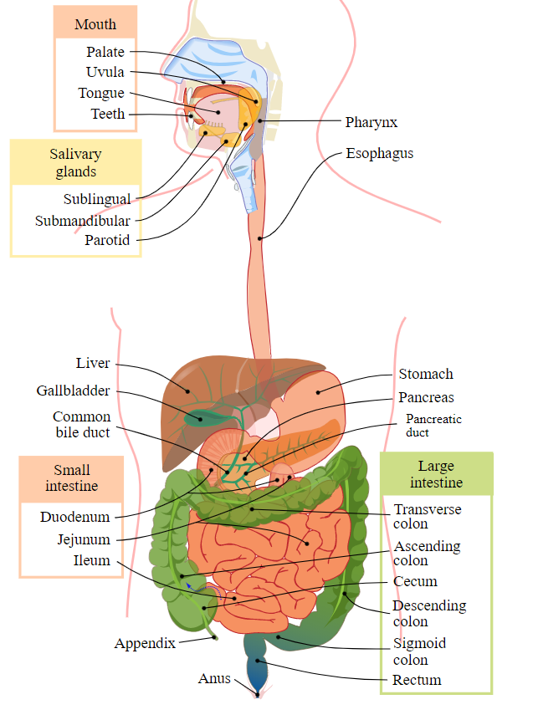

Slide 3
Definition
Appendicitis is inflammation of the vermiform appendix caused by an obstruction of the intestinal lumen from infection, stricture, fecal mass, foreign body, or tumor.

Slide 4
Pathophysiology/Etiology
Obstruction is followed by inflammation of the appendix, edema, infection, and mucous ulceration, ischemia and the lumen filled with pus.
As intraluminal tension develops, necrosis and perforation usually occur.
Appendicitis can affect any age group, but is most common in males 10 to 30 years old.

Slide 5
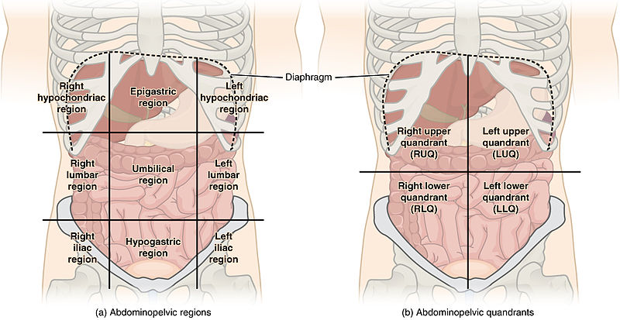
The 9 Regions of the Abdomen

Slide 6
Clinical Manifestations
Generalized or localized abdominal pain in the epigastric or periumbilical areas and the right upper abdomen. Within 2 to 12 hours, the pain localizes in the right lower quadrant and intensity increases.
Local tenderness at the mcBurny's point (point just below midpoint of line between umbilicus and iliac crest on the right side)
Rebound tenderness, involuntary guarding.

Slide 7
Cont.
4). Rovsing's sign by palpating left lower quadrant cause pain in the right lower quadrant.
5). Anorexia, moderate malaise, mild fever, nausea and vomiting.
6). Usually constipation occurs; occasionally diarrhea.
7). Late, tachycardia and fever.
8). If appendix ruptures, pain becomes more diffuse, abdominal distension from paralytic ileus and the condition worsen.

Slide 8
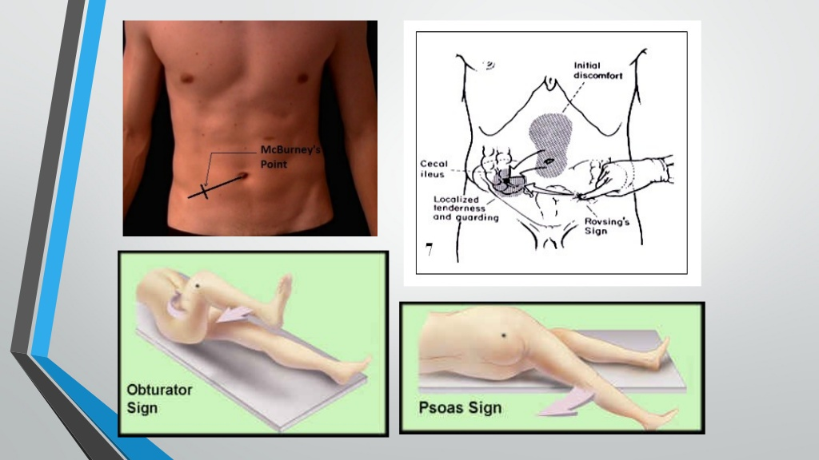


Slide 9
Diagnostic Evaluation
Physical examination consistent with clinical manifestations.
White blood cell (WBC) count reveals moderate leukocytosis (10,000 to 16,000/mm) with shift to the left (increased neutrophils).
Abdominal x-ray may visualize shadow consistent with fecalith in appendix.
Pelvic sonogram can visualize appendix and rule out ovarian cyst.

Slide 10
Management
Surgery
Simple appendectomy or laparoscopic appendectomy.
Preoperatively maintain bed rest, NPO status, IV hydration, possible antibiotic prophylaxis, and analgesia.
Complications
  Perforation (in 95% of cases)
  Abscess
  Peritonitis

Slide 11
Nursing Assessment
Obtain history for location and extent of pain.
Auscultate for presence of bowel sounds; peristalsis may be absent or diminished.
On palpation of the abdomen, assess for tenderness anywhere in the right lower quadrant, but often localized over McBurney’s point (point just below midpoint of line between umbilicus and iliac crest on the right side).

Slide 12
Cont..
4). Assess for rebound tenderness in the right lower quadrant as well as referred rebound when palpating the left lower quadrant.
5). Assess for positive psoas sign by having the patient attempt to raise the right thigh against the pressure of your hand placed over the right knee. Inflammation of the psoas muscle in acute appendicitis will increase abdominal pain with this maneuver.
6). Assess for positive obturator sign by flexing the patient’s right hip and knee and rotating the leg internally. Hypogastric pain with this maneuver indicates inflammation of the obturator muscle.

Slide 13
Nursing Diagnoses
Pain related to inflamed appendix
Risk for Infection related to perforation

Slide 14
Nursing Interventions
A. Relieving Pain
Monitor pain level, including location, intensity, pattern.
Assist patient to more comfortable positions, such as semi-Fowler’s and knees up.
Restrict activity that may aggravate pain, such as coughing and ambulation.
Apply ice bag to abdomen for comfort.
Give analgesics only as ordered after diagnosis is determined.
Avoid indiscriminant palpation of the abdomen to avoid increasing the patient’s discomfort.
Do not give antipyretics to mask fever and do not administer cathartics, because they may cause rupture.

Slide 15
Nursing Interventions
B. Preventing Infection
Monitor frequently for signs and symptoms of worsening condition indicating perforation, abscess, or peritonitis: increasing severity of pain, tenderness, rigidity, distention, ileus, fever, malaise, tachycardia.
Administer antibiotics as ordered.
Promptly prepare patient for surgery.

Slide 16
Evaluation
Verbalizes increased comfort with positioning and analgesics
Afebrile; no rigidity or distention

Slide 17
Thanks
For Listening

