Slide 1
linear programming Practical application
م .د وليد علي حمزة
م. م ينب كاظم جابر

Slide 2
What is linear programming
Linear programming is a mathematical concept used to determine the solution to a linear problem. Typically, the goal of linear programming is to maximize or minimize specified objectives, such as profit or cost. This process is known as optimization. It relies upon three different concepts: variables, objectives, and constraints

Slide 3
Variables are numerical or logic values, such as quantity of product to be produced or whether a distribution center is open
Linear programming determines the optimal value for such variables.
Objectives, such as maximum profit, are a linear function of an optimization’s variables
Constraints are also linear functions of an optimization variables, and are used to restrict the values an optimization can return for a variable. Constraints must be logic linear functions.

Slide 4
^{LP Application Requirements}
In order to apply Linear Programming for Data Science, the below requirements have to be met:
We should be able to define the objective or the aim clearly in mathematical terms.
The input variables that determine the objective should be distinct and quantitative.
Limitations or constraints that have to be considered should be quantitative and measurable.
Relationship between the objective and the input variables has to be linear in nature.

Slide 5
^{Formulation of LP Problems}
Below are the steps to be followed to formulate LP Problem:
Identify the decision variables that are used to formulate and achieve the objective function
Define the objective function: It defines the business objective in mathematical form
List out the constraints or limitations using the decision variables in mathematical form
Identify and list out the non-negative constraints
we will look at the 2 tools (Graphical method, Excel Solver) which can be used to solve LP problems.

Slide 6
Solution using Excel Solver
The solver is a mathematical program or software that takes required input, applies the selected algorithm and provides a mathematical solution to the problem.
Ensure you have Solver add-in available in the Data tab of your Excel Workbook as shown in the figure below

Slide 7
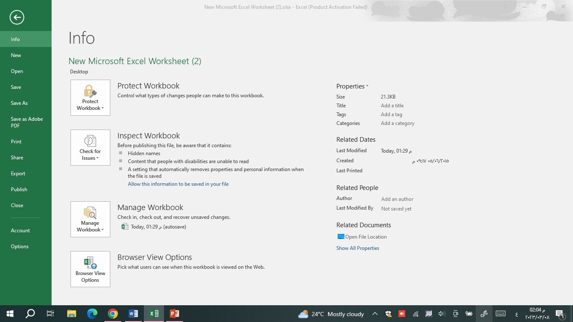
First, we click on the file icon
Then click on options

Slide 8
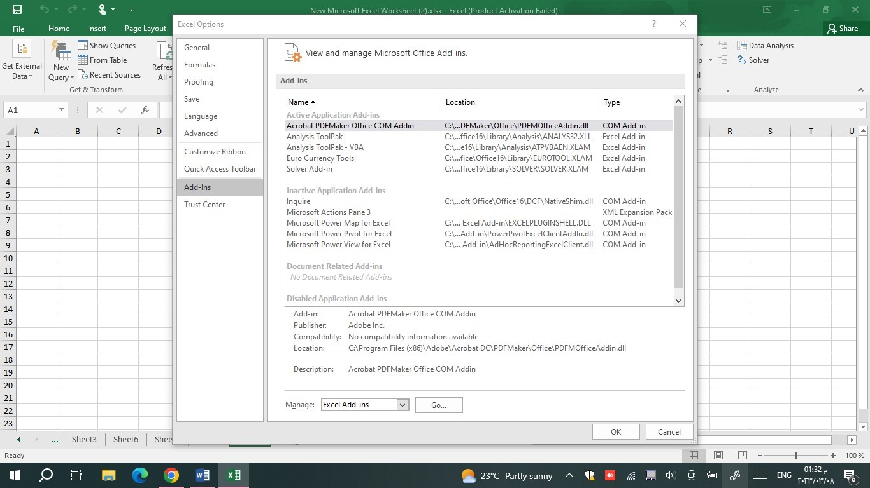
Then click on Add- Ins
After that click on
Solver Add in
Finally click on ok button

Slide 9
Example 1: Solve the following linear programming problem using the graphical method. Maximize: Z = 2x1 +4x2 4x1 + 3x2≥ 12, 2x1 + 2x2≤10, x1, x2 ≥ 0
FIRST WE USED THE GRAPHICAL:
Solution: Using the constraints we get the equations of the lines as 4x1 + 3x2= 12 and 2x1 + 2x2= 10.
4x1+ 3x2 = 12 passes through (0, 4) and (3, 0). Any point lying on or above this line satisfies 4x1 + x2 ≥ 12
2x1 + 2x2 = 10 passes through (0, 5) and (5, 0). Any point lying on or above this line satisfies 2x1 +2x2 ≥ 10. The graph is given as

Slide 10
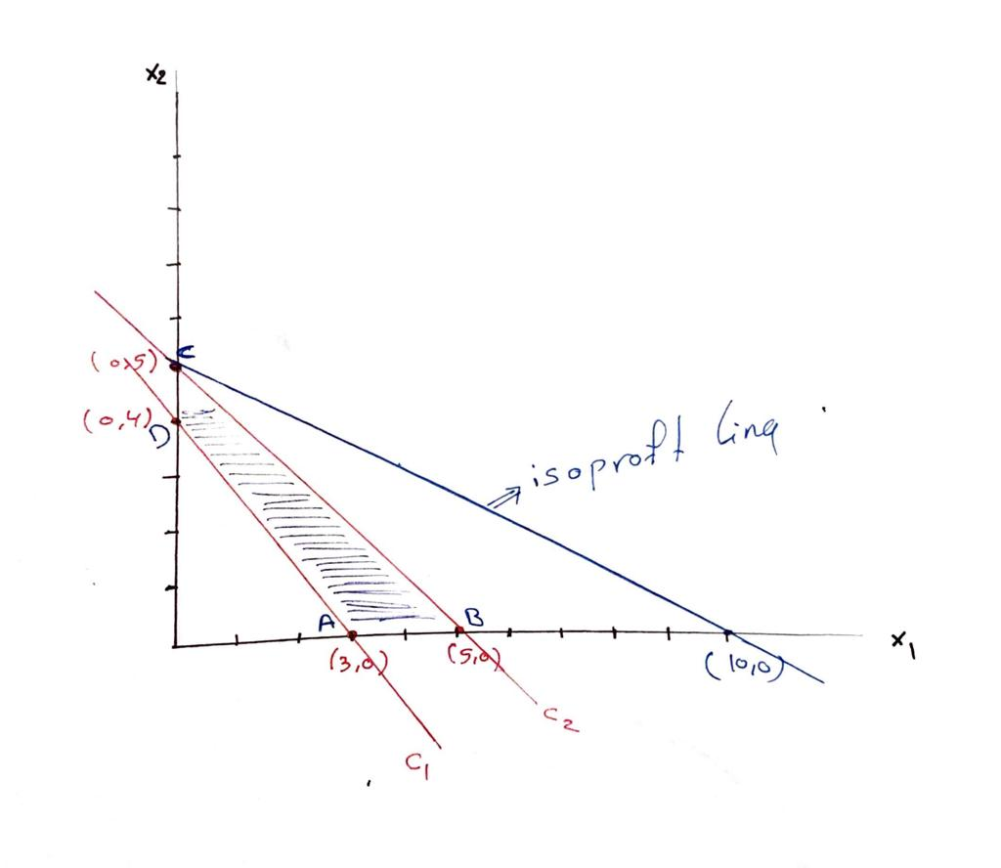
The maximum value of Z = 20 and it occurs at C (0,5) Answer: the maximum value of Z = 20 and the optimal solution is (0,5)
Corner points | Z = 2x1 + 4X2
A = (3, 0) | 6
B = (5,0) | 10
C = (0,5) | 20
D = (0, 4) | 8

Slide 11
SOLVE THE SAME PROBLEM BY USING SOLVER
Z= 2X1+4X2
=2*B2+4*B3
4X1+3X2>=12
=4*B2+3*B3
2X1+2X2<=10
=2*B2+2*B3

Slide 12
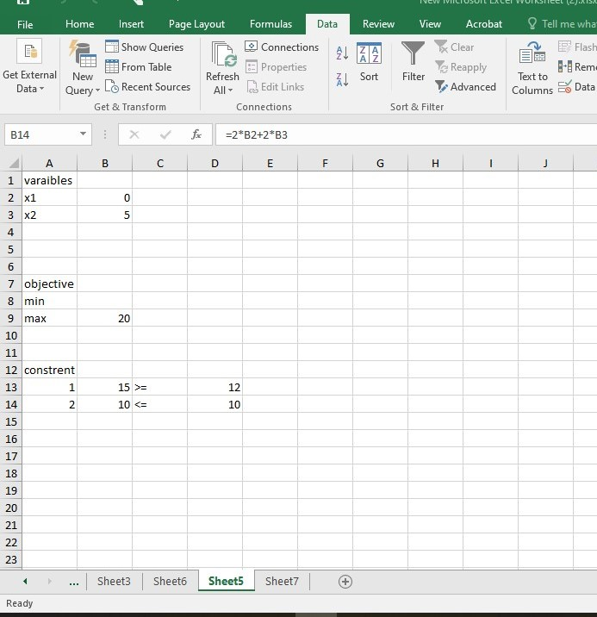
CLICK ON SOLVE
The maximum value of Z = 20 and it occurs at C (0,5) Answer: the maximum value of Z = 20 and the optimal solution is (0,5)

Slide 13
Advantages of Linear Programming
LP is useful for the business as the decision-maker can obtain an optimum solution by considering the effective use of scarce resources
It is a structured technique and helps in making informed data-driven decisions
It provides alternate solutions which the decision-maker can analyze further and finalize based on subjective matters that also need to be considered
LP can also be used for changing situations. Changed constraints or additional constraints can be included in the model to get revised output.

Slide 14
Application of Linear Programming
LP is widely used in Production to decide on Production mix, Production Planning, Assembly line balancing, etc.
Oil industries use LP to get optimum quality of the oil by blending the right proportion of different crude oils, octane, etc.
In finance, decisions have to be taken on where the money should be spent and from where the company needs to get the money to ensure that they maximize the returns keeping the risks under acceptable control. Buying and selling bonds, managing corporate finances, and making financial decisions.
Media selection, plant location, and reducing traveling salesman’s cost are some of the areas where LP is used in the sales and marketing space.
In call centers and hospitals, LP is used for scheduling shifts for employees.
Defense makes use of LP to decide on the optimum level of force deployment to a particular place considering the different situations and constraints.

