Slide 1



AL-Mustaqbal University
Microsoft PowerPoint
Lecture 2
Home Tab – Styling your Presentation
By M.Sc. Shahlaa yaseen
College of Engineering and Technology
Department of Medical Instrumentation Techniques Engineering

Slide 2

Introduction
Microsoft PowerPoint comes packed with a ton of features. And, all these features are usually accessible using the “Tabs” and “Ribbons” in PowerPoint.
It is important to know about each “Tab” in PowerPoint in further detail to help you remember its features. Knowing how to access each feature can drastically reduce the time you spend creating a presentation.
The lecture will provide an in-depth exploration of the "Home“ tab in PowerPoint, shedding light on its features and functionalities.

Slide 3
Home Tab – Styling your Presentation
The “Home” tab in Microsoft PowerPoint contains all the necessary commands for inserting and editing slides in a presentation. It usually contains shortcuts to some of the most commonly used features that are available in other tabs in PowerPoint.
The “Home” tab is the second tab in the menu ribbon located at the top of the screen. It is between the “File” tab and the “Insert” tab. When you open a new PowerPoint file, the “Home” tab will open in the menu ribbon by default.

Slide 4

Home Tab – Styling your Presentation
In Microsoft PowerPoint, the commands in the “Home” menu are arranged in 6 groups based on the similarity of their functions (Clipboard, Slides, Font, Paragraph, Drawing, Editing). Each of these groups contains a range of functions.
1. Clipboard
2. Slides
3. Font
4. Paragraph
5. Drawing
6. Editing

Slide 5
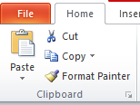
Home Tab- Clipboard Group
The “Clipboard” feature allows you to copy items from any source and paste it into your presentation slides. You can keep copied texts, pictures, graphics, charts, datasheets, slides, etc. in the PowerPoint Clipboard.
The “Clipboard” option contains (Copy, Cut, Paste, Format Painter)
Copy
This command allows you to make a copy of selected text, objects, or slides and store it on the clipboard. To use this command, select the content you want to copy and click the "Copy" button or press (Ctrl+C) on your keyboard.

Slide 6
Home Tab- Clipboard Group
Cut
The "Cut" command works similarly to the copy command but also removes the selected content from its original location. To use this command, select the content you want to cut and click the "Cut" button or press (Ctrl+X) on your keyboard.
Paste
Once you have copied or cut content, you can use the "Paste" command to insert it into a new location within your presentation. Place the cursor where you want to paste the content, click the "Paste" button, or press (Ctrl+V) on your keyboard.

Slide 7
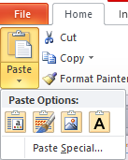
Home Tab- Clipboard Group
The Paste Options in PowerPoint 2010 provide the following choices when pasting content:
Use Destination Theme: Applies the formatting of the destination presentation's theme to the pasted content, ensuring consistency with the overall theme of the presentation.
Keep Source Formatting: Preserves the original formatting of the copied content, including font styles, colors, and other formatting attributes.
Picture: When copying an image or screenshot, allows you to paste it as an independent image file, without any text or formatting.
Keep Text Only: Pastes only the plain text from the copied content, discarding any formatting or styling. Useful for removing formatting inconsistencies or when the source formatting is not important.

Slide 8

Home Tab- Slides Group
Slides group provides options for managing and modifying slides in your presentation. It includes commands such as New Slide, Layout, Reset, and Section.
New Slide: Insert a new slide into your presentation, offering different layout options.
Layout: Changes the layout of the selected slide, determining the arrangement of text and content placeholders.
Reset: Restores the selected slide to its original layout and formatting.
Section: Help you organize your slides into logical groups, making it easier to navigate and manage larger PowerPoint presentations. You can collapse or expand sections to hide or show the slides within them by clicking on the arrow next to the section header.

Slide 9
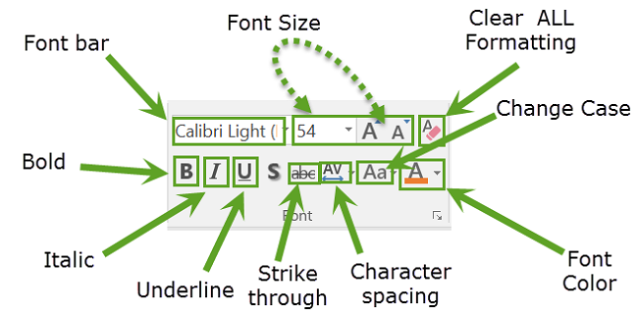
Home Tab- Font Group
The Font group provides options for modifying the appearance and formatting of selected text such as:
Font Bar/Name: Allows you to select a specific font for the selected text.
Font Size: Enables you to choose the size of the font for the selected text.
Bold: Applies bold formatting to the selected text.
Italic: Applies italic formatting to the selected text.
Underline: Adds an underline to the selected text.
Strikethrough: Adds a horizontal line through the middle of the selected text.

Slide 10
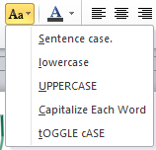
Home Tab- Font Group
Character Spacing: Modify the space between individual characters in the selected text.
Change Case: Modify the capitalization of selected text.
Sentence case: Capitalizes the first letter of each sentence and converts the remaining text to lowercase.
Lowercase: Converts all the selected text to lowercase.
Uppercase: Converts all the selected text to uppercase.
Capitalize Each Word: Capitalize the first letter of each word in the selected text.
Toggle Case: Toggles the case of each character in the selected text, converting uppercase letters to lowercase and vice versa.

Slide 11
Home Tab- Font Group
Font Color: Allows you to select a specific color for the selected text.
Clear All Formatting: Clear all formatting from selected text and restore it to its default formatting.

Slide 12

Home Tab- Paragraph Group
The Paragraph group provides several options for formatting and manipulating text within a slide. The commonly used options within the paragraph group are:
Numbering
Line Spacing
Bullets
Left Align
Center Align
Right Align
Justify
Left to Right
Right to Left

Slide 13
Home Tab- Paragraph Group
The Paragraph group provides several options for formatting and manipulating text within a slide. The commonly used options within the paragraph group are:
Bullets and Numbering: Bullets and Numbering: This button allows you to apply bullet points or numbering to your paragraphs. You can choose different bullet styles, create custom bullets, or modify the numbering format.
Text Alignment: This set of buttons lets you align your text within a text box or placeholder. You can choose from options like left align, center align, right align, or justify (align text to both left and right margins).

Slide 14
Home Tab- Paragraph Group
Line Spacing: This button allows you to adjust the spacing between lines in a paragraph. You can choose options like single spacing, 1.5 spacing, or double spacing. Additionally, you can select "Line Spacing Options" to customize the spacing further.
Left to Right Text Direction: Set the direction of text to be displayed from left to right.
Right to Left Text Direction: Set the direction of text to be displayed from right to left.
Text Direction: This button allows you to change the direction of the text in a text box or placeholder. You can choose options like horizontal, vertical, or rotate the text.
Convert to SmartArt: Transform plain text into visually appealing and organized smart art graphics.

Slide 15

Home Tab- Editing Group
By utilizing the "Find" and "Replace" options within the "Editing" group on the "Home" tab in PowerPoint, you can efficiently search for specific text within your presentation and make replacements as needed.
"The 'Find' option allows you to search for specific text within your presentation. By clicking on the 'Find' button, a dialog box will appear where you can enter the text you want to locate. PowerPoint will then highlight the instances of that text, making it easy for you to navigate through your slides."

Slide 16
Home Tab- Editing Group
On the other hand, the 'Replace' option goes a step further by finding specific text and allowing you to replace it with different text. When you click on the 'Replace' button, a dialog box appears where you can enter the text you want to find and the text you want to replace it with. PowerPoint will search for the specified text and allow you to replace individual occurrences or all instances of the text.
These 'Find' and 'Replace' options are handy when you need to make changes to your presentation. Whether you want to correct a typo, update a term, or replace a particular phrase throughout your slides, these tools make it quick and efficient.

Slide 17
Thank You

