Slide 1



AL-Mustaqbal University
Microsoft PowerPoint
Lecture 4
Insert Tab – Inserting Objects II
By M.Sc. Shahlaa yaseen
College of Engineering and Technology
Department of Medical Instrumentation Techniques Engineering

Slide 2

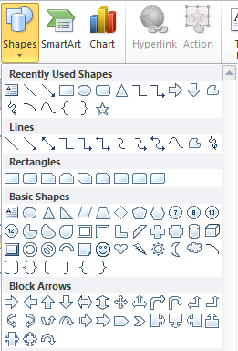
Insert Tab – Inserting Objects II
Illustrations: In PowerPoint, the "Illustrations" group under the "Insert" tab provides options for adding various visual elements to your presentation. The main features and options you'll find in the "Illustrations" group are:
Shapes: This tool allows presenters to add a variety of shapes and drawing objects to slides. These shapes can be customized with different colors, outlines, and effects to create diagrams, icons, or other visual aids.

Slide 3
Insert Tab – Inserting Objects II
In PowerPoint, the "Drawing Tools" are primarily found in the "Format" tab, not the "Insert" tab. When you insert a shape or object on a slide, the "Drawing Tools" or "Format" tab appears, providing options to edit and format the selected shape. Here are the main features available in the "Drawing Tools" tab:.
Drawing Tools
Insert Shape
Shape Styles
WordArt Styles
Arrange
Size

Slide 4


Insert Tab – Inserting Objects II
1. Insert Shapes: The "Shapes" gallery in the "Drawing Tools" tab allows users to select and insert various shapes such as rectangles, circles, arrows, and more.
Edit Shape: The "Edit Shape" feature enables users to modify the selected shape by converting it into different shapes.
Text Box
Change Shape feature allows you to quickly switch between different predefined shapes while keeping the size and formatting of the original shape intact.
Edit Points feature allows you to modify the shape of a drawn object by manipulating individual points that define its outline.
Text Box: Text boxes are versatile elements that allow you to place and format text in a flexible manner within your presentation.

Slide 5

Insert Tab – Inserting Objects II
2. Shape Styles: Using shape styles in PowerPoint ensures a consistent and professional design across shapes, promoting visual cohesion in your presentation. Additionally, shape styles save time by offering quick, predefined formatting options, enhancing the overall efficiency of your design process.
To refine a predefined shape style in PowerPoint, utilize the "Format" tab tools, including:
"Shape Fill" for adjusting colors and patterns and remove the shape fill.
"Shape Outline" for modifying outline attributes and remove the shape outline.
"Shape Effects" for enhancements like shadows and reflections.
shape Fill
Predefine shape style
shape Outline
shape Effects

Slide 6


Insert Tab – Inserting Objects II
3. Arrange: The "Arrange" group includes options to adjust the layering of objects on the slide. Users can bring objects to the front or send them to the back, align objects, group or ungroup shapes, and rotate them.
4. Size: The "Size" group in the "Format" tab provides tools for adjusting the size and dimensions of selected shapes

Slide 7
Thank You

