Slide 1



AL-Mustaqbal University
Microsoft PowerPoint
Lecture 1
Introduction to PowerPoint
By M.Sc. Shahlaa yaseen
College of Engineering and Technology
Department of Medical Instrumentation Techniques Engineering

Slide 2

Introduction
Microsoft PowerPoint is a type of visual communication tool developed by Microsoft. It consists of a series of slides that can contain text, images, videos, charts, and other multimedia elements. PowerPoint presentations are commonly used for business meetings, educational purposes, and various other settings to convey information in a structured and visually appealing manner. PowerPoint presentations have two common file extensions:
    ppt: Compatible with older PowerPoint versions (97-2003).
    pptx: Default format for modern PowerPoint versions (2007 and later), offering enhanced features and broad compatibility

Slide 3
Benefits of Power Point
PowerPoint provides multiple benefits to users, including:
Ease of Use: PowerPoint is designed for simplicity, making it accessible even to those with minimal technical skills. Its user-friendly interface allows anyone to create presentations effortlessly.
Visual Appeal: PowerPoint enables users to craft visually appealing slides by incorporating images, charts, graphs, and other visual elements. This enhances the overall impact and comprehension of the content.
Flexibility: Users have the freedom to customize their presentations using various templates, fonts, colors, and design options. This flexibility allows for a unique and tailored presentation style.

Slide 4
Benefits of Power Point
Compatibility: PowerPoint presentations are highly compatible, ensuring that they can be easily shared and viewed on different devices, including computers, tablets, and smartphones. This broad accessibility is a significant advantage for reaching diverse audiences.
Efficiency: PowerPoint provides time-saving features such as pre-designed templates, slide layouts, and content creation tools. These tools streamline the process of assembling and formatting content, allowing users to focus on the message rather than technical details.

Slide 5
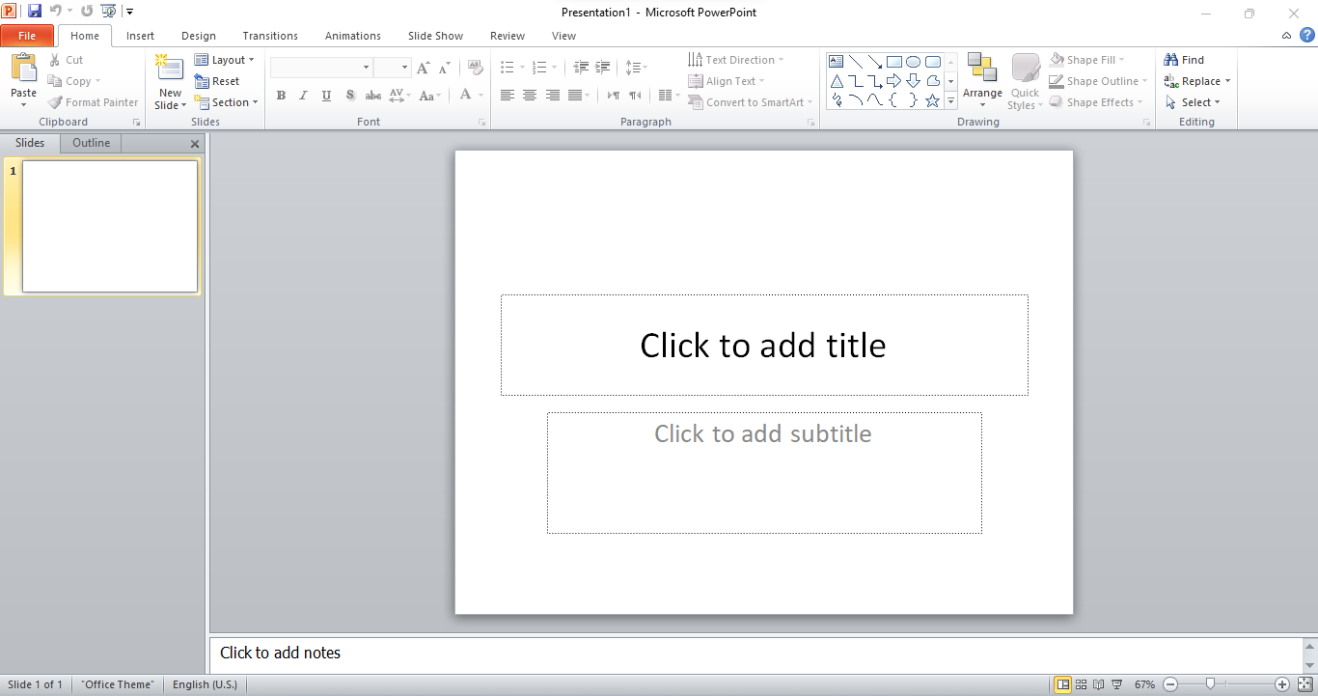
Microsoft PowerPoint Interface Parts
3. Quick Access Toolbar
1. Title Bar
Close Button
9. File Tab
2. Ribbon
New PowerPoint Slide
4.Slides/outline Pane
5. Slide Workspace
7. Notes Pane
6. Status bar
8. View Buttons

Slide 6
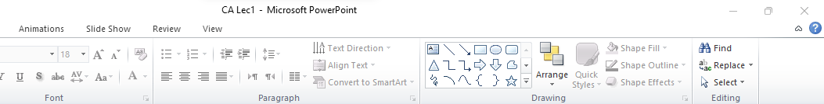
The Title Bar
1. Title Bar: The topmost part of the window displays the name of your presentation file. You can use the buttons here to minimize, maximize, or close the PowerPoint window.
Presentation File Name
Close Button
Minimize Button

Slide 7
Ribbon
2. Ribbon: Below the title bar, you'll find the Ribbon. It is divided into tabs, such as "Home," "Insert," "Design," and more. Each tab contains groups of related commands and tools for formatting and designing your slides.
Home Tap
Design Tap
Ribbon

Slide 8
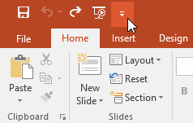
The Quick Access Toolbar
3. The Quick Access Toolbar, located just above the Ribbon, allows you to access the most common commands regardless of the selected tab. By default, it includes commands like Save, Undo, Redo, and Start From Beginning, and you can also add other commands based on your preferences.

Slide 9
Slides/Outline Pane & Slide Workspace
4. Slides/Outline Pane: on the left side of the window, you'll see a pane that displays thumbnails of your slides in Slide view or a text outline of your presentation in Outline view. You can switch between these views as needed.
5. Slide Workspace: The main area in the center of the window is where you create and edit your slides. You can add text, images, shapes, charts, and other elements to your slides here.

Slide 10
Status Bar & Notes Pane & View Buttons
6. Status Bar: At the very bottom of the window, the status bar provides information about your presentation, including the slide number and view mode. It also includes zoom controls.
7. Notes Pane: In Normal view, you can find a pane at the bottom to add speaker notes for each slide. These notes can be useful for your reference during a presentation.
8. View Buttons: In the bottom-right corner, you'll find buttons to switch between different view modes like Normal view, Slide Sorter view, and Slide Show view.
Notes Pane
View Buttons
Status Bar

Slide 11
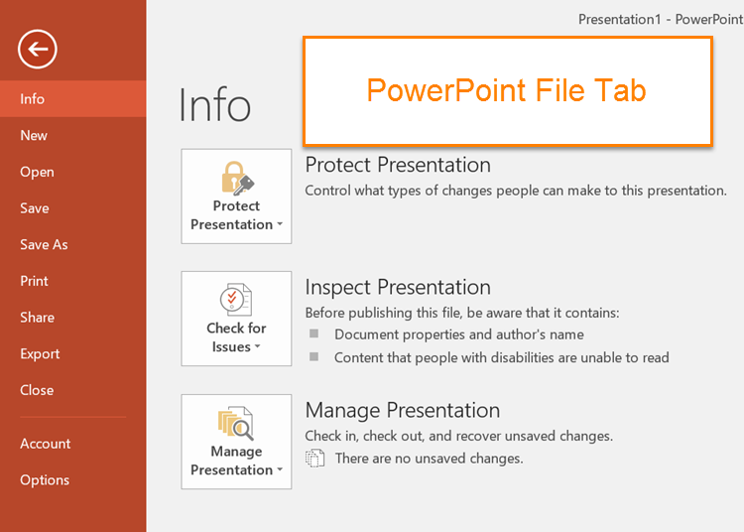
File Tab
9. File Tab: In the top-left corner, the File tab (also known as the Backstage view) allows you to access commands related to opening, saving, printing, and sharing your presentation. It's where you can manage the file itself.

Slide 12
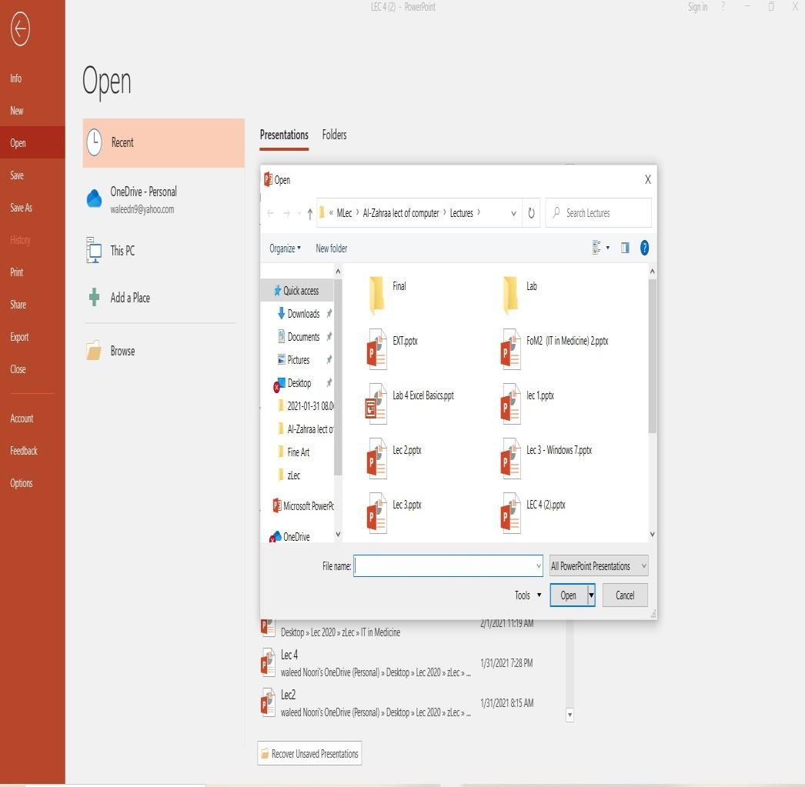
Opening a Presentation
Opening a presentation allows you to access and use a previously created and saved presentation, whether it was created by you or someone else. This lesson will explain how to do that.
Open a presentation
While you can easily locate a presentation on your computer and open it by simply double-clicking the file, you can also open a presentation from within the PowerPoint program itself.
There are two ways to open a file in PowerPoint:
You can click the File tab and select Open, which will bring up the Open dialog box. Then, you'll need to specify the location of the file you want to open.
You can use the keyboard shortcut <Ctrl>+ <O> to open a presentation.

Slide 13
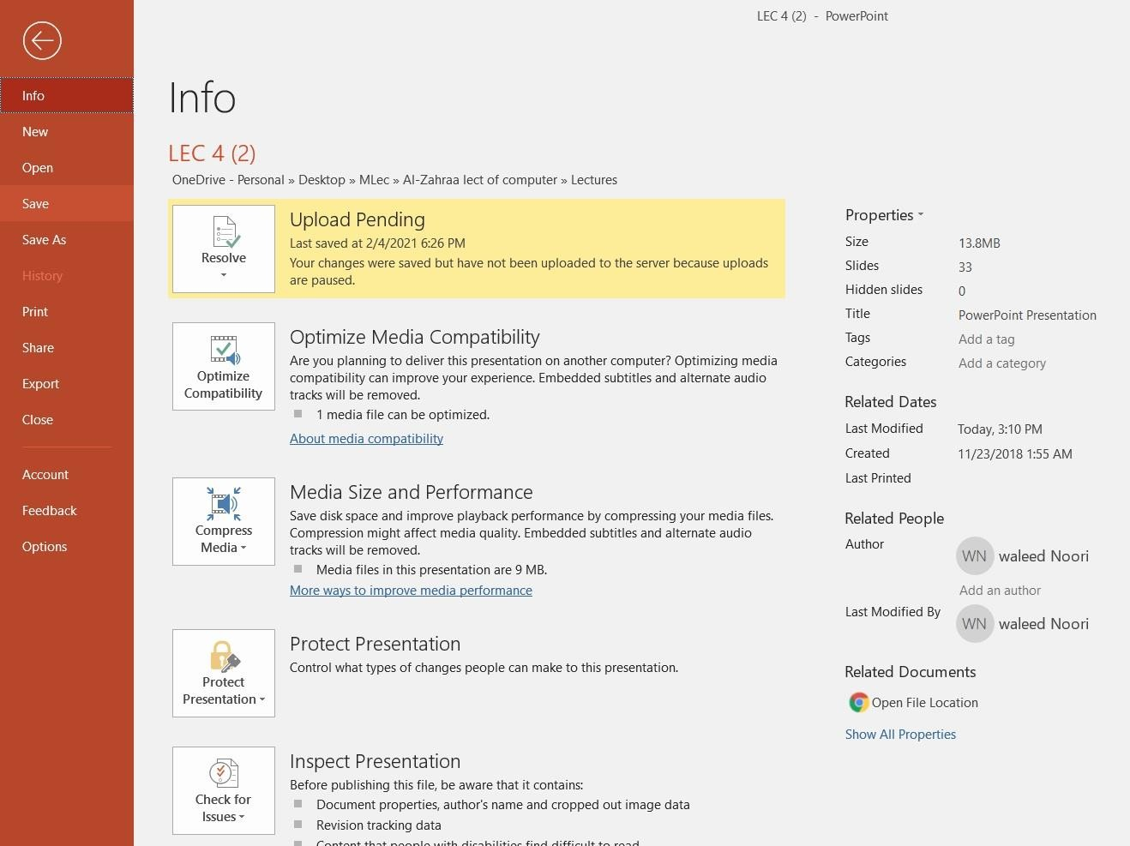
Saving a Presentation
Saving a Presentation
After creating a presentation, remember to save it for later use. If you make changes, save them too. You can also save a copy with a new name, in a different place, or in a different format.
Save a new presentation
To save a new presentation in PowerPoint,
you can click the Save button on the Quick Access Toolbar to open the Save As dialog box.
Other Ways to Save: Press <Ctrl>+ <S>.
Click the File tab and select Save.

Slide 14
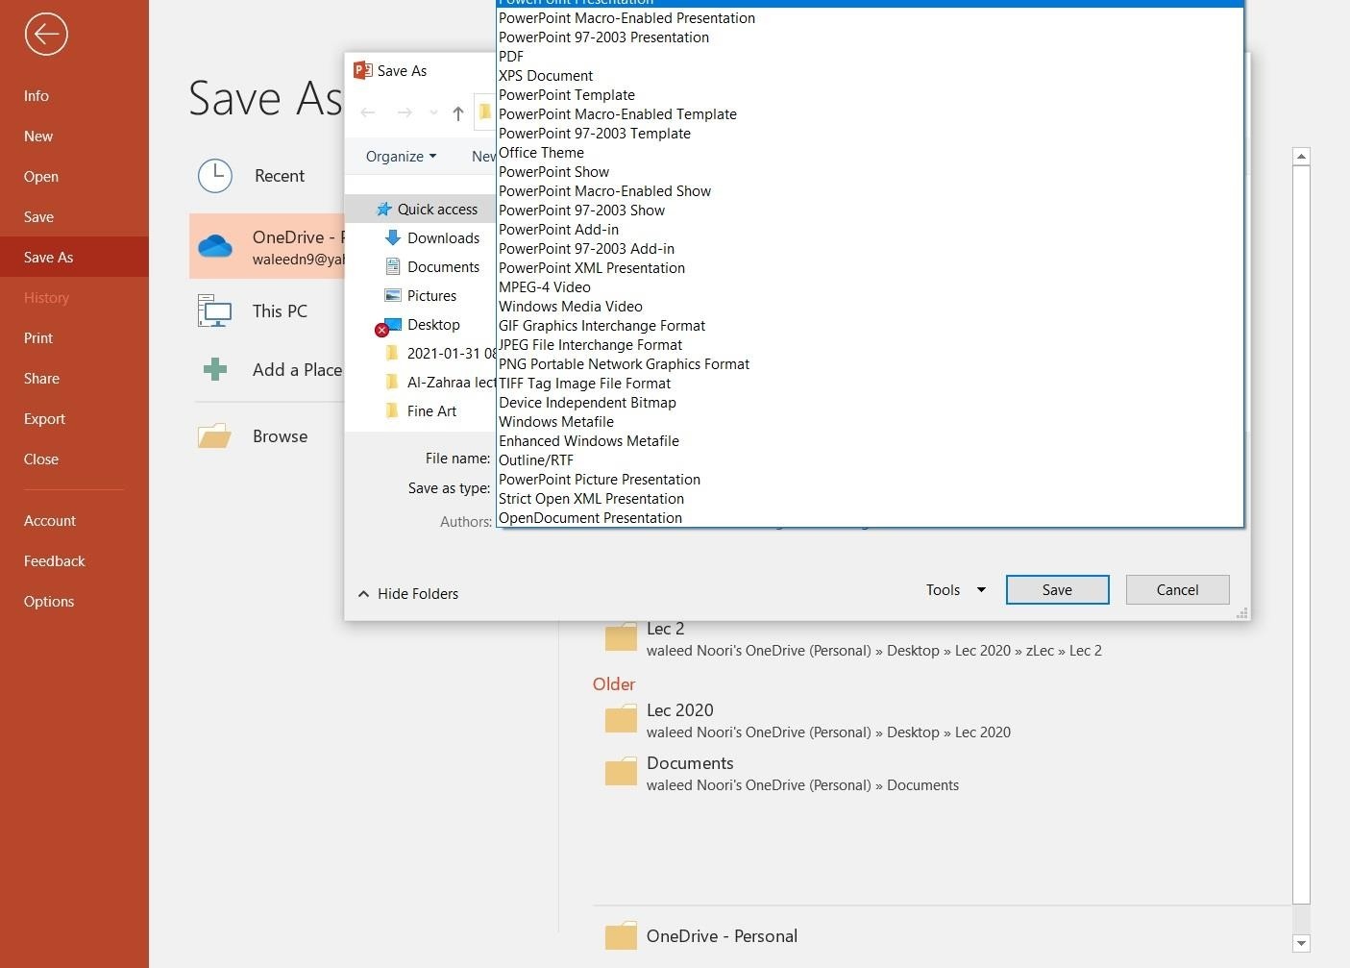
Save a presentation as a different file type
Save a presentation as a different file type
Just as some people can speak several languages, PowerPoint can handle multiple file formats, making it easier to exchange information with other programs.
Go to the "File" tab.
Select "Save As" to open the Save As dialog box.
Choose the location to save the file.
Pick the desired file format from the "Save as type" dropdown menu.
Click "Save" to save the presentation in the selected file format.

Slide 15
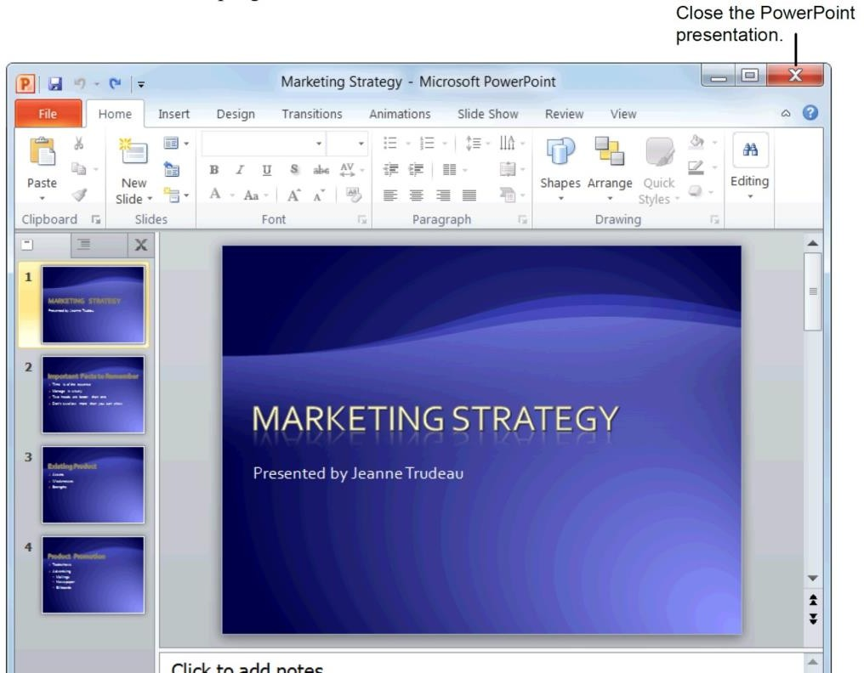
Closing a Presentation
Closing a Presentation
When you've finished working on a presentation, you should close it.
1. Click the File tab and select Close. The presentation
closes. You can access the file again by opening it later.
Other Ways to Close a Presentation: Press <Ctrl>+ <W>. Or, click the Close button in the upper right corner of the PowerPoint window.

Slide 16
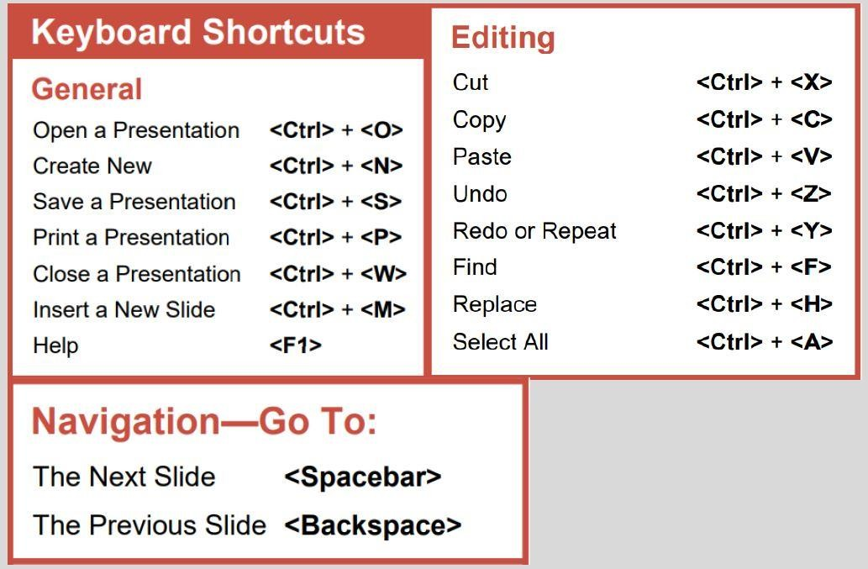
PowerPoint Keyboard Shortcuts

Slide 17
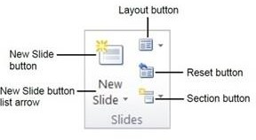
Inserting and Deleting Slides
Insert a new slide
Inserting a new slide is easy
Click the Home tab on the Ribbon and click the New Slide button in the Slides group.
Delete a slide
On the slides tab in the outline pane, select the slide you want to delete Press <delete>.

Slide 18
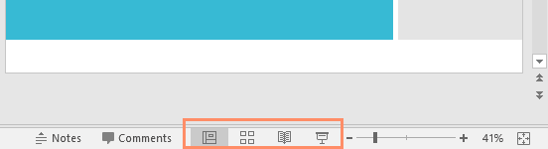
Zoom and other view options
PowerPoint has a variety of viewing options that change how your presentation is displayed. You can choose to view your presentation in Normal view , Slide Sorted review, Reading view, or Slide Show view. You can also zoom in and out to make your presentation easier to read.
Switching Slide Views
Switching between different slide views is easy. Just locate and select the desired slide view command in the bottom-right corner of the PowerPoint window.

Slide 19
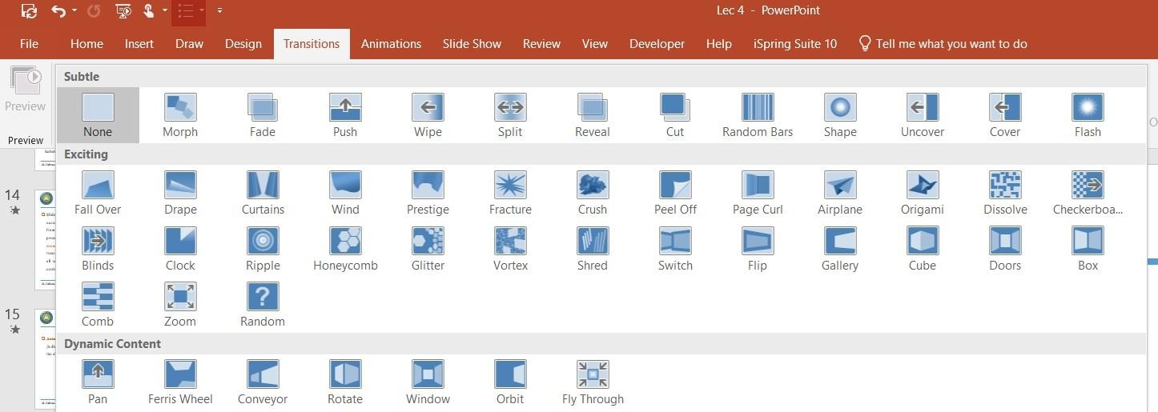
Slide Transitions
Slide transitions are motion effects that occur in Slide Show view when you move from one slide to then another during a presentation. You can control the speed, add sound, and even customize the properties of transition effects. To add a transition first of all select a slide in the left hand panel that contains the Slides and Outline tabs.

Slide 20
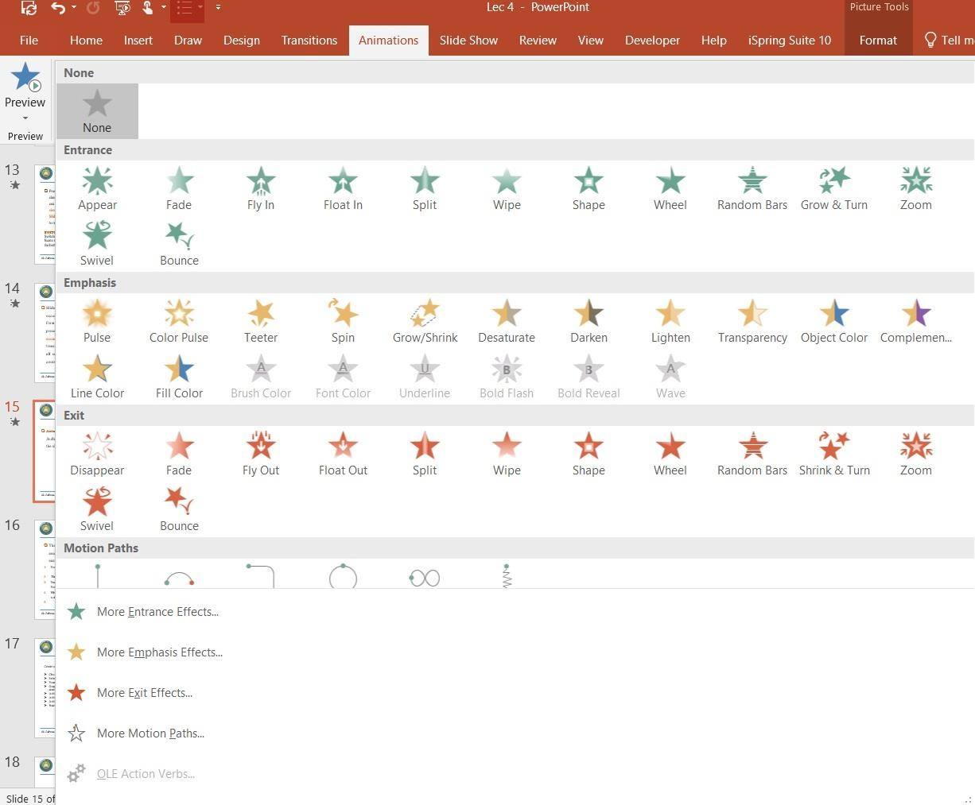
Animations
Animations in PowerPoint can indeed be applied to text boxes, bullet points, images, and other elements, allowing them to move or appear in a certain way during a slide show for added visual effects and engagement.

Slide 21
Thank Your

