Slide 1


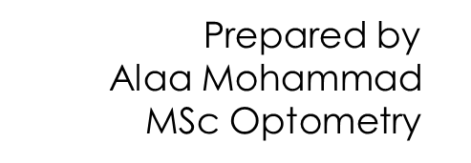



Slide 2
Medical Terminology | Meaning | Definition
Acc | Accommodation | the ability to modify the focal length of the lens by changing the curvature of the eye lens.
Cat | Cataract | A cataract is a cloudy area in the lens of your eye.
CT | Cover Test | The test is done by using an opaque or translucent occluder to cover one eye. The occluder is held in front of the eye for a few seconds and then removed.
DVA | Distance Visual Acuity | At 6 metres or 20 feet, a human eye with that performance is able to separate contours that are approximately 1.75 mm apart.
NVA | Near Visual Acuity | a measurement of how well you can see close objects. About 25 cm or 30 cm
EOM | Extraocular Movement | These muscles are responsible for movements of the eye along three different axes: horizontal, either toward the nose (adduction) or away from the nose (abduction); vertical, either elevation or depression; and torsional, movements that bring the top of the eye toward the nose (intorsion) or away from the nose.
ET | Esotropia | Esotropia is a type of strabismus (eye misalignment) in which one or both eyes turn inward.

Slide 3
EX | Exotropia | Exotropia is a form of strabismus (eye misalignment) in which one or both of the eyes turn outward.
KC | Keratoconus | an eye condition in which your cornea — the clear, dome-shaped front of your eye — gets thinner and gradually bulges outward into a cone shape.
FA | Fluorescein Angiography | an imaging test to view the blood vessels in your retina.
FHx | Family History | More than 350 eye diseases are attributed to hereditary factors, for that we should including the family history during the investigation .
LP | Light Perception | (LP) is used when vision is worse than hand movement vision. A bright light is shone on to the eye and you will be asked if any light is noticed.
HM | Hand Movements or Hand Motion | If the patient cannot count fingers at 1 metre, wave your hand and check if he/she can see this.
IOP | Intraocular Pressure | the fluid pressure of the eye. This clear fluid is produced by the ciliary epithelium of the iris, A healthy amount of intraocular pressure is between 10 mmHg and 20 mmHg.
LRm | Lateral Rectus muscle | a flat-shaped muscle, and it is wider in its anterior part. The lateral rectus muscle is an abductor and moves the eye laterally,

Slide 4
MRm | Medial Rectus Muscle | an adductor muscle. It moves the eye from side to side with the lateral rectus,
IRm | Inferior Rectus Muscle | depress the eye, causing the cornea and pupil to move inferiorly.
SRm | Superior Rectus Muscle | elevating the eye, causing the cornea to move superiorly.
IRm | Inferior Rectus Muscle
IOm | Inferior Oblique (Muscle) | The primary action of this muscle is to elevate and abduct (laterally move) the eyeball.
SOm | Superior Oblique Muscle | move the eye in the down-and-out position and intort the eye.
CL | Contact Lens | thin lenses that sit on top of the cornea. They correct refractive errors to make your vision clearer.
FB | Foreign Body | an object in your eye that shouldn't be there, such as a speck of dust, a wood chip, a metal shaving, an insect or a piece of glass.

Slide 5
PD | Prism Diopter | One prism diopter represents the deviation of light by 1 centimeter and perpendicular to the initial direction of the light ray on a plane placed 1 meter away from the prism.
PCT | Prism Cover Test | an objective measurement and the gold standard in measuring strabismus.
NRC | Normal Retinal Correspondence | (NRC) means the eyes are correctly positioned, with both eyes looking in the same direction, with no eye turn.
ARC | Abnormal Retinal Correspondence | (ARC) — also known as anomalous retinal correspondence — there is an eye turn, known as strabismus. In this situation, the fovea of the turned eye is not looking at the object.
BIp | Base In prism | the thickest edge of the prism and tells you where the light is redirected.
BOp | Base Out prism | Base out (the prism's base is on the outer edge of the lens)
BUp | Base Up prism | When a wearer is looking through the top of a minus lens or through the bottom of a plus lens.
BDp | Base Down prism | When a wearer is looking through the down of a minus lens or through the bottom of a plus lens.

Slide 6
BSL | Bandage Soft Contact Lens | worn over the front surface of the eye to protect or support areas affected by disease or injury.
W4D | Worth 4 Dots test | Worth Four Dot Test is a clinical test mainly used for assessing a patient's degree of binocular vision and binocular single vision.
LOV | Loss of Vision | The leading causes of blindness and low vision .
LOE | Loss of Eye | Total blindness (no light perception) is often due to: Severe trauma or injury. Complete retinal detachment.
EOM | Extraocular Muscle | There are seven extraocular muscles – the levator palpebrae superioris, superior rectus, inferior rectus, medial rectus, lateral rectus, inferior oblique and superior oblique.
CF | Counting Fingers | (CF). One or two fingers are placed 1 meter in front you, and you will be asked to count the number of fingers that are shown .
DM | Diabetes Mellitus | a group of diseases that affect how the body uses blood sugar (glucose).
BP | Blood Pressure | the force of your blood pushing against the walls of your arteries.

Slide 7
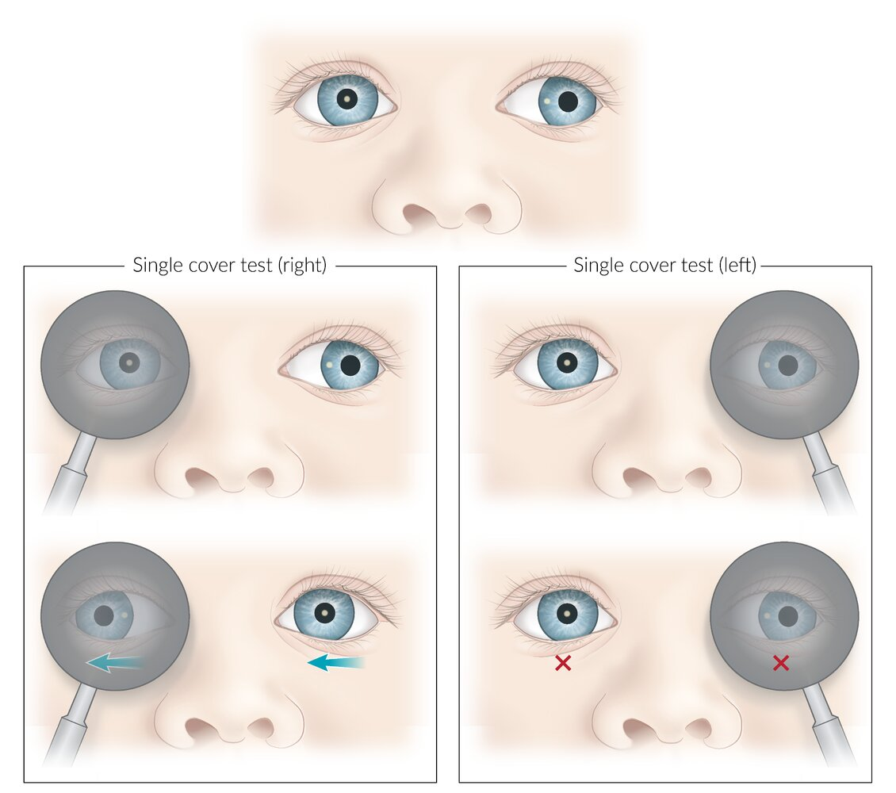
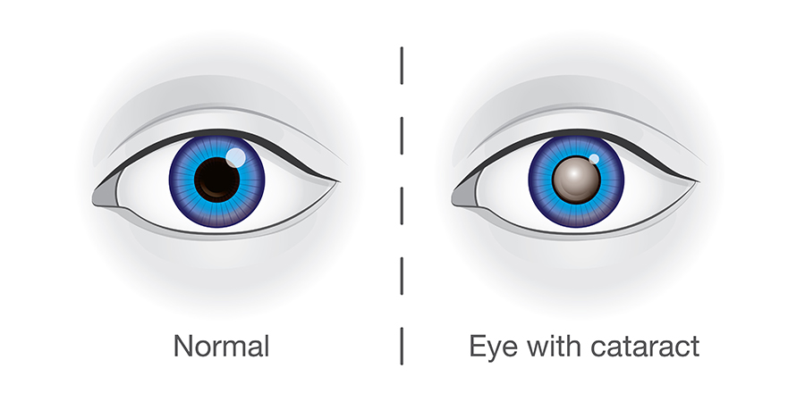
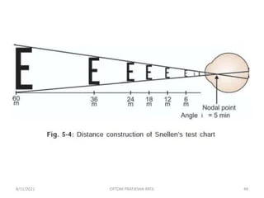
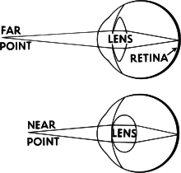
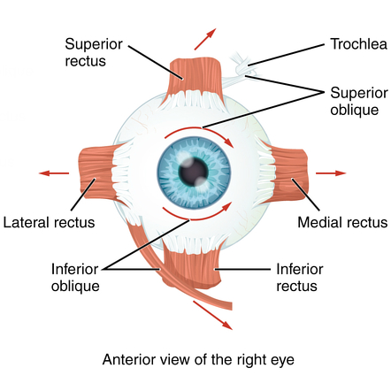
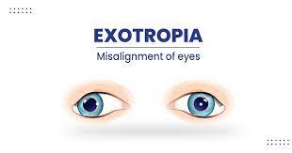
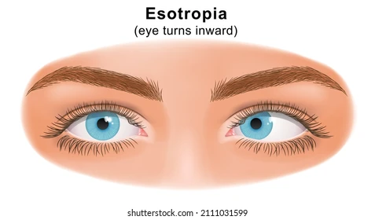
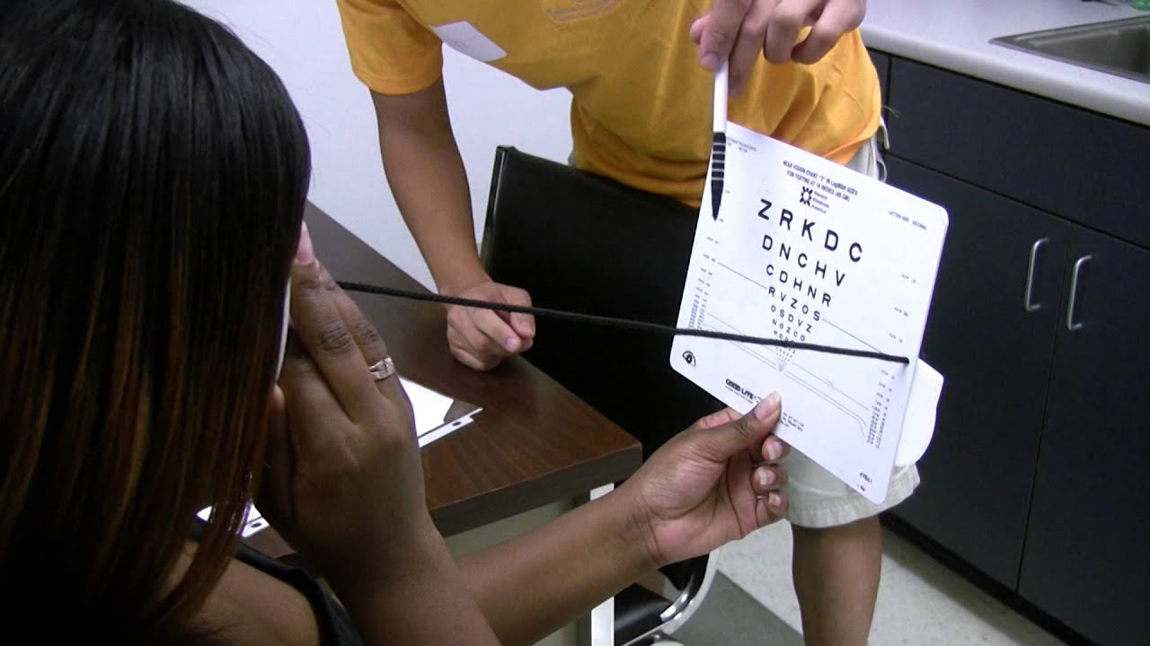

Slide 8
