Slide 1


Nutrition Assessment
Lecture.2
Prof. Dr. Fakhria Jaber

Slide 2
Nutrition Assessment: is the systematic process of collecting and interpreting information in order to make decisions about the nature and cause of nutrition related health issues that affect an individual.
Assessment: gathering of data about a person to identify his or her physical, psychological, social, and economic assets and liabilities.

Slide 3
Comprehensive nutritional assessment includes : 1- Dietary assessments
2- Clinical examination (history and physical examination).
3- Anthropometric measurements.
4- Diagnostic tests.

Slide 4
1- Dietary Assessment: Dietary assessment is necessary to ensure adequate nutrition and hydration intake.
A- History about dietary habits: frequency of meals, food preferences, restrictive diets, and allergies should be noted.
B- Recorded the Current nutrient and fluid intake.
C- If patients are on parenteral or enteral diets, information on feeding regimens.
D- Factors affecting these feedings, such as displacement of feeding tubes, site irritation, or infections.

Slide 5
2- Clinical examination (history and physical examination).
A- History: aims to look for indications of malnutrition and identify underlying factors that may lead to malnutrition or increase the risk of malnutrition.

Slide 6
General malnutrition may result from:
a-Primary factors (deficient dietary intake) take
dietary history.
b-Secondary factors (defect in nutrients utilization), e.g. GI disorders, metabolic disorders take clinical
history.

Slide 7
B- Physical examination:
Aims to identify signs of malnutrition and factors affecting nutritional status.
1- General condition: Note the patient is conscious, alert, and ambulatory. An initial observation of the patient's cognitive, mental, and emotional status.

Slide 8
2- Vital signs: Vital signs should be checked.
Temperature > 38 degrees Celsius can signify active inflammation/infection.
Temperature < 35 degrees Celsius (Hypothermia ) can be associated with impaired nutritional status, such as sepsis, trauma, burns, stroke, alcohol intoxication, and metabolic disorders like hypothyroidism, adrenal insufficiency.
High pulse rates can indicate fever, anemia, pregnancy, hyperthyroidism, septic shock, Beriberi,( Vit. B1 deficiency ) and anxiety.
High blood pressure or hypertension is one of the risk criteria for metabolic syndrome.
Abnormal rate and patterns of respiration can be indicative of various pathologies.

Slide 9
3- Height and Weight: Body mass index (BMI) calculated from these variables can help determine whether an individual is undernourished or over nourished.

Slide 10
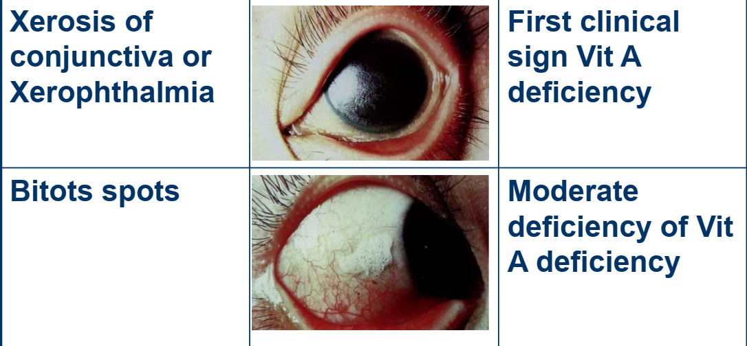
4- Eyes:

Slide 11
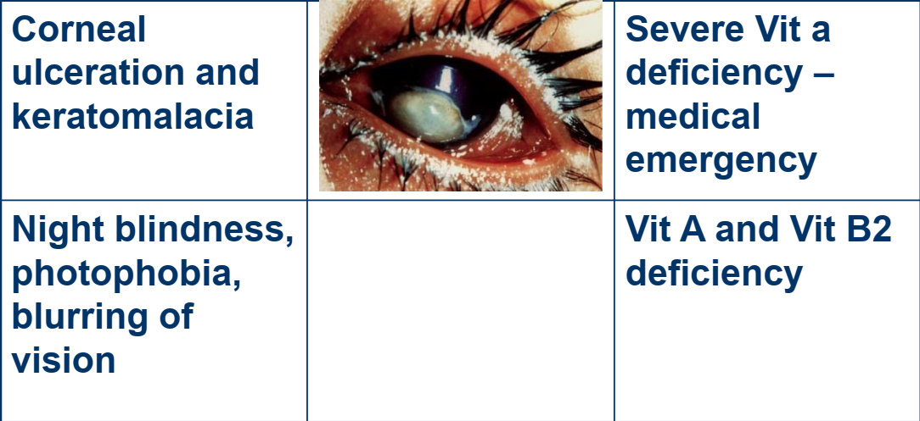

Slide 12
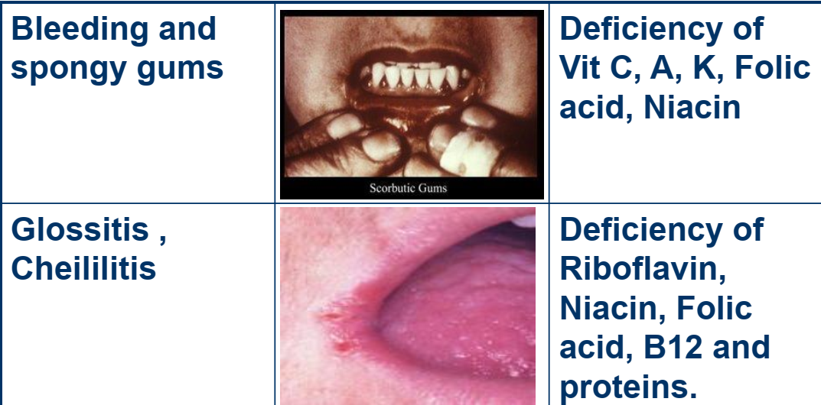
5- Oral cavity:
Taste abnormality: Zinc deficiency (also it is decrease with the age, drugs, smoking).

Slide 13
6- Skin:
Petechia, purpura, and ecchymosis may be associated with vitamin C and vitamin K deficiencies.
Poorly healed wounds indicate vitamin C, protein, and/or zinc deficiencies.
Dermatitis: due to Zinc deficiencies, essential fatty acid deficiency.

Slide 14
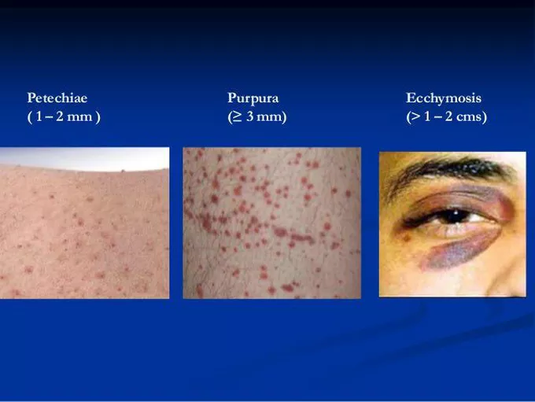

Slide 15

7- Hair:
Dry hair can be a sign of vitamin A or vitamin E deficiency.

Slide 16
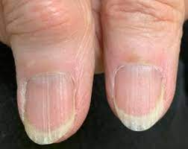
8- Nails: Dry and brittle nails can be associated with deficiencies in biotin, zinc, and proteins.

Slide 17
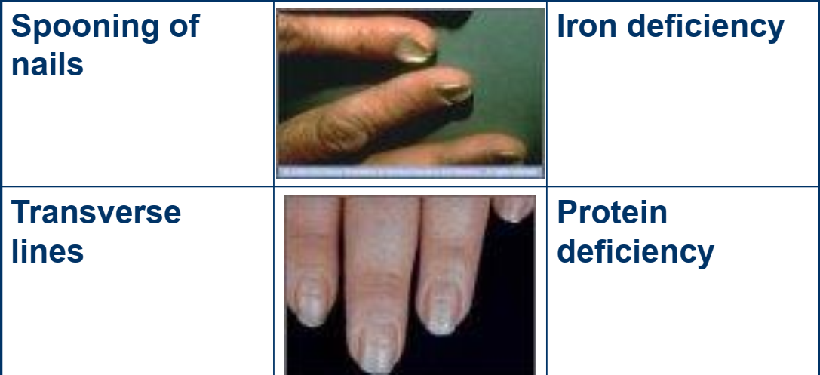

Slide 18
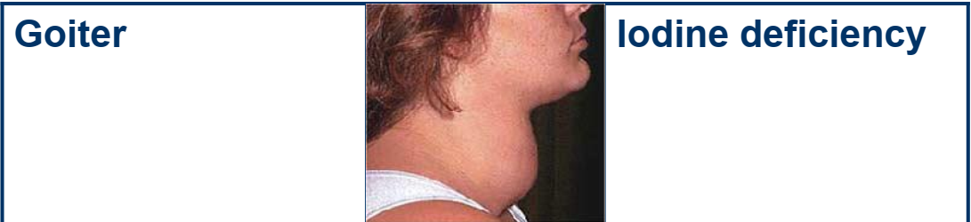
9- Gland

Slide 19
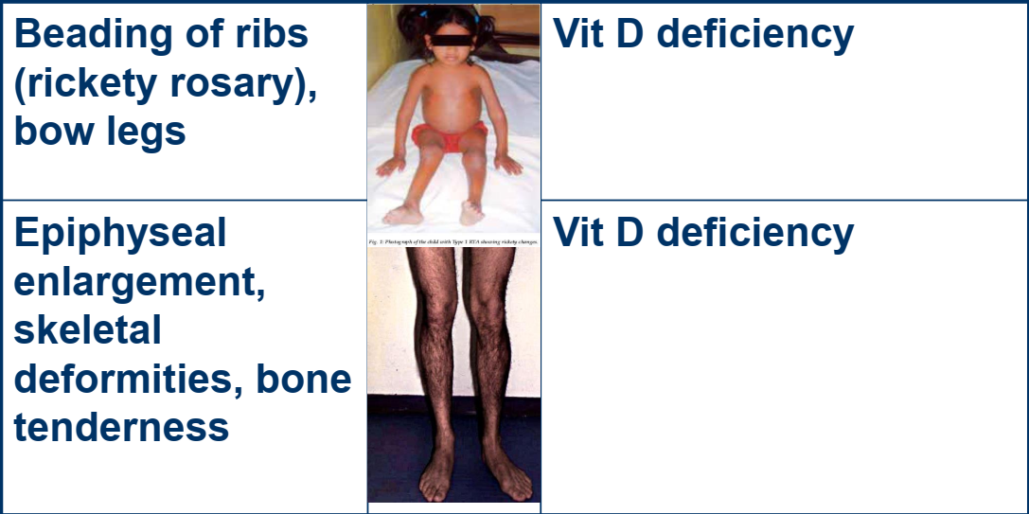
10- Skeletal system

Slide 20
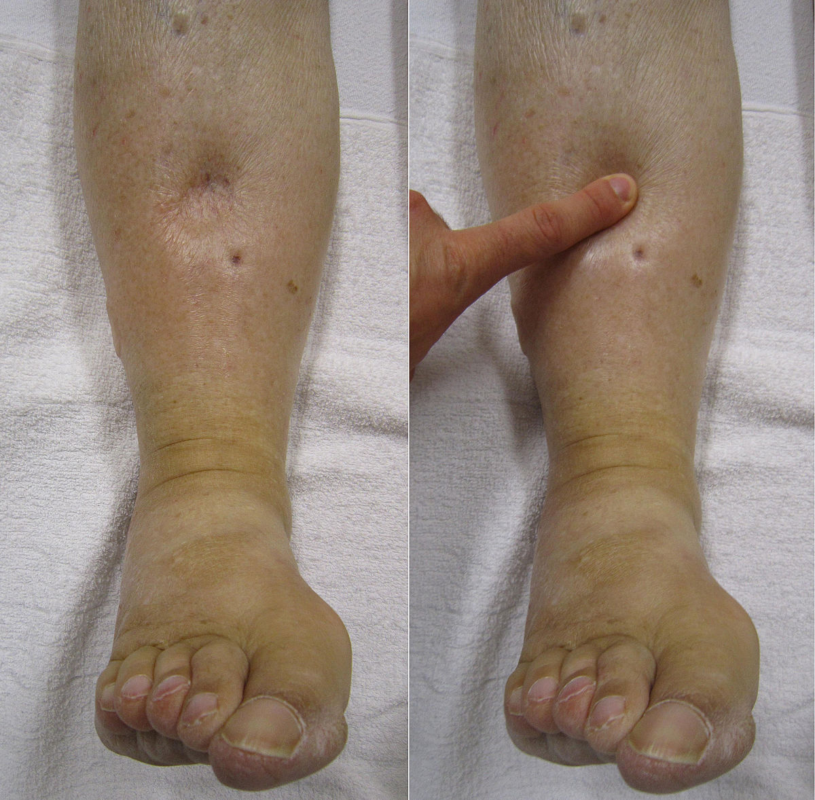
11- Extremities:
Protein or thiamine deficiency can lead to edema. Vitamin B12, thiamine, vitamin E, and vitamin B6 deficiencies can present with paresthesia and muscle weakness.

Slide 21
12- Odors:
Fruity acetone odor in patients with ketoacidosis, or the smell of alcohol can also be helpful during the examination of patients.

Slide 22
3- Anthropometric measurements
include
➢ height,
➢ weight,
➢ BMI (body mass index),
Body Mass Index (BMI): calculated from height weight data, is an indicator of the body fat content.
(Weight) in kg
BMI = -----------------
(high) in meters 2

Slide 23
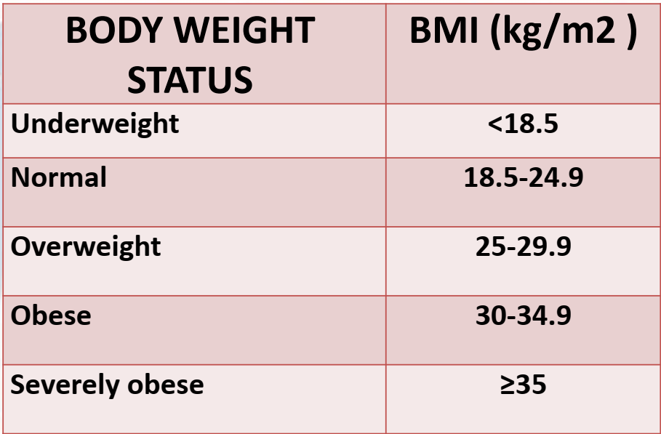

Slide 24
4- laboratory assessment:
It can identify specific nutritional related
abnormalities, e.g. anemia, protein deficiency,
biochemical tests, provide the 1st indication of
nutritional abnormalities before clinical
anthropometric changes occur.

Slide 25
Thank you

