Slide 1


Al-Mustaqbal University.
College of Engineering and Engineering Technologies.
Biomedical Engineering Department.
Subject: Biomedical Clinical issues of Biomedical
Engineering.
Class : 4th
Lecture: 2
BY: M.SC. ZAINAB SATTAR JABBAR
BME

Slide 2

Clinical Environment
The clinical environment is defined as that portion of the health care system in which patient care is delivered, and clinical activities include direct patient care, research, teaching, and public service activities intended to enhance patient care.
BME

Slide 3
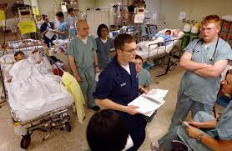
Hospital Organization and the Role of Clinical Engineering
In the hospital, management organization has evolved into a diffuse authority structure that is commonly referred to as the triad model. The three primary components are the governing board (trustees), hospital administration (CEO and administrative staff), and the medical staff organization.
The role of the governing board and the chief executive officer are briefly discussed next to provide some insight regarding their individual responsibilities and their interrelationship.
BME

Slide 4
Hospital Organization and the Role of Clinical Engineering
The major duties of the governing board as “adopting by-laws in accordance with its legal accountability and its responsibility to the patient.”
The governing body, therefore, requires both medical and paramedical departments to monitor and evaluate the quality of patient care, which is a critical success factor in hospitals today. To meet this goal, the governing board essentially is responsible for establishing the mission statement and defining the specific goals and objectives that the institution must satisfy.
BME

Slide 5
Governing Board (Trustees)
The trustees are involved in the following functions:
Establishing the policies of the institution.
Providing equipment and facilities to conduct patient care.
Ensuring that proper professional standards are defined and maintained (i.e., providing quality assurance).
Coordinating professional interests with administrative, financial, and community needs.
Providing adequate financing by securing sufficient income and managing the control of expenditures.
Providing a safe environment.
Selecting qualified administrators, medical staff, and other professionals to manage the hospital.

Slide 6

Hospital Administration
The hospital administrator, the chief executive officer of the medical enterprise, has a function similar to that of the chief executive officer of any corporation. The administrator represents the governing board in carrying out the day-to-day operations to reflect the broad policy formulated by the trustees. The duties of the administrator are summarized as follows.
BME

Slide 7
Hospital Administration
Preparing a plan for accomplishing the institutional objectives, as approved by the board.
Selecting medical chiefs and department directors to set standards in their respective fields.
Submitting for board approval an annual budget reflecting both expenditures and income projections.
Maintaining all physical properties (plant and equipment) in safe operating condition.
Representing the hospital in its relationships with the community and health agencies.
Submitting to the board annual reports that describe the nature and volume of the services delivered during the past year, including appropriate financial data and any special reports that may be requested by the board.
BME

Slide 8
Clinical Engineering Programs
In many hospitals, administrators have established clinical engineering departments to manage effectively all the technological resources, especially those relating to medical equipment, that are necessary for providing patient care. The primary objective of these departments is to provide a broad-based engineering program that addresses all aspects of medical instrumentation and systems support.
Figure illustrates the organizational chart of the medical support services division of a typical major medical facility.
BME

Slide 9
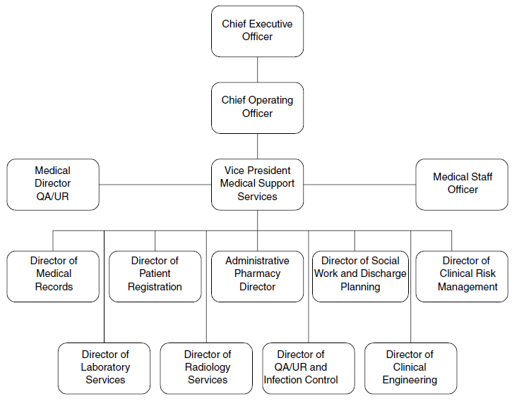
Clinical Engineering Programs
BME

Slide 10
Clinical Engineering Programs
Note that within this organizational structure, the director of clinical engineering reports directly to the vice-president of medical support services. This administrative relationship is extremely important because it recognizes the important role clinical engineering departments play in delivering quality care.
It should be noted, however, that in other common organizational structures, clinical engineering services may fall under the category of “facilities”, “materials management,” or even just “support services.” Clinical engineers also can work directly with clinical departments, thereby bypassing much of the hospital hierarchy. In this situation, clinical departments can offer the clinical engineer both the chance for intense specialization and, at the same time, the opportunity to develop personal relationships with specific clinicians based on mutual concerns and interests.
BME

Slide 11
General Statement
The clinical engineering director, by his or her education and experience, acts as a manager and technical director of the clinical engineering department.
The individual designs and directs the design of equipment modifications that may correct design deficiencies or enhance the clinical performance of medical equipment. The individual may also supervise the implementation of those design modifications
BME

Slide 12
General Statement
The education and experience that the director possesses enables him or her to analyze complex medical or laboratory equipment for purposes of defining corrective maintenance and developing appropriate preventive maintenance or performance assurance protocols.
The clinical engineering director works with nursing and medical staff to analyze new medical equipment needs and participates in both the pre-purchase planning process and the incoming testing process. The individual also participates in the equipment management process through involvement in the system development, implementation, maintenance, and modification processes.
BME

Slide 13
Duties and Responsibilities
The director of clinical engineering has a wide range of duties and responsibilities. For example, this individual:
Works with medical and nursing staff in the development of technical and performance specifications for equipment requirements in the medical mission.
Once equipment is specified and the purchase order developed, generates appropriate testing of the new equipment.
Makes complete performance analysis on complex medical or laboratory equipment and summarizes results in brief,, easy-to-understand terms for the purposes of recommending corrective aconcisection or for developing appropriate preventive maintenance and performance assurance protocols.
BME

Slide 14
Duties and Responsibilities
Designs and implements modifications that permit enhanced operational capability. May supervise the maintenance or modification as it is performed by others.
Must know the relevant codes and standards related to the hospital environment and the performance assurance activities.
Is responsible for obtaining the engineering specifications (systems definitions) for systems that are considered unusual or not commercially available.
BME

Slide 15
Duties and Responsibilities
Supervises in-service maintenance technicians as they work on codes and standards and on preventive maintenance, performance assurance, corrective maintenance, and modification of new and existing patient care and laboratory equipment.
Sets departmental goals, develops budgets and policy, prepares and analyzes management reports to monitor department activity, and manages and organizes the department to implement them.
BME

Slide 16
Duties and Responsibilities
Teaches measurement, calibration, and standardization techniques that promote optimal performance.
In equipment-related duties, works closely with maintenance and medical personnel. Communicates orally and in writing with medical, maintenance, and administrative professionals. Develops written procedures and recommendations for administrative and technical personnel.
BME

Slide 17
Minimum Qualifications
A bachelor’s degree (4 years) in an electrical or electronics program or its equivalent is required (preferably with a clinical or biomedical adjunct). A master’s degree is desirable. A minimum of 3 years’ experience as a clinical engineer and 2 years in a progressively responsible supervisory capacity is needed.
Must have some business knowledge and management skills that enable him or her to participate in budgeting, cost accounting, personnel management, behavioral counseling, job description development, and interviewing for hiring or firing purposes. Knowledge and experience in the use of microcomputers are desirable.
BME

Slide 18
Minimum Qualifications
Must be able to use conventional electronic trouble-shooting instruments such as multi meters, function generators, oscillators, and oscilloscopes. Should be able to use conventional machine shop equipment such as standard hand tools.
Must possess or be able to acquire knowledge of the techniques, theories, and characteristics of materials, drafting, and fabrication techniques in conjunction with chemistry, anatomy, physiology, optics, mechanics, and hospital procedures.
Clinical engineering certification or professional engineering registration is required.
.
BME

Slide 19
Major Functions of a Clinical Engineering Department
It should be clear by the preceding job description that clinical engineers are first and foremost engineering professionals. However, as a result of the wide-ranging scope of interrelationships within the medical setting, the duties and responsibilities of clinical engineering directors are extremely diversified. Yet a common thread is provided by the very nature of the technology they manage. Directors of clinical engineering departments are usually involved in the following core functions:
BME

Slide 20
Technology Management:
Developing, implementing, and directing equipment management programs. Specific tasks include accepting and installing new equipment, establishing preventive maintenance and repair programs, and managing the inventory of medical instrumentation. Issues such as cost-effective use and quality assurance are integral parts of any technology management program. The director advises the hospital administrator of the budgetary, personnel, space, and test equipment requirements necessary to support this equipment management program.
BME

Slide 21
Risk management:
Evaluating and taking appropriate action on incidents attributed to equipment malfunctions or misuse. For example, the clinical engineering director is responsible for summarizing the technological significance of each incident and documenting the findings of the investigation. He or she then submits a report to the appropriate hospital authority and, according to the Safe Medical Devices Act of 1990, to the device manufacturer, the Food and Drug Administration (FDA), or both.
BME

Slide 22
Technology assessment:
Evaluating and selecting new equipment. The director must be proactive in the evaluation of new requests for capital equipment expenditures, providing hospital administrators and clinical staff with an in-depth appraisal of the benefits/advantages of candidate equipment. Furthermore, the process of technology assessment for all equipment used in the hospital should be an ongoing activity.
BME

Slide 23
Facilities design and project management:
Assisting in the design of new or renovated clinical facilities that house specific medical technologies. This includes operating rooms, imaging facilities, and radiology treatment centers.
Training:
Establish and deliver instructional modules for clinical engineering staff as well as clinical staff on the operation of medical equipment.
BME

Slide 24
THANK YOU

