Slide 1


Al-Mustaqbal University
College of Engineering and Engineering Technologies
Biomedical Engineering Department
Subject: Systemic Physiology I
Body Fluids
Class : 3th
Lecture: 2
By Assistant Lecturer : Zainab Sattar Jabbar
BME

Slide 2
Body fluids
In the average young adult male , 18% of the body weight is protein & related substances , 7% is mineral & 15% is fat .
The remaining 60% is water .
Total body water is comprised of extracellular & intracellular fluid.
The fluid collectively contained within all body cells is called intracellular fluid (ICF) .
The fluid outside the cells is called extracellular fluid (ECF).
The ECF is outside the cells but inside the body. Thus, the ECF is the internal environment of the body.

Slide 3
Extracellular fluid (ECF)
The Extracellular fluid (ECF) can be subdivided into two main sub-compartments :-
The plasma , the fluid portion of the blood, which makes up almost one – fourth of the extracellular fluid.
And the interstitial fluid which lies between the tissue cells, surrounds and bathes the cells (inter means “between”; stitial means “that which stands”) & amounts to more than three – fourths of the extracellular fluid .
The Extracellular fluid (ECF) , which is about 20% of total body weight (plasma = 5% of body weight) & (interstitial fluid = 15% of body weight).
Extracellular fluid contains large quantities of sodium and chloride ions ,but only small amounts of potassium ,magnesium and phosphate ions (the major cat ion is Na+ and the major anions are Cl-& HCO3-)

Slide 4
Extracellular fluid (ECF)
Because the plasma & interstitial fluids are separated only by highly permeable capillary membranes , their ionic compositions are similar & they are often considered together as one large compartment of homogeneous fluid.
The most important difference between plasma & interstitial fluid is the higher concentration of protein in the plasma , which exists because the capillaries have a low permeability to the plasma proteins .

Slide 5
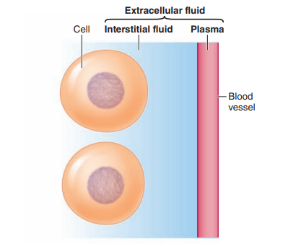
Extracellular fluid (ECF)

Slide 6
Intracellular fluid (ICF)
Whereas , the intracellular fluid (ICF) accounts for about 40% of body weight .
Both extracellular & intracellular fluid contain nutrients that are needed by the cells , including glucose , amino acids, oxygen & other nutrients.
Intracellular fluid contains large amounts of K+& phosphate ions , moderate amounts of Mg+2 ions & few Ca+2 ions ( The major cations are K+& Mg+2& the major anions are protein & organic phosphates such as ATP, ADP & AMP ).
These differences in the ionic composition of the fluids cause a membrane potential to develop across the two sides of the cell membrane – negative on the inside and positive outside .

Slide 7
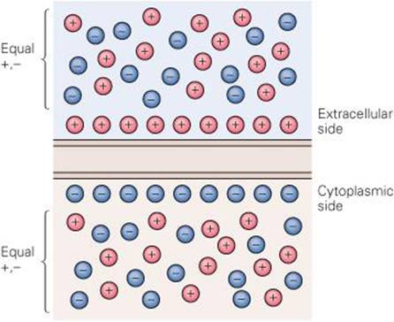
Transport across cell membranes
All cells are enveloped by a plasma membrane, a thin, flexible, lipid barrier that separates the contents of the cell from its surroundings.
Cells have a membrane potential, a slight excess of negative charges lined up along the inside of the membrane and a slight excess of positive charges on the outside.
Particles that can permeate the membrane diffuse passively down their concentration gradient.
1. Passive Transport .
Simple diffusion
Facilitated diffusion
Osmosis
2. Active Transport .

Slide 8
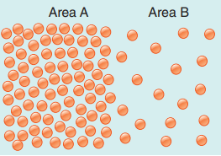
Passive Transport
Solutions are homogeneous mixtures containing a relatively large amount of one substance called the solvent (the dissolving medium, which in the body is water) and smaller amounts of one or more dissolved substances called solutes. The concentration of the solute in a solution differs between area A and area B. Such a difference in concentration between two adjacent areas is called a concentration gradient (or chemical gradient).
A difference in charge between two adjacent areas thus produces an electrical gradient that promotes movement of ions toward the area of opposite charge.
Because a cell does not have to expend energy for ions to move into or out of it along an electrical gradient, this method of membrane transport is passive.
Both an electrical and a concentration (chemical) gradient may be acting on a particular ion at the same time. The net effect of simultaneous electrical and concentration gradients on this ion is called an electrochemical gradient.

Slide 9
Simple diffusion
Diffusere means “to spread out”.
Simple diffusion occurs down an electrochemical gradient ("downhill") which is the net movement of molecules through the cell membrane along chemical or electrical gradients.
Molecules migrate from a region of high concentration to one lower concentration.
This form of transport is not carrier mediated.
Not require metabolic energy , therefore is passive .
The rate of diffusion across the cell membrane is directly related to :-
The electrical potential &chemical concentration differences across the membrane
The surface area of the membrane .
The permeability of the membrane for the solute .

Slide 10
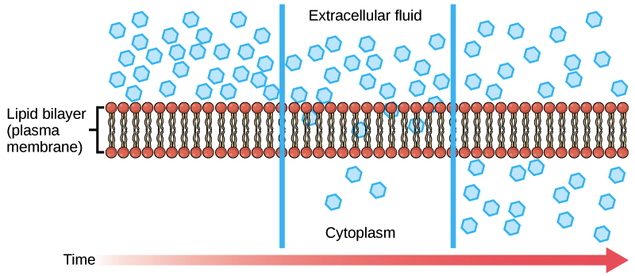
Simple diffusion

Slide 11
Facilitated diffusion
Facilitated diffusion occurs down an electrochemical gradient (“downhill”), similar to simple diffusion.
Membrane proteins such as carriers and channels facilitate the movement of molecules across the plasma membrane.
Dose not require metabolic energy & therefore is passive.
Is more rapid than simple diffusion.
Is carrier – mediated.
Ex. Glucose transport in muscle & adipose cells is “downhill” is carrier – mediated.

Slide 12
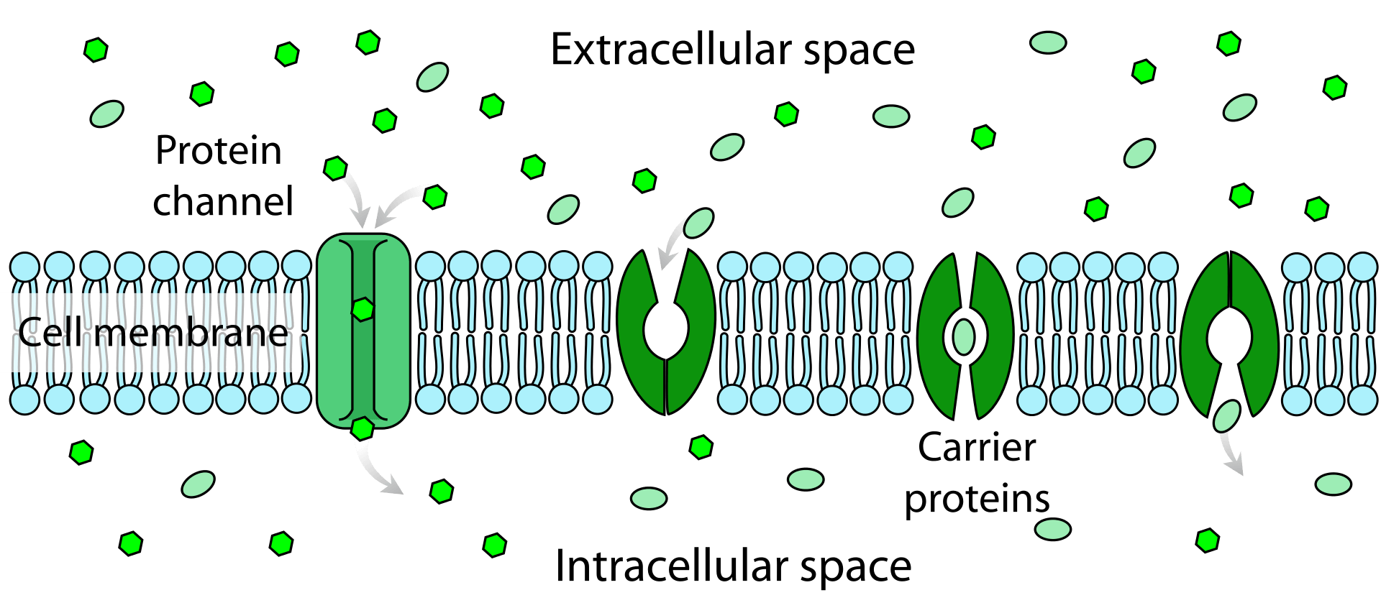
Facilitated diffusion

Slide 13
Osmosis
Is the diffusion of water across a membrane .
Cell membranes in the body are highly permeable to water & whenever there is a higher concentration of solute on one side of the membrane , water rapidly diffuses across the membrane toward the region of higher solute concentration .
So, osmosis is the flow of water across a semipermeable membrane from a solution with low solute concentration to a solution with high solute concentration.
The osmotic pressure increases when the solute concentration increases.
The higher the osmotic pressure of a solution, the greater the water flow into it.
Osmolarity is the concentration of osmotically active particles in a solution.

Slide 14
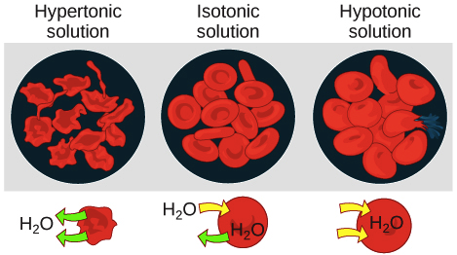
Osmosis

Slide 15
Isotonic
A solution is said to be isotonic if no osmotic force develops across the cell membrane when a normal cell is placed in the solution.
This means that an isotonic solution has the same osmolarity as the cell & that the cells will not shrink or swell is placed in this solution.
Example of isotonic solutions are: 0.9% Nacl & a 5% glucose solution..

Slide 16
Hypertonic
A solution is said to be hypertonic when it contains a higher osmotic concentration of substances than dose the cell.
In this case , osmotic force develops that causes water to flow out the cell into the solution , thereby greatly concentrating intracellular fluid & shrinking the cell.

Slide 17
Hypotonic
The solution is said to be hypotonic if the osmotic concentration of substances in the solution is less than their concentration in the cell.
An osmotic force develops immediately when the cell is exposed to the solution , causes water to flow by osmosis into the cell until the intracellular fluid has about the same concentration as the extracellular fluid , or until the cell bursts from excessive swelling.

Slide 18
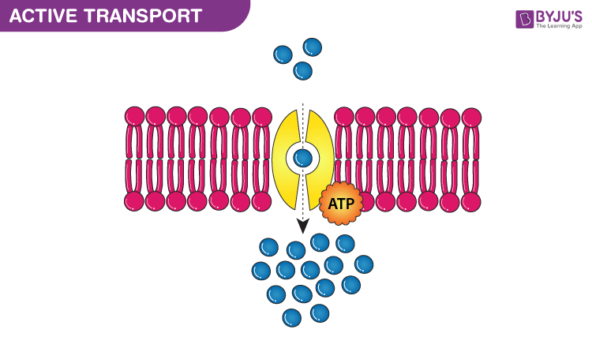
Active Transport
Occurs against an electrochemical gradient (“uphill”).
Requires direct input of metabolic energy in form of ATP & is active.
Is carrier – mediated?
Examples of primary active transport:-
H+, K+ – ATPase ( or proton pump ) in gastric parietal cells transports H+ into lumen of the stomach against its electrochemical gradient.

Slide 19
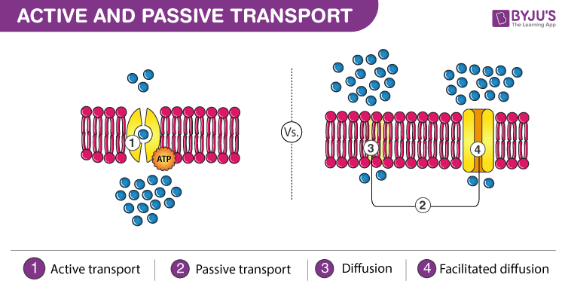

Slide 20
THANK YOU

