Slide 1
Al-Mustaqbal University
Biomedical Engineering Department
Class: 5th
Subject: Biomedical Instrumentation Lab
Lecturer: M.SC. ZAINAB SATTAR JABBAR
1st term – Lect. 4: Electrocardiogram (ECG)
Email: zainab.sattar.jabbar@uomus.edu.iq

Slide 2
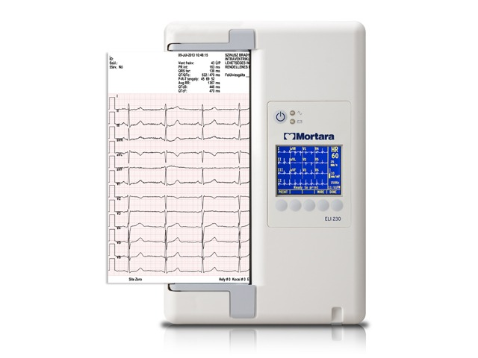
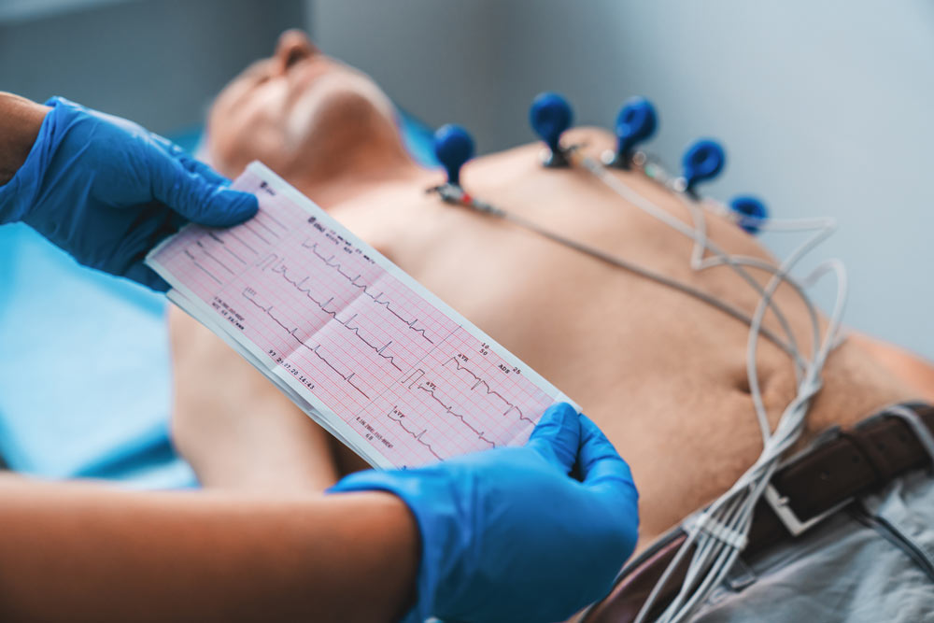
Electrocardiogram (ECG)

Slide 3
Electrocardiogram (ECG)
Is a simple, non-invasive test that records the electrical activity of the heart. An ECG can help diagnose certain heart conditions, including abnormal heart rhythms and coronary heart disease (heart attack and angina).
ECG = Electrocardiogram /Electrocardiograph
Electro
Cardio
Gram (graph)

Slide 4
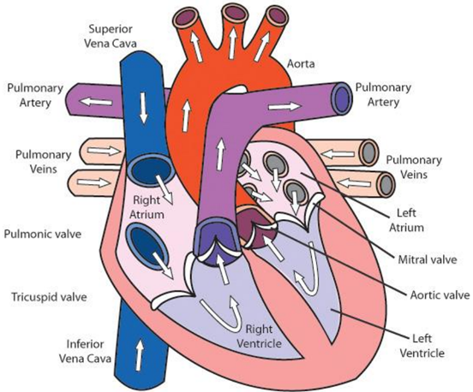
Function of the heart
There are four chambers : the left atrium and right atrium (upper chambers), and the left ventricle and right ventricle (lower chambers)
Muscular walls, called septum, divide the heart into two sides.
The wall of the heart separates into the following layers: Epicardium, Myocardium, and Endocardium.
It is also made up of four valves: the tricuspid, pulmonary, mitral and aortic valves.

Slide 5
Function of the heart
There are around 10 veins that are found in or connected to the heart. The two largest veins that bring blood from the body to the heart are the superior vena cava and inferior vena cava. The first collects blood from the top portion of the body, such as from the jugular vein and auxiliary vein
There are two primary coronary arteries, the right coronary artery (RCA) and the left main coronary artery (LMCA). Both of these originate from the root of the aorta. The RCA emerges from the anterior ascending aorta and supplies blood primarily to the right atrium, right ventricle.

Slide 6
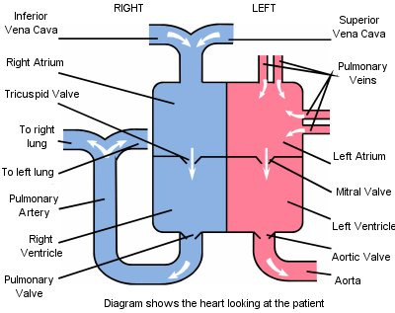
Functional diagram of the pumping heart

Slide 7
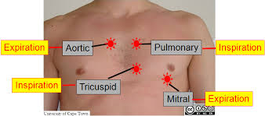
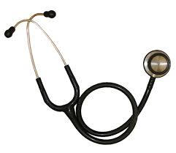
Heart Valves and Sounds
Which valves make which heart sound?
The first heart sound (S1) represents closure of the atrioventricular (mitral and tricuspid) valves as the ventricular pressures exceed atrial pressures at the beginning of systole.
The second heart sound (S2) represents closure of the semilunar (aortic and pulmonary) valves.

Slide 8
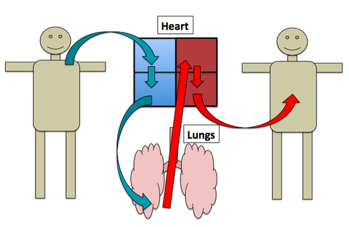
Action of heart
There are 2 phases to your heart's pumping cycle:
Systole – this is when your heart contracts, pushing blood out of the chambers.
Diastole – this is the period between contractions when the muscle of your heart (myocardium) relaxes and the chambers fill with blood.

Slide 9
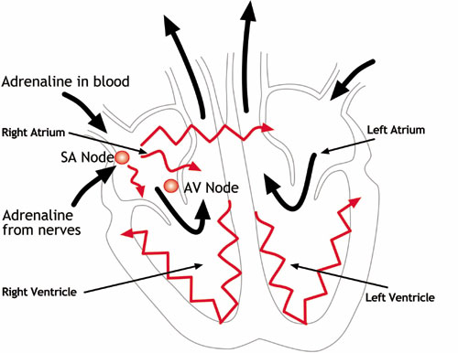
Action of heart
The SA (sinoatrial) node generates an electrical signal that causes the upper heart chambers (atria) to contract.
The signal then passes through the AV (atrioventricular) node to the lower heart chambers (ventricles), causing them to contract, or pump.
Contraction = Depolarization
Relaxation = Repolarization

Slide 10
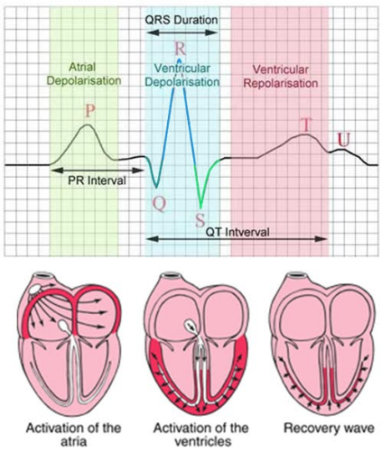
ECG Signals
Electrocardiography (ECG) is the process of recording the electrical activity of the heart over a period of time using electrodes placed on a patient's body. These electrodes detect the tiny electrical changes on the skin that arise from the heart muscle cells depolarizing during each heartbeat.
During each heartbeat, a healthy heart will have an orderly progression of depolarization that:
  Starts with pacemaker cells in the sino-atrial (SA) node, with a rhythm influenced by the central nervous system (brain),
  Spreads out through the atrium,
  Passes with a delay through the atrio-ventricular (AV) node,
  Spreads throughout the ventricles via specialized ‘electrical path ways’.
The cardiac muscle cells also pass on the electrical signals to each other.
This orderly pattern of depolarization causes the specific ECG tracing.

Slide 11
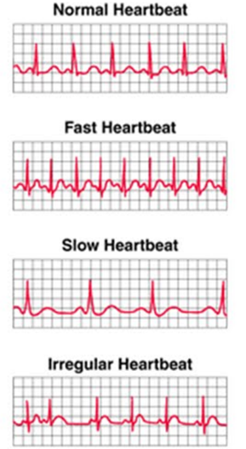
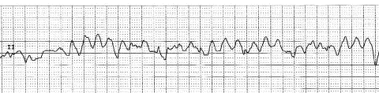
Normal and abnormal rhythms
An ECG can be used to:
  Measure the rate of heartbeats,
  Measure the rhythm (regular, irregular) of the heart beats,
  Measure the size and position of the heart chambers,
  Detect the presence of any damage to the heart's muscle cells or conduction system,
  Measure the effects of cardiac drugs,
  Measure the function of implanted pacemakers.
ECG during Ventricular Fibrillation

Slide 12
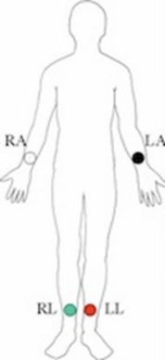
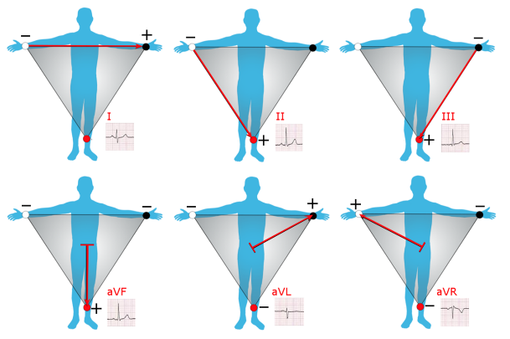
Lead Placement: 3 electrodes, 6 leads
The 3-lead ECG has been in use for over 100 years. Currently, it is mainly used on transport monitors (e.g. in ambulances). The reason for this is that configurations with more leads provide more information.
Recordings are made between two electrodes: Lead I, II, III
or
between one electrode and the average of the other two:
Lead aVR, aVL, aVF
ECG with 3 electrodes
on 3 limbs;
RL serves as ground

Slide 13
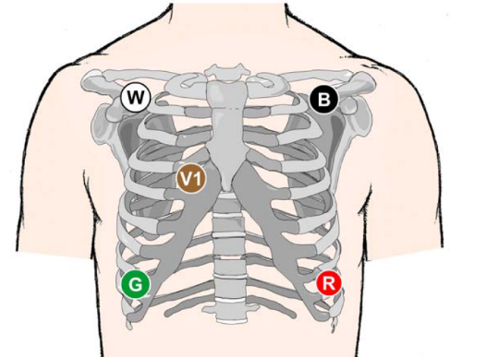
Lead Placement: 5 electrodes
The 5-lead ECG is often preferred in an
ICU (Intensive Care Unit).
It gives more information than the 3 Lead ECG.
Position of electrodes in 5 Lead ECG system

Slide 14
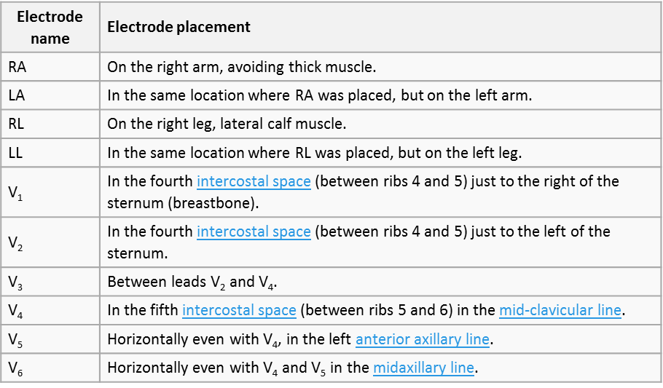
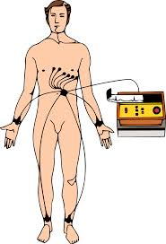
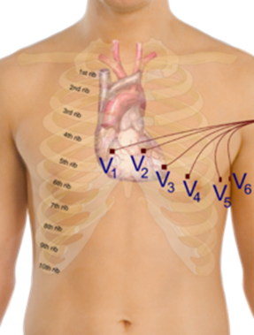
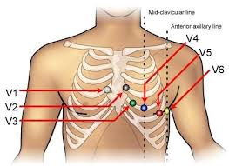
Lead Placement: 10 electrodes for standard 12 lead ECG
ECG with 10 electrodes
for best detail

Slide 15
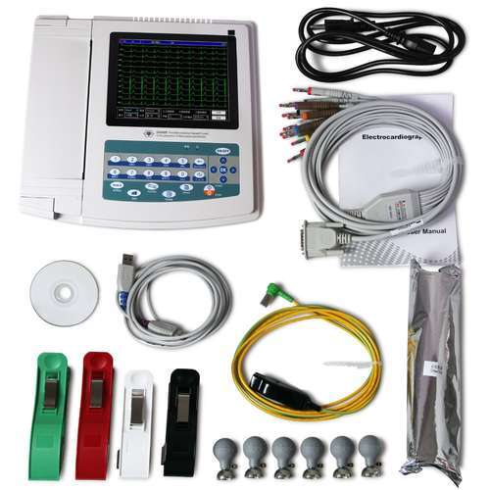
ECG Device Parts
The ECG machine consists of four basic elements:
Electrodes.
Connecting wires.
Keyboard.
LCD.
Printer.
Power supply.
Batteries.

Slide 16
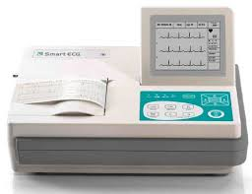
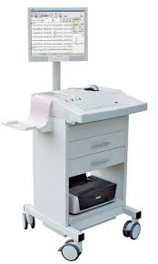
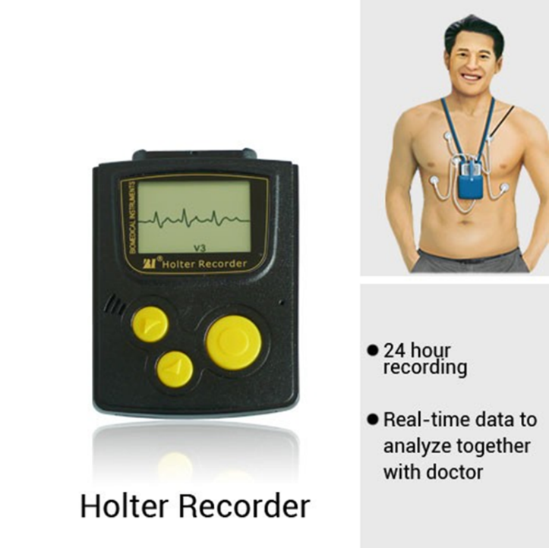
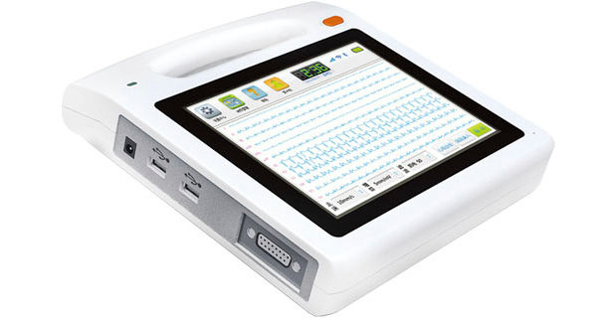
ECG Types
Desktop ECG recorder
Portable ECG recorder
Cart based
ECG recorder
©

Slide 17
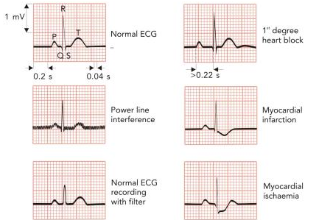
Use
The ECG can be influenced by technical issues such as power line interference, poor connections and ECG filtering
Of course, the ECG is also influenced by heart condition and disease
For a BMET, it is important to recognize whether an ECG is disturbed by system problems or by cardiac abnormalities

Slide 18
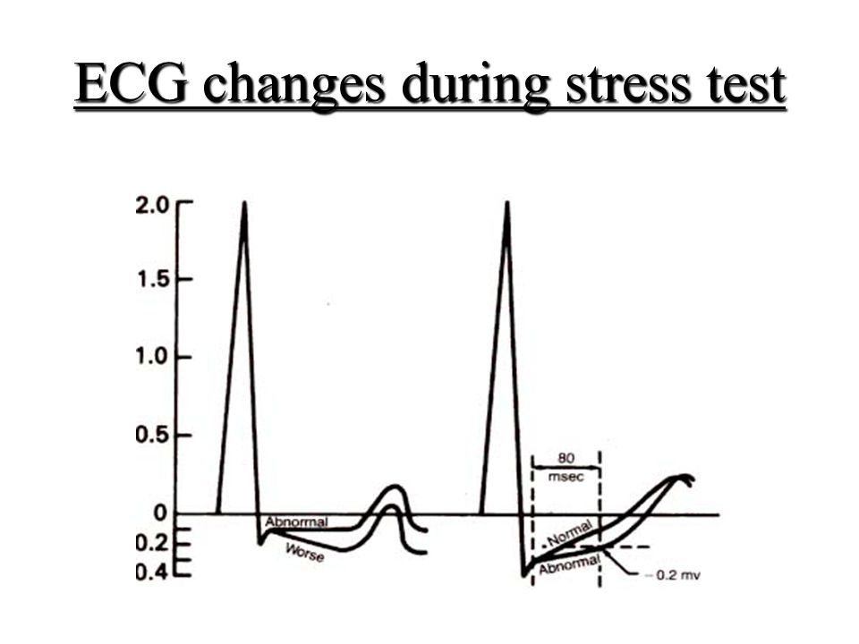
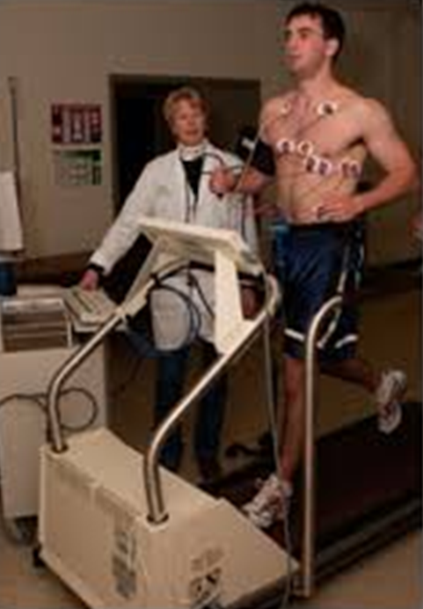
Use
ECG recording can be made at rest and during exercise (stress test).
This is useful because some heart abnormalities only show up during exercise when the heart has to work harder and faster.
ECG recorders may also be used for monitoring, e.g. during surgery or intensive care.
In this case, the ECG recorder is usually a part of a physiological monitor.

Slide 19
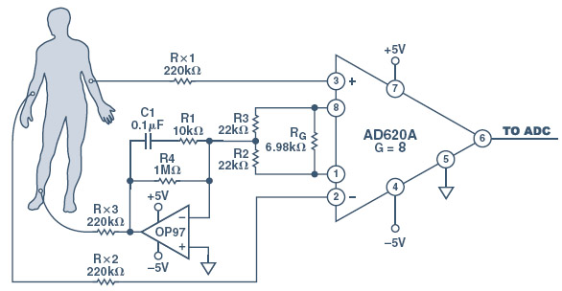
System Diagram
An ECG units consist of the ECG unit, electrodes, and cables.
The core of the ECG system is the Amplifier.
An ECG amplifier has high Input Impedance ( >100 MΩ) and a high gain (1000x), amplifying the ECG signal from milli-Volts >> Volts.
Its Frequency Range is 0.05–150 Hz.

Slide 20
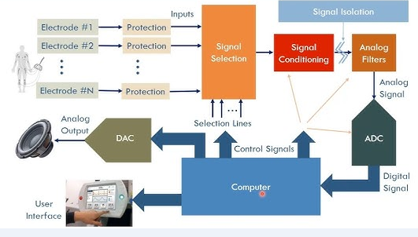
System Diagram

Slide 21
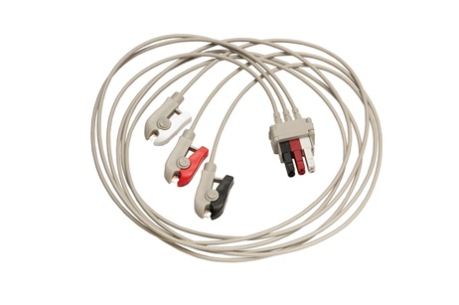
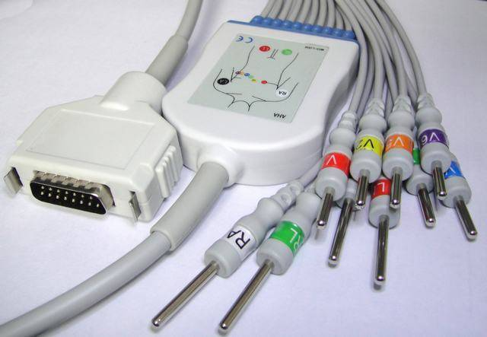
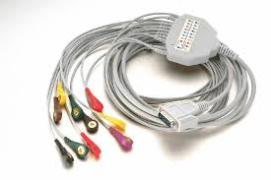
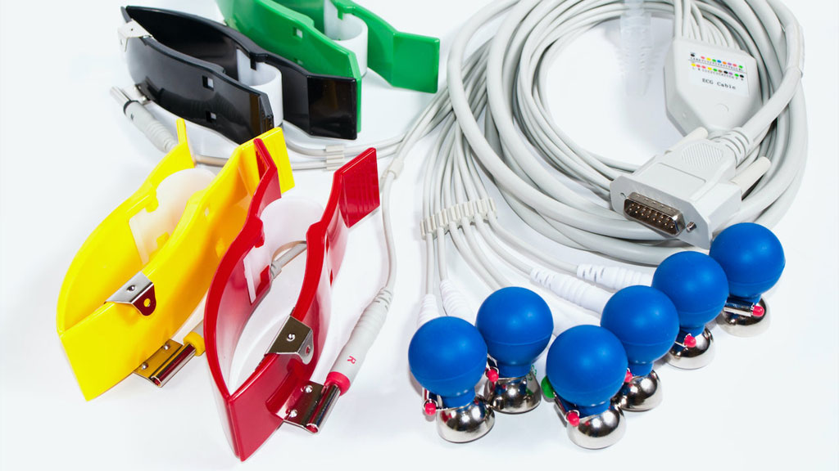
Cables
Cables from different manufacturers differ in connections
both on system side and on electrode side ….

Slide 22

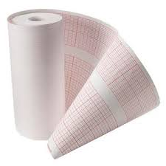
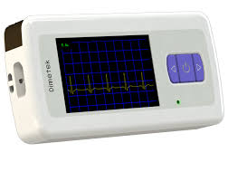
Output
ECG paper: different sizes dependent on brand and model….
And different screens for different applications (e.g. ambulance)

Slide 23
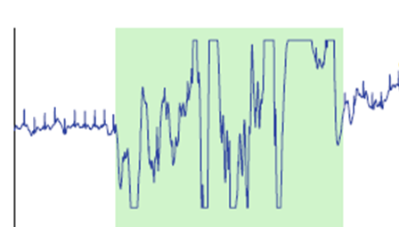
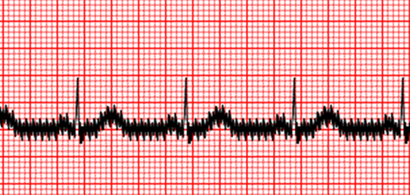
Troubleshooting: User error, electrode placement
The most common problem with ECG systems is user error. Modern ECG recorders have many buttons and controls and can be quite confusing. Therefore, if the machine turns on, the first thing to suspect is user error.
poor electrode cleaning
poor electrode placement
poor skin preparation
can be the cause of a poor, noisy ECG signal and can result in a BMET call
A saturated ECG is almost always caused by problems with electrodes or lead wires (or loose connections.),
an ECG distorted by AC interference = power line noise (50 Hz). You can verify this by removing the machine room to see if this solves the problem.

Slide 24
Troubleshooting: User error, electrode placement
Attention points with electrode placement:
  Electrodes should not be placed on scar tissue
  Electrodes should not be placed over a lot of body hair
  If more than one device requires that electrodes be placed on the patient they may interfere with each other.
Switching to different leads, repositioning electrodes and shaving the skin may resolve these problems
When no trace shows up at all, the most typical cause is user error.
  There may be brightness settings, or an off position.
  Power supply problems should also be suspected.
Bad electrodes and lead wires do not typically cause the trace to disappear.
If the trace does not appear, and the device is a printing-ECG system, you may have problems with the printer. With the heated stylus, the pressure of the stylus on the paper can affect the width of the trace and its frequency response. If too much heat is used the trace will also be widened. If too little is applied, then no trace will appear.

Slide 25
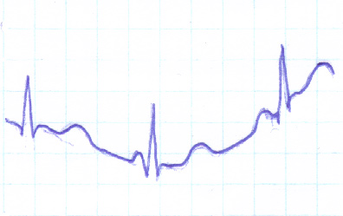
Troubleshooting: More user error
  Patient movement during recording
  The patient may be cold or nervous and shivering. If so, muscle tremors could be causing the interference.
  The patient or nurse may be touching any metal or nearby wall during recording.
  System settings:
    The device must be set correctly for the local power line frequency.
    ‘Gain’ (amplification) settings must not be too high (saturation) or too low (no signal)
      Wrong gain setting may also cause incorrect display on the heart rate meter, if this does not have an automatic gain, as in older machines.
Wandering baseline is noticed by the technician as the line between cardiac cycles bounces around or jumps. This is most often caused by attempting to use a monitor in the wrong (diagnostic) mode or by electrode placement or electrode quality.

Slide 26
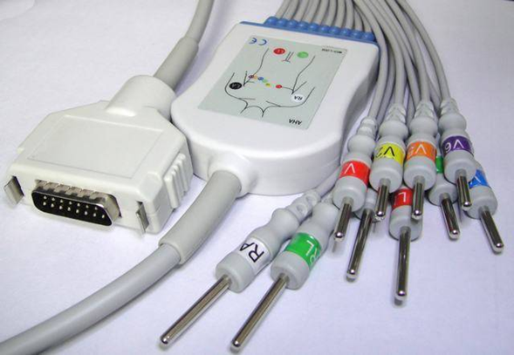
Troubleshooting: Technical problems
Technically, the weakest link in an ECG system are the lead wires. The patient cable should last for many years. However, abusive use can lead to wire breakage.
Before rejecting a lead wire, try a different wire from another machine to confirm that this is the cause. Lead wires often look to be in poor condition because of tape residue on the cable. This residue can be removed using alcohol or other solvents.
If the lead wire is at fault, replacement is the preferred option. However, lead wires can be repaired in some cases

Slide 27
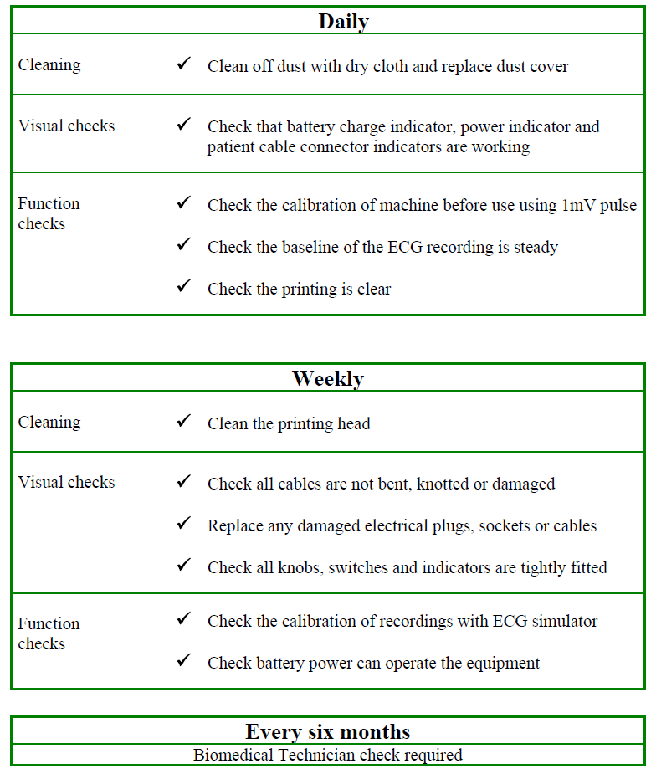
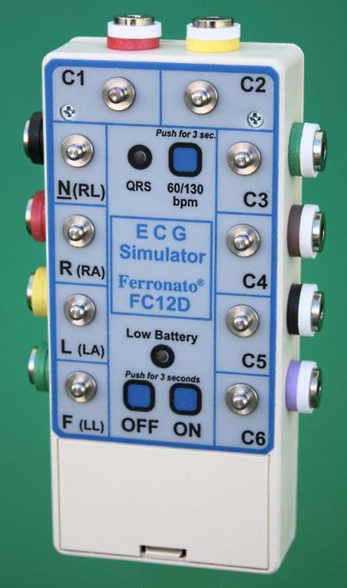
Preventive Maintenance
©
ECG Recorder and Monitor

Slide 28


