Slide 1
Lecture# 5
semester# 1
Chest Tube
:by
lecturer
M.Sc.N: Ali J. Mohammed
Al-Mustaqbal University
College of Nursing
4th Class
The Clinical Part of Critical Care Nursing

Slide 2
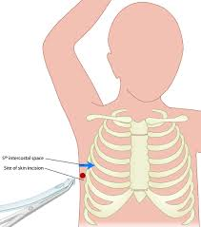
DEFINITION
Chest Tube Insertion: This procedure involves the insertion of a flexible tube into the chest cavity to drain excess fluid (such as blood or pleural effusion) or air (such as in cases of pneumothorax) from around the lungs or heart. The chest tube is typically inserted through a small incision between the ribs and connected to a drainage system.

Slide 3
Sites for chest tube insertion
In the lung apex at the second or fourth inter-costal space, mid-clavicular line to drain air.
In the lateral chest area at the lower site, usually the 5th or 6th intercostal space at the mid-axillary line inter-costal space to drain blood or fluid.
In the anterior media-stinal beneath the sternum, which called retro-sternal tube in case of cardiac surgery.

Slide 4
INDICATION
Pneumothorax (Collapsed Lung)
Air leaks into the pleural space, preventing lung expansion.
2.Hemothorax
  Blood accumulates in the pleural space, often due to trauma or surgery.
3.Pleural Effusion
Excess fluid builds up in the pleural space, caused by infections, heart failure, or cancer.
4.Empyema
  Pus accumulates in the pleural space, often due to a bacterial infection.
5.Postoperative
  Used after thoracic surgery or trauma to prevent fluid or air accumulation.

Slide 5
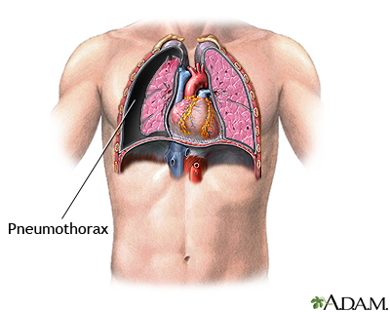
PNEUMOTHORAX
1. For Pneumothorax (Air Removal)
Insertion Site:
  2nd to 4th intercostal space at the midclavicular line or
  4th to 6th intercostal space at the mid-axillary line.
Reason: Air rises to the upper part of the pleural cavity, so the tube is placed higher.

Slide 6
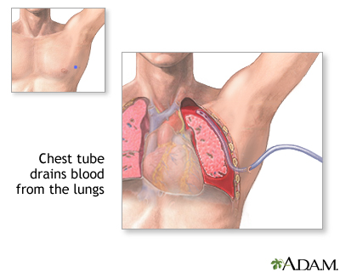
Pleural Effusion, Hemothorax, or Empyema
2. For Pleural Effusion, Hemothorax, or Empyema (Fluid, Blood or pus Removal)
Insertion Site:
  4th to 6th intercostal space at the mid-axillary line.
Reason: Fluids collect in the lower parts of the pleural cavity, so the tube is positioned lower to facilitate drainage.

Slide 7
Postoperative Conditions
For Postoperative Conditions
Insertion Site: 4th or 5th intercostal space at the mid-axillary line is commonly used as it allows for both air and fluid drainage depending on patient positioning.

Slide 8
Chest Tube Insertion Procedure
■ The practitioner puts on a cap, a mask, eye protection, a sterile gown, and sterile gloves and prepares a sterile field using sterile drapes.
■ The practitioner prepares the insertion site using chlorhexidine-based antiseptic swabs.
■ After the antiseptic dries completely, the practitioner drapes the patient, leaving the insertion site exposed.
■ The nurse disinfects the rubber stopper of the lidocaine vial with an antiseptic pad. The nurse then inverts the bottle and holds it for the practitioner to withdraw the anesthetic.
■ The practitioner injects a local anesthetic at the site to reduce the pain of the procedure and waits for the anesthetic to take effect.

Slide 9
Chest Tube Insertion Procedure Continue…
■ The practitioner makes a skin incision about 1″ (2.5 cm) long and then inserts a hemostat through the opening to enter the pleural space. Typically, when the pleural space is entered, you’ll see a return of pleural contents, confirming penetration.
■ The practitioner spreads the hemostat open slightly to enlarge the opening enough to accommodate the chest tube.
■ Using a finger, the practitioner creates a track for the chest tube and then clamps the chest tube with the hemostat and inserts them through the incision, guiding the hemostat and tube along the inserted finger.
■ The practitioner removes the hemostat and immediately connects the chest tube to the drainage system.

Slide 10
Complications
Pain during insertion and after placement of chest tube: Although pain during insertion and mild discomfort after placement are common, your healthcare provider can help minimize these effects with pain medicines.
Infection.
Improper placement.
Dislodged chest tube
excessive bleeding
perforation (puncturing) of the diaphragm
cardiac shock, if the tube punctures an area of the heart

Slide 11
Removal of a chest tube
Explain procedure to patient and place in a position of comfort.
Remove sterile dressing.
Cut suture and …. Ask patient to take a deep breath and hold it - then remove the tube and place a sterile piece of gauze and airtight over the site

Slide 12
Nursing care for Chest tube
At least every 2 hours, document a comprehensive pulmonary assessment, including respiratory rate, breathing, breathing sounds, and arterial oxyhemoglobin saturation measured by pulse oximetry (SpO2)
Inspect the dressing and note any drainage.
Assess the insertion site for subcutaneous emphysema and tube
Chest Tube Care basics: Keep all tubing free of kinks and occlusions; for instance, check for tubing beneath the patient or pinched between bed rails.

