Slide 1
Lecture# 1
semester# 1
Basics of ECG Interpretation
:by
lecturer
MSN: Ali J. Mohammed
Al-Mustaqbal University
College of Nursing
4th Class
The Clinical Part of Critical Care Nursing

Slide 2
The Conduction System
1- Sinoatrial (SA) Node:
Located in the right atrium.
Acts as the natural pacemaker of the heart.
Generates electrical impulses that initiate each heartbeat.
Causes the atria to contract and push blood into the ventricles.
2- Atrioventricular (AV) Node:
Located at the junction between the atria and ventricles.
Receives the impulse from the SA node.
Delays the impulse briefly to allow the ventricles to fill with blood before they contract.

Slide 3
3- Bundle of His:
Located in the septum between the ventricles.
Transmits the electrical impulse from the AV node to the ventricles.
Divides into two branches (right and left bundle branches).
4- Right and Left Bundle Branches:
Carry the impulse down the interventricular septum.
Direct the impulse towards the apex of the heart.
5- Purkinje Fibers:
Spread throughout the ventricles.
Conduct the impulse rapidly to the ventricular muscle, causing it to contract.
Ensures that the ventricles contract from the bottom up, pushing blood out of the heart.

Slide 4
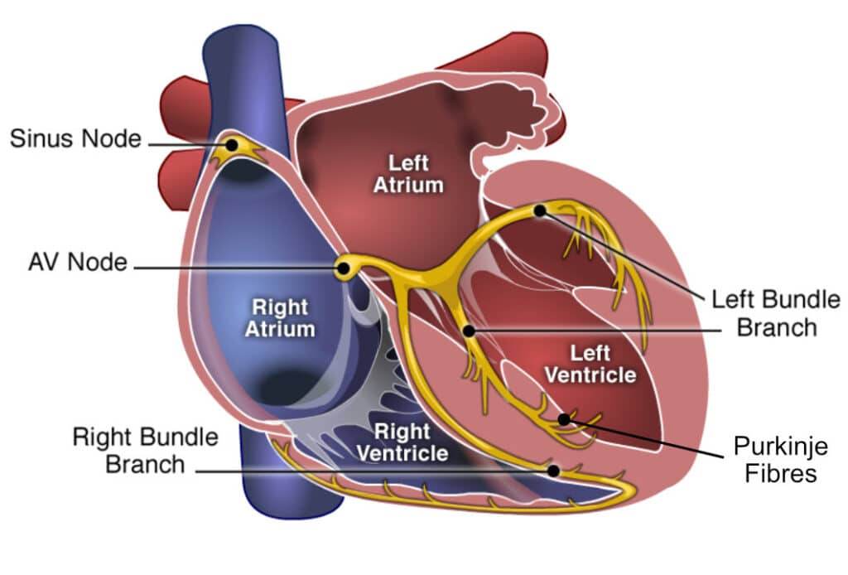

Slide 5
History
Willem Einthoven (1860-1927):
A Dutch physiologist who invented the first practical electrocardiograph in 1903.
He is considered the father of electrocardiography because he developed a device that could record the electrical activity of the heart using a string galvanometer.
Einthoven introduced the standard ECG waveforms (P, Q, R, S, T) that are still in use today.
He won the Nobel Prize in Physiology or Medicine in 1924 for his pioneering work.

Slide 6
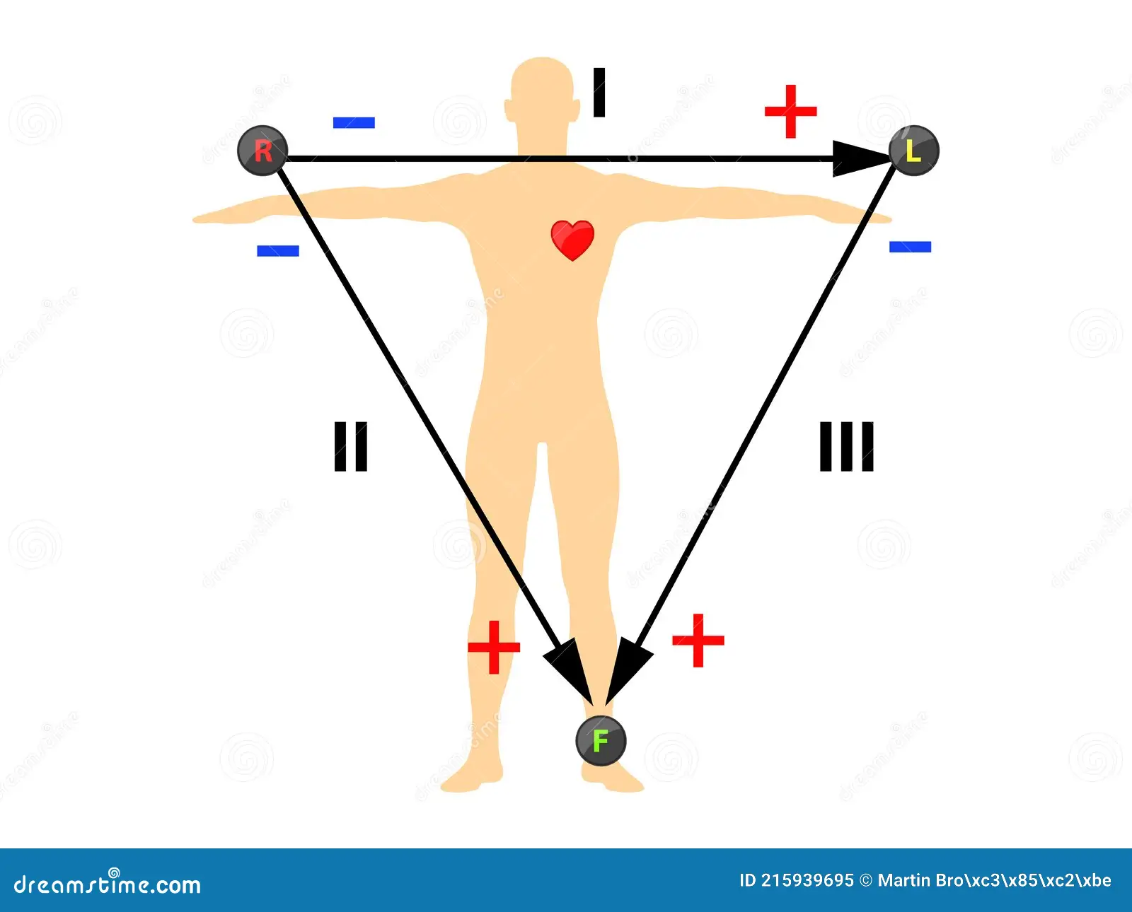
Einthoven’s Triangle

Slide 7
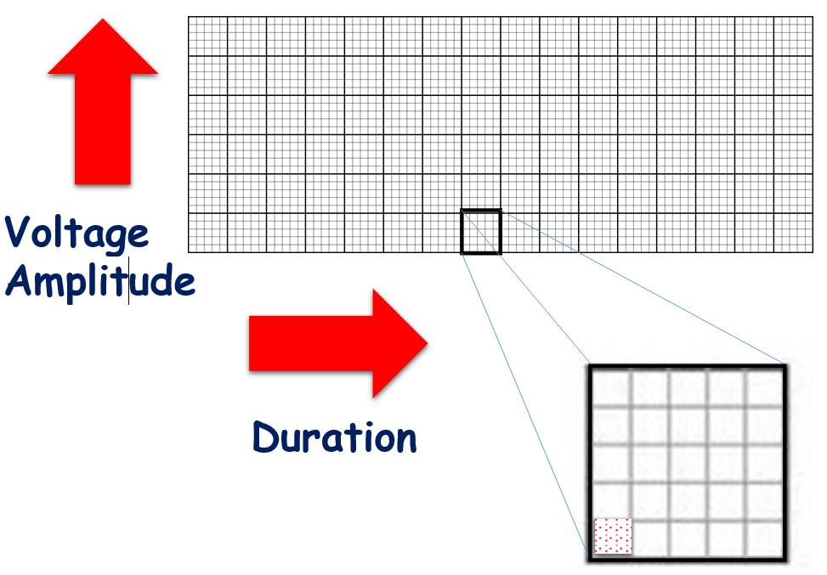
كل مربع كبير يحتوي على 25 مربع صغير بداخله

Slide 8
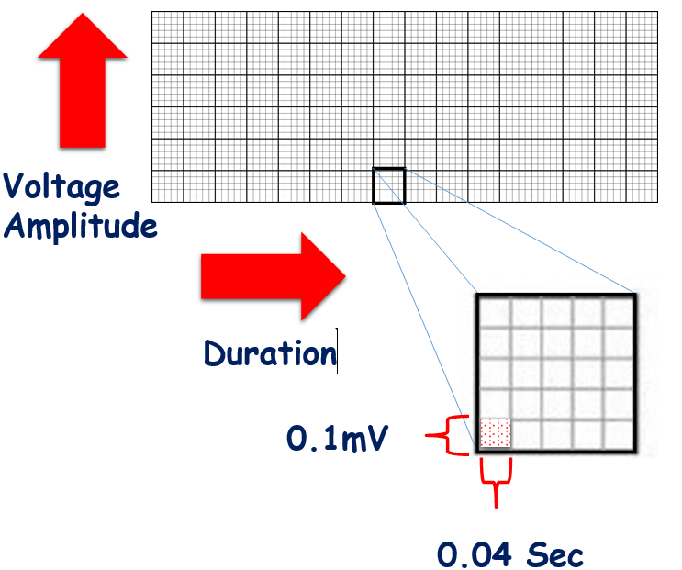

Slide 9
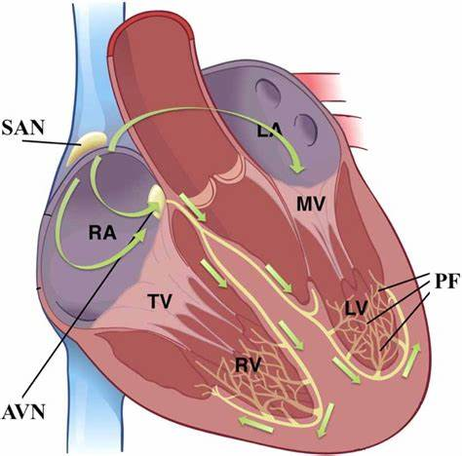
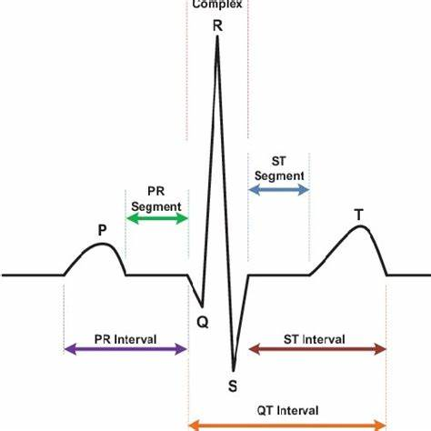

Slide 10
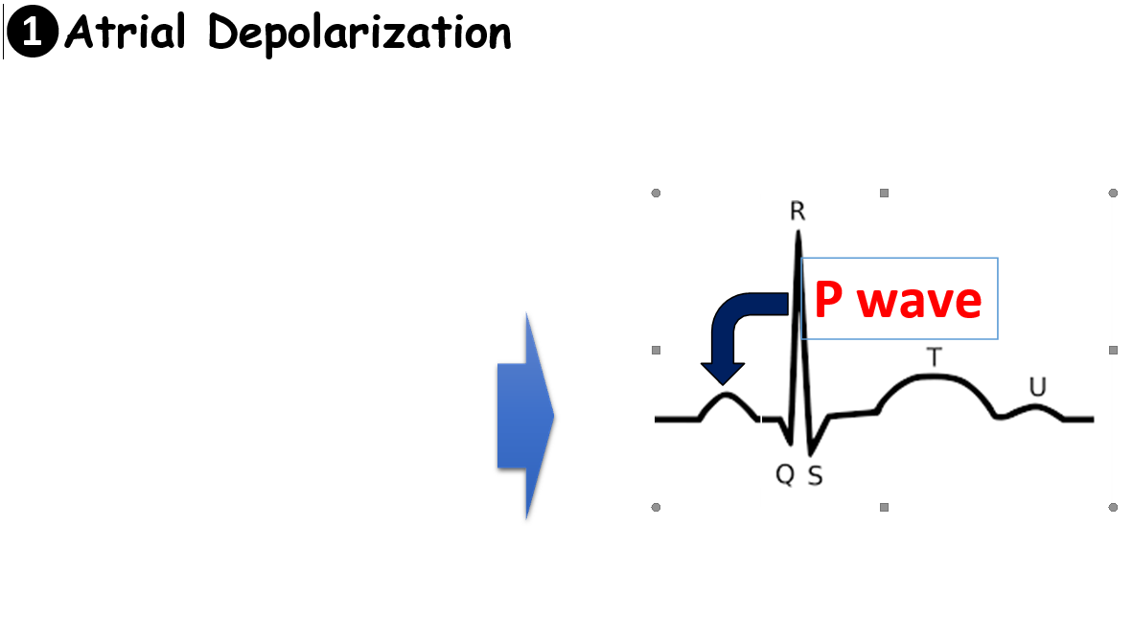
Atrial depolarization: is the process by which the electrical impulses in the heart cause the atria to contract. This happens when the sinoatrial (SA) node, generates an electrical signal that spreads across the atria, leading to their contraction and pushing blood into the ventricles . On an (ECG), atrial depolarization is represented by the P wave.

Slide 11

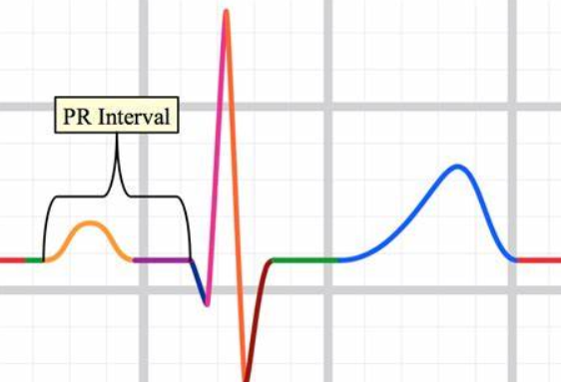
PR Interval : It represents the time it takes for the electrical impulse to travel from the atria, through the atrioventricular (AV) node, and down to the ventricles. A normal PR interval lasts about 0.12 to 0.20 seconds.

Slide 12
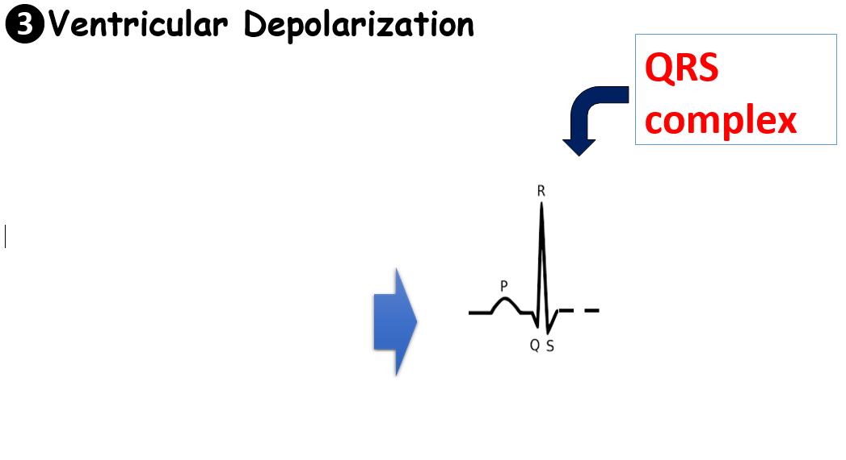
QRS complex: represents ventricular depolarization, which is the electrical activity that causes the ventricles to contract and pump blood out of the heart. It appears as a narrow and typically less than 3 small sequer.

Slide 13
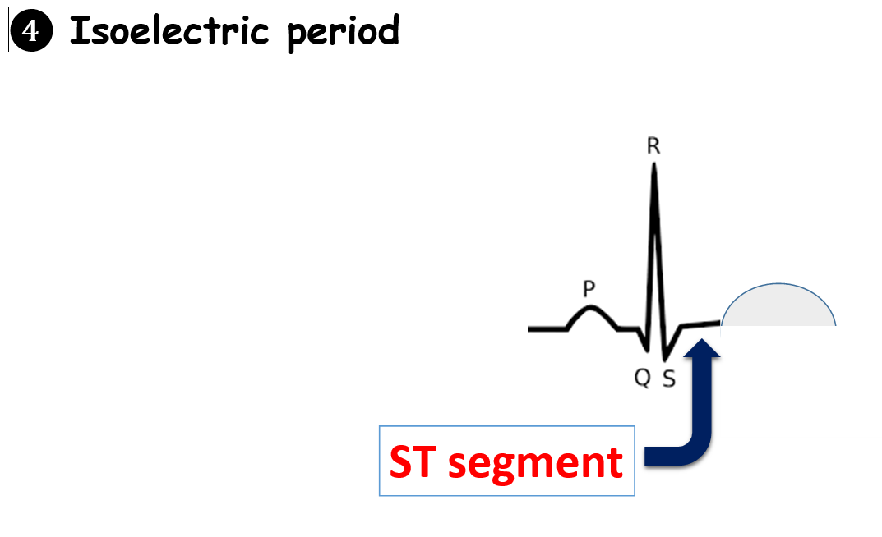
The ST segment represents the period between the end of ventricular depolarization and the beginning of ventricular repolarization.
Changes in the ST segment, such as elevation or depression, can indicate various heart conditions, including myocardial ischemia, myocardial infarction, or other cardiac abnormalities.

Slide 14
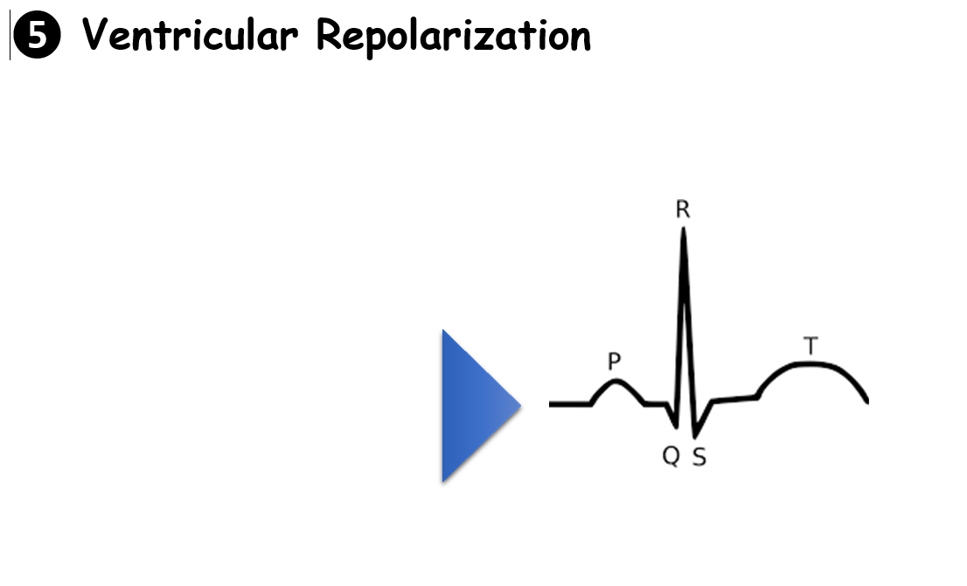
The T wave in an ECG represents the repolarization (or relaxation) of the heart's ventricles after they have contracted. It appears as a rounded, upward wave following the QRS complex.

Slide 15
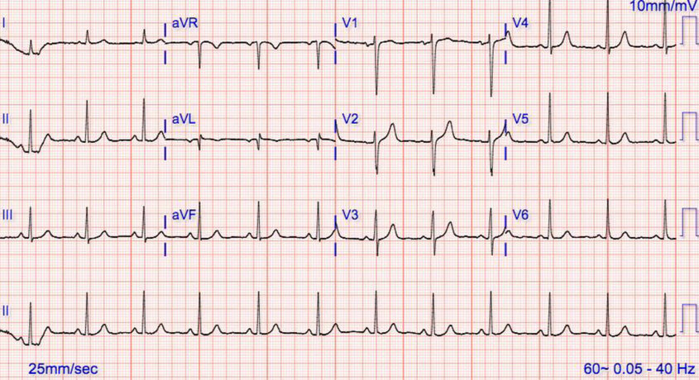
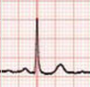
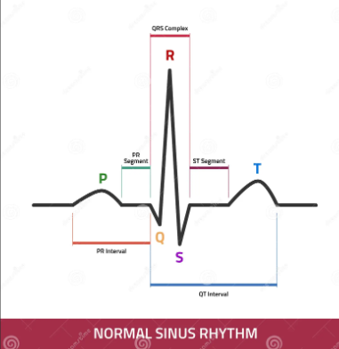


Slide 16
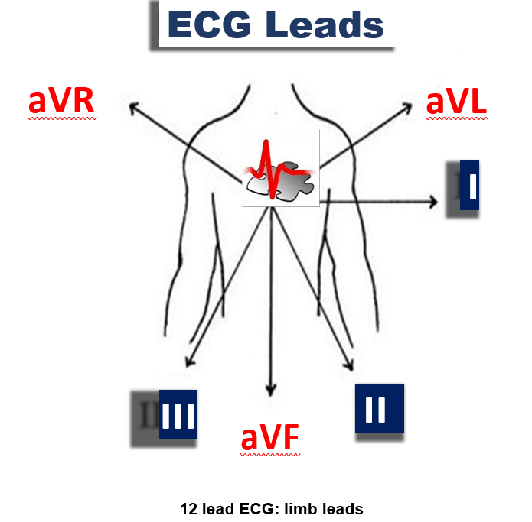

Slide 17
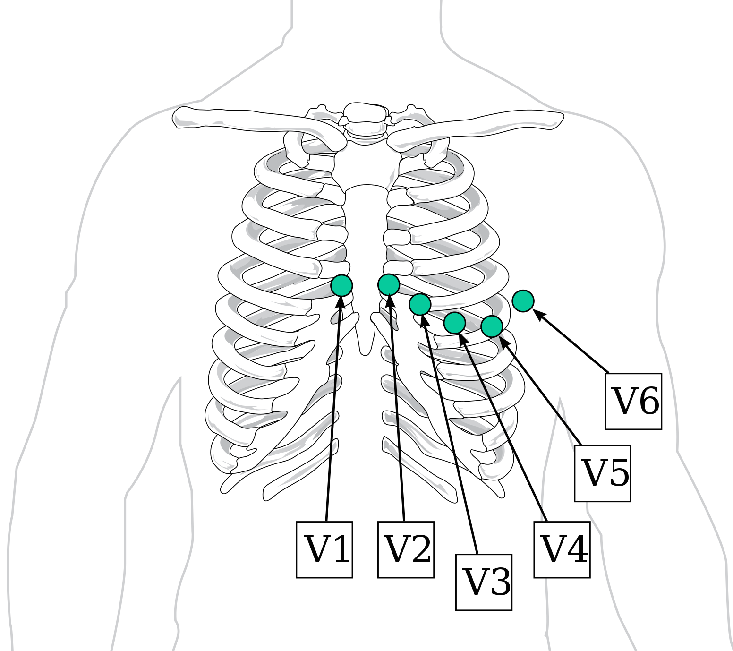
Chest Leads

Slide 18
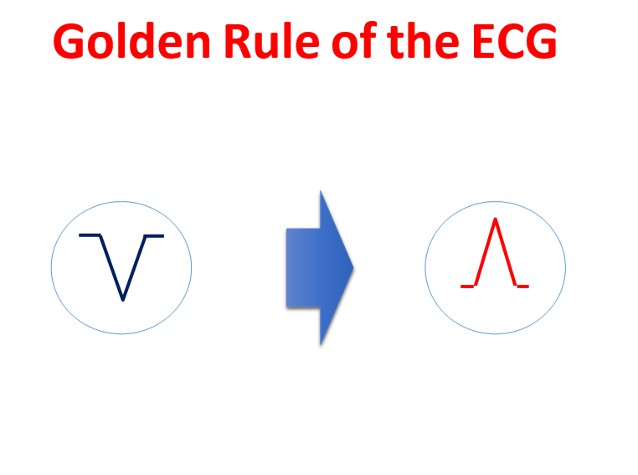
القاعدة الذهبية في تخطيط القلب
إذا كان متجه كهربائية القلب يتجه نحو أي
قطب فانه يرسم موجة موجبة (للأعلى) ....
بينما إذا كان متجه كهربائية القلب يتجه مبتعدا عن أي قطب فانه يرسم موجة سالبة
(للأسفل)..

Slide 19
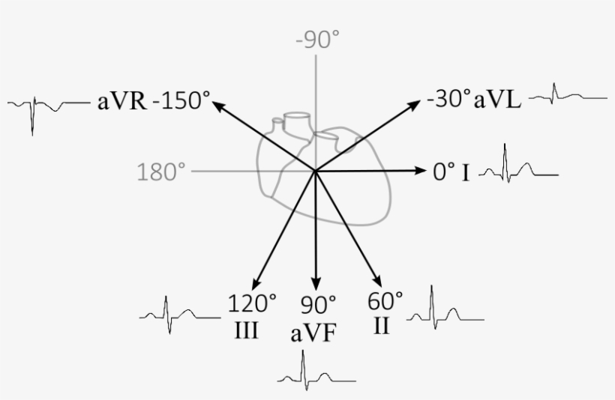

Slide 20
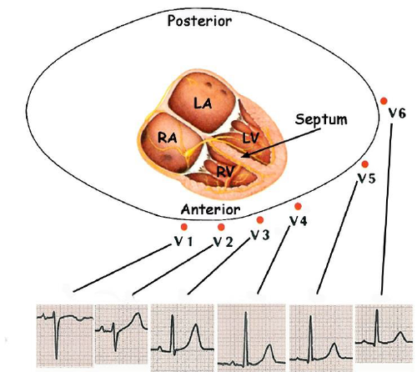

Slide 21
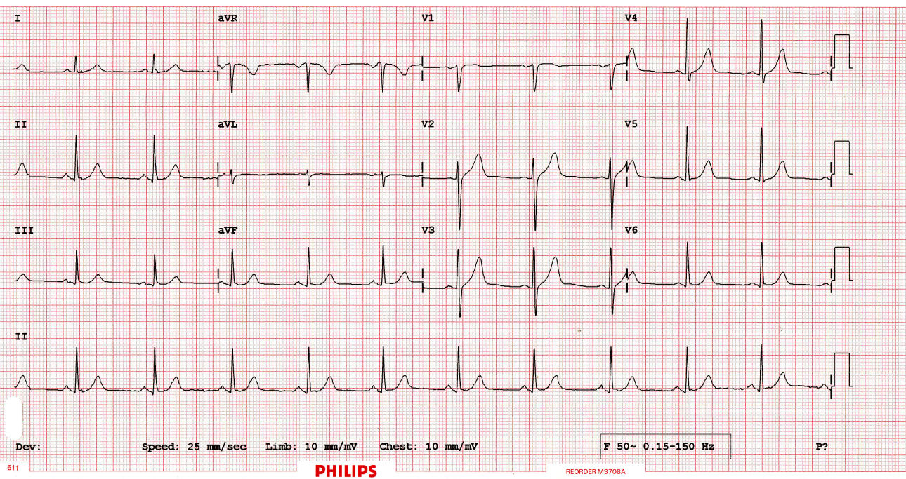
Normal ECG

Slide 22
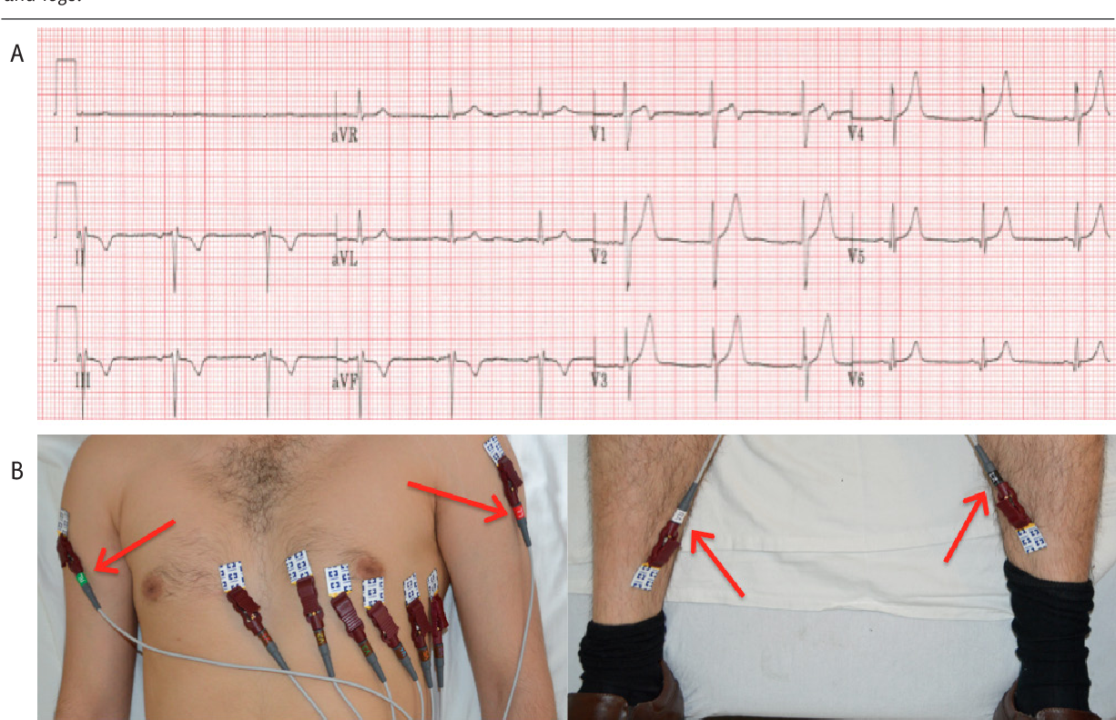
Abnormal ECG

Slide 23
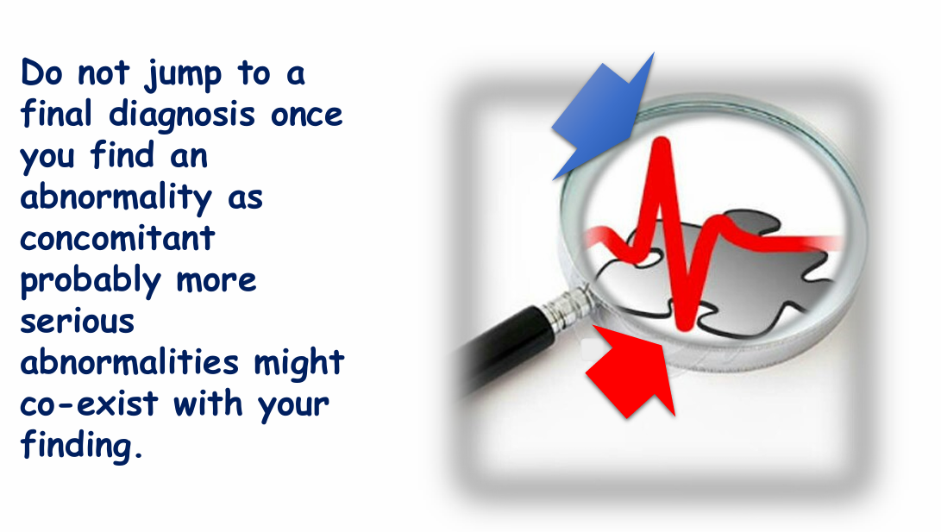

Slide 24
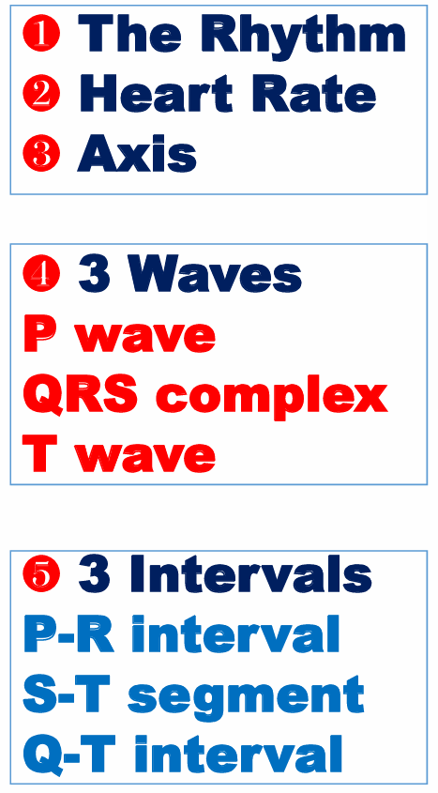
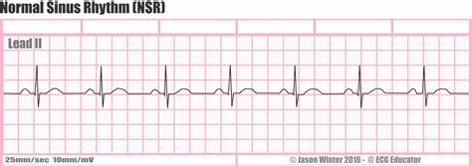

Slide 25


