Slide 1
Unit 5: Anxiety disorder:
Anxiety as a response to stress.
Types and the levels of anxiety disorder.
Etiology and Treatment Modalities.
Al-Mustaqbal University/ College of Nursing

Slide 2
• Anxiety as Stress Response
❖Stress:
❖Stress occurs when a person has difficulty dealing with life situations, problems, and goals.
❖People handle stress causing events differently.
Anxiety can have positive functions such as motivating the person to take action to solve a problem

Slide 3
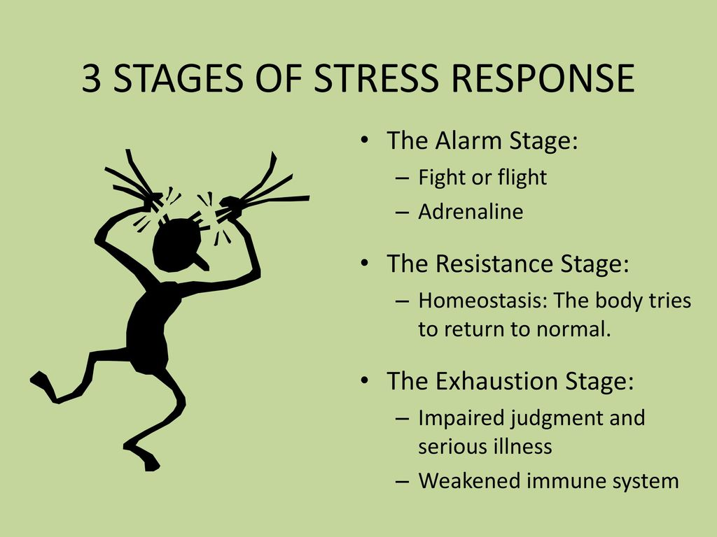

Slide 4
  Anxiety: Is an uncomfortable feeling that occur in response to the fear of being hurt or losing something valued.
  Stressor: is an external pressure that is brought to bear on the individual.
  Anxiety is the subjective emotional response to that stressor.
  • Anxiety: apprehension, tension, or uneasiness from anticipation of danger, the source of which is largely unknown.

Slide 5
❖Levels of Anxiety:
1. Mild Anxiety
• This is the type of anxiety associated with the normal tension of everyday life.
• The individual is alert.
• Perceptual field is increased
• Produce growth and creativity, as e.g. Helps students to focus on studying for an examination.

Slide 6
2. Moderate Anxiety:
• The response of the body to immediate danger and focus is directed to immediate concerns.
• Moderate anxiety include elevated heart rate, increased breathing and sweaty palms.
• Narrows the perceptual field to pay attention to particular details as the person sees, hears, and grasps less.
• Selective in attentiveness occurs.
• The increased tension makes this the optimal time for learning

Slide 7
3. Severe Anxiety
• Creates a feeling that something bad is about to happen, or feeling of an impending doom.
• Severe anxiety include a racing heart, shortness of breath, dizziness and fear of losing complete control.
• Fight and flight response sets

Slide 8
Narrow perceptual field occurs and focus is on specific details or scattered details so that learning and problem-solving is not possible.
• The individual needs direction to focus.
• Dilated pupils, fixed vision.

Slide 9
4. Panic Level :( Panic Attack)
• There is increased motor activity, decreased ability to relate with others, distorted perceptions, lose of contact with reality may occur and loss of rational thought.
• The person in panic is unable to communicate or function effectively.
• Feelings of helplessness and terror.
• Inability to concentrate.
• If prolonged, panic can lead to exhaustion and death

Slide 10

Working with Anxious Clients
• Mild anxiety is an asset to the client and requires no direct intervention.
People with mild anxiety can learn and solve problems and are even eager for information. Teaching can be effective when the client is mildly anxious.

Slide 11
Moderate anxiety the nurse must be certain that the client is following what the nurse is saying. The client’s attention can wander, and he or she may have some difficulty concentrating over time.
Speaking in short, simple, and easy-to-understand sentences is effective; the nurse must stop to ensure that the client is still taking in the information correctly.

Slide 12
Severe anxiety, the client can no longer pay attention or take in information. The nurse’s goal must be to lower the person’s anxiety level to moderate or mild before proceeding with anything else. It is also essential to remain with the person because anxiety is likely to worsen if he or she is left alone.
Talking to the client in a low, calm, and soothing voice can help. If the person cannot sit still, walking with him or her while talking can be effective.

Slide 13
Panic anxiety, the person’s safety is the primary concern. He or she cannot perceive potential harm and may have no capacity for rational thought. The nurse must keep talking to the person in a comforting manner, even though the client cannot process what the nurse is saying. Going to a small, quiet, and non stimulating environment may help reduce anxiety. The nurse can reassure the person that this is anxiety, it will pass, and he or she is in a safe place. The nurse should remain with the client until the panic recedes.

Slide 14
OVERVIEW OF ANXIETY DISORDERS
• Anxiety disorders are diagnosed when anxiety no longer functions as a signal of danger or a motivation for needed change but becomes chronic and permeates major portions of the person’s life, resulting in maladaptive behaviors and emotional disability.
✓ Types of anxiety disorders include the following:
• Agoraphobia
• Panic disorder
• Specific phobia
• Social anxiety disorder (social phobia)
• Generalized anxiety disorder (GAD)

Slide 15
INCIDENCE
Anxiety disorders are more prevalent in women
▪ Anxiety disorders are more prevalent in people younger than 45 years of age
▪ Anxiety disorders are more prevalent in people who are divorced or separated
▪ Anxiety disorders are more prevalent in people of lower socioeconomic status

Slide 16
Classification:
1.Generalized anxiety disorder:
✓ Generalized anxiety disorder (GAD) is a common chronic disorder characterized by chronic, unrealistic, excessive anxiety, irritability ,muscle tension, sleep disturbance and worry that is not focused on any one object or situation.
✓ Generalized anxiety disorder is the most common anxiety disorder to affect older adults.

Slide 17
2. Panic disorder:
❑ In panic disorder, a person suffers from brief attacks of intense terror and apprehension, often marked by trembling, shaking, confusion, dizziness, nausea, difficulty breathing.
❑ These panic attack, defined by the APA as fear or discomfort that abruptly arises and peaks in less than ten minutes, can last for several hours and can be triggered by stress, fear; the specific cause is not
always apparent. Discrete episodes of panic attacks, last from 15 to 30 minutes.

Slide 18
3. Phobias – phobic disorder:
❑ Phobia is an irrational, present fear of an event, situation, activity or object. The extent recognizes this fear as irrational but is unable to prevent it. Sufferers understand that their fear is not proportional to the actual potential danger but still are overwhelmed by the fear.

Slide 19
a. Agoraphobia: fear of being in places or situations from which escape might be difficult or in which help might not be available in the event of panic attack.
b. Social Anxiety Disorder (Social Phobia) :is an excessive fear of situations in which a person might do something embarrassing or be evaluated negatively by others. Include fear of using a public places ,fear of speaking or eating in a public place , fear of writing in the presence of others .

Slide 20
c. Specific phobia: excessive or unreasonable fear when in the presence of, or when anticipating an encounter with a specific object or situation. Identified by fear of specific objects or situations that could conceivably cause harm (e.g., snakes,
heights), but the person’s reaction to them is excessive, unreasonable, andinappropriate

Slide 21
❑Specific phobias are subdivided into the following categories:
1. • Natural environmental phobias (Astraphobia, Aquaphobia, acrophobia): fear of storms, water, heights, or other natural phenomena
2. • Blood–injection phobias (Hemophobia): fear of seeing one’s own or others’ blood, traumatic injury, or an invasive medical procedure such as an injection
3. • Situational phobias (Claustrophobia): fear of being in a specific situation such as on a bridge or in a tunnel, elevator, small room, hospital, or airplane

Slide 22
4. Anxiety Disorder Due to Another Medical Condition and Substance/ Medication-Induced Anxiety Disorder:
➢ Medical condition-Induced anxiety disorder include:
Cardiac conditions, such as myocardial infarction, congestive heart failure, and mitral valve prolapse.
Respiratory conditions, such as chronic obstructive pulmonary disease and hyperventilation.
Neurological conditions, such as complex partial seizures, neoplasms, and encephalitis.
➢ Substance/ Medication-Induced anxiety disorder include: Alcohol, amphetamines, cocaine, hallucinogens, sedative-hypnotics, caffeine, cannabis, or other substances.

Slide 23
❖ ETIOLOGY
• Biologic Theories:
➢ Genetic Theories;
Anxiety may have an inherited component because first degree relatives of clients with increased anxiety have higher rates of developing anxiety.

Slide 24
➢ Neurochemical Theories
• Gamma-aminobutyric acid (-aminobutyric acid [GABA]) is the amino acid neurotransmitter believed to be dysfunctional in anxiety disorders.
• 5-Hydroxytryptamine type 1a plays a role in anxiety, and it also affects aggression and mood.
• Serotonin excess is believed to play a distinct role in OCD, panic disorder, and GAD.
• An excess of norepinephrine is suspected in panic disorder, GAD, and posttraumatic stress disorder

Slide 25
• Psychodynamic Theories
➢ Intrapsychic / Psychoanalytic Theories
• Freud (1936) saw a person’s innate anxiety as the stimulus for behavior. He described defense mechanisms as the human’s attempt to control awareness of and to reduce anxiety.
➢ Interpersonal Theory
• Harry Stack Sullivan (1952) viewed anxiety as being generated from problems in interpersonal relationships.
• Hildegard Peplau (1952) understood that humans exist in interpersonal and physiologic realms; thus, the nurse can better help the client to achieve health by attending to both areas.

Slide 26
CARE PLAN FOR THE CLIENT WITH ANXIETY
• NURSING DIAGNOSIS: PANIC ANXIETY
• RELATED TO: Real or perceived threat to biological integrity or self-concept
NURSING INTERVENTIONS
1. Stay with the client and offer reassurance of safety and security.
Do not leave the client in panic anxiety alone.
2. Use simple words and brief messages, spoken calmly and clearly.
3. Keep immediate surroundings low in stimuli (dim lighting, few
people, simple decor).
4. Teach signs and symptoms of escalating anxiety, and ways to
interrupt its progression (relaxation techniques, such as deep breathing exercises and meditation, or physical exercise, such as
walks).

Slide 27
❖ Treatment Modalities
❑ Behavior Therapy
Behavioral therapists initially focus on teaching what anxiety is, helping the client identify anxiety responses, teaching relaxation techniques, setting goals, discussing methods to achieve those goals, and helping the client visualize phobic situations. Therapies that help the client develop self-esteem and self-control are common.
One behavioral therapy often used to treat phobias is systematic (serial) desensitization, in which the therapist progressively exposes the client to the threatening object in a safe setting until the client’s anxiety decreases.
Flooding is a form of rapid desensitization in which a behavioral therapist confronts the client with the phobic object (either a picture or the actual object) until it no longer produces anxiety.

Slide 28
❑Cognitive Therapy
• Cognitive therapy strives to assist the individual to reduce anxiety responses by altering cognitive distortions.
❑Positive reframing
Positive reframing means turning negative messages into positive messages. The therapist teaches the client to create positive messages for use during panic episodes. For example, instead of thinking, “My heart is pounding. I think I’m going to die,” the client thinks, “I can stand this. This is just anxiety. It will go away.” The client can write down these messages and keep them readily accessible, such as in an address book, a calendar, or a wallet.

Slide 29
❑Decatastrophizing
• involves the therapist’s use of questions to more realistically appraise the situation.
The therapist may ask, “What is the worst thing that could happen? Is that likely? Could you survive that? Is that as bad as you imagine?” The client uses thoughtstopping and distraction techniques to jolt him or herself from focusing on negative thoughts. Splashing the face with cold water, snapping a rubber band worn on the wrist, or shouting are all techniques that can break the cycle of negative thoughts.

Slide 30
Assertiveness training
• Assertiveness training helps the person take more control over life situations. These techniques help the person negotiate interpersonal situations and foster self-assurance.
• Examples include “I feel angry when you turn your back while I’m talking,”
• “I want to have 5 minutes of your time for an uninterrupted conversation about something important,”
• “I would like to have about 30 minutes in the evening to relax without interruption.”

Slide 31


