Slide 1

Psychosocial theories
Lecture Psychiatric Nursing
Al-Mustaqbal University/ College of Nursing

Slide 2
❖Psychoanalytic Theory: Freudian theory (Psychodynamic/Psychoanalytic theory)
•Sigmund Freud: The first to link childhood experiences with adult problems. He believes that the internal emotional life of the individual is the most significant factor in development of personality (intra-psychic). Illness is defined in terms of behavior disorders & originates in conflicts among the id, ego, superego and or environment

Slide 3
Much of our behavior is caused by parts of personality which are found in the unconscious and of which we are unaware.

Slide 4
  • Freud’s Levels of Consciousness Conscious Mind: Functions only when person is awake.
  Concerned with thoughts, feelings, sensations, memory, & wishes (easily remembered). Directs person to behave in a rational, thoughtful way.

Slide 5
Preconscious/ Subconscious Mind: Reactions and ideas are stored and partially forgotten .
These ideas can be recalled easily with concentration .

Slide 6
▪Unconscious Mind: It constitute largest part of our mind Storehouse for all memories, feelings, wishes, and responses experienced in entire life.
Cannot be recalled at will. Demonstrated through dreams, slips of tongue, unexplained behavior, & jokes.

Slide 7

Free association Technique: Bring the unconscious feelings into awareness: Ask patients to relax and say whatever came to mind without any consideration.

Slide 8
Freud’s Personality Structure
Id: (1 day –1 year) ➢Id is the unorganized, inborn part of personality
➢The id seeks immediate gratification of primitive pleasure (food, drink, play, & other primitives )
➢The purpose is to immediately reduce tensions.
➢Has no sense of worth or wrong; avoid pain and maintain pleasure at all costs.

Slide 9
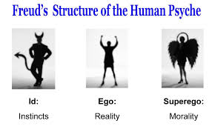
Ego: ➢It is the rational, conscious, reasonable part of the personality.
➢Takes the real world into consideration when there is a need to be gratified. ➢Promotes satisfactory adjustment to environment.
➢Ego balancing between Id and super ego).

Slide 10
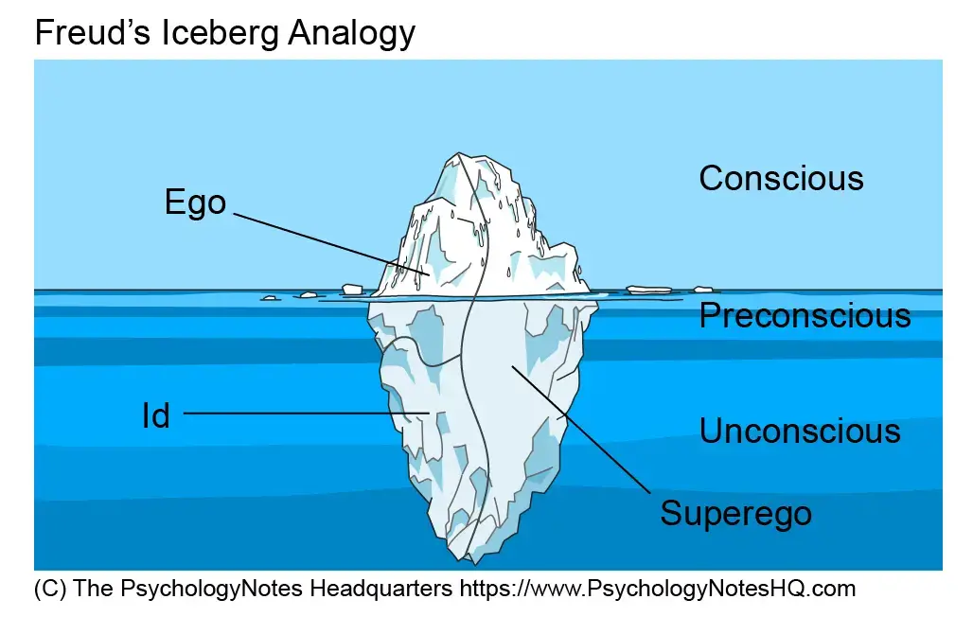
Superego ➢It is the internal representation of the values and morals of society.
➢The values and morals of society usually taught to the child by the parents.
➢An individual judges whether an action is right or wrong according to the standards of society.

Slide 11
The superego strives for perfection .
➢Superego develops in response to parental rewards and punishment.
➢The child no longer needs any one to tell him it is wrong to steal, his superego tells him
Superego has 2 parts :
a) Conscience: punishes by guilt and anxiety .
b) Ego ideal: Rewards with euphoria, well -being

Slide 12
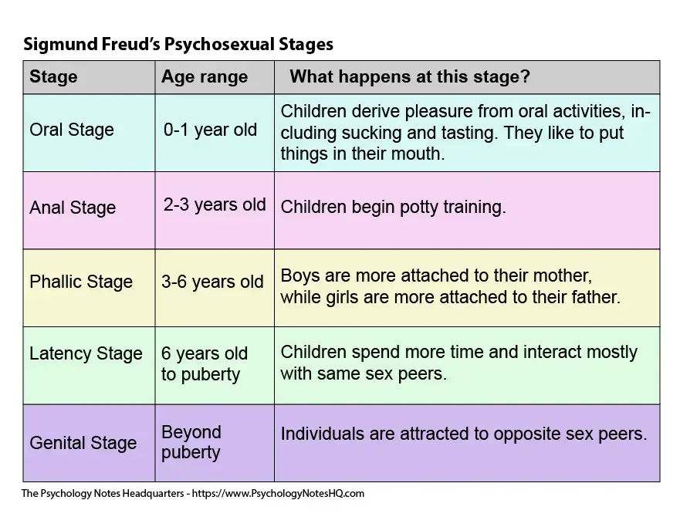

Slide 13
2. Developmental theory
Erik Erikson's: (Developmental theory )
➢Erikson extended Freud’s work on personality development while focusing on social and psychological development in the life stages
➢He believed the psychosocial relationship important in individual development.

Slide 14
Erikson described that people pass through eight psychosocial stages of development.
➢In each stage, the person must complete a life task that is essential to his/her mental health.
➢These tasks allow the person to achieve life’s qualities: hope, purpose, fidelity, love, caring, and wisdom.

Slide 15
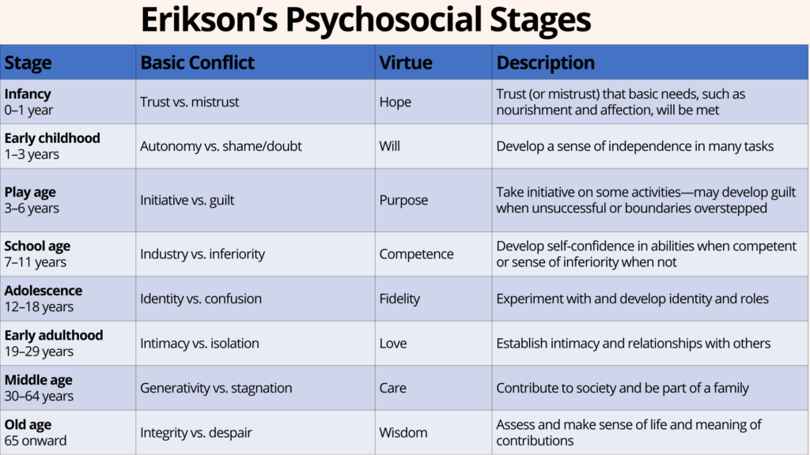

Slide 16
3-Harry Sullivan (Interpersonal theory )
➢Focuses on interaction between an individual and his environment.
➢He believed that inadequate or no satisfying
relationships produce anxiety and emotional problems
➢Sullivan focusing on interpersonal relationship by discover (therapeutic community or therapeutic milieu)

Slide 17
Concept of Milieu Therapy
▪ Milieu therapy is developed by Sullivan
1. The therapist provides a corrective interpersonal relationship for the client.
2. Giving one another feedback about behavior .
3. Working cooperatively with other as a group to solve day to day problems

Slide 18
4-Hildegard Peplau (interpersonal theory). (Nurse Patient relationship) ▪
Is a nursing theorist who developed the concept of the therapeutic nurse –patient relationship ,which include 4 phases:
1 Orientation phase
2. Identification phase
3. Exploration phase
4. Resolution phase

Slide 19
5-Jean Piaget (cognitive theory).
➢Piaget focused on the ability to develop thinking from child to adult hood .
➢He believed that Individuals born tendency to adapt with environment .
E.g. The nurse can use dolls or toy and medical equipment to explain a surgical process to a preschool age about to undergo surgery.

Slide 20
Humanistic Theories.
➢ Humanism focuses on a person’s positive qualities, his or her capacity to change (human potential), and the promotion of self-esteem.
➢ Humanists do consider the person’s past experiences, but they direct more attention toward the present and future.

Slide 21
Abraham Maslow : Hierarchy of Needs ▪ Abraham Maslow (1921–1970) was an American psychologist who studied the needs or motivations of the individual.
Maslow (1954) formulated the hierarchy of needs, in which he used a pyramid to arrange and illustrate the basic drives or needs that motivate people..

Slide 22
Maslow hypothesized that the basic needs at the bottom of the pyramid would dominate the person’s behavior until those needs were met, at which time the next level of needs would become dominant. For example, if the needs for food and shelter are not met, they become the overriding concern in life; the hungry person risks danger and social ostracism to find food

Slide 23
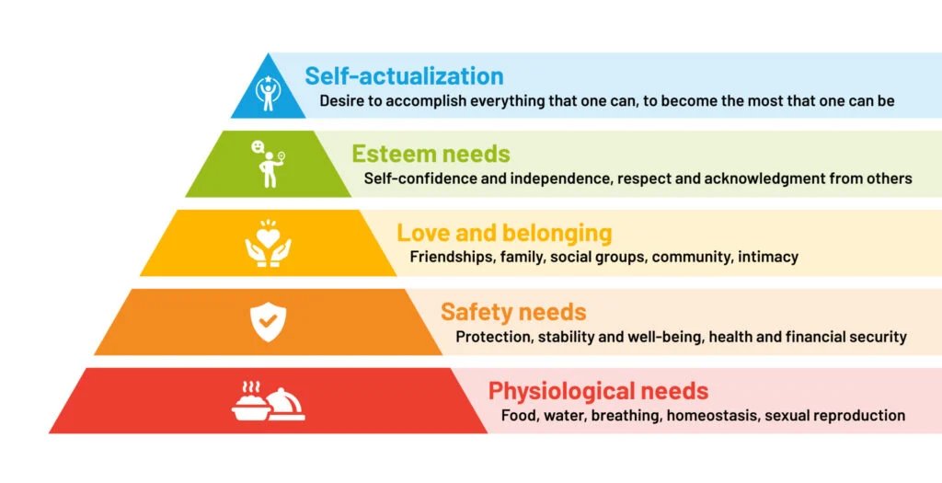

Slide 24
Carl Rogers : Client Centered Therapy ▪Carl Rogers (1902–1987) was a humanistic American psychologist who focused on the therapeutic relationship and developed a new method of client-centered therapy.
▪ Rogers was one of the first to use the term client rather than patient.
▪ The therapist must promote the client’s self-esteem as much as possible through three central concepts:

Slide 25
Unconditional positive regard—a nonjudgmental caring for the client that is not dependent on the client’s behavior
Genuineness—realness or congruence between what the therapist feels and what he or she says to the client
Empathetic understanding—in which the therapist senses the feelings and personal meaning from the client and communicates this understanding to the client

Slide 26


