Slide 1
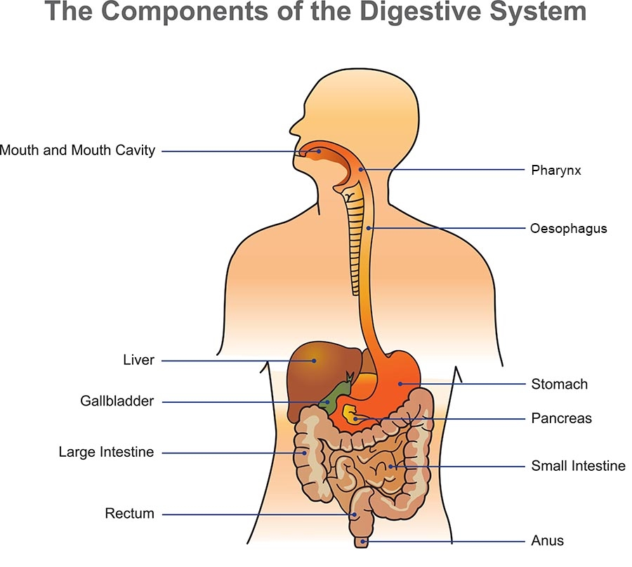
Adult Nursing –Second Stage
Digestive System
Dr.
Wissam Mohammed
Lecture 4

Slide 2
Anatomy Of The Gastrointestinal System
The GI tract is a pathway (23 to 26 feet) in length that extends from the mouth to the esophagus, stomach, small and large intestines, and rectum, to the terminal structure, the anus.
The stomach is situated in the left upper portion of the abdomen under the left lobe of the liver and the diaphragm, overlaying most of the pancreas.
The stomach stores food during eating, secretes digestive fluids, and propels the partially digested food, into the small intestine.

Slide 3
The large intestine consists of an ascending segment on the right side of the abdomen, a transverse segment that extends from right to left in the upper abdomen, and a descending segment on the left side of the abdomen.
The sigmoid colon, the rectum, and the anus complete the terminal portion of the large intestine. A network of striated muscle that forms both the internal and the external anal sphincters regulates the anal outlet.

Slide 4
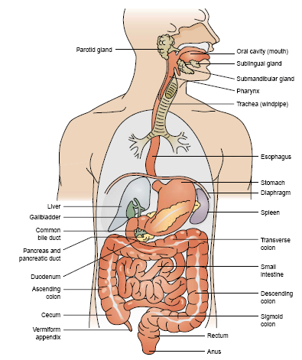

Slide 5
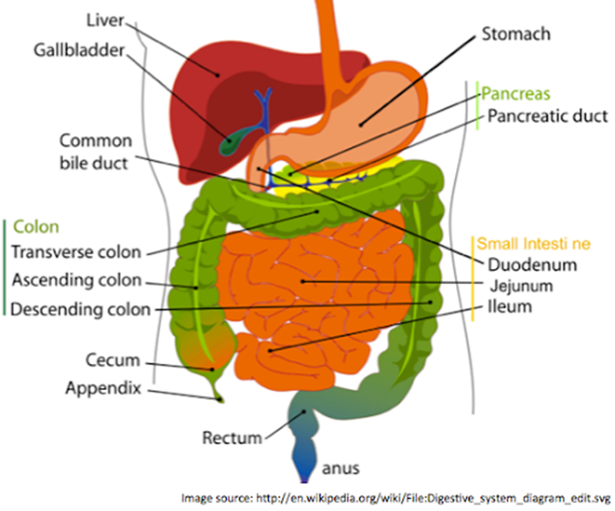

Slide 6
Function Of The Digestive System
Major functions of the GI tract include:
1. Breakdown of food particles into the molecular form for digestion
2. Absorption into the bloodstream of small nutrient molecules produced by digestion
3. Elimination of undigested unabsorbed foodstuffs and other waste products.

Slide 7
Gastric Function
Stores and mixes food with secretions.
Break down food into more absorbable components.
Destruction of most ingested bacteria.
Pepsin, an important enzyme for protein digestion

Slide 8
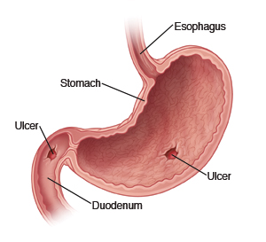
Definition
Peptic Ulcer: is a mucosal lesion of the stomach or duodenum.
Peptic ulcer disease (PUD) results when mucosal defenses become impaired and no longer protect the epithelium from the effects of acid and pepsin.

Slide 9
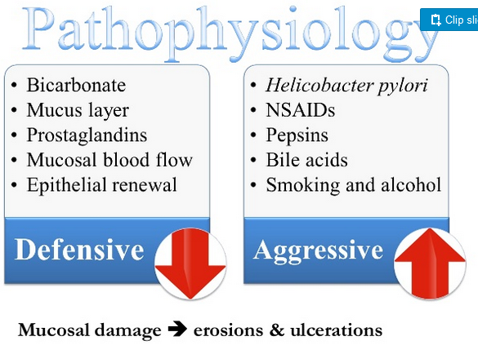
Pathophysiology
The gastro duodenal mucosal integrity is determined by protective ( defensive) and damaging (aggressive ) factors.

Slide 10
Types Of Ulcers
Three types of ulcers may occur:
Gastric ulcers.
Duodenal ulcers.
Stress ulcers (less common).
Most gastric and duodenal ulcers are caused by H. pylori infection. Although it is not certain about how H. pylori is transmitted, it is believed to be spread through contaminated food or water.
Studies have also suggested that contact with stool, vomit, and sometimes saliva of an infected person can spread the infection As a response to the bacteria.

Slide 11
Differences Between Gastric And Duodenal Ulcer
Duodenal ulcer | Gastric ulcer
Occur in the duodenum | Occur in the stomach
Abdominal pain can be relieve by eating | Abdominal pain cannot be relieve by eating
Epigastric pain 2-5 hours after eating | Epigastric pain 1-2 hours after eating
Gas formation occur | Hemorrhage occur
Gain of weight | Loss of weight
Pain often awaken patient during the night | Pain are less likely awaken patient at night
Anorexia, nausea less common | Anorexia, nausea more common

Slide 12
Factors in the Development of PU
H.pylrio.
Smoking.
Caffeine.
Alcohol
Stress.
Acid and pepsin.
NSAIDs.

Slide 13
Symptoms Of Gastric And Duodenal Ulcer
Belching.
Nausea and vomiting.
Poor appetite.
Loss of weight.
Feeling tired and weak.

Slide 14
Complications Of PUD
Hemorrhage.
Perforation.
pyloric obstruction.
Gastric outlet obstruction.
Hemorrhage is the most serious complication. It tends to occur more often in patients with gastric ulcers and in older adults.

Slide 15
Diagnosis
Barium swallow.
Endoscopy.
Blood test.

Slide 16
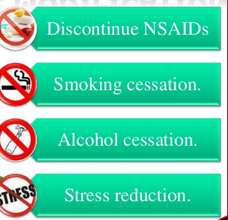
Treatment
Life style change.
Medications:
H2 blocker.
Proton pump inhibitors.
Mucosal protective agent.
Antibiotics.

Slide 17
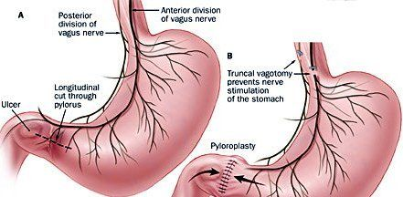
Surgery:
Types of surgery:
Vagotomy: a surgical operation in which one or more branches of the vagus nerve are cut, typically to reduce the rate of gastric secretion (in treating peptic ulcer).

Slide 18
2. pyloroplasty: to widen the opining in the lower part of the stomach (pylorus) , so that stomach contents can be empty in the small intestine (duodenum) .The pylorus is a thick , muscular area, food can not pass through.
3. Antrectomy: surgical removal of the walls of the antrum , especially the antrum of the stomach.

Slide 19
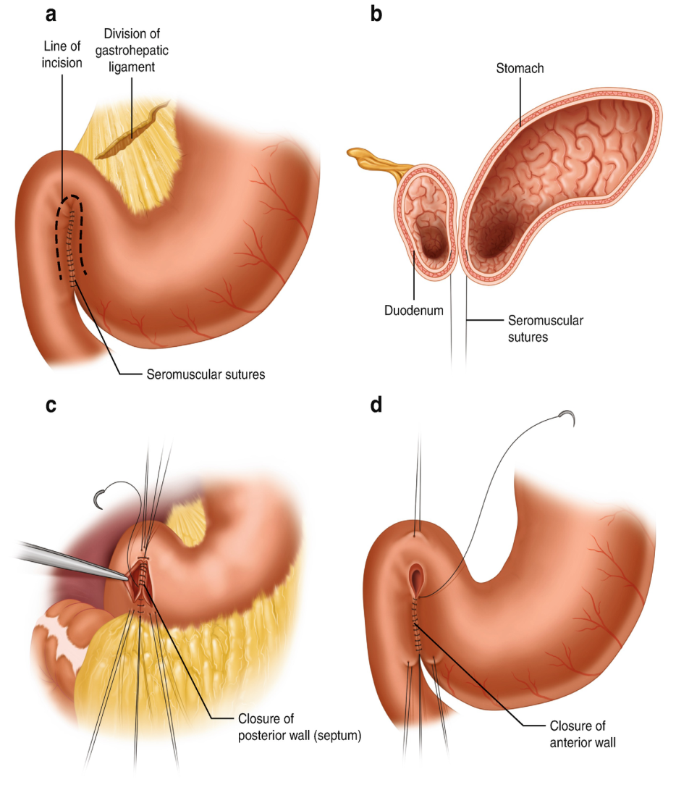
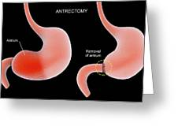

Slide 20
Nursing Diagnosis
Acute pain related to the effect of gastric acid secretion on damaged tissue.
Vomiting R/T indigestion of food.
Loss of appetite R/T ulceration of the stomach.
Loss of weight R/T decrease nutrients intake secondary to peptic ulcer.
Stress and anxiety R/T disease process.

Slide 21
Nursing Intervention
Support the patient emotionally.
Administer medications as prescribed.
Provide small meal a day or small hourly meals as ordered.
Monitor the effectiveness of administered medications, and also watch for adverse reaction.
Assess the pt nutritional status and the effectiveness of measures used to maintain it.

Slide 22
Cont……..
6. Teach the pt about peptic ulcer disease and help him to recognize it’s signs and symptoms.
7. Instruct the pt to take antacids 1 hour after meals.
8. Warn the pt to avoid aspirin drugs because irritate gastric.

Slide 23
Irritable bowel syndrome (IBS)
Irritable bowel syndrome (IBS) is a chronic functional disorder characterized by recurrent abdominal pain associated with disordered bowel movements, which may include diarrhea, constipation, or both.
(IBS) is not a disease but rather a functional problem.

Slide 24
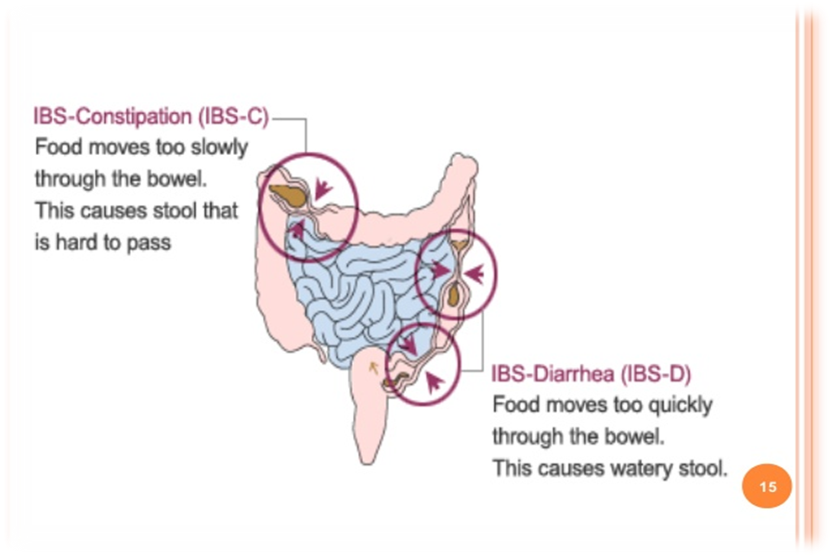
IBS Classified As
IBS with diarrhea.
IBS with constipation.
IBS with mixed diarrhea and constipation.

Slide 25
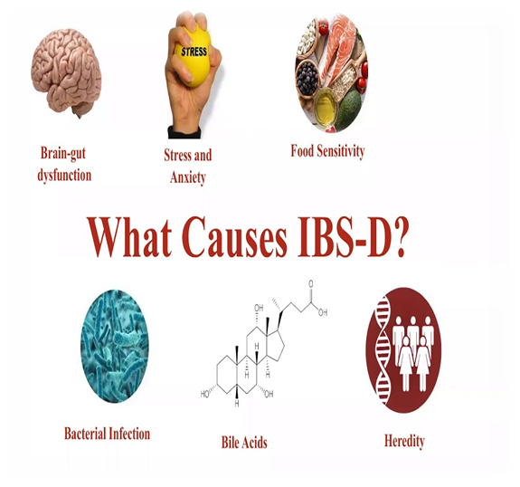
Etiology
There is a hereditary tendency for IBS.
IBS is more common in women than men and in those who are young to middle aged.
can be caused by other illnesses, infections, or the menstrual cycle.

Slide 26
Clinical Manifestations
The main symptom is:
Alteration in bowel patterns:
Constipation (as IBS-C).
Diarrhea (as IBS-D).
combination of both (as IBS-M for “mixed”)
2. Pain.
3. Abdominal bloating with or without visible abdominal distention.

Slide 27
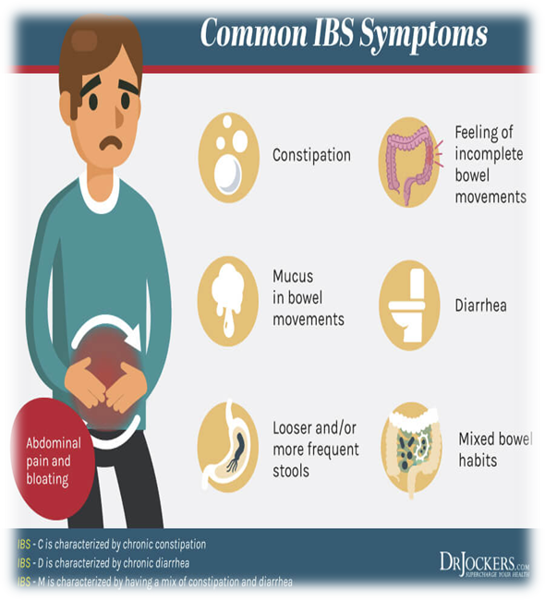
Other Symptoms Include
Rectal passage of mucus.
Feeling of incomplete evacuation.
Depression and anxiety.
Palpitations.

Slide 28
Diagnostic Tests
Diagnosis of IBS is made based on history and physical examination along with:
stool examination.
colonoscopy.
Sigmoidoscopy to rule out other disorders.
Avoiding milk products for a time may be advised to rule out lactose intolerance.

Slide 29
Medical Management
Antibiotic.
Antispasmodic.
Antidepressant.
Laxatives.
Anti diarrheal.
Lifestyle modification:
Stress reduction.
Ensuring adequate sleep.
Exercise regimen, can result in symptom improvement.

Slide 30
Nursing Diagnoses
Constipation related to irregular motility of GI tract.
Diarrhea related to irregular motility of GI tract.
Acute pain related to intestinal hyper motility.

Slide 31
Patient Teaching
Explain the disorder to the patient, and reassure her that irritable bowel syndrome can be relieved.
Encourage the patient to drink eight to ten glasses of water or other compatible fluids daily.
Discuss the proper use of prescribed drugs, reviewing their desired effects and possible adverse effects.
Help the patient to implement lifestyle changes that will reduce stress.

Slide 32


