Slide 1
Lecture# 2
semester# 1
Basics of ECG Interpretation
:by
lecturer
M.Sc.N: Ali J. Mohammed
Al-Mustaqbal University
College of Nursing
4th Class
The Clinical Part of Critical Care Nursing

Slide 2


Slide 3
Normal Sinus Rhythm
Normal sinus rhythm occurs when the electrical impulse starts at a regular rate and rhythm in the SA node and travels through the normal conduction pathway. Normal sinus rhythm has the following characteristics :
1- Heart rate : 60 to 100 bpm in the adult
2- Heart rhythm : Regular
3- QRS shape and duration: Usually narrow , less than 3 small squares.
4- P wave: Normal and consistent shape; always in front of the QRS,
5- PR interval: Consistent interval between 3 -5 small squares
6- P:QRS ratio: 1:1

Slide 4
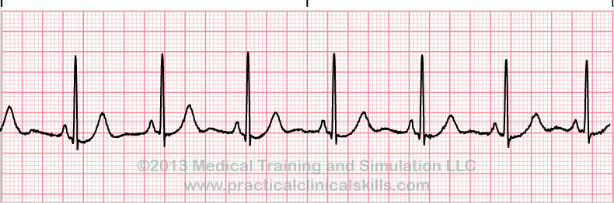
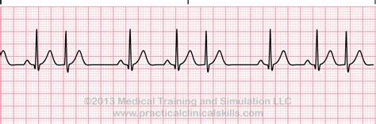
Normal sinus rhythm
Abnormal rhythm

Slide 5
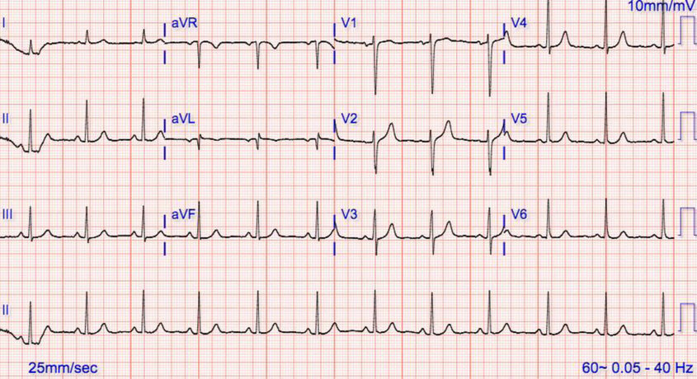
Normal sinus rhythm

Slide 6

Normal ECG shows a regular rhythm. If you find it irregular you need to consider
❶ Premature Ventricle Contraction
❷ Atrial Fibrillation
Premature Ventricular Contraction (PVC) Characteristics:
Wide QRS complex: PVCs are characterized by a broad (> 3 small squares), often bizarre-looking QRS complex because the impulse originates in the ventricles and takes longer to spread.
2. No preceding P wave: There is typically no P wave before the PVC because the impulse does not originate from the atria.
3. T wave opposite direction

Slide 7
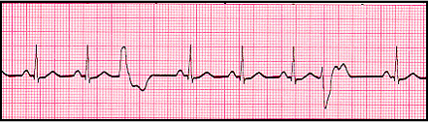
PVC
Normal sinus rhythm

Slide 8
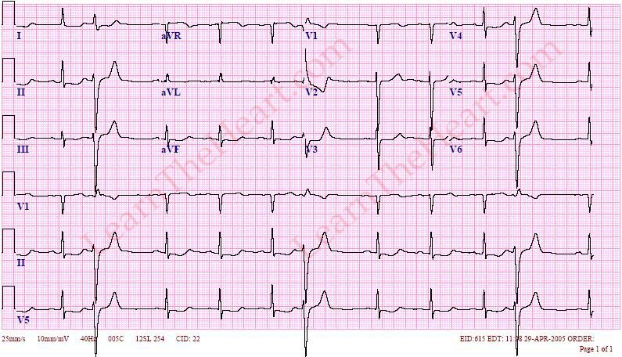
Premature Ventricular Contraction (PVC)

Slide 9
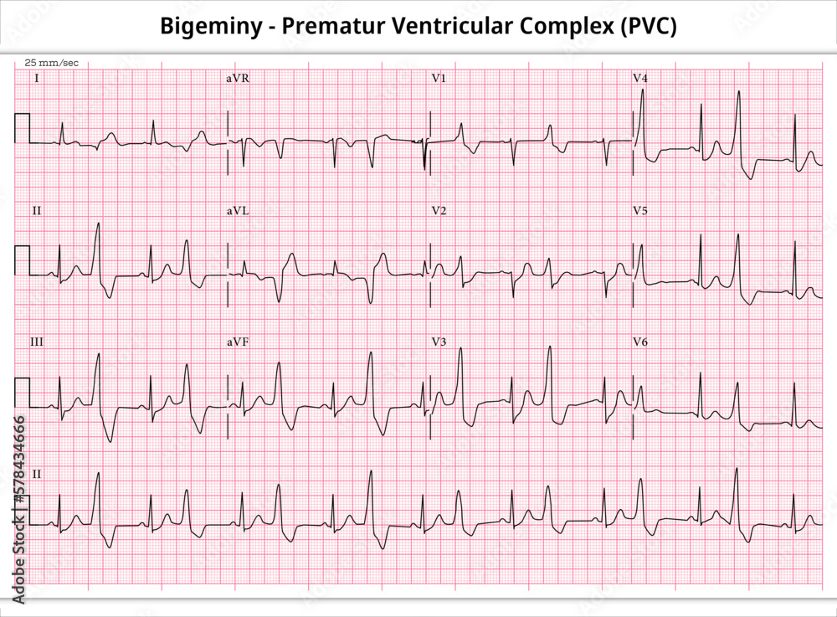
Premature Ventricular Contraction (PVC)

Slide 10
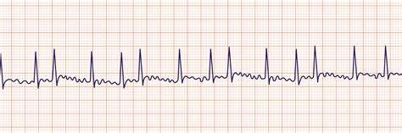
Atrial Fibrillation (AF) Characteristics
Completely Irregular Rhythm: The hallmark of AF is an unpredictable, irregular heart rhythm. There is no consistent pattern to the R-R intervals.
Absence of P Waves: P waves are not visible because the atria are not contracting in a coordinated manner.
Fibrillatory (f) Waves: The baseline shows small, irregular, and rapid fibrillatory waves.

Slide 11
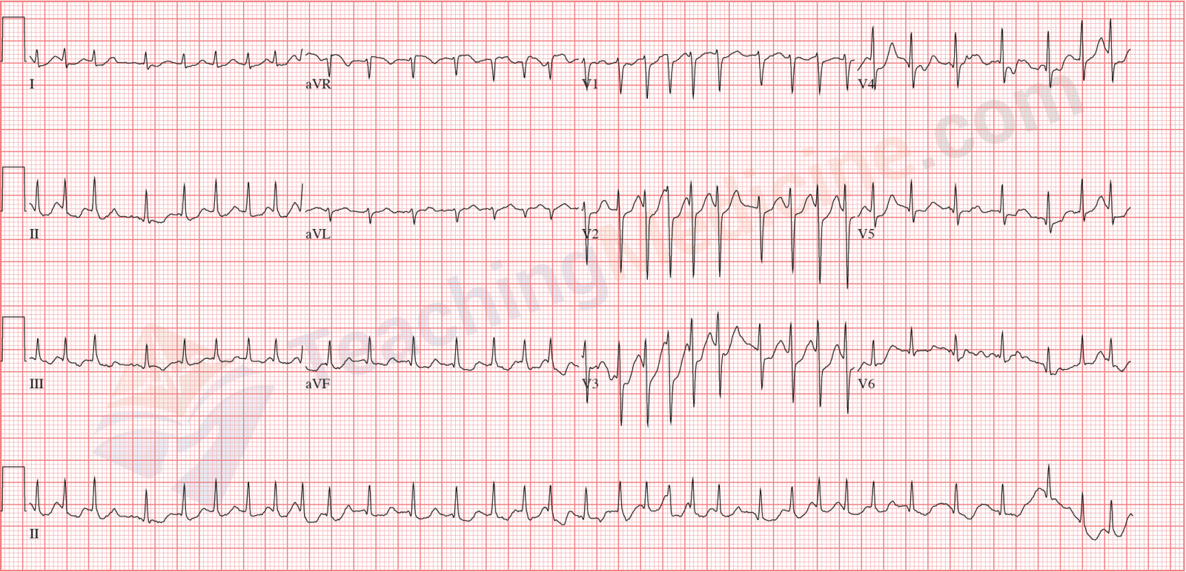
Atrial Fibrillation (AF)

Slide 12


Slide 13
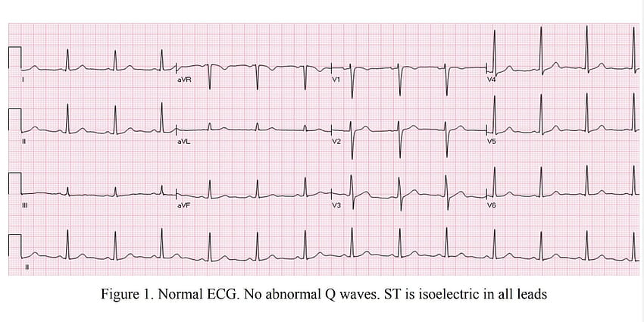
Comment on ECG

Slide 14
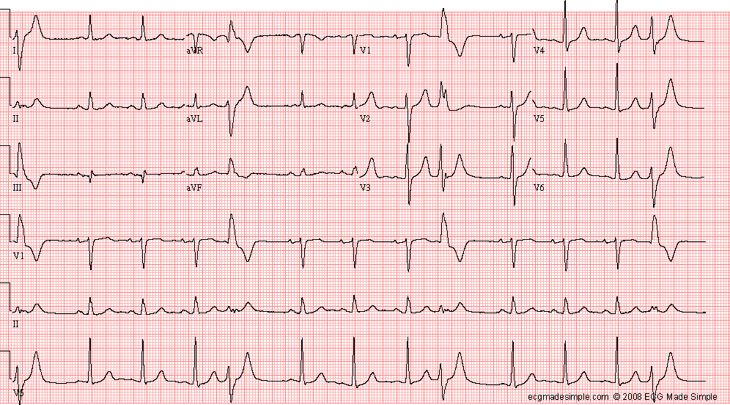
Comment on ECG

Slide 15
Comment on ECG

Slide 16
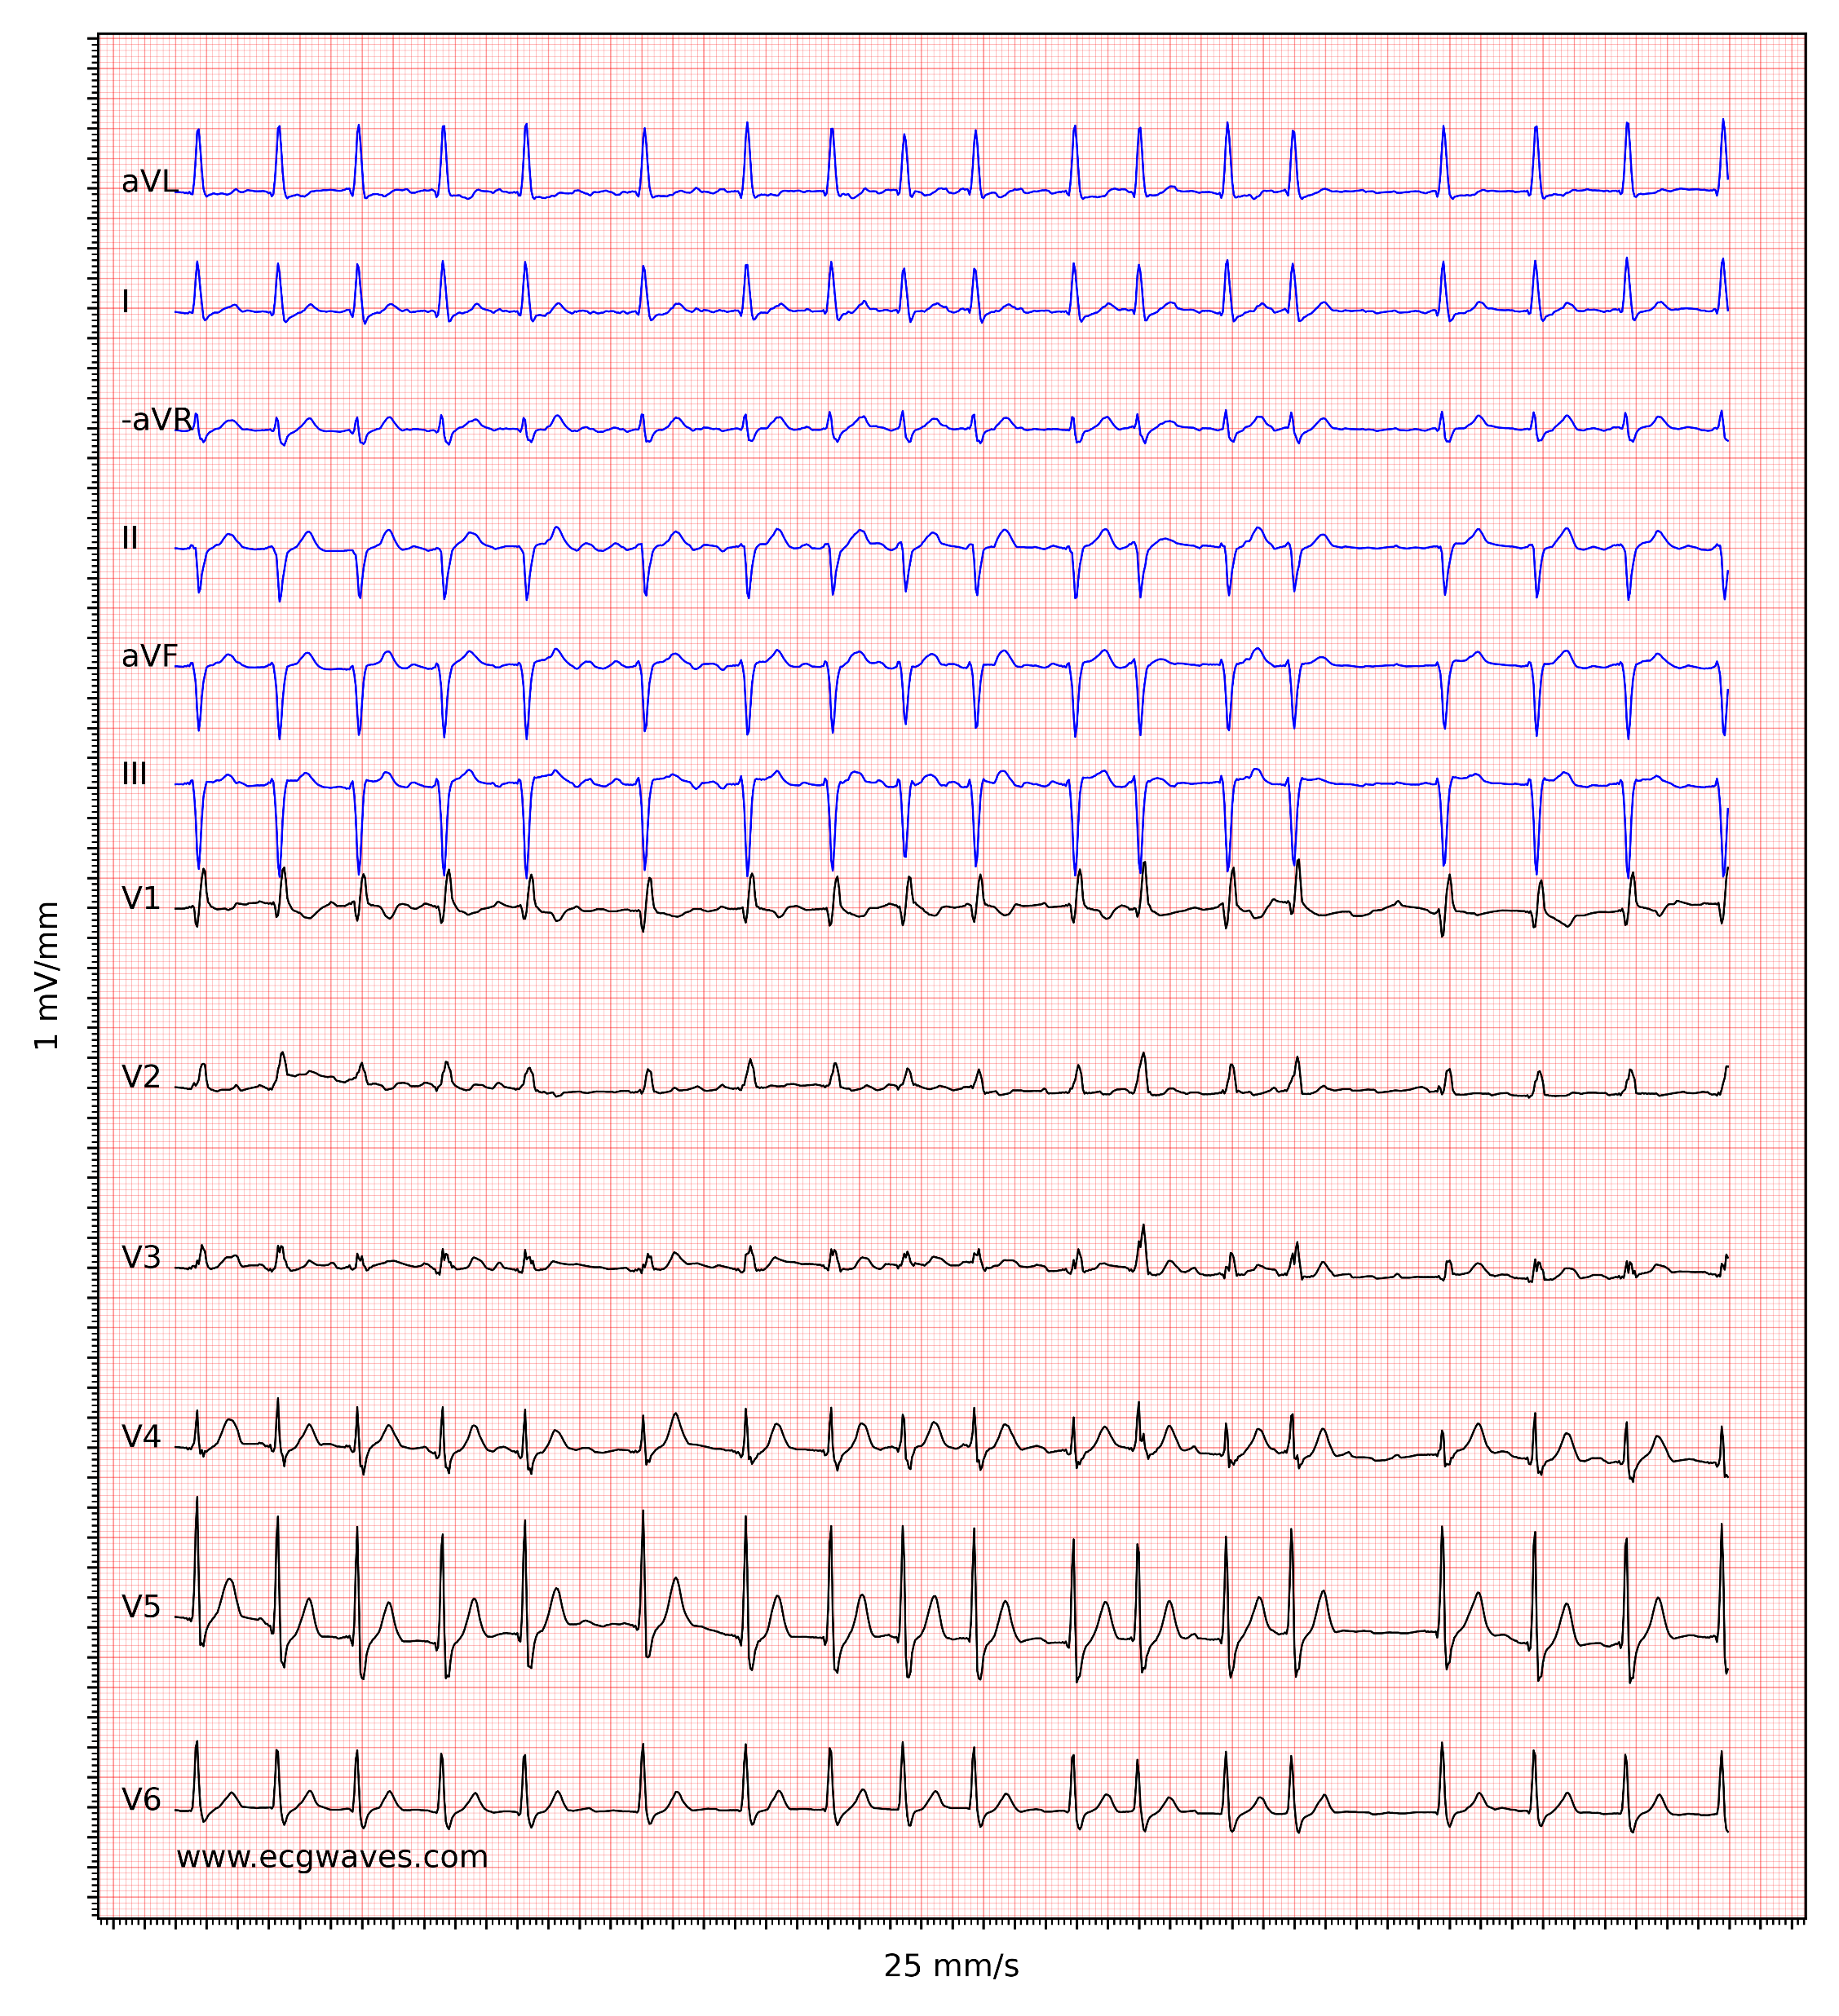
Comment on ECG

Slide 17
Comment on ECG

Slide 18


Slide 19
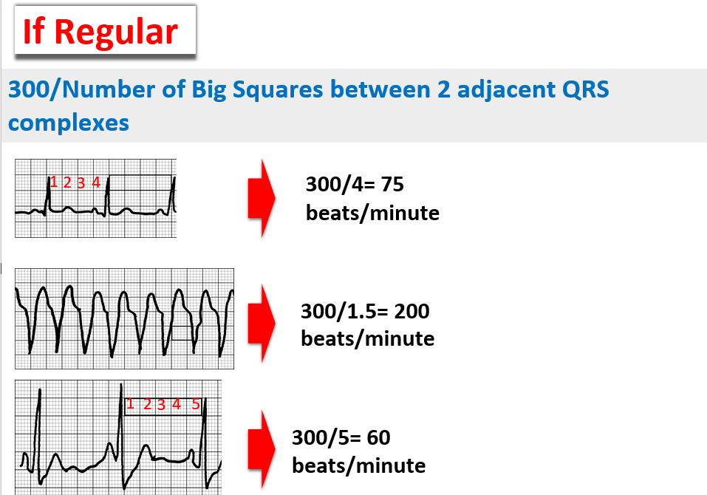

Slide 20
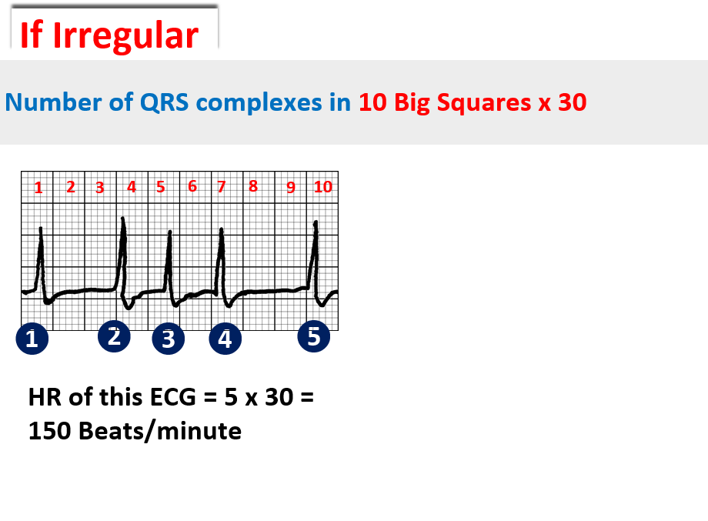

Slide 21


Slide 22
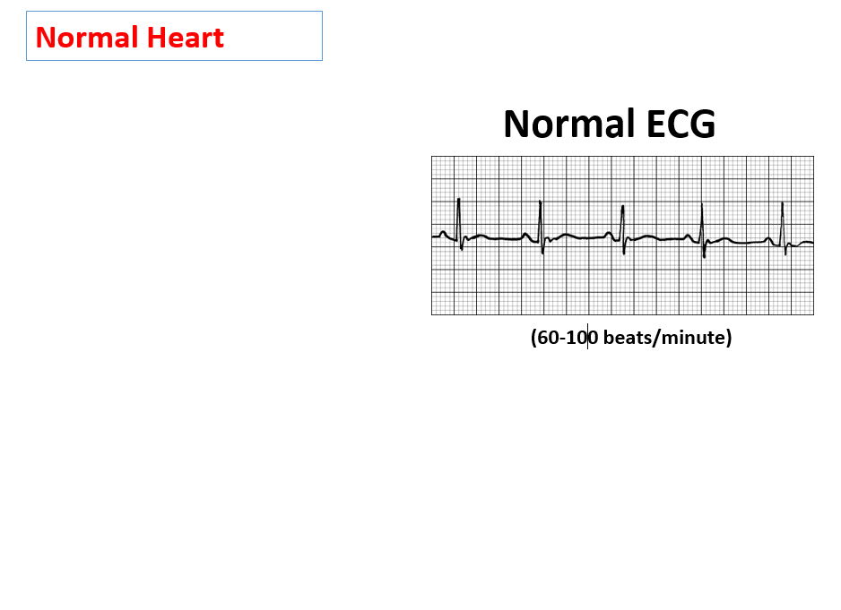

Slide 23

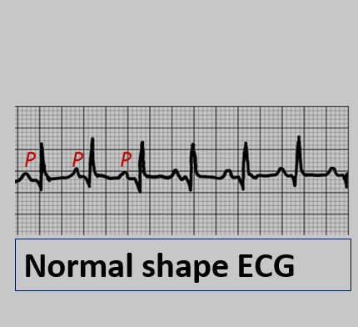
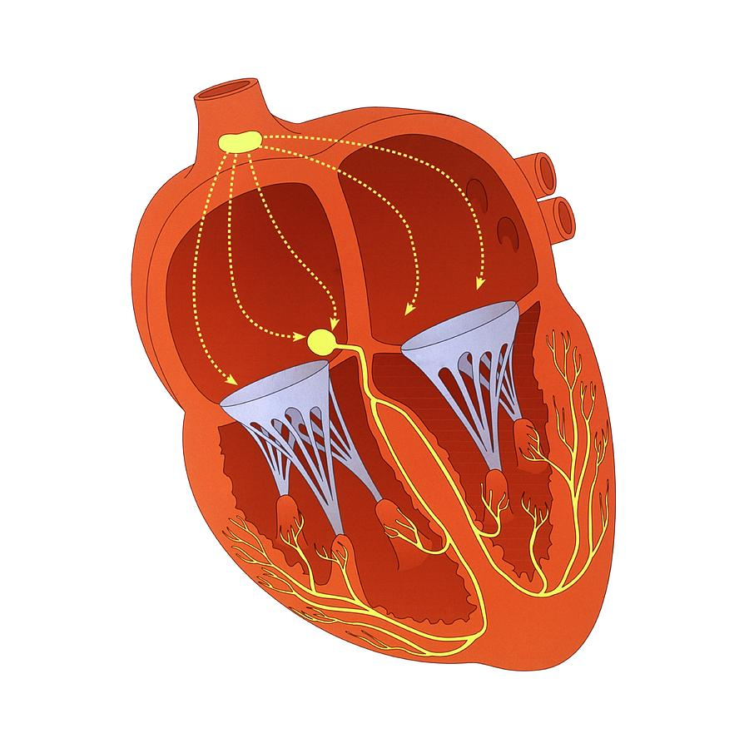
Sinus Tachycardia
SA node
Heart Rate > 100 bpm

Slide 24

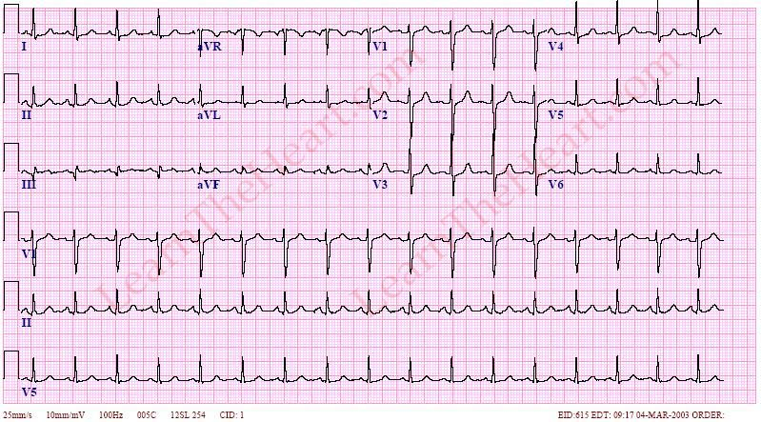

Slide 25
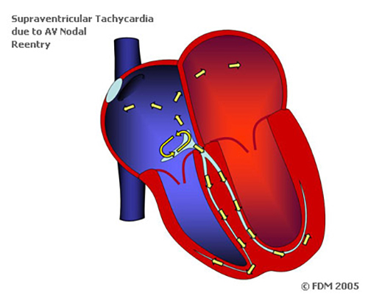
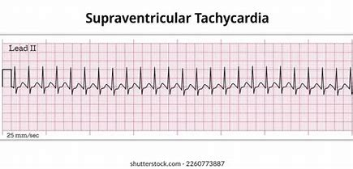
Supraventricular Tachycardia SVT
The main ECG criteria for Supraventricular Tachycardia (SVT) are:
1- Heart Rate: Rapid heart rate, typically between 150-250 bpm.
2- Regular Rhythm: Usually a very regular rhythm.
3- Narrow QRS Complexes.
4- P Waves: Often difficult to see or may be hidden in the preceding T wave. If visible, they may have an abnormal shape.
5- Sudden Onset and Termination: SVT often starts and stops abruptly.
These criteria help differentiate SVT from other tachycardias, especially ventricular tachycardia, which has wide QRS complexes.

Slide 26
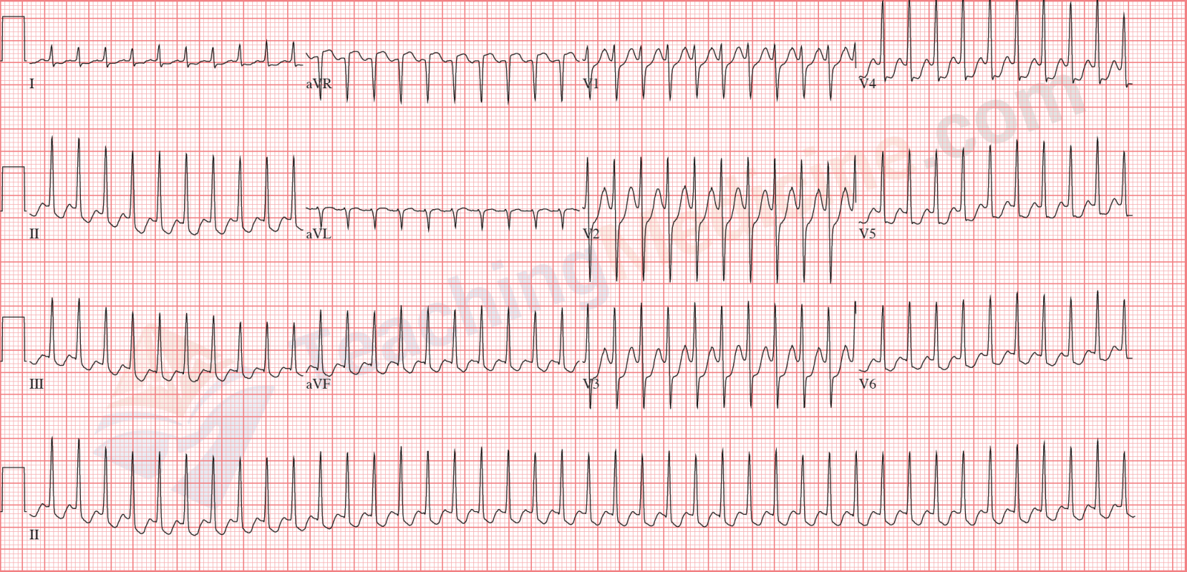
Supraventricular Tachycardia SVT

Slide 27
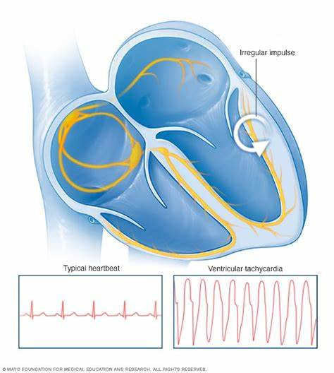
Ventricular Tachycardia (VT)
The main ECG criteria for Ventricular Tachycardia (VT) are:
1- Wide bizarre QRS Complexes: QRS duration is typically greater than 3 small squares.
2- Rapid Heart Rate: Usually between 100-250 bpm.
3- Capture and Fusion Beats: Occasional normal beats seen among wide QRS complexes.
4- Regular or Slightly Irregular Rhythm: Mostly regular rhythm, though it can vary slightly.

Slide 28
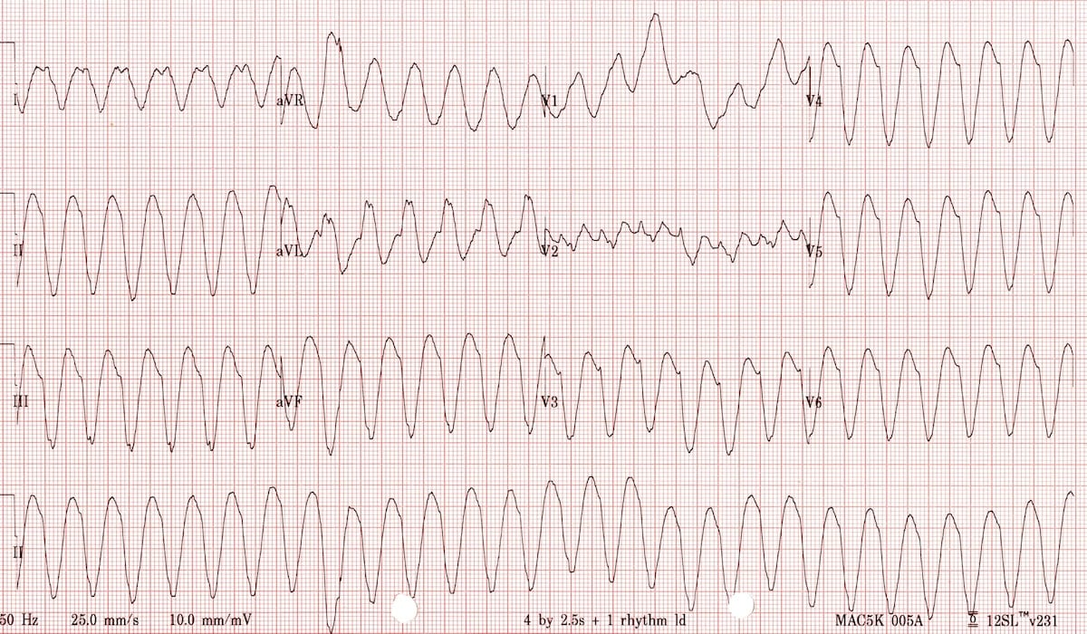
Ventricular Tachycardia (VT)

Slide 29
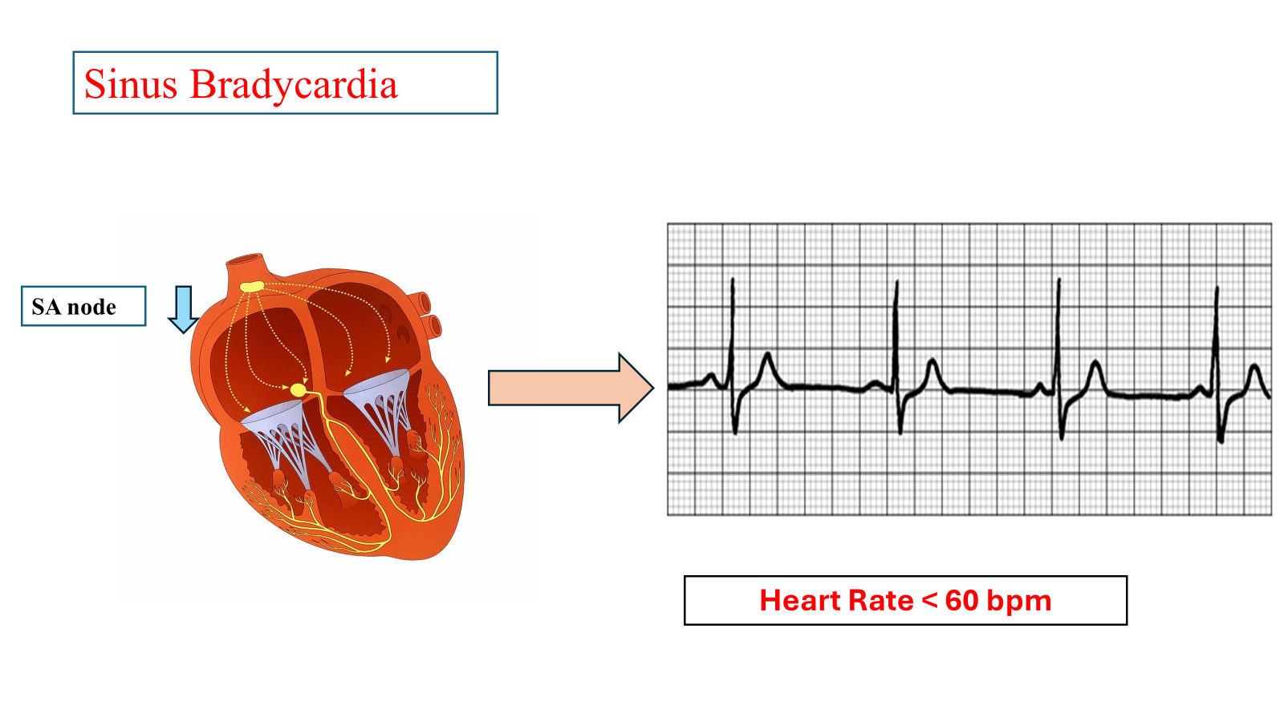

Slide 30
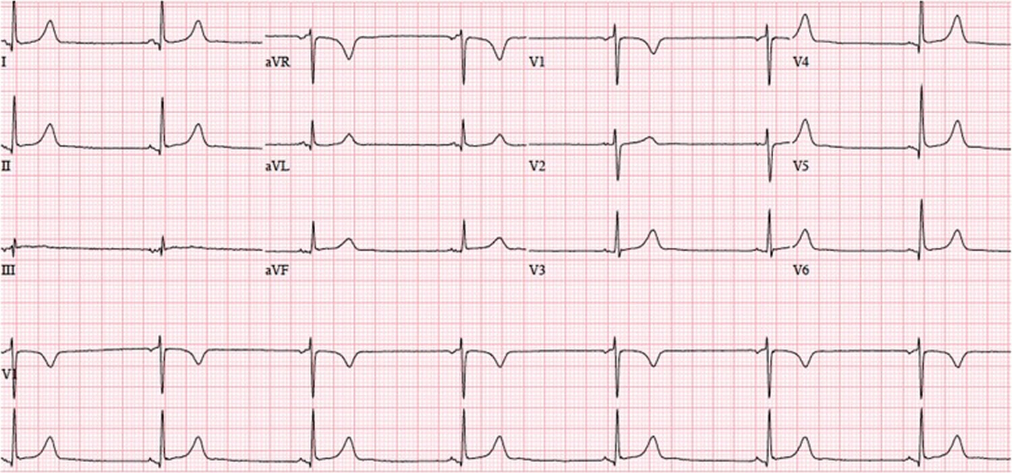
Sinus Bradycardia

Slide 31


Slide 32
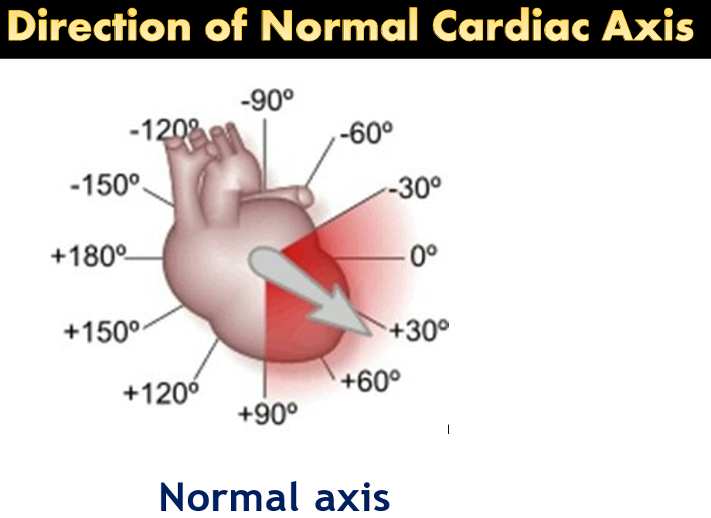
The cardiac axis refers to the direction of the electrical conduction through the heart, mainly the ventricles. Normally, the electrical impulse travels from the upper right side of the heart to the lower left, resulting in a normal axis ranging from -30° to +90°.

Slide 33
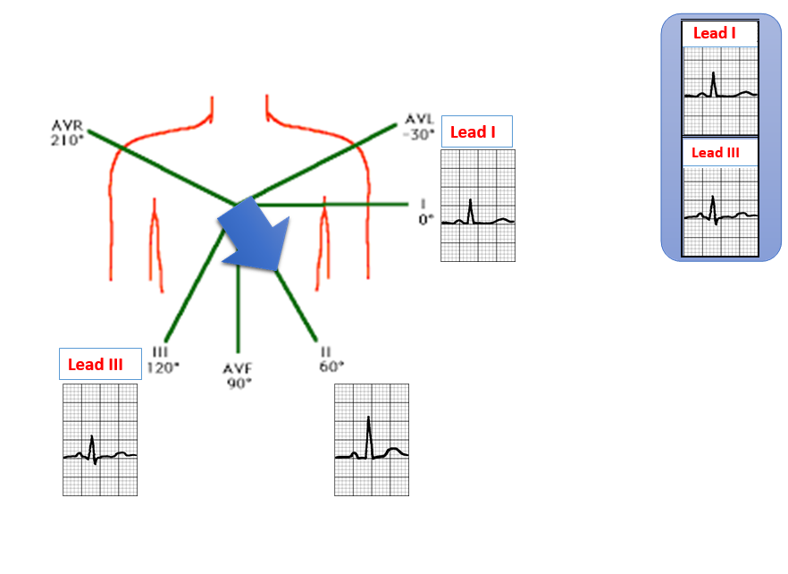
Normal cardiac axis

Slide 34
Normal cardiac axis

Slide 35
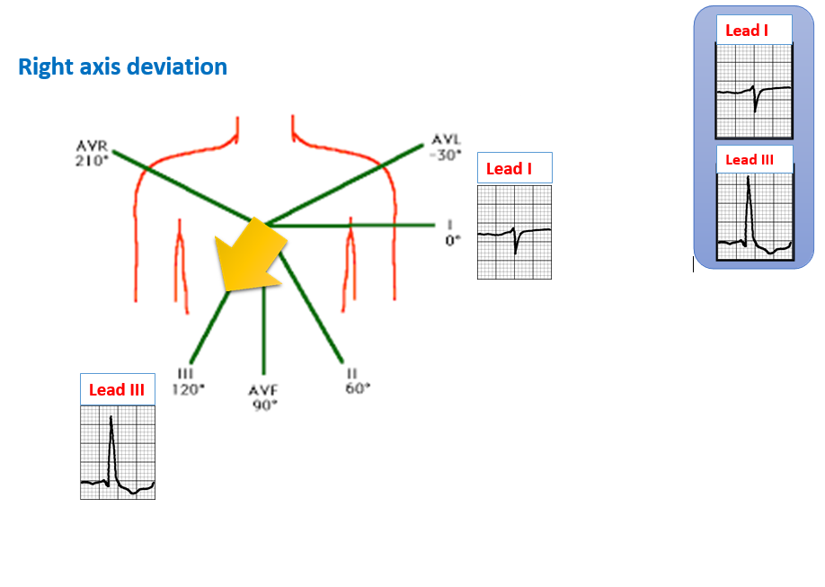
Right Axis Deviation occurs when the electrical axis shifts to the right. It can be caused by:
1- Right Ventricular Hypertrophy (RVH)
2- Pulmonary Embolism
3-Chronic Lung Disease
4- Congenital Heart

Slide 36
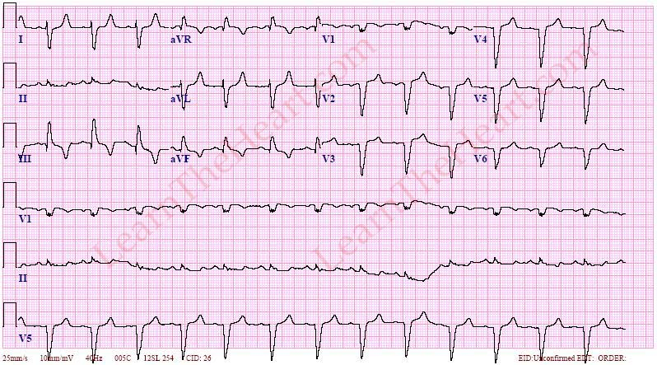
Right axis deviation

