Slide 1


Al-Mustaqbal University / Nursing College
Academic Year 2024-2025
Epidemiology
Lecture 4
Measurements in Epidemiology
By
Dr. Ali. Hussein H.

Slide 2
The four types of epidemiologic measures are:
1. Count
2. Ratio
3. Proportion
4. Rate

Slide 3
Count
The simplest and most frequently performed quantitative measurement in epidemiology is a count.
Count of the number of persons in the group who have a particular disease or a particular characteristics.
E.g. cases of hemophilia reported in New York, during January of a particular year.

Slide 4
Ratio
Ratio is numerical expression, which indicates the relationship in quantity between two parts.
Obtained by dividing one quantity by another.
Example: (20) male patients were attended the clinic and (10 )female patients the ratio of male to female is 2:1.

Slide 5
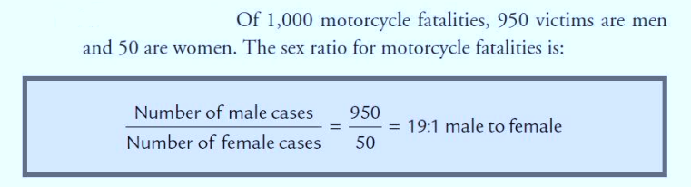

Slide 6
Proportion:
For a count to be descriptive of a group it must be seen in proportion to it;
that is must be divided by the total number in the group.
proportions may be expressed as percentages (%)

Slide 7
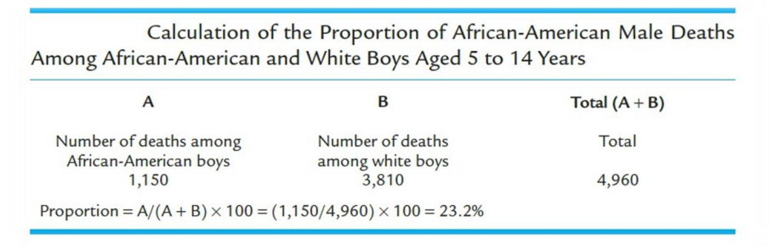

Slide 8
Rate
Rate: is the quantity amount or degree of something measured in specific period of time.
It is similar to proportion but it is calculated in a specific period(usually one year)

Slide 9
Epidemiologic rates contain the following elements:
1- Disease frequency.
2- Unit size of population.
3- Time period during which an event occurs.

Slide 10
The crude death rate: reflects all deaths in the population regardless of age or cause of death. The crude death rate presents a picture of the overall health status of the population. Calculate for each thousand. Taken for specific period.
(e.g. all cancer deaths in 2000).
total 𝑵𝒖𝒎𝒃𝒆𝒓 𝒐𝒇 𝒅𝒆𝒂𝒕𝒉
𝑪𝑫R = --------------------------------------------- * 1000
total 𝑵𝒖𝒎𝒃𝒆𝒓 𝒐𝒇 𝒑𝒐𝒑𝒖𝒍𝒂𝒕𝒊𝒐n
Deaths: 2448017 total populations: 295895897 what CDR?

Slide 11
Specific Rate: Rates for specific segments/groups of the population (e.g. sex, age, race, cause of death, cancer site).

Slide 12
Prevalence
The number of existing cases depends on the number of people who developed their illness in the past and have continued to be ill at the present time (i.e. old and new).

Slide 13
Incidence
Is defined as the number (No.) of new cases of disease.
Incidence is a measure of a disease developed in a person who did not have the disease.
Transition from non disease to disease status.

Slide 15
Factors Influencing on prevalence rate :
1.The number of new cases: if the incidence increase the prevalence will increase.
2.The severity of illness :if the deaths increase the prevalence will decrease ,if the disease is easily cured the prevalence also decrease.
3.The duration of illness: if the duration of the disease increase the prevalence will increase.

Slide 16
Period prevalence:
The prevalence of a particular disease in a longer period such as one month , six months , one year or even more (life time prevalence).

Slide 17
Point prevalence :
Is used to know how much of a particular disease is present in a population at a particular point in time(one day ) ,
exampleDec.31,2019.

Slide 18
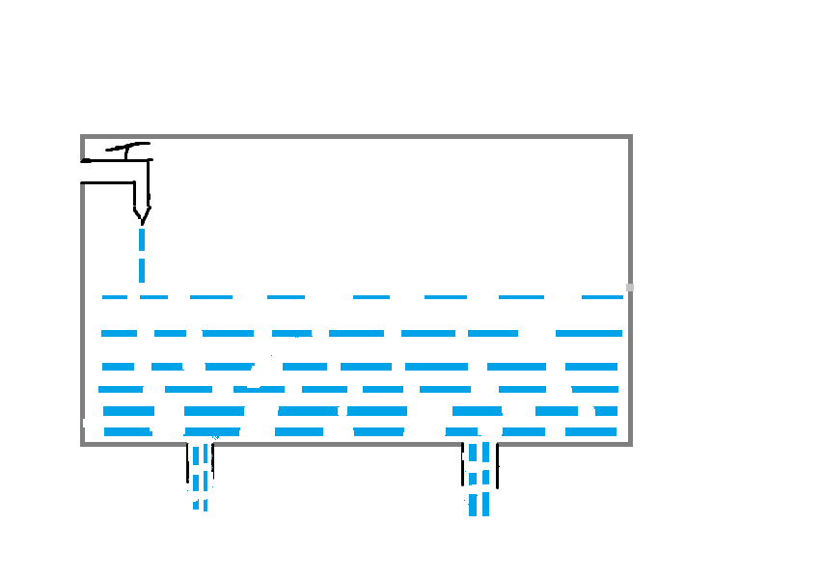
Relationship between incidence and prevalence
Incidence
Prevalence
Cure
Death

Slide 19
Vital statistics:
Tools used to evaluate the health status of the community .
By vital statistics we refer to data collected from ongoing recording ,registration of all vital events ( birth, deaths ,fetal deaths ,marriages and divorces ).
The nurse or physician is responsible for filling the certificates of death , birth and fetal death

Slide 20
Crude Birth Rate (CBR)
Crude Birth Rate (CBR) :Is the No. of live births per 1000 population of certain locality and year .
Number of live birth (during a year)
------------------------------------------------ X (1000)
Total population in certain locality

Slide 21
Birth rate is generally high in developing countries including Iraq , due to :
1- high fertility rates due social and traditional motives .
2- poor family planning facilities
3– factors related to marriage ( the youngest age of marriage is associated with long childbearing period .

Slide 22
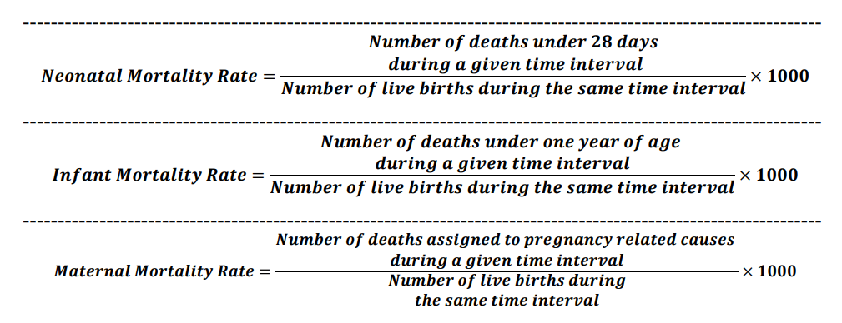

Slide 23
Thanks

