Slide 1
Lecture# 3
semester# 1
Basics of ECG Interpretation
:by
lecturer
M.Sc.N: Ali J. Mohammed
Al-Mustaqbal University
College of Nursing
4th Class
The Clinical Part of Critical Care Nursing

Slide 2
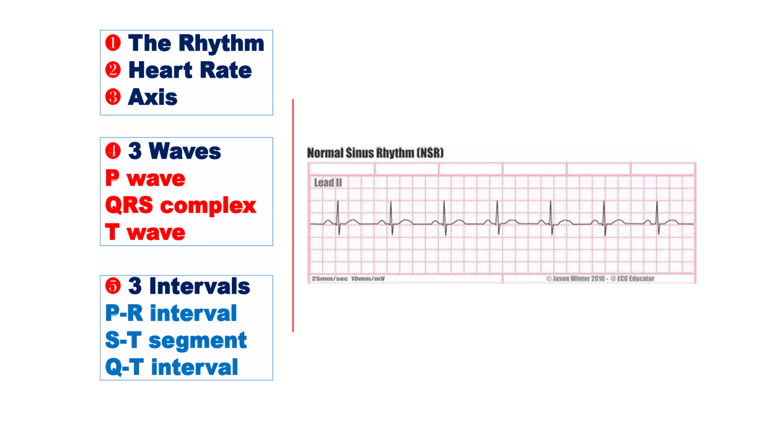

Slide 3


Slide 4
The P wave on an ECG represents atrial depolarization, which is the electrical activation of the atria.
lead II is generally the best lead for assess P wave.
Normal P wave is not more than 2.5 X
2.5 small squares

Slide 5
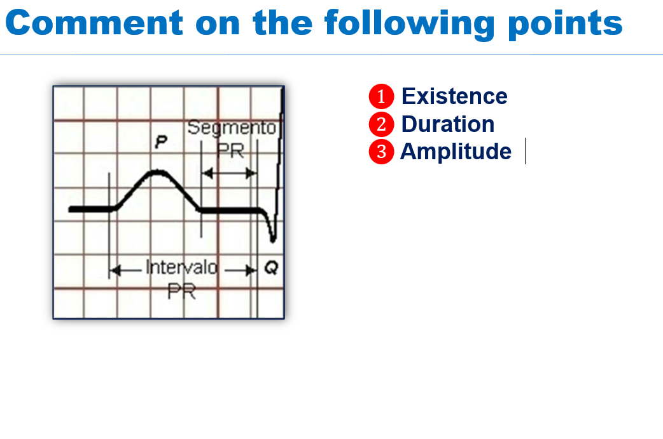

Slide 6
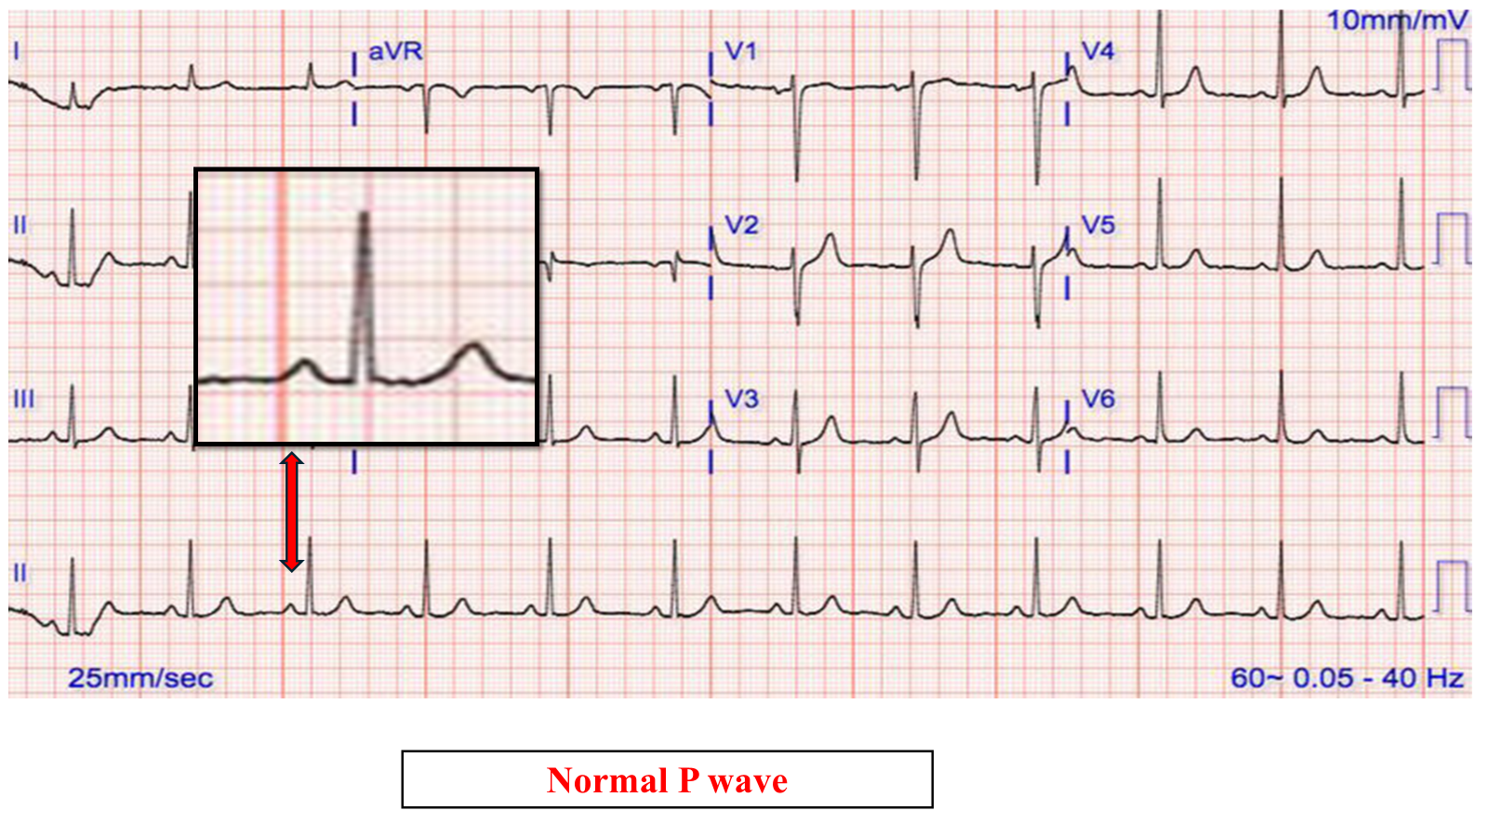

Slide 7
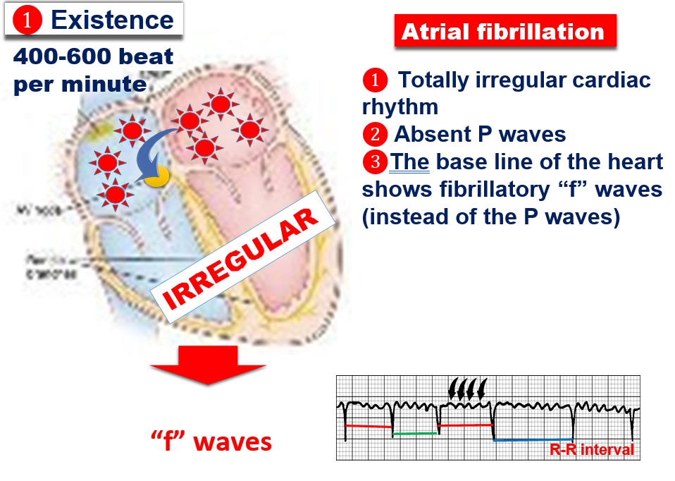

Slide 8
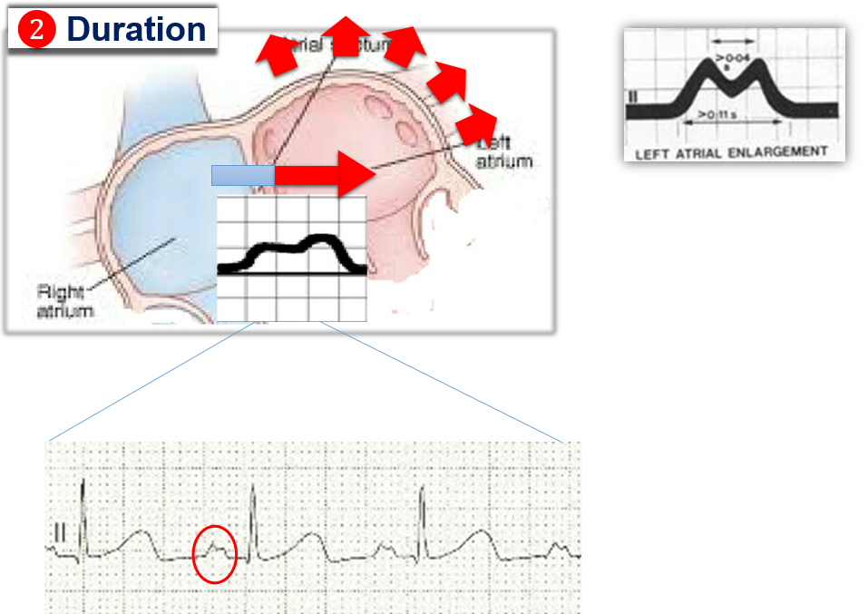
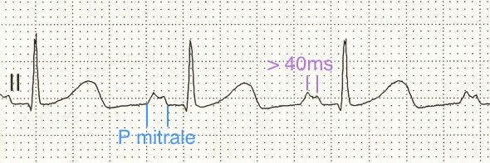
P mitrale = "M" shape P wave : This pattern typically indicates left atrial enlargement and is often associated with conditions that increase left atrial pressure, such as mitral valve stenosis.

Slide 9
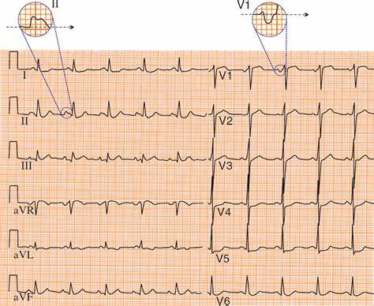
P mitrale
"M" shape
Mitral valve stenosis

Slide 10
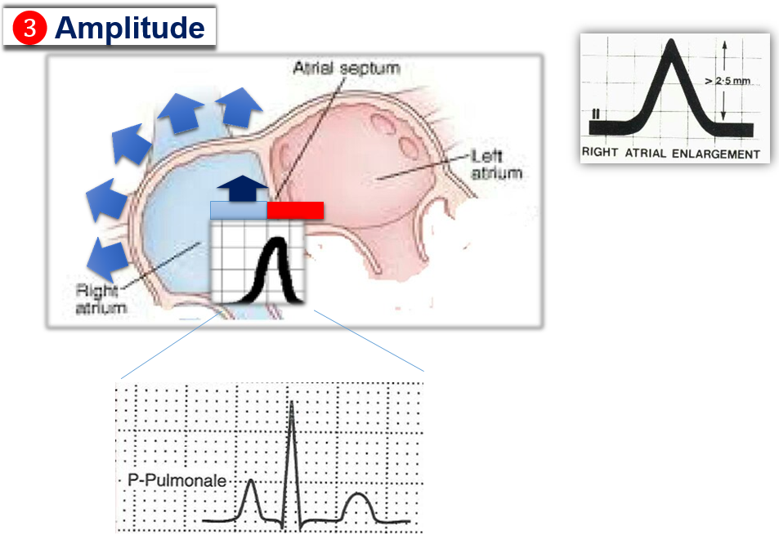
P pulmonale is an ECG pattern where the P wave is tall and peaked (≥2.5 mm), particularly in lead II. This finding suggests right atrial enlargement, often due to pulmonary hypertension or lung diseases like chronic obstructive pulmonary disease (COPD).

Slide 11
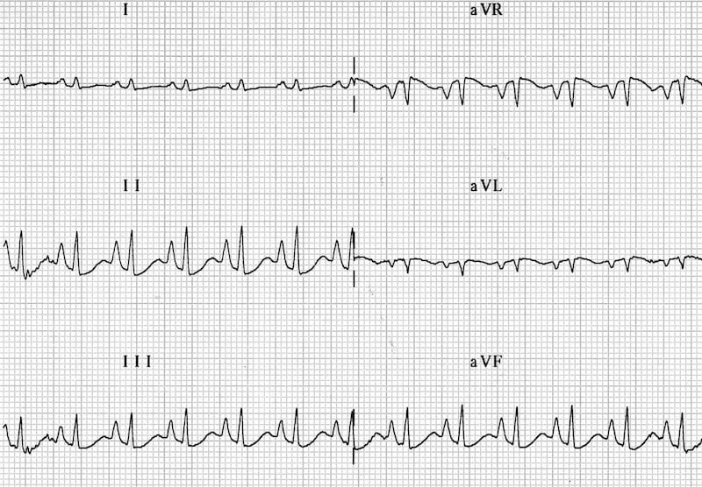
P pulmonale , often due to pulmonary hypertension or lung diseases like (COPD).

Slide 12


Slide 13
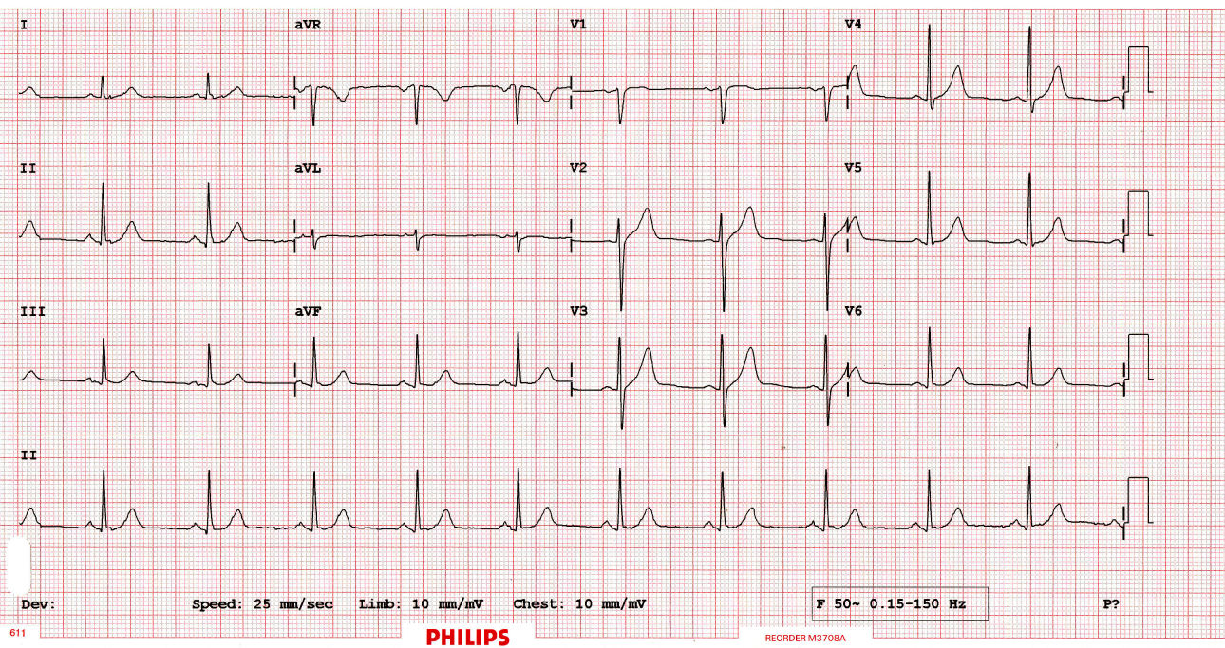
Comment on ECG

Slide 14
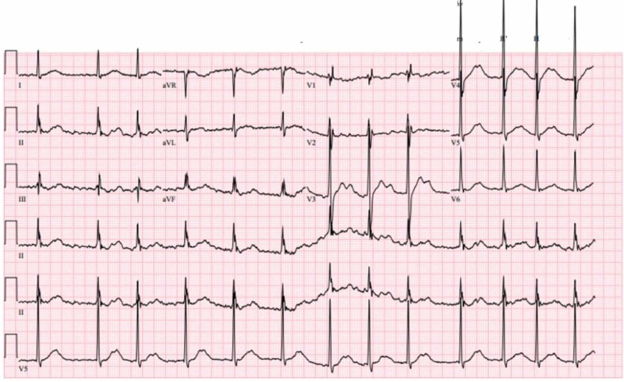
Comment on ECG

Slide 15
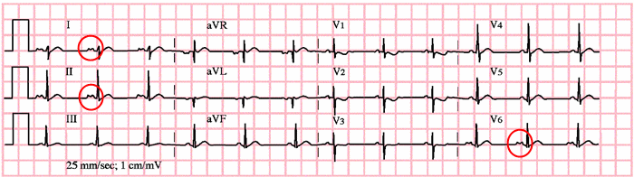
Comment on ECG

Slide 16
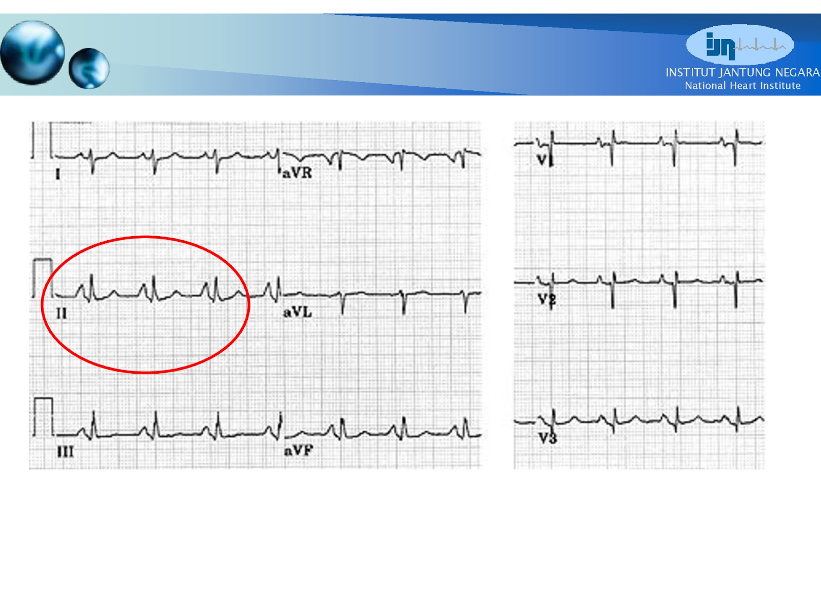
Comment on ECG

Slide 17


Slide 18
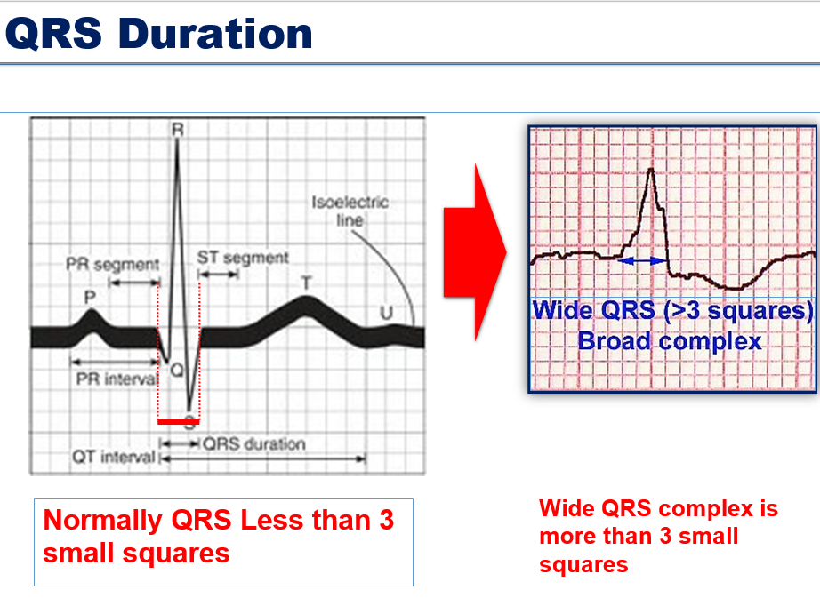
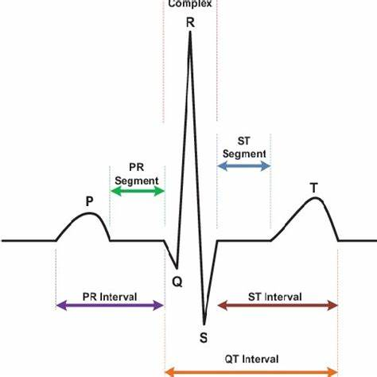

Slide 19
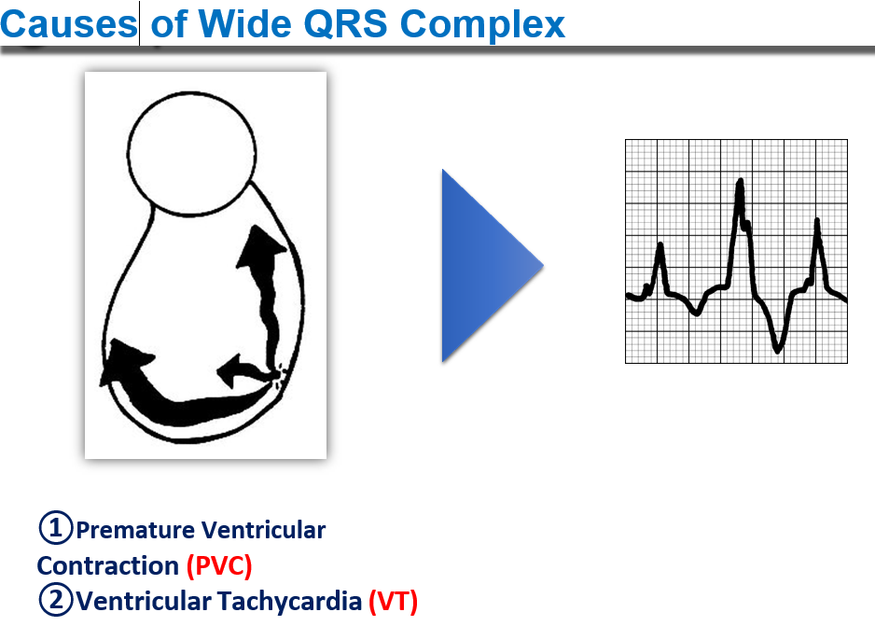

Slide 20


Slide 21
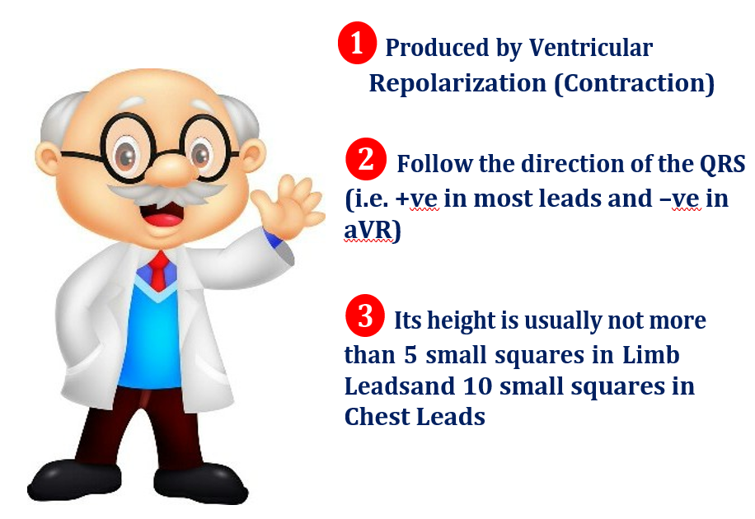
(relaxation)

Slide 22
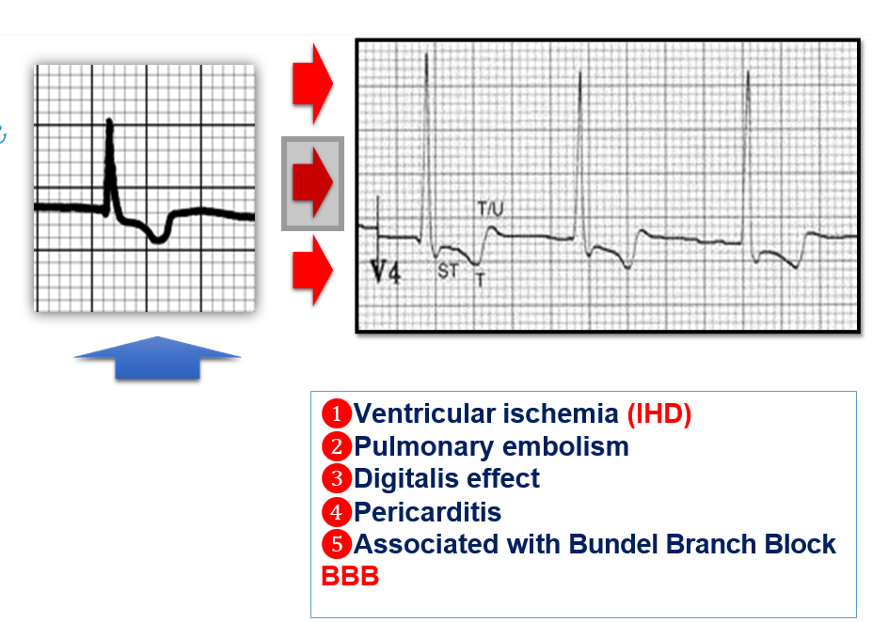
Causes of T wave inversion
أسباب انقلاب موجة
T

Slide 23
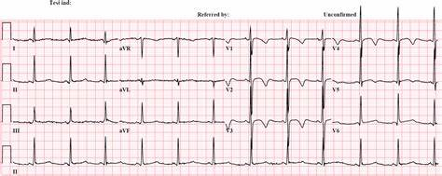
T wave inversion= mostly due to cardiac Ischemia

Slide 24
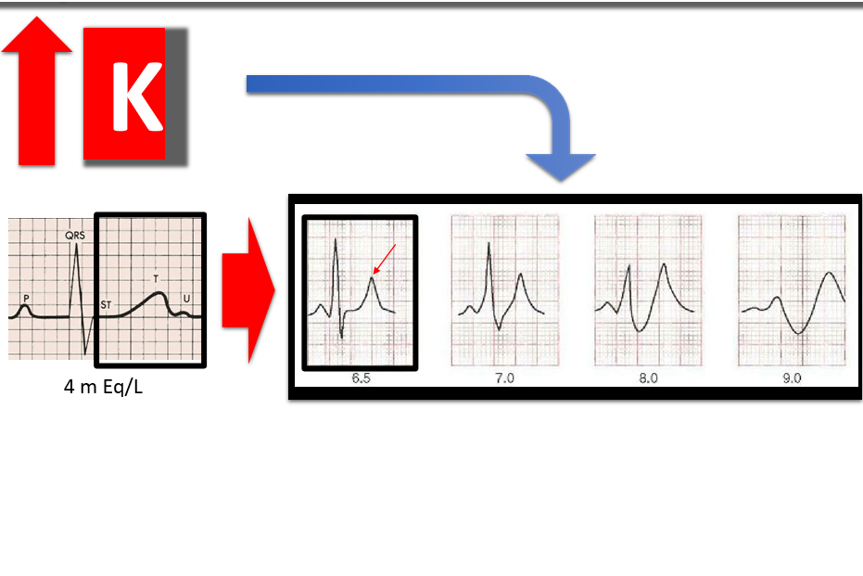
A tall, peaked T wave on an ECG is often associated with hyperkalemia (elevated potassium levels in the blood). This abnormality is typically seen in multiple leads across the ECG.
A tall, peaked T wave

Slide 25
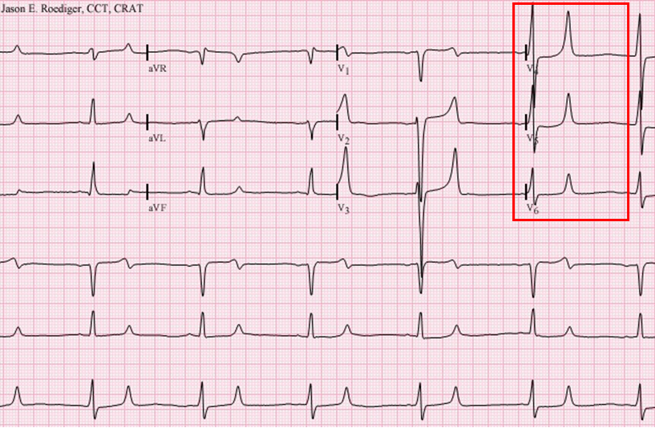
A tall, peaked T wave = mostly due to hyperkalemia

