Slide 1



Fundamental of Control Engineering
Time Response Analysis Lecure-6

Slide 2

Time Response Analysis
1- First step in analysing any control systems is to derive its mathematical model.
2- In analyzing and designing any control system we must have a basis of performance comparison with different control systems
3- This basis may be setup by specifying particular test input signals and by comparing the responses of various control systems to these input signals.
4- System is effected by changing the input test signal or its initial conditions.
5-

Slide 3
Time Response Analysis
5- Typical test signals which commonly used in testing are of the type of: -Step functions - Ramp function - Impulse functions and Sinusoidal functions.
6- Time response analysis can be performed only for stable systems.
7- Time response of any system consists from Transient response and steady- state response.
8- Stability and steady state error are the most important characteristics in any control system.

Slide 4
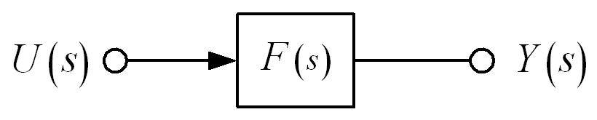
Definition of Pole and Zero
Consider the transfer function F(s):
Numerator polynomial
Denominator polynomial
The system response is given by:
The poles are the values of s for which the denominator A(s) = 0.
The zeros are the values of s for which the numerator B(s) = 0.

Slide 5
Effect of Pole Locations
Chapter 3
Dynamic Response
Consider the transfer function F(s):
A form of first-order transfer function
The impulse response will be an exponential function:
How?
When σ > 0, the pole is located at s < 0,
➔ The exponential expression y(t) decays.
➔ Impulse response is stable.
When σ < 0, the pole is located at s > 0,
➔ The exponential expression y(t) grows with time.
➔ Impulse response is referred to as unstable.

Slide 6
Effect of Pole Locations
Chapter 3
Dynamic Response
Example:
Find the impulse response of H(s),
PFE
The terms e^{–t} and e^{–2t}, which are stable, are determined by the poles at s = –1 and –2. This is true for more complicated cases as well.
In general, the response of a transfer function is determined by the locations of its poles.

Slide 7
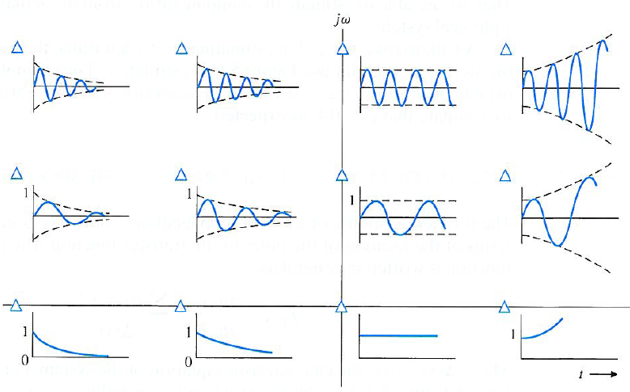
Effect of Pole Locations
Chapter 3
Dynamic Response
Time function of impulse response assosiated with
the pole location in s-plane
LHP
RHP
LHP : left half-plane
RHP : right half-plane

Slide 8
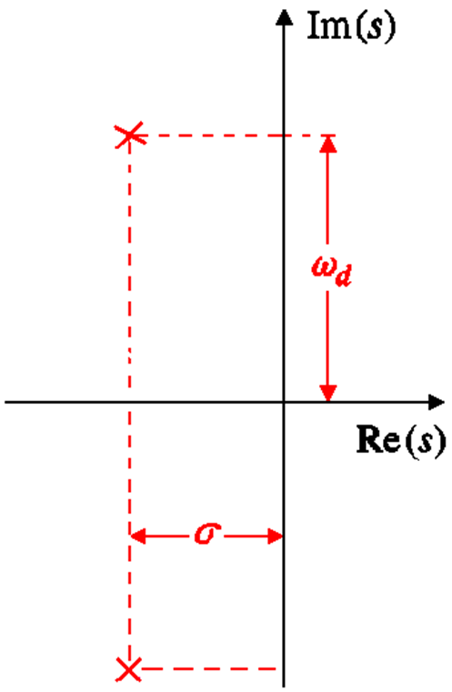
Representation of a Pole in s-Domain
Chapter 3
Dynamic Response
The position of a pole (or a zero) in s-domain is defined by its real and imaginary parts, Re(s) and Im(s).
In rectangular coordinates, the complex poles are defined as
(–s ± jω_{d}).
Complex poles always come in conjugate pairs.
A pair of complex poles

Slide 9
Representation of a Pole in s-Domain
Chapter 3
Dynamic Response
The denominator corresponding to a complex pair will be:
On the other hand, the typical polynomial form of a second-order transfer function is:
Comparing A(s) and denominator of H(s), the correspondence between the parameters can be found:
ζ : damping ratio
ω_{n} : undamped natural frequency
ω_{d} : damped frequency

Slide 10
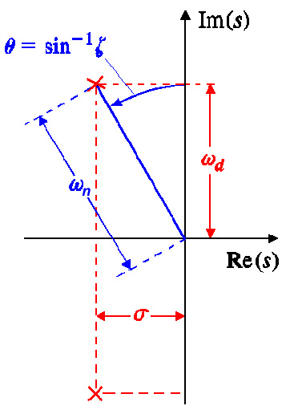
Representation of a Pole in s-Domain
Chapter 3
Dynamic Response
Previously, in rectangular coordinates, the complex poles are at (–σ ± jω_{d}).
In polar coordinates, the poles are at (ω_{n}, sin^{–1}ζ), as can be examined from the figure.

Slide 11
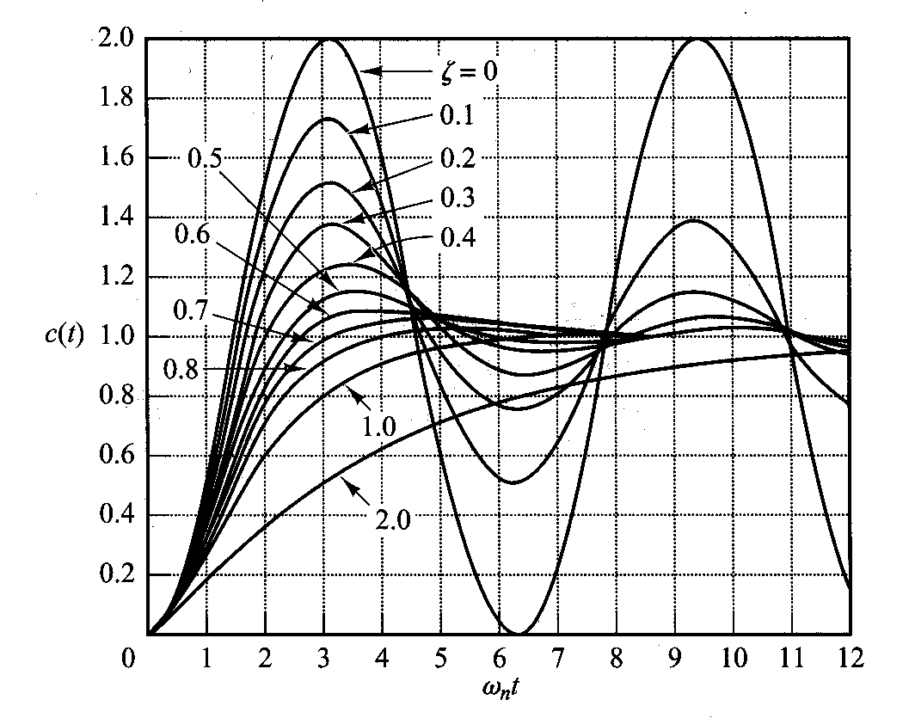
Unit Step Resonses of Second-Order System
Chapter 3
Dynamic Response

Slide 12
Effect of Pole Locations
Chapter 3
Dynamic Response
Example:
Find the correlation between the poles and the impulse response of the following system, and further find the exact impulse response.
Since
The exact response can be otained from:

Slide 13
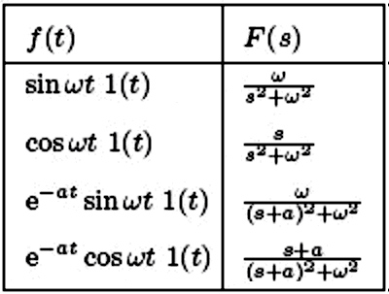
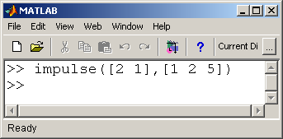
Effect of Pole Locations
Chapter 3
Dynamic Response
To find the inverse Laplace transform, the righthand side of the last equation is broken into two parts:
Damped sinusoidal oscillation

Slide 14
Time Domain Specifications
Chapter 3
Dynamic Response
Specification for a control system design often involve certain requirements associated with the step response of the system:
Delay time, t_{d}, is the time required for the response to reach half the final value for the very first time.
Rise time, t_{r}, is the time needed by the system to reach the vicinity of its new set point.
Settling time, t_{s}, is the time required for the response curve to reach and stay within a range about the final value, of size specified by absolute percentage of the final value.
Overshoot, M_{p}, is the maximum peak value of the response measured from the final steady-state value of the response (often expressed as a percentage).
Peak time, t_{p}, is the time required for the response to reach the first peak of the overshoot.

Slide 15
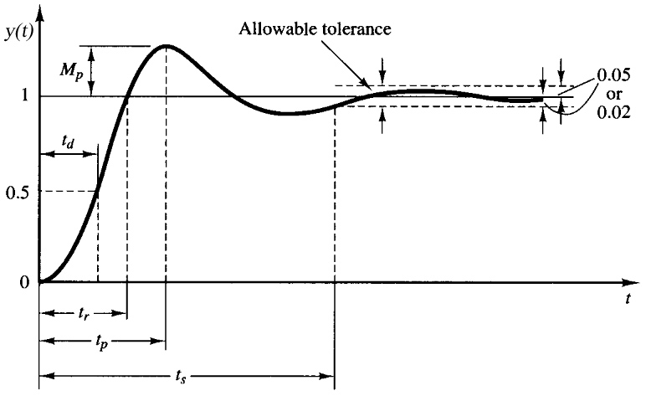
Time Domain Specifications
Chapter 3
Dynamic Response

Slide 16
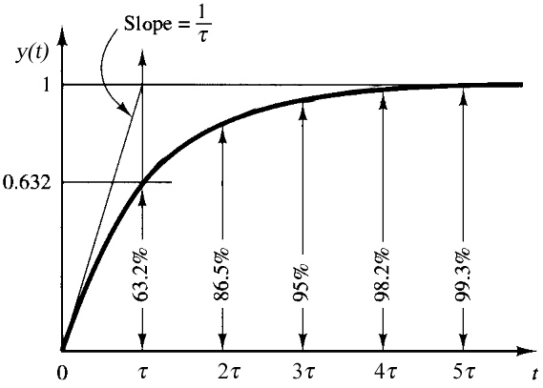
First-Order System
Chapter 3
Dynamic Response
The step response of first-order system in typical form:
is given by:
τ : time constant
For first order system, M_{p} and t_{p} do not apply

Slide 17
Second-Order System
Chapter 3
Dynamic Response
The step response of second-order system in typical form:
is given by:

Slide 18
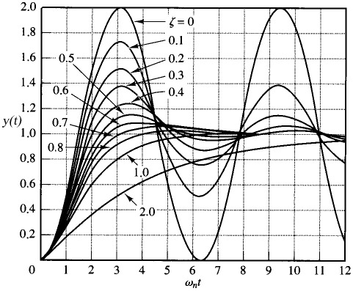
Second-Order System
Chapter 3
Dynamic Response
Time domain specification parameters apply for most second-order systems.
Exception: overdamped systems, where ζ > 1 (system response similar to first-order system).
Desirable response of a second-order system is usually acquired with
0.4 < ζ < 0.8.

Slide 19
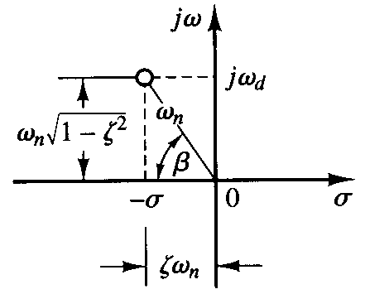
Rise Time
Chapter 3
Dynamic Response
The step response expression of the second order system is now used to calculate the rise time, t_{r,0%–100%}:
Since , this condition will be fulfilled if:
φ
or,
t_{r} is a function of ω_{d}

Slide 20
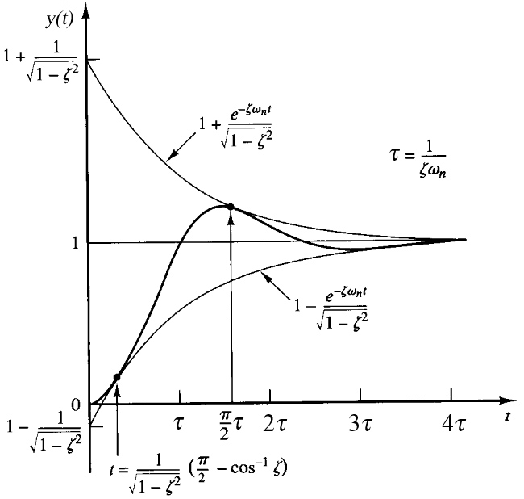
Settling Time
Chapter 3
Dynamic Response
Using the following rule:
with:
The step response expression can be rewritten as:
where:
t_{s} is a function of ζ

Slide 21
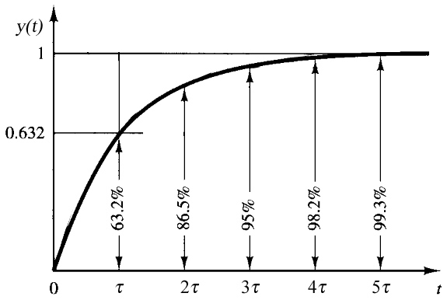
Settling Time
Chapter 3
Dynamic Response
The time constant of the envelope curves shown previously is 1/ζω_{n} , so that the settling time corresponding to a certain tolerance band may be measured in term of this time constant.

Slide 22
Peak Time
Chapter 3
Dynamic Response
When the step response y(t) reaches its maximum value (maximum overshoot), its derivative will be zero:

Slide 23
Peak Time
Chapter 3
Dynamic Response
At the peak time,
≡0
Since the peak time corresponds to the first peak overshoot,
t_{p} is a function of ω_{d}

Slide 24
Maximum Overshoot
Chapter 3
Dynamic Response
Substituting the value of t_{p} into the expression for y(t),
if y(∞) = 1

Slide 25
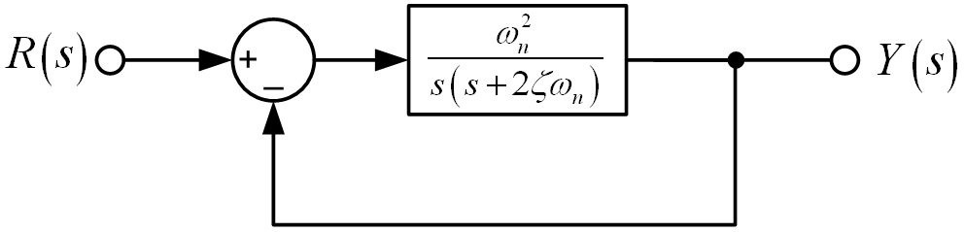
Example 1: Time Domain Specifications
Chapter 3
Dynamic Response
Example:
Consider a system shown below with ζ = 0.6 and ω_{n} = 5 rad/s. Obtain the rise time, peak time, maximum overshoot, and settling time of the system when it is subjected to a unit step input.
After block diagram simplification,
Standard form of second-order system

Slide 26
Example 1: Time Domain Specifications
Chapter 3
Dynamic Response
In second quadrant

Slide 27
Example 1: Time Domain Specifications
Chapter 3
Dynamic Response
Check y(∞) for unit step input, if

Slide 28
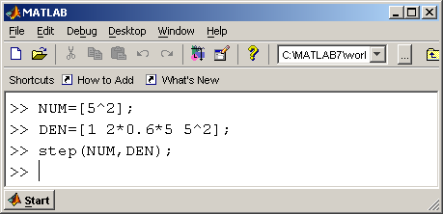
Example 1: Time Domain Specifications
Chapter 3
Dynamic Response

Slide 29

Example 2: Time Domain Specifications
Chapter 3
Dynamic Response
Example:
For the unity feedback system shown below, specify the gain K of the proportional controller so that the output y(t) has an overshoot of no more than 10% in response to a unit step.

Slide 30
Example 2: Time Domain Specifications
Chapter 3
Dynamic Response
: K = 2
: K = 2.8
: K = 3

