Slide 1
Astigmatism
Definition of Astigmatism:
Incident parallel rays of light are brought to a line of focus instead of a single point focus due to inequality in curvature of different meridians.

Slide 2
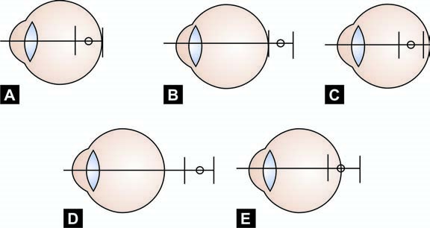
TYPES
Based on relative position of image of distant object on the retina (Fig. 9-4).
a- Simple astigmatism–Here one image is located in the retinal plane and based on the location of the other image it may be:
  1- Simple myopic astigmatism–The other image is located in front of the retina (A in Fig. 9-4).
  2- Simple hypermetropic astigmatism–The other image is located behind the retina (B in Fig 9-4).
b- Compound astigmatism–Here both the images are either in front of the retina or behind the retina and designated as:
  1- Compound myopic astigmatism (C in Fig.9-4).
  2- Compound hypermetropic astigmatism (D in Fig.9-4).
c- Mixed astigmatism–Here one image is formed in front of the retina and the other image is located behind the retina (E in Fig. 9-4).
Fig. 9-4: Types of astigmatism, O = Circle of least diffusion

Slide 3
Based on angle between the two principal meridians of maximum and minimum curvature
A- Regular astigmatism–Here two principal meridians of maximum and minimum curvature are positioned at right angles, i.e. 90° to each other.
B- Irregular (or Bi–Oblique) astigmatism– Here two principal meridians of maximum and minimum curvature are positioned to each other at angles other than 90°. It is very uncommon and found in keratoconus, scarred cornea and after penetrating keratoplasty.

Slide 4
Based on Aetiology
1- Orientation of maximum curvature of cornea
  A- Astigmatism with–the–rule (or direct)–Usually vertical corneal meridian is more curved than horizontal one due to pressure of the eyelids on the eyeball. So, astigmatism in which the refractive power of the vertical or near vertical meridian is maximum is called astigmatism with-the-rule (Fig.9-5A).
  |B- Astigmatism against-the-rule (or inverse or indirect)–Here the corneal curvature in horizontal meridian is greater than the vertical one, i.e. the refractive power of the horizontal or near horizontal meridian is the maximum (Fig. 9-5B).
  C- Oblique astigmatism–Here the radius of curvature of maximum and minimum curvature are aligned at 90° to each other but the two principal meridians are neither near horizontal nor near vertical (Fig. 9-5C).

Slide 5
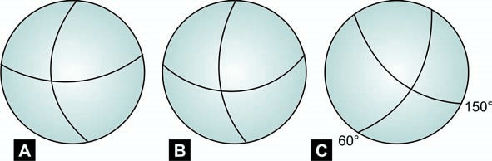
Figs 9-5A to C: Types of astigmatism based on orientation of maximum curvature of cornea.
(A) = With-the-rule,
(B) = Against-the-rule and
(C) = Oblique

Slide 6
2- Lenticular astigmatism–It is due to:
  A- Curvature–It is due to variations in the curvature of one or both surfaces. Lenticular astigmatism is typically against the rule and it tends to neutralise the corneal astigmatism.
  B- Index–It is due to inequalities of refractive index in different sections of the lens. It is seen in early cataract and is the reason of polyopia in early cataract.
  C- Displacement of the refractive element of
    crystalline lens, i.e. subluxation.
    decentration or tilting of pseudophakos (IOL).
3- External pressure on the cornea or globe
  A- Chalazion or lid tumour.
  B- After scleral buckling in retinal detachment surgery.

Slide 7
4- Diseases of the cornea
  A- Pterygium
  B- Keratoconus
  C- Corneal scarring, etc.

Slide 8
OPTICS OF ASTIGMATISM
A regularly astigmatic surface have a toric curvature and have the following features:
i. The maximum curved meridian have greater refractive power than the least curved one.
ii. If parallel rays of light fall upon a convex astigmatic surface the vertical rays will come to a focus earlier than the horizontal rays.
However, both the vertical and the horizontal rays after refraction will be perfectly symmetrical in their planes but they will have two foci.
iv. The whole bundle of rays is termed “STURM’S CONOID”. The distance between the two foci is termed “Focal interval of STURM”. At a point the vertical and horizontal rays symmetrically diverge and converge respectively to form a circle on section. This is termed as the “Circle of least diffusion” (Figs 9-4 and 9-6).

Slide 9
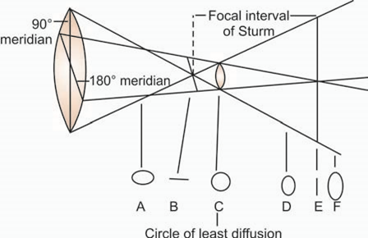
Fig. 9-6: Formation of Sturm’s conoid in astigmatism. Cross sections of the conoid are shown at A,B,C,D,E and F.C represents circle of least diffusion
It is not uncommon to detect significantly good distant vision in presence of high mixed astigmatism. This surprising fact occurs because the circle of least diffusion falls upon or near the light sensitive layer of the retina.

Slide 10
SYMPTOMS
i. Diminished distant visual acuity–This is least in mixed astigmatism
ii. Eye strain or asthenopia–It is often more common and worse in lower degree of astigmatism than the higher one. This is due to effort of the eye to accommodate so that the circle of least diffusion falls upon or near the retina
iii. Headache and eye ache
iv. Blurring of letters while reading.

Slide 11
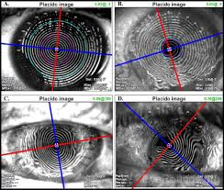
DIAGNOSIS
Objective
1- Retinoscopy
2- Keratometry
3- Placido keratoscopic disc–This test reflects irregularities on the corneal surface. The examiner looks through a hole in the Centre of the disc, with alternatingly painted black and white circles, at the corneal image reflected from a light behind the patient.
4- Computerised corneal topography.

Slide 12
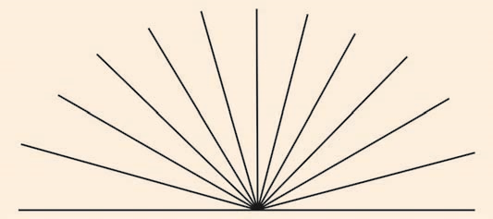
Subjective
1- Astigmatic fan (Fig. 9-7)–It is used to measure the strength of the cylindrical lens and it’s axis. The end point of cylindrical lens correction is achieved when the outline of the whole fan becomes equally clear and sharp. The axis of the cylinder is at right angles to the line which was initially most clearly 2- Stenopaeic slit test–In this test the slit is rotated till the patient sees the chart clearest. Then required spherical lenses are added. Then the slit is rotated 90° and again vision is adjusted with spherical lenses. This stenopaeic slit only allows light in the axis of the slit to enter the eye.
Fig. 9-7: Astigmatic fan

Slide 13
Thus, when its axis coincides with one of the principal axis of the eye, blurring is eliminated. The algebraic difference between the two spherical correction equals the power/strength of the cylindrical lens and its axis is determined by the initial direction of the slit.
iii. Jackson’s cross cylinder test (JCC test)–This test is discussed in detail in chapter–10.

