Slide 1
Abdominal Assessment
Alaa Hamza Hermis, Ph.D

Slide 2
Objectives:
At the end the students will be able to:
1 .Demonstrate the ability to safely & accurately complete abdominal assessment.
2. Demonstrate the ability to accurately document abdominal assessment data in organized manner.
Equipment Needed
I. Stethoscope.
2. Measuring tip centimeter.
3. Skin-marking pen.
4. Alcohol swab to clean end piece.

Slide 3
Preparation
Explain to the client what you are going to do, why it is necessary.
Drape the genitalia & female breast ( provide for client privacy).
Ask the client to empty the bladder.
Keep the room warm.
Position the client supine, with the head on a pillow, the knees bent or
on pillow, & the arm at the sides or cross the chest.
Expose the abdomen so that it is visible.
Expose the client’s abdomen only from the chest line to the pubic area to avoid chilling and shivering, which can tense the abdominal muscles.
Warm the stethoscope end piece.
Warm your hand.
insure about any painful area, examine such area last to avoid any muscle guarding.
Note:
Assessment of abdomen different from other assessments in that inspection & auscultation precede percussion & palpation.

Slide 4
Subjective data:
Appetite
Abdominal pain
Dysphagia
Nausea & vomiting
Food intolerance
Bowel habits
Past abdominal history
Medications
Nutritional assessment

Slide 5
Assessment
When assessing the abdomen, the nurse performs inspection first, followed by auscultation, percussion, and/or palpation.
Auscultation is done before palpation and percussion because palpation and percussion cause movement or stimulation of the bowel, which can increase bowel motility and thus heighten bowel sounds, creating false results.

Slide 6
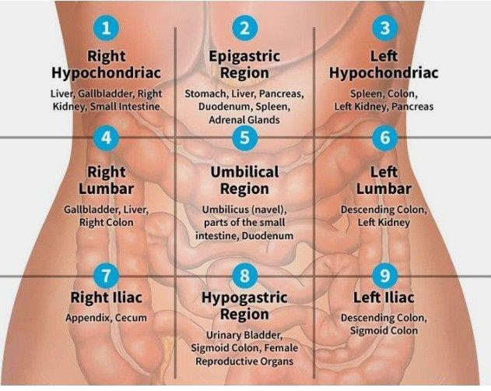
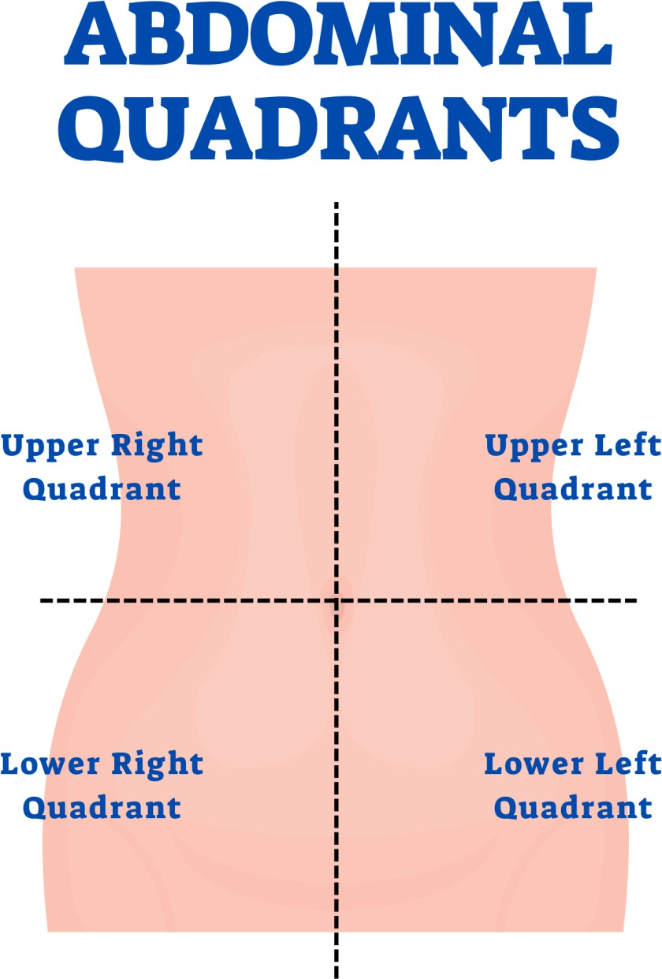
To describes abdominal findings using two common methods of subdividing
the abdomen: quadrants and regions by use certain landmarks.

Slide 7
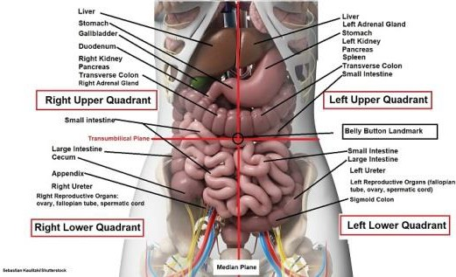

Slide 8
Inspection:
Color
Contour ( shape): flat or slightly rounded Abnormal: scaphoid & distension
Symmetry: symmetrical ( when client supine position raise his head). Note any localized bulging, visible mass, or asymmetric shape.
Abnormal: Asymmetrical caused by organ
enlargement , mass , hernia
Respiratory movement: can seen clearly in male
Aortic pulsation: no pulsation seen or slight
pulsation in the epigastric region in thin people.

Slide 9
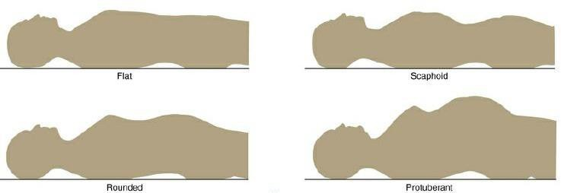
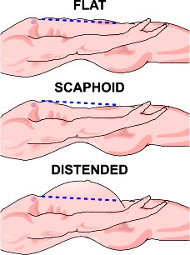

Slide 10
Inspect for lesion and rash: free on lesion and rash Abnormal: change in mole , petechiae
Striae: free of striae , silver to white color striae may seen in obese or multigraveda
Vascularity: fine veins may seen located above or blow the
umbilical area.
Abnormal: dilated vein seen in liver cirrhosis , obstruction of inferior vena cava , portal hypertension or ascites , spider angioma : dilated artery or capilliary in portal hypertension and liver disease
Scar: free of scar
Abnormal: assess scar according to location , size and color ( young scar is pink while old scar is white).

Slide 11
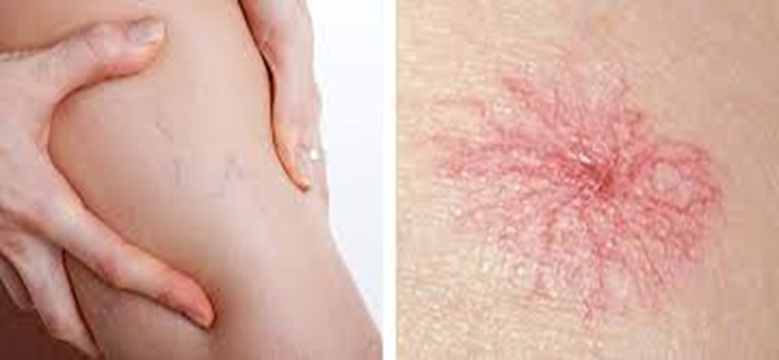
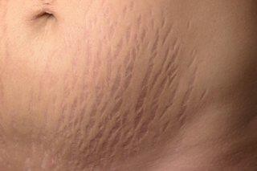
Striae sign

Slide 12
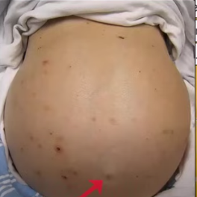
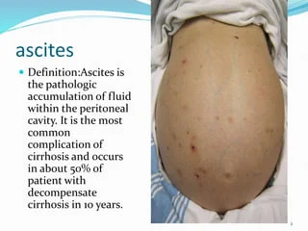
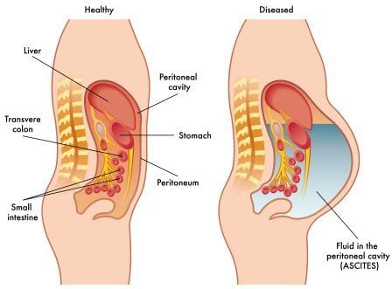
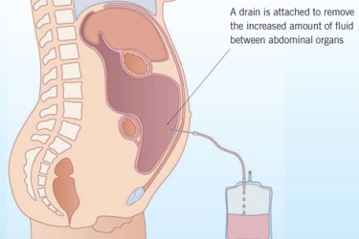

Slide 13
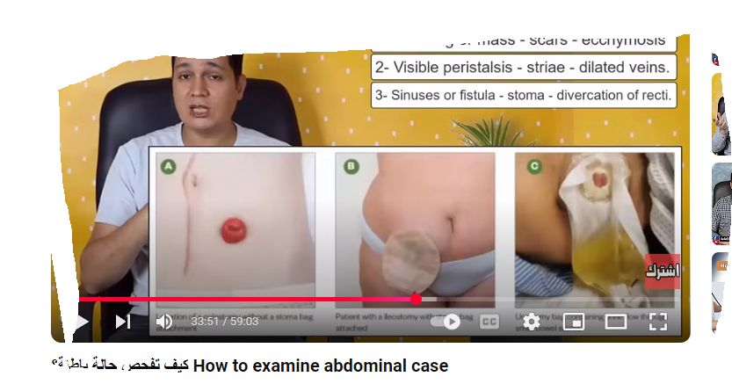
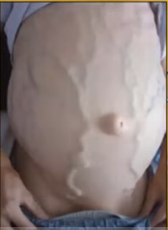
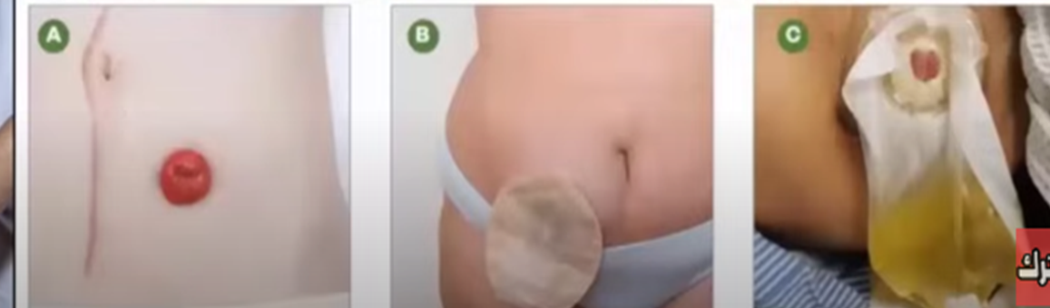

Slide 14
Umbilicus inspect for the following:
Normally: its midline and inverted, with no sign of discoloration, inflammation, or hernia.
  Color : pink skin around it should be evenly as abdomen color.
Abnormal: bluish around umbilicus ) cullen’s sign) intra - abdominal bleeding
  shape inverted or protruded not more than 0.5 cm
Ab: everted in abdominal distension or hernia C- Location: midline at lateral line
Ab: deviated umbilicus caused by mass , scar , hernia
Grey Turner sign is a discoloration of the left flank associated with acute hemorrhagic pancreatitis

Slide 15
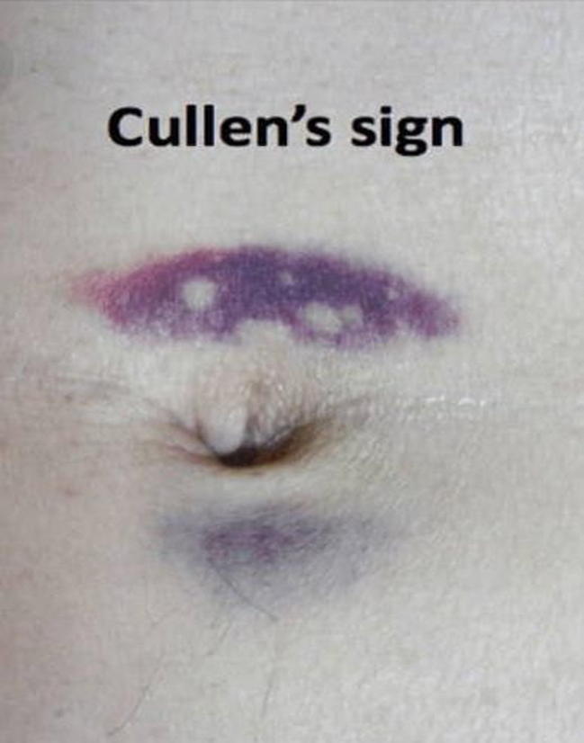
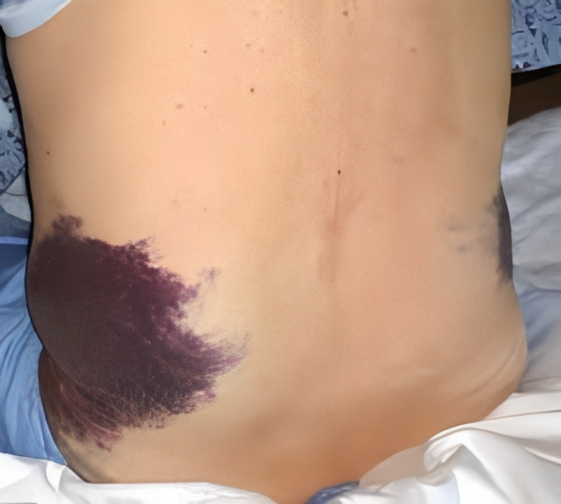
Grey Turner sign

Slide 16
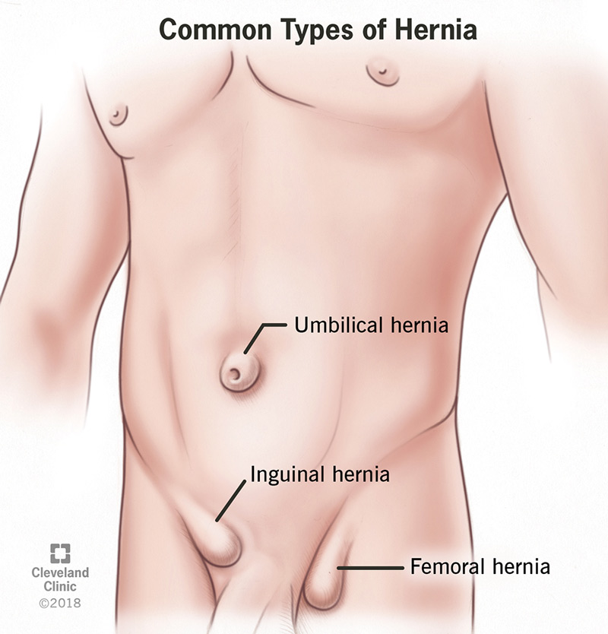
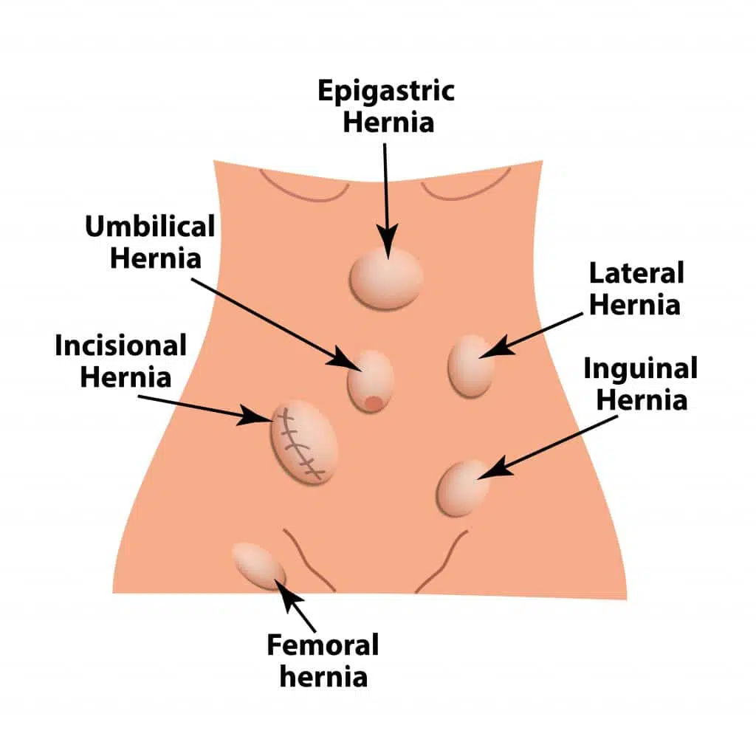
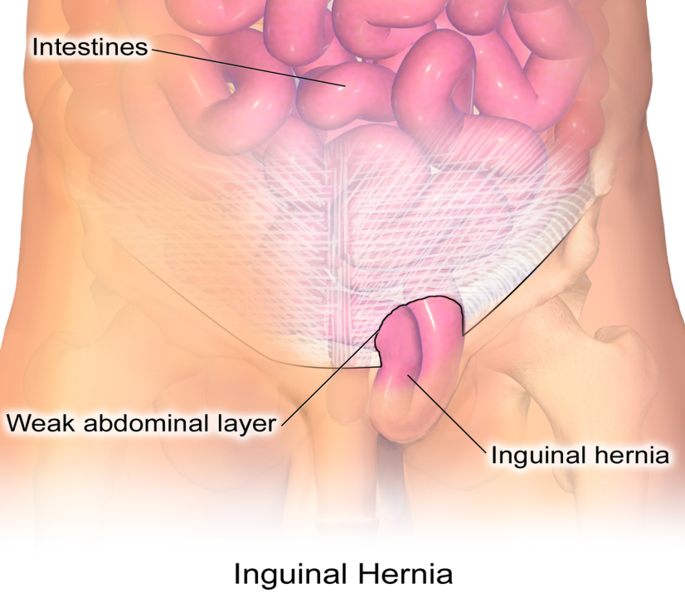
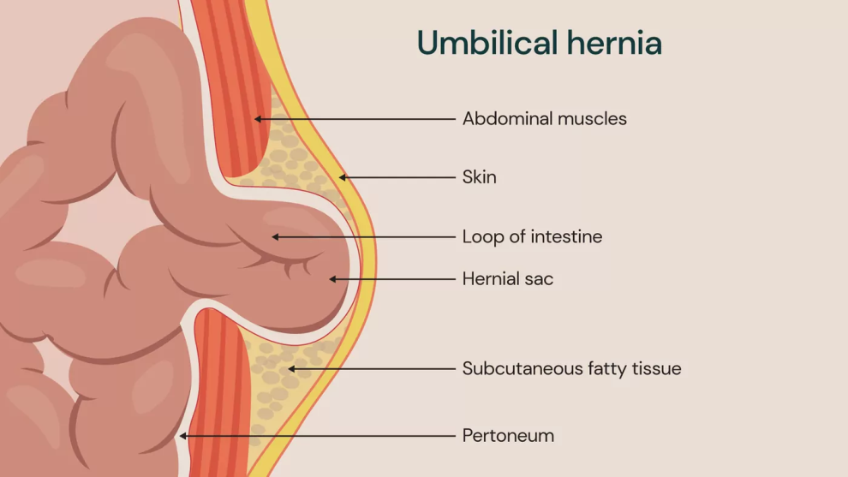

Slide 17
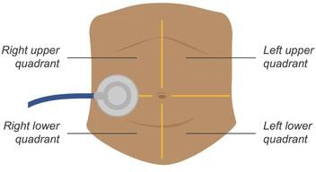
Auscultation of abdomen for the following: Bowel sounds
Use the diaphragm of a warm stethoscope
Apply light pressure to auscultation
bowel sounds for up to 5 minutes in each quadrant.
Begin in the right lower quadrant
(RLQ) at the ileocecal valve area
Assess for frequency and pitch.

Slide 18
Normal bowel sound: soft clicks and gargling heard in 5-30 per minute.
Loud prolong gurgle of stomach growling – hyperactive sound called ( borborygmi ).
Abnormal:
Hypoactive bowel sound in diminished motility in surgery , late bowel obstruction
Hyperactive bowel sound occur by diarrhea , gastroenteritis or early bowel obstruction
Absent bowel sound associated with peritonitis or paralytic ileus.
(must listen for 5 minutes by your watch before deciding whether bowel sounds are completely absent).

Slide 19
Vascular sound
As you listen to the abdomen, note the presence of any vascular sounds or bruits. Using firmer pressure, check over the aorta, renal arteries, iliac, and femoral arteries, especially in people with hypertension.
Use the bell to auscultate for vascular
Sounds normally: No bruits, no venous hums, no friction rubs.

Slide 20
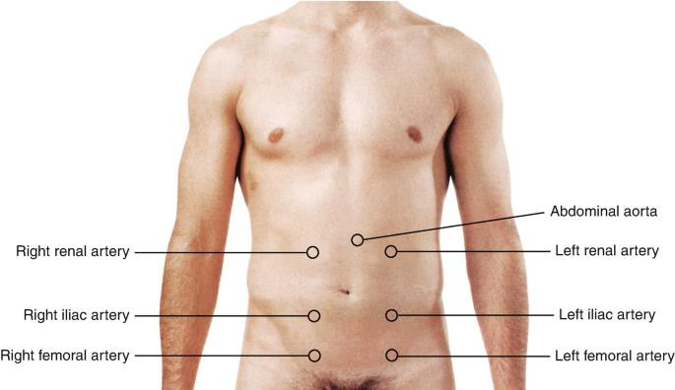
Right renal artery
Left renal artery
Right iliac artery
Left iliac artery
Right femoral artery
Left femoral artery
Aortic hum
Umbilical hum

Slide 21
Percussion of the abdomen
Percuss to assess the relative density of abdominal contents and to screen for abnormal fluid or masses.
First percuss lightly in all four quadrants to determine the prevailing amount of tympany and dullness. Move clockwise. Tympany should predominate because air in the intestines rises to the surface when the person is supine.

Slide 22
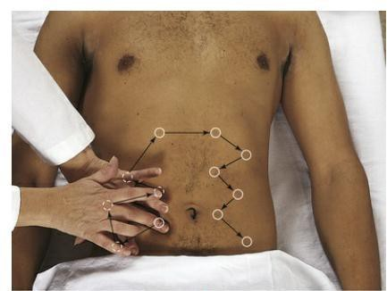

Slide 23
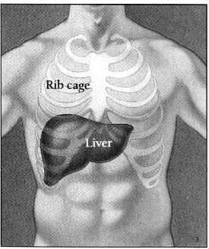



Percussion of the abdomen for the following:
General percussion
Liver span
  percuss starting below umbilicus at client's right midclavicular line (MCL(
  Percuss upward until you hear dullness; mark this point.
  Percuss downward from the lung resonance in the right MCL to dullness & mark.
  Repeat in midsternal line. Midclavicular line: 6-12 cm Midsternal line: 4-8 cm
-3Scratch test to assess liver

Slide 24
Percussion
Stomach:
Normal: tympany of gastric air bubble is lower in pitch than the tympany of the intestine
Abnormal: gastric distension
Fist precussion:
kidney & liver
Normal: kidney & liver: no tenderness
Abnormal: tenderness (pyelonephritis kidney), ( cholecystitis or hepatitis- liver)

Slide 25
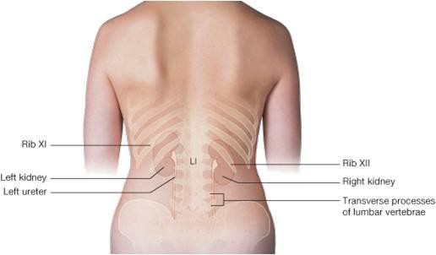
-4 Blunt percussion to assess kidneys

Slide 26
Bladder:
Normal: a urine fulled bladder is dull to percussion. A recently emptied bladder should not percussable above the symphsis pubis
Abnormal: dullness if difficulty voiding, prostatic hypertrophy, medication

Slide 27
Splenic percussion
Check for a splenic percussion sign. Percuss the lowest interspace in the left anterior axillary line. This area is usually tympanitic.
Then ask the patient to take a deep breath, and percuss again. When spleen size is normal, the percussion note usually remains tympanitic.

Slide 28
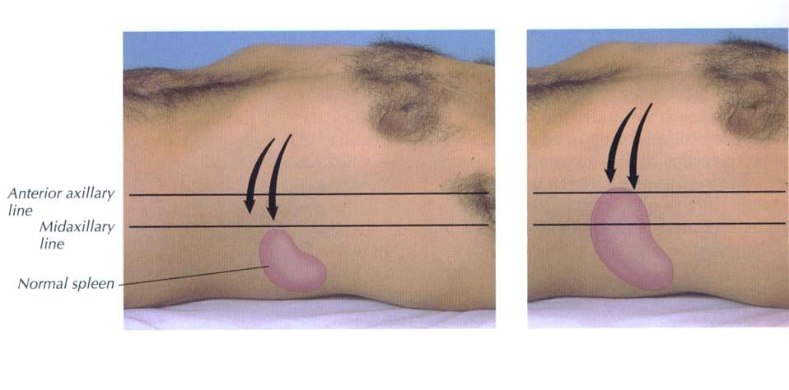
5- Assess spleen
•

Slide 29
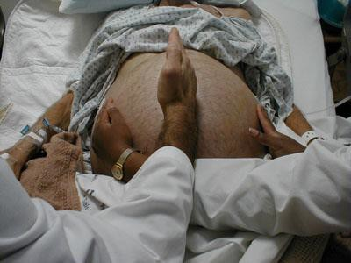
Special test ( Ascites(
Shifting dullness
Fluid wave test

Slide 30
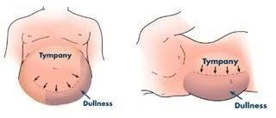

Slide 31
Physical Exam: Palpation
Palpation: to judge size, location, consistency of certain organs and to screen for abnormal mass or tenderness.
Light palpation: first four fingers close together, depress skin about 1 cm.
Make gentle, rotary motion sliding fingers and skin together.
  N-Abdomen feel smooth with consistent softness.
  Abnormal-(tumors ,inflammation ,feces)
Deep palpation: 5-8 cm (2-3 inches). No organ enlargement

Slide 32
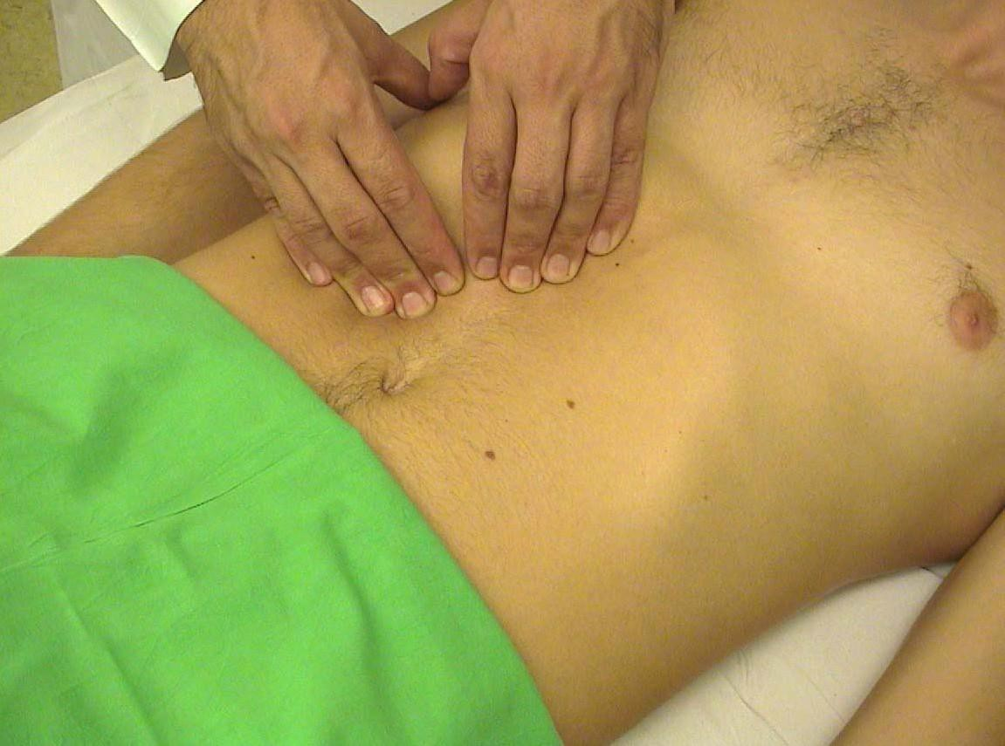

Slide 33
Palpation
Spleen: should not palpable in normal(note size, shape , consistency and any masses.
Abnormal: splenomegaly –inflammation
Kidneys :should not palpable in normal Abnormal: enlarged –hydronephrosis
,neoplasms or polycytic
Bladder: empty bladder is not palpable
Inguinal lymph Nodes: normal palpate small
,movable nodes less than 1cm not

Slide 34
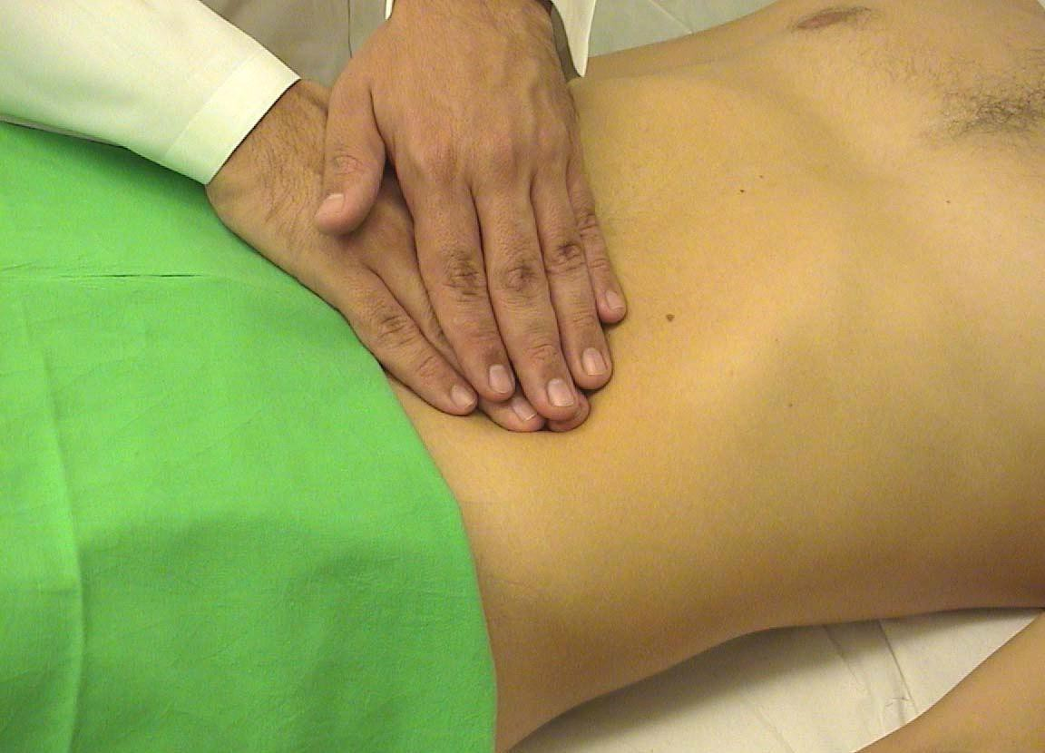

Slide 35
Physical Exam: Palpation
If a mass is located, note:
Location, size, shape
Consistency- soft, firm, or hard.
Mobility- including movement with respirations.
Tenderness

Slide 36
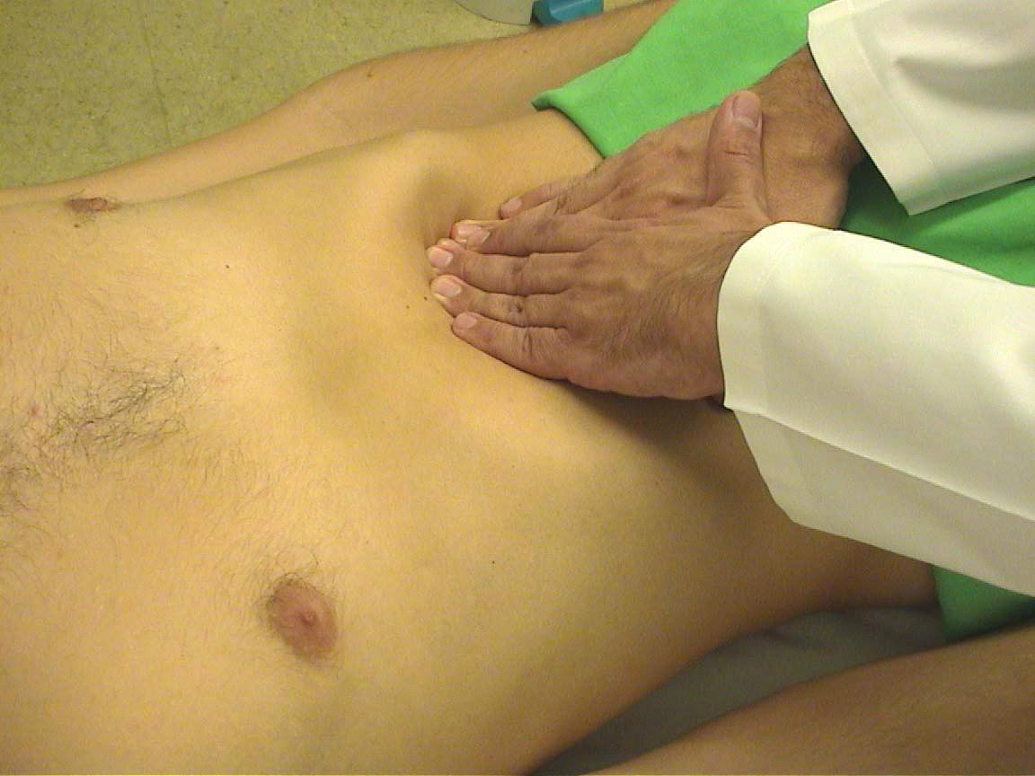

Slide 37
