Slide 1
Al-Mustaqbal University
Biomedical Engineering Department
Class: 5th
Subject: Biomedical Instrumentation Lab
Lecturer: M.SC. ZAINAB SATTAR JABBAR
1st term – Lect. 8: Pulse Oximeter
Email: zainab.sattar.jabbar@uomus.edu.iq

Slide 2
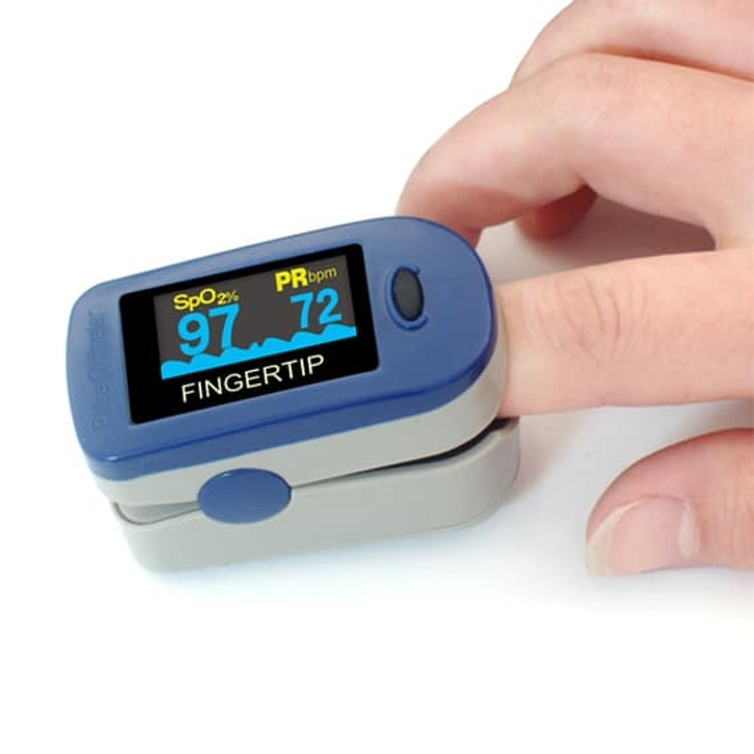
Pulse Oximeter
Oximetry is a non-invasive method of measuring the oxygen saturation of the (hemoglobin in the) blood. This is a good indicator of the oxygen carrying capacity of the blood. A blood-oxygen monitor displays the percentage of blood that is loaded with oxygen. More specifically, it measures what percentage of hemoglobin, the protein in blood that carries oxygen, is loaded.
©

Slide 3
Function: measure oxygen saturation of the blood
Why is it important ?
All tissues in the body depend on oxygen for survival. A shortage of oxygen in the tissues is called hypoxia. When a patient is hypoxic their tissues lose the bright red appearance of being well oxygenated and become dark red. The brain is damaged very quickly if the supply of oxygen to the tissues is interrupted.
What are normal values for the blood oxygen content ?
In a healthy human, nearly 100% of the hemoglobin is saturated all of the time in the arteries. Acceptable normal ranges for patients without pulmonary pathology are from 95 to 99 percent.
©

Slide 4
Use: many places in the hospital and at home
The probe can be placed on a finger, ear lobe, toe or forehead depending upon its design. Some probes are single use while others are multi-use. Multi-use probes are preferred in the developing world. However, disposable probes are often reused.
The Pulse (Heart) Rate is 72 beats per minute
The oxygen saturation is 98%
Pulse oximetry is very convenient for non-invasive continuous measurement of blood oxygen saturation. Pulse oximetry is useful in any setting where a patient's oxygenation is unstable, including intensive care, operating, recovery, emergency and hospital ward settings, and neonatal unit.

Slide 5
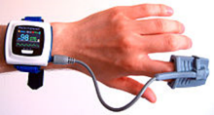
Use: many places in the hospital and at home
Two sites commonly used for transmittance pulse oximetry are the ear and the finger. The finger is the most convenient site, and is often the most comfortable for the patient. There are some situations in which it is inappropriate, including :
  In patients wearing finger nail polish, light transmission through the finger is blocked.
  The fingers and toes of neonates are sometimes too small for adult finger probes.
  In patients with poor perfusion, the blood flow through the finger may be too low.

Slide 6
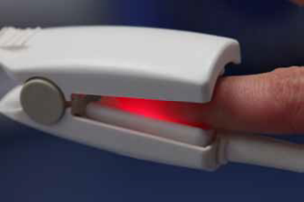
Scientific principles: oxygen and blood
The colour of blood depends how much haemoglobin is saturated with oxygen. Arterial blood is fully saturated and is bright red; venous blood has less oxygen and is dark red.
Blood is oxygenated in the lungs and is then pumped by the heart to the tissues. In arterial blood some 98% of haemoglobin is saturated with oxygen.
Venous blood from the tissues has delivered some of its oxygen to the tissues. Normally only 75% of the haemoglobin of venous blood is saturated with oxygen.
This color difference is the basis for pulse oximetry.
©

Slide 7
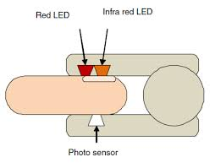
Scientific principles: the pulse oximeter
A typical pulse oximeter utilizes a pair of small light-emitting diodes (LEDs) facing a photodiode through a translucent part of the patient's body. One LED is red, with a wavelength of 660 nm, and the other is infrared with a wavelength of 940 nm.
Absorption of light at these wavelengths differs significantly between blood loaded with oxygen and blood lacking oxygen. Oxygenated hemoglobin absorbs more infrared light and allows more red light to pass through. Deoxygenated hemoglobin allows more infrared light to pass through and absorbs more red light.
The LEDs flash about thirty times per second which allows the photodiode to respond to the red and infrared light separately. The amount of light that is transmitted (in other words, that is not absorbed) is measured. These signals fluctuate in time because the amount of arterial blood that is present increases (literally pulses) with each heartbeat. The SpO2 is calculated from this. Detecting a pulse (in the diode signal & blood flow) is essential to the operation of a pulse oximeter; it will not function if there is none.
©

Slide 8
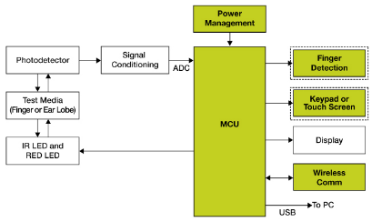
Construction of pulse oximeter
©

Slide 9
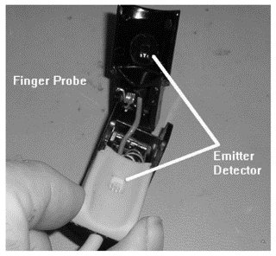
Trouble shooting
Broken wires, springs and plastic cases are common problems that can be fixed in the field.
The most common problems with the pulse oximeter are related to the probe. The constant reuse of disposable probes eventually results in lead breakage. These can often be repaired, if only a single wire is broken.
There are a few areas of user error which are common. Sensor placement is the most common. The sensor should be positioned to avoid letting ambient light enter the tissue or the sensor. Some nail polish will block light transmission. If the patient is cold the blood vessels may constrict making detection of blood flow difficult.

Slide 10
Safety and testing considerations
A pulse oximeter can be easily tested on yourself.
Your heart rate should be accurately reflected (to within 1 bpm) on the display as compared to a standard stop-watch/neck-artery technique.
Also, check the alarms to assure that when your heart rate is outside of the set range, the alarms sound.

Slide 11


