Slide 1
Al-Mustaqbal University
Biomedical Engineering Department
Class: 5th
Subject: Biomedical Instrumentation Lab
Lecturer: M.SC. ZAINAB SATTAR JABBAR
1st term – Lect. 6: X ray machine
Email: zainab.sattar.jabbar@uomus.edu.iq

Slide 2
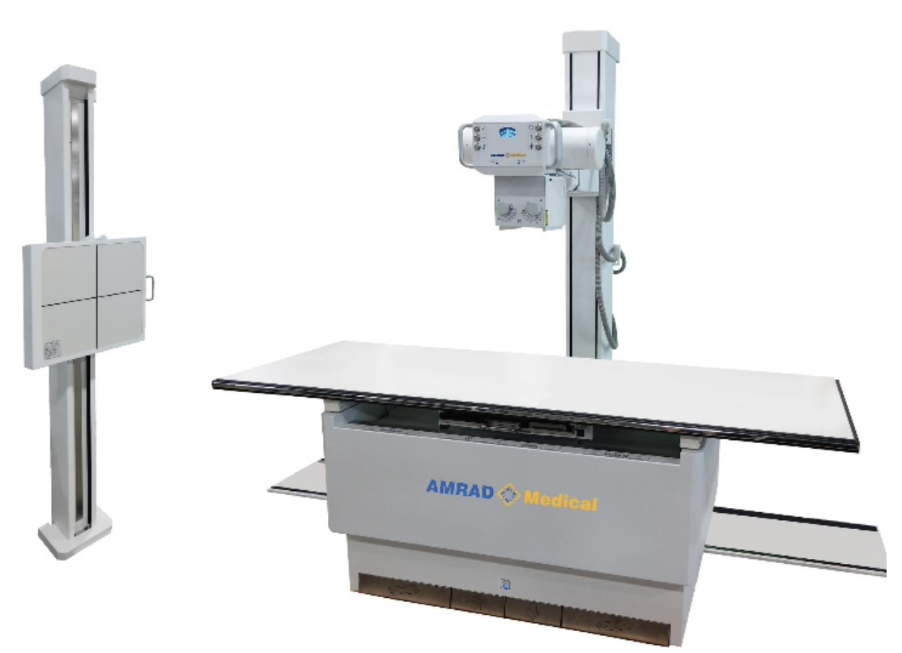
X ray machine

Slide 3
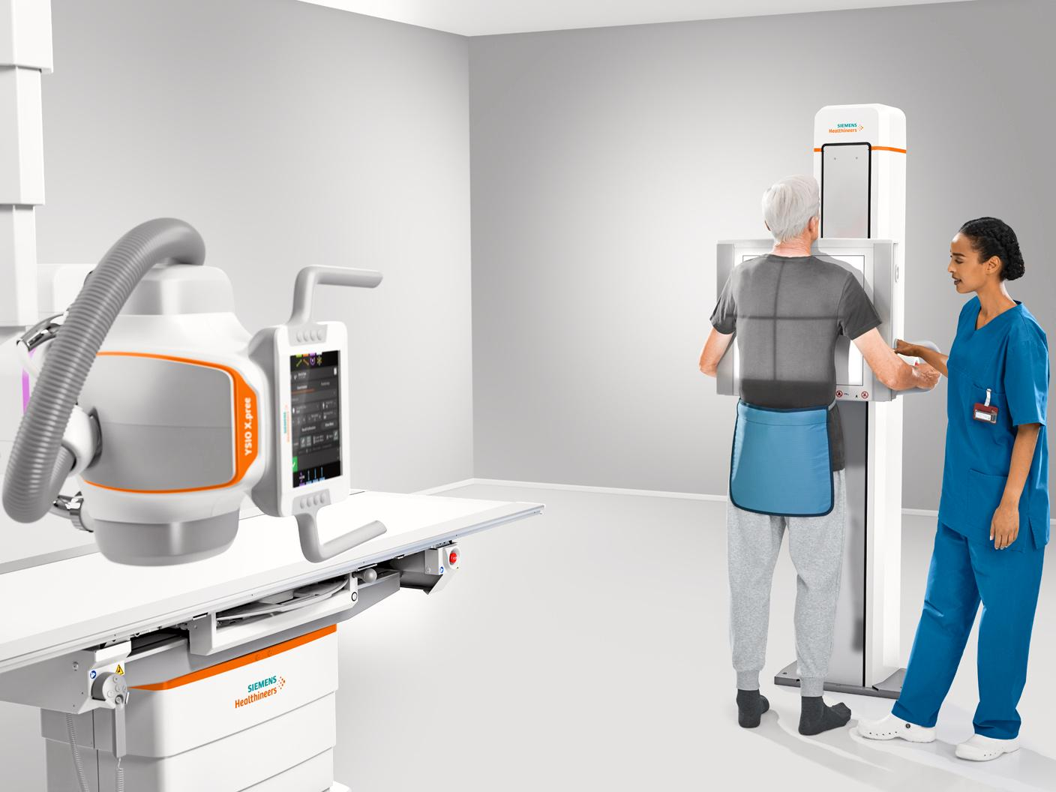
Introduction to X-ray Technology
X-rays are a form of electromagnetic radiation. They are capable of penetrating various materials, which makes them ideal for imaging and diagnostic purposes, especially in the human body.
In medical diagnostics, X-rays are used to visualize the internal structure of the body, helping in the detection of diseases, fractures, infections, and other abnormalities.

Slide 4
Basic Principles of X-ray Imaging
X-ray imaging works based on the differential absorption of X-rays by different tissues in the body. Here's how the process unfolds:
X-ray Generation: X-rays are produced when high-energy electrons collide with a metal target (usually tungsten) inside an X-ray tube.
Penetration and Absorption: As X-rays pass through the body, they interact with tissues. Dense tissues, like bones, absorb more X-rays and appear white on the resulting image. Less dense tissues, like muscles and organs, allow more X-rays to pass through and appear darker.
Image Detection: After passing through the body, the remaining X-rays hit a detector (either film or digital detectors). The contrast between different tissues creates the radiographic image.

Slide 5
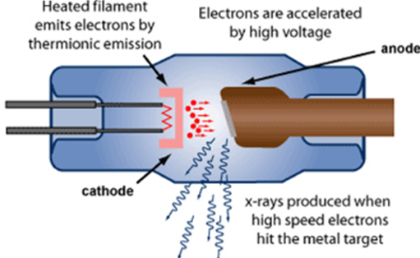
Production of x-rays
X-rays are produced by ‘shooting’ high energy electrons on a piece of metal (tungsten), called the ‘anode’. The electrons are absorbed in this metal and cause the creation of X-ray radiation.
You get high energy electrons by taking low energy electrons and accelerating these by means of a high electric voltage. This high voltage is created by the X-ray generator and applied between the anode (+), attracting the electrons, and the cathode (-).
99% of the energy released is given off as heat and only 1% is in the form of X-ray radiation! Getting rid of the heat is a major issue in tube design and operation.

Slide 6
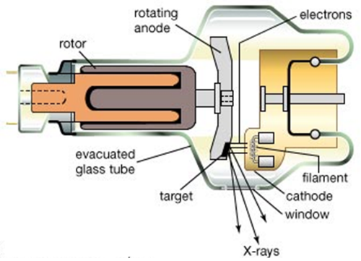
X-ray tube
External structures
Support structures
Protective housing
Glass or metal encloser
Internal structures
Anode and cathode

Slide 7
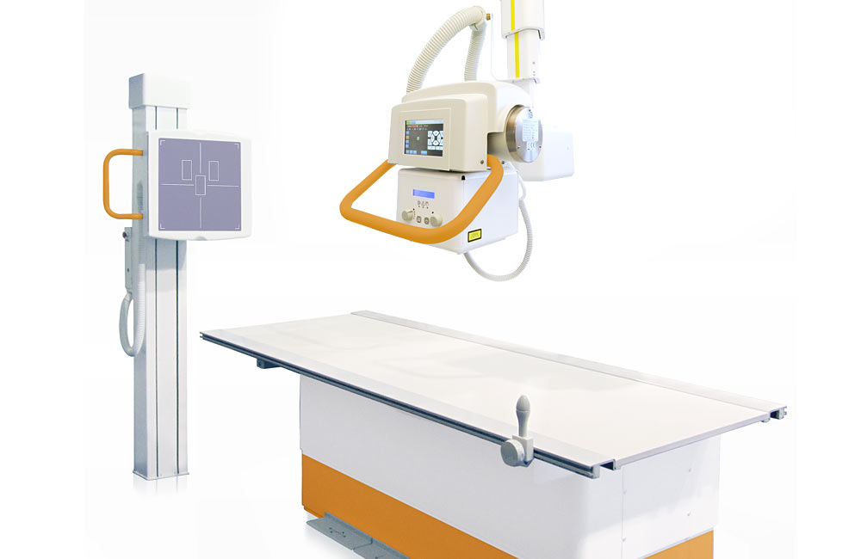
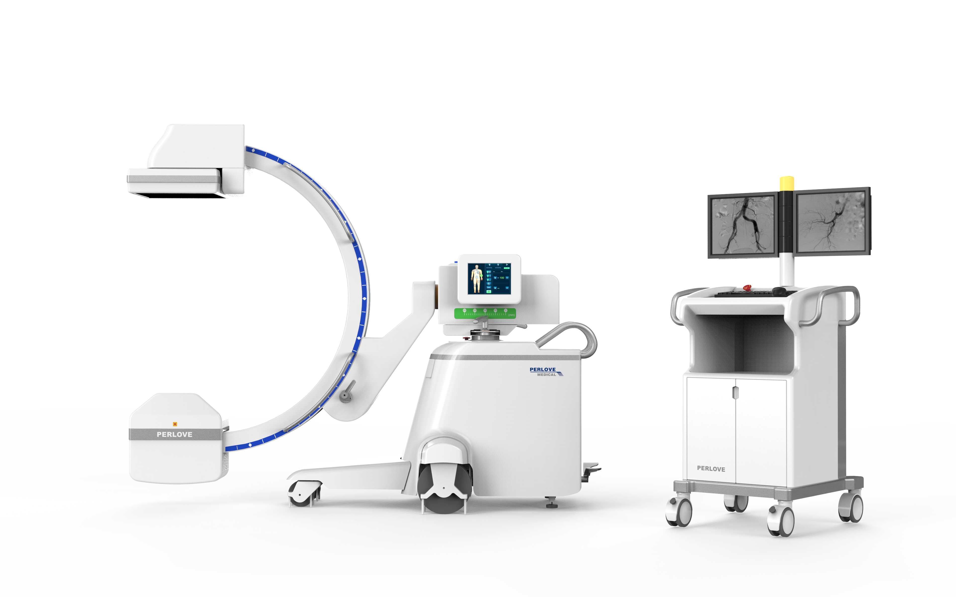
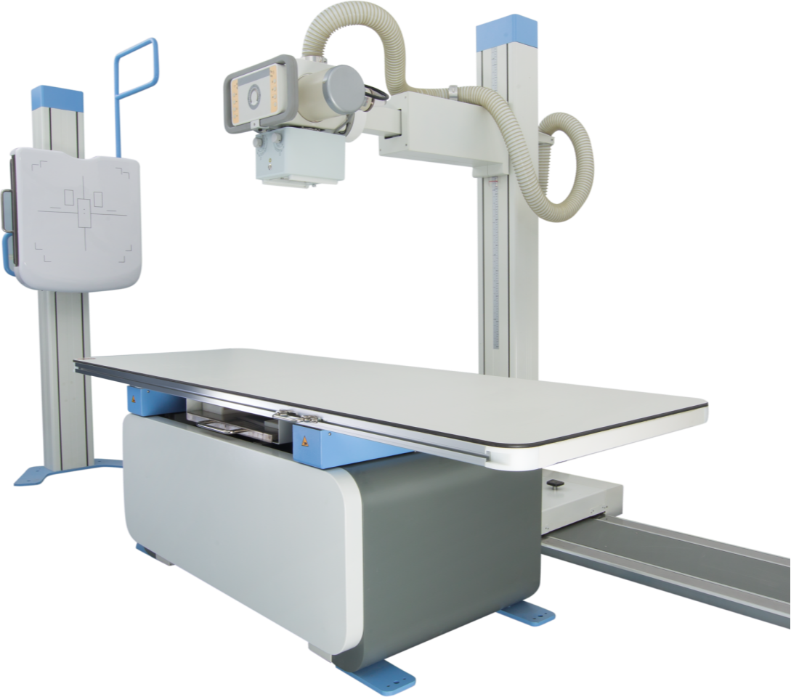
X-ray tube support structures
Xray tube and housing assembly are quite heavy
Required support mechanism so radiologist can position them
Mainly ceiling, floor or C arm support system

Slide 8
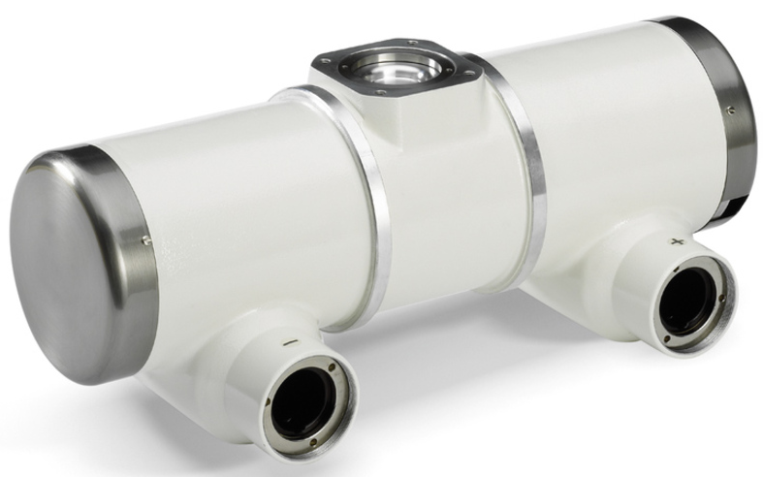
Protective Housing
When x-rays are produced, they are emitted isotropically
  That is, with equal intensity in all directions
Only x-rays emitted through window are called useful beam
  X-rays that escape through protective housing: leakage radiation
  Leakage radiation contributes nothing to diagnostic information and result in unnecessary exposure of patient and radiologic technologist
Protective housing guards against excessive radiation exposure and electric shock
  Also mechanically protects x-ray tube

Slide 9
Metal or Glass Enclosure
X-ray tube is an electronic vacuum tube with components contained within a glass or metal enclosure
  vacuum allows for more efficient x-ray production and longer tube life
As glass enclosure tube ages, some tungsten vaporizes and coats the inside of glass enclosure
  Alter electrical properties of the tube, allowing tube current to stray and interact with the glass enclosure resulting in arcing and tube failure
  Most common cause of tube failure
Metal enclosures maintain constant electric potential between electrons of tube current and enclosure
  Longer life and less likely to fail
  Virtually all high-capacity x-ray tubes now use metal enclosures

Slide 10
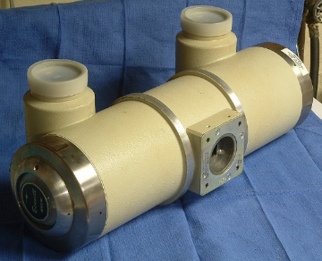
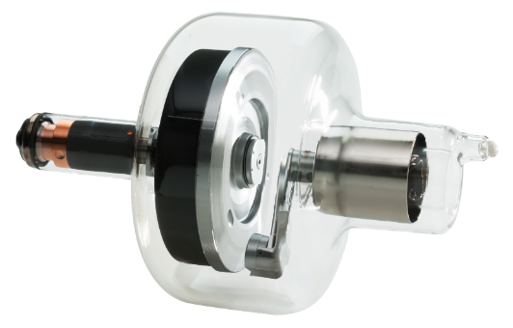
X-ray tube
High Voltage In
Anode disc rotation mechanism (‘rotor’)
X-ray Out
anode disk
X-ray Tube Container
protects the tube from mechanical shock and absorbs stray X-ray radiation
cathode
X-ray Tube ‘Insert’; the inside is vacuum

Slide 11
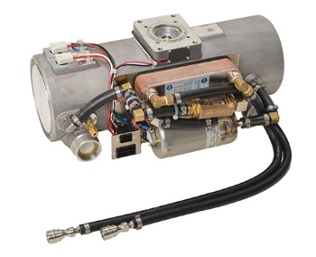
X-ray tube
In high end X-ray tubes, the anode is rotating, so that it can absorb more heat.
Also, the anode may be cooled with water or with oil, that is circulated through the tube and cooled with a ‘heat exchanger’ outside the tube.
The place on the anode where X-rays are generated is called the ‘focal spot’.
tubes with cooling fluid
©

Slide 12
Cathode
Cathode is the negative side of the x-ray tube
It has two primary parts, a filament and a focusing cup
  Dual-filament cathode allows two focal spots (e.g., 0.5 and 1.5 mm)
  Focusing cup is a metal shroud that surrounds filament
  Tube current is adjusted by controlling filament current

Slide 13
Anode
Anode is the positive side of the x-ray tube
Two types: stationary (dental) and rotating (general purpose)
  Higher tube currents and shorter exposure times are possible with rotating anode because of their better heat dissipation
Three functions in an x-ray tube:
  Electrical conductor that receives electrons emitted by cathode and conducts them through the tube to the connecting cables and back to the high-voltage generator
  Mechanical support for the target
  Thermal dissipation

Slide 14
Target
The target is area of anode struck by electrons from cathode

Slide 15
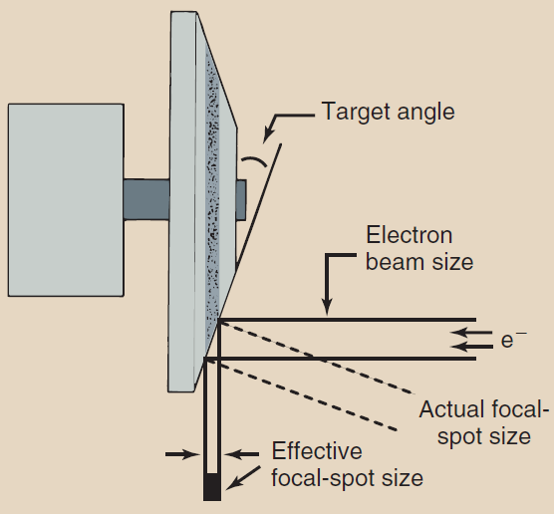
Focal Spot
Focal spot is the area of target from which x-rays are emitted
  The smaller the focal spot, the better the spatial resolution of the image
  Unfortunately, as the size of focal spot decreases, heating of target is concentrated onto a smaller area (limiting factor to focal spot size(
Line-focus principle: angling target makes effective area of the target much smaller than actual area of electron interaction

Slide 16
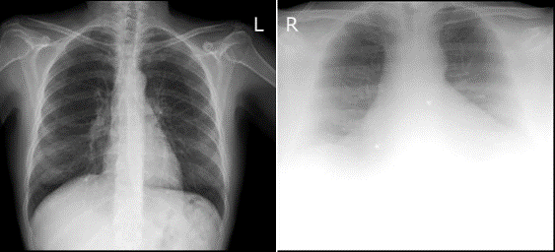
X-ray Image Quality
Most user complaints on a functioning X-ray systems are about reduced Image Quality. The factors that determine image quality are:
  spatial resolution or sharpness
  image contrast
  image noise
  image artefacts
Each of these factors can lead to reduced visibility of image details and to a sub-optimal/wrong diagnosis.
Chest X-ray of normal (left) and obese (right) patient
Some image quality reduction occurs in case of high X-ray absorption, as sometimes caused by obese patients.
This can lead to low contrast and high noise in the image. It can sometimes not be improved by improving the system.

Slide 17


