Slide 1
Al-Mustaqbal University
Biomedical Engineering Department
Class: 3th
Subject: Biomedical Instrumentation Lab
Lecturer: M.SC. ZAINAB SATTAR JABBAR
1st term – Lect. 7: The Urinary System
Email: zainab.sattar.jabbar@uomus.edu.iq

Slide 2
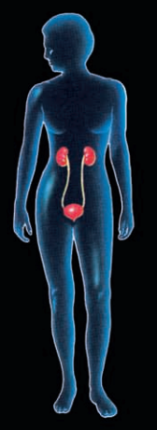
The Urinary System
The survival and proper functioning of cells depend on maintaining stable concentrations of salt, acids, and other electrolytes in the internal fluid environment.
Cell survival also depends on continuous removal of toxic metabolic wastes that cells produce as they perform life-sustaining chemical reactions.
The urinary system's function is to filter blood and create urine as a waste by-product.

Slide 3
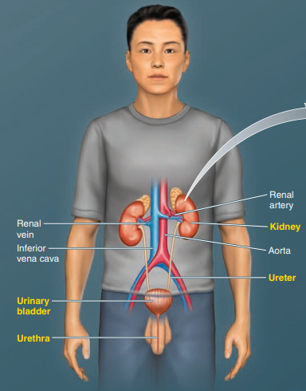
Component of Urinary System
Urinary system: Kidneys, ureters, urinary bladder, urethra.
Excretes metabolic wastes , regulates fluid balance and acid base balance.
The kidneys play a major role in maintaining homeostasis by regulating the concentration of many plasma constituents, especially electrolytes and water, and by eliminating all metabolic wastes (except CO2, which is removed by the lungs).

Slide 4
Urinary System
The urinary system consists of the urine-forming organs—the kidneys—and the structures that carry the urine from the kidneys to the outside for elimination from the body.
After urine is formed, it drains into a central collecting cavity, the renal pelvis, located at the medial inner core of each kidney.
From there urine is channeled into the ureter, a duct that exits at the medial border close to the renal artery and vein. There are two ureters, one carrying urine from each kidney to the single urinary bladder. The urinary bladder, which temporarily stores urine.
Urine is emptied from the bladder to the outside through another tube, the urethra, as a result of bladder contraction.

Slide 5
The Kidneys
The kidneys are solid, bean-shaped organs. Located below the ribs toward the middle of the back. The right kidney is positioned slightly lower than the left. Each of which is about 11 cm long, 6 cm wide, 3 cm thick. Each kidney has a lateral convex & medial concave border.
Each kidney has a fibrous capsule. On the concave, each kidney's medial side is called the hilus, which contains renal blood vessels and nerves. Medial to the hilum is the renal pelvis, a flat funnel-shaped structure that continues with the upper end of the ureter. The kidneys remove urea from the blood through tiny filtering units called nephrons. Each nephron consists of a ball formed of small blood capillaries, called a glomerulus, and a small tube called a renal tubule.

Slide 6
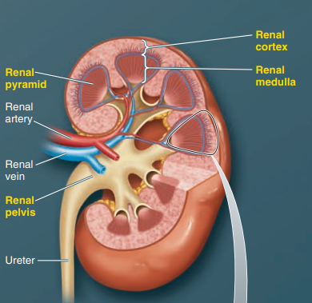
The Kidneys

Slide 7
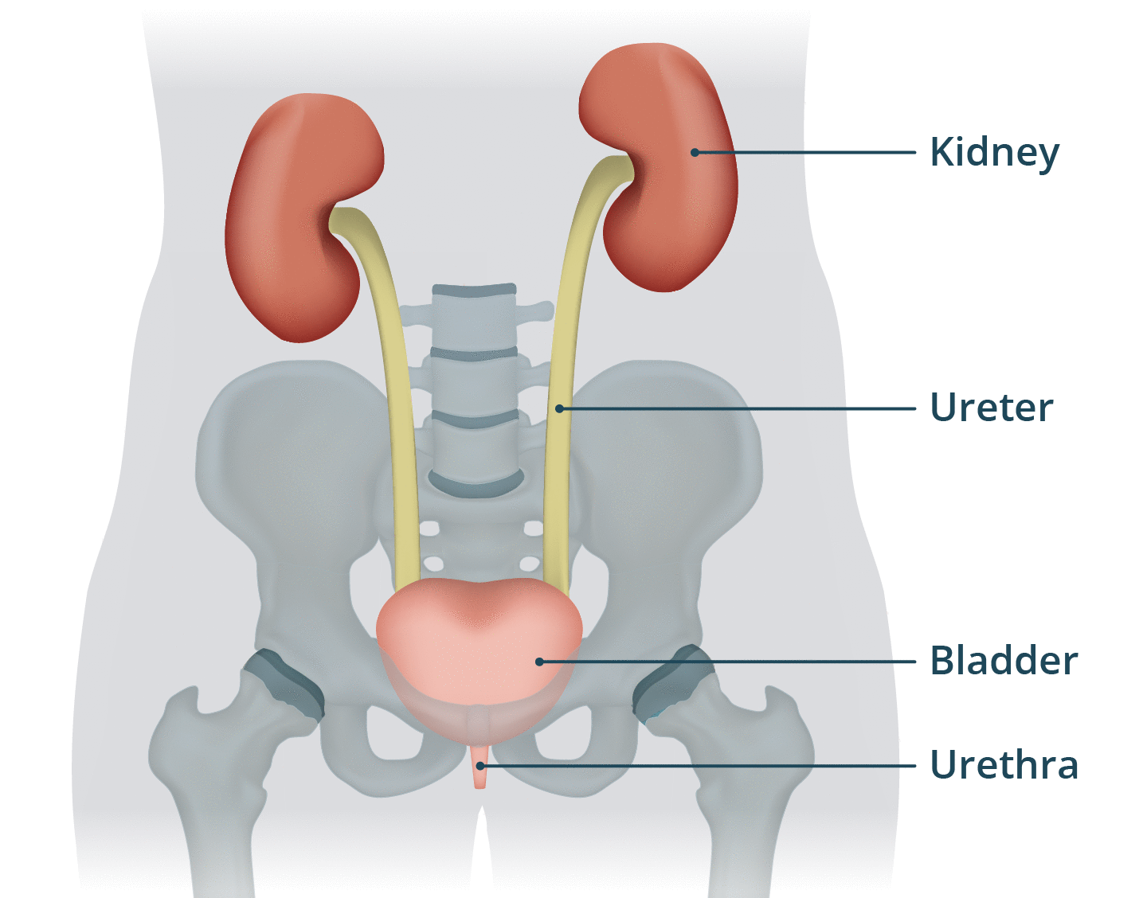
The function of the kidney
Remove waste products and drugs from the body.
Balance the body's fluids.
Release hormones to regulate blood pressure(Producing renin).
Control production of red blood cells(Producing erythropoietin).

Slide 8
Coverings of kidneys
The kidneys have the following coverings:
1. Fibrous capsule: This surrounds the kidney and is closely applied to its outer surface.
2. Perirenal fat: This covers the fibrous capsule.
3. Renal fascia: This is a connective tissue that lies outside the perirenal fat and encloses the kidneys and suprarenal glands.
4. Pararenal fat: This lies external to the renal fascia and is often in large quantities.

Slide 9
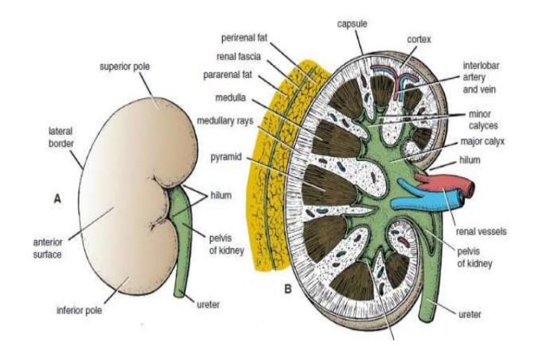
Coverings of kidneys

Slide 10
The Kidneys
When a kidney is cut lengthwise, 2- regions become apparent.
1. Cortex: The outer region, which is light in color.
2. Medulla: It is a darker reddish-brown area, deep to the cortex.
The parenchyma of the kidney consists of renal tubules.
These renal tubules are consisting of:
1. Secretory tubules (Nephron): its function is the formation of urine.
2. Excretory tubules: These are ducts that collect urine and carry it to the pelvis.
The nephron is the functional unit of the kidney.

Slide 11
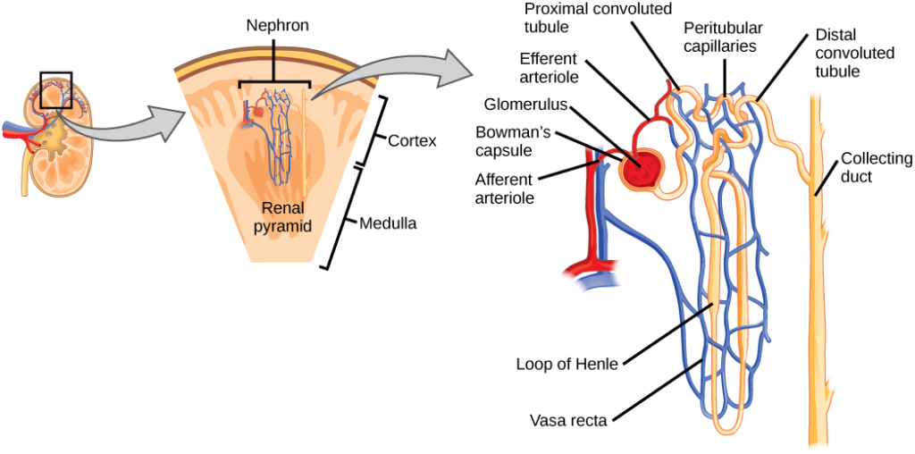
The Kidneys
Each nephron consists of:
1. The renal corpuscle consists of two parts (Glomerulus, Bowman's capsule).
2. Proximal convoluted tubule.
3. Loop of Henle.
4. Distal convoluted tubule.

Slide 12
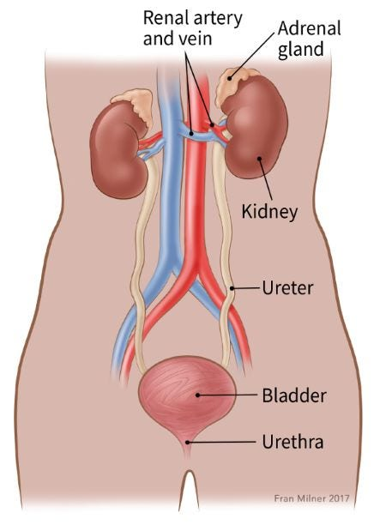
The Suprarenal glands (Adrenal glands)
The adrenal glands are small glands located on top of each kidney. They produce essential hormones, including sex hormones and cortisol

Slide 13
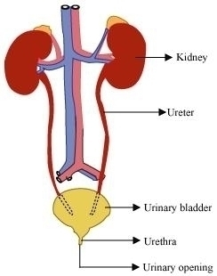
The Ureter
Narrow slender tubes carry urine from the kidneys to the bladder.
The ureters are tubes, 25-30 cm long and 6 mm in diameter.
Muscles in the ureter walls continually tighten and relax, forcing urine downward away from the kidneys. If urine backs up or is allowed to stand still, a kidney infection can develop.
About every 10 to 15 seconds, small amounts of urine are emptied into the bladder from the ureters.
Functions: The ureters carry urine from the kidneys to the bladder.

Slide 14
Urinary Bladder
It is a smooth, collapsible muscular sac that stores urine temporarily.
Three openings are seen in the bladder- the two ureter openings and the single opening of the urethra, which drain the bladder.
The empty bladder is 5-7.5 cm long, while the full bladder is about 12.5cm long and holds about 500ml of urine, but it is capable of holding more than twice that amount (1500ml).
It is the reservoir for urine received from the kidneys.
Two sphincter muscles. These circular muscles help keep urine from leaking by closing tightly like a rubber band around the bladder's opening.
Nerves in the bladder. The nerves alert a person when it is time to urinate or empty the bladder.

Slide 15


