Slide 1
Al-Mustaqbal University
Biomedical Engineering Department
Class: 5th
Subject: Biomedical Instrumentation Lab
Lecturer: M.SC. ZAINAB SATTAR JABBAR
1st term – Lect. 10: Biomedical inst. lab 10
Email: zainab.sattar.jabbar@uomus.edu.iq

Slide 2
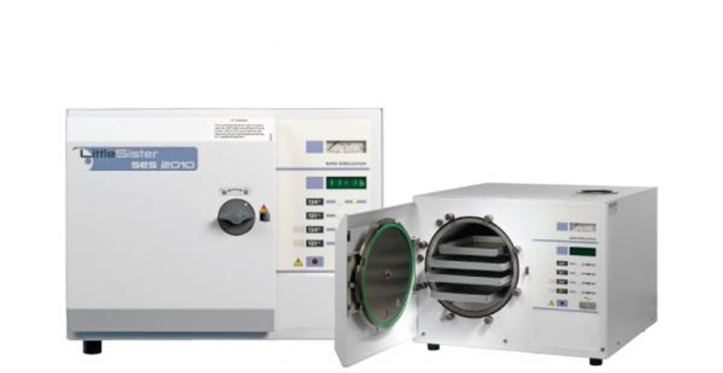
Autoclave
  Principles of operation
    function
    use
    scientific principles
  construction
    components
    system diagram
    inputs/outputs
  troubleshooting
    identifying common faults
    replacing components
    rectifying faults
  preventive maintenance
    replacing components
    calibrating
  safety considerations
    user safety
    electrical safety
  performance monitoring
    quality assurance and control

Slide 3
Autoclave: function
What is an autoclave ?
The autoclave or sterilizer is a pressure chamber used to sterilize equipment and supplies by subjecting them to high pressure, saturated steam. Sterilizing means the inactivation of all forms of life (bacteria, viruses, fungi, spores) present in inanimate objects.
Why is high pressure used ?
Because under pressure you can increase the temperature of water to higher than 100º C, destroying life quickly.

Slide 4
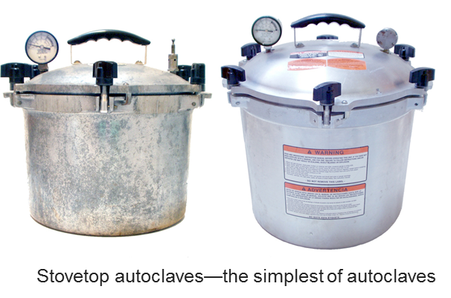
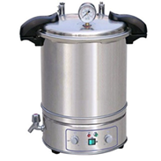
Autoclave: used in hospitals, laboratories
The autoclave or sterilizer is equipment designed with the aim of reliably eliminating microorganisms, which would otherwise be present on objects used in diagnostic or therapeutic activities in health institutions, including surgery and dentistry.
In the laboratory, materials and objects are sterilized for the following purposes:
  To prepare materials for bacteriological cell cultures (test tubes) in order to avoid their contamination.
  Prepare elements used for taking samples. (All must be in sterile conditions: needles, tubes, containers).
  Sterilize contaminated material.

Slide 5
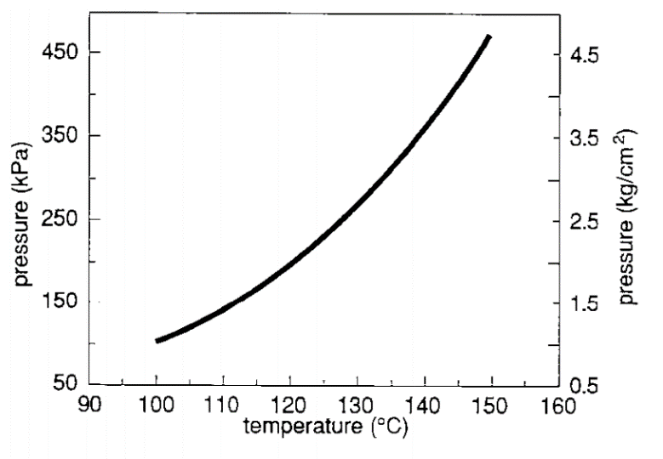
Autoclave: scientific principles
Autoclaves work by taking advantage of the thermo-dynamic properties of water. In normal conditions (at sea level and pressure of 1 atmosphere) water (in liquid phase) boils and is converted into vapour (gaseous phase) at a 100 °C.
If the pressure is reduced, it boils at a lower temperature (98.6 °C at 1250 m. altitude). If the pressure rises, it boils at a higher temperature.
Through the control of water vapour pressure, the autoclave can, in its sealed chamber, reach temperatures higher than 100 °C; or inversely, by controlling the temperature, can achieve pressures greater than atmospheric pressure.
Fixed relation between steam pressure and temperature

Slide 6
Operation of the autoclave
1. Turn the autoclave ON.
2. Open the door of the autoclave. In large capacity autoclaves, this process is done electromechanically.
3. Place the sterilization containers with the prepared material (cleaned, washed, dried) into the sterilization chamber.
4. Close the door of the autoclave.
5. Select the required sterilization cycle depending on the type of objects or materials to be sterilized.

Slide 7
Operation of the autoclave
From this moment on, the process proceeds as indicated next:
  The pre-treatment phase is initiated. In this phase, short alternate cycles of emptying and injecting of vapour into the sterilization chamber are performed so that air is extracted from it and packets protecting the material are sterilized.
  b) When the air has been removed, filling and pressurization of the sterilization chamber is initiated. At this time, the vapour enters into contact with objects to be sterilized and a process of heat transference is initiated between high temperature vapour and articles to be sterilized. Upon transferring thermal energy, a portion of vapour is converted into liquid water (condensed liquid) in the exterior layers of the material used for packing, simultaneously decreasing its volume in a significant way. More vapour can then enter the sterilization chamber, which penetrates even further inside the packages to be sterilized. Vapour eventually completely surrounds these and the pressure and temperature are established.

Slide 8
Operation of the autoclave
  c) Once these conditions are attained, the countdown for completing the sterilization (depending on the type of objects or materials being processed) is initiated. The higher the temperature and pressure, the lesser the time required for sterilizing.
  d) Once the programmed sterilization time has ended, post treatment process is initiated. This includes depressurization of the chamber .
  e) Finally, controlled entry of air through valves with high efficiency filters will be allowed until the pressure in the sterilization chamber is equal to the atmospheric pressure.
  7. Open the door of the autoclave.
  8. Unload the sterilized material.
  9. Close the door once the sterilized material is unloaded to conserve the heat
  in the sterilization chamber and facilitate the next sterilization cycle.
  10. Store the sterilized material appropriately.

Slide 9
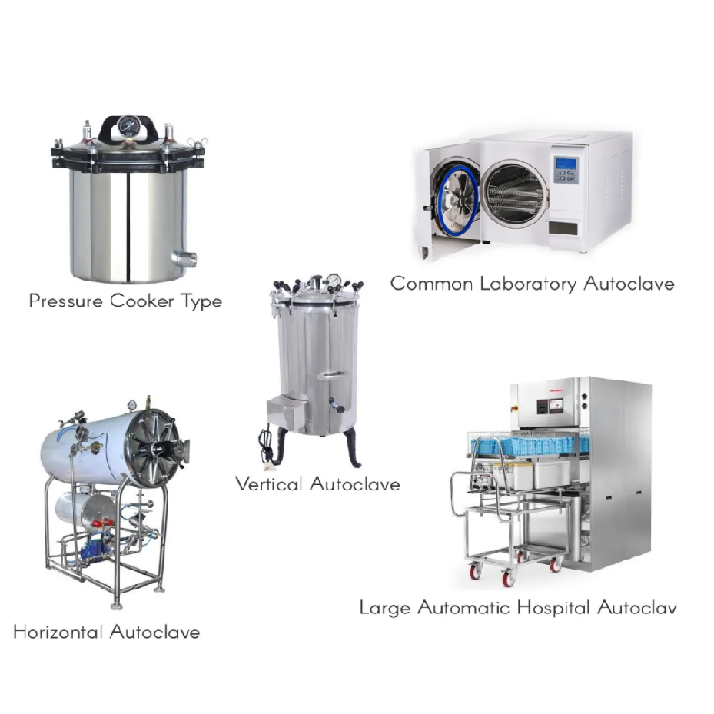
Autoclave: Construction
Autoclaves are available in many sizes. The smallest are the table-top type and the largest are complex equipment that require a great amount of pre-installation for their operation. The volume of the sterilization chamber is taken as a reference in litres [l] in order to measure the autoclave’s size.
.

Slide 10
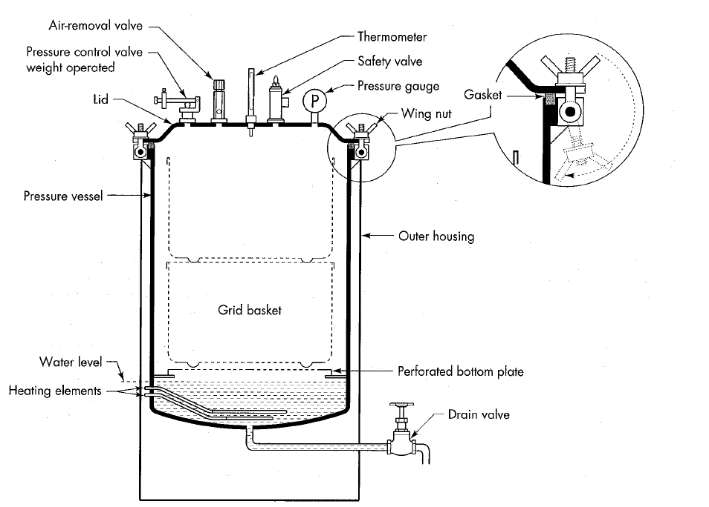
Autoclave: Construction

Slide 11
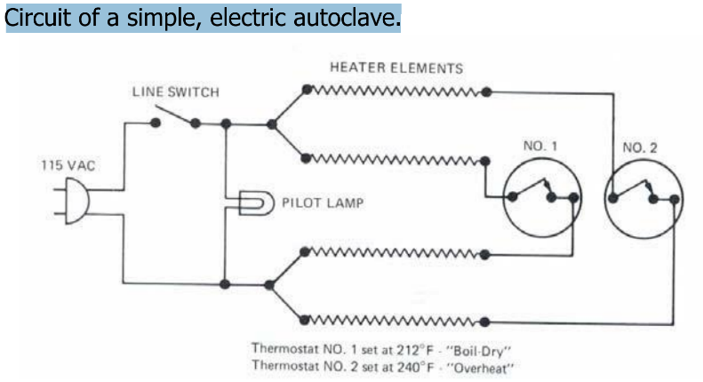
Autoclave construction: thermostats
There are often two thermostats.
One is a boil-dry safety thermostat connected in series with one of the elements and set to open at 100 ⁰C. This will reduce the violence of boiling once 100 ⁰C is reached.
The second thermostat, often called the overheat relay, is set to turn off the electricity going to the nicrome elements when the temperature is excessive, usually meaning that the water has boiled away.

Slide 12
Autoclave: Trouble shooting
If you hear a hissing noise, then there is a leak in the pressure vessel or valve.
Try to isolate the problem by looking for steam escaping and by using your ear. If the problem is a valve, you probably need to replace the valve. If the problem is the vessel, it is impossible to fix and the autoclave should be discarded.
The seal on the vessel is also a common source of leaks. Check to see that there are no obstructions (dirt, or scale build up) along the seal. Some machines use a plastic or rubber seal. For these machines, run your fingernail into the seal. It should be pliable. If the seal is hard, or worse cracked, then it must be replaced.

Slide 13
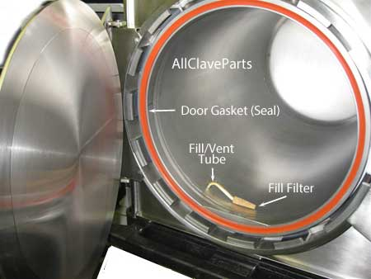
Autoclave: Trouble shooting
Several types of seals and gaskets are used in the construction of the autoclave, from door seals to generator gaskets. Made from quality grade silicone, these seals keep moisture from escaping the autoclave, as well as protecting the contents from the outside atmosphere.

Slide 14
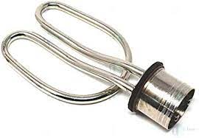
Autoclave: Trouble shooting
If the seals are working and there are no leaks or clogs, the manual autoclave should work.
The automatic autoclave may still not reach the proper temperature. The cause may be the thermostat or the heating element. In the most sophisticated autoclaves, the controller can be suspected.
If there is no heat generated, it could be the heating element or the thermostats. The typical heating element consists of two coils of nickel-chrome resistance wire, each of which has approximately 14 ohms of resistance. If the resistance across a coil is significantly higher, it is probably broken.

Slide 15
Autoclave: Preventive maintenance
Clean the sterilization chamber drainage filter.
2. Clean the inside of the sterilization chamber using cleaning products.
3. Clean with an acetified solution, if solutions with chlorine are being sterilized. The chlorine causes corrosion even on stainless steel implants.
4. Clean the external rust-proof surfaces with a mild detergent.
5. In autoclaves with manually activated doors, verify that these mechanisms are well adjusted and that their operation is smooth.
6. Drain the vapour generator (if the equipment has one). To do this, open a valve located on the lower part of the generator which allows its contents to be drained.

Slide 16
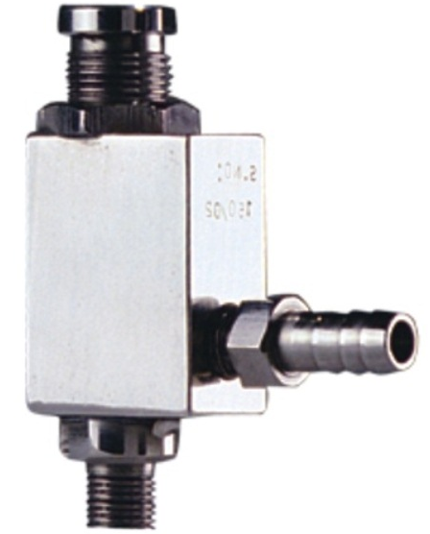
Autoclave: Safety considerations
Autoclaves can injure the operator or leave the equipment undetectably contaminated.
Therefore, testing should be done before releasing the device for use.
If possible, check the temperature inside the vessel during sterilization. Most US hospital users put test strips with each sterilization pack. These strips verify that the temperature reached the required level for the required time and that humidity was present.
Check the safety valve on the vessel. If it is dirty or corroded, try to replace it

Slide 17

Autoclave: Performance Monitoring
Sterilization bags often have a "sterilization indicator mark" that typically darkens when the bag and its contents have been adequately processed. There are physical, chemical, and biological indicators that can be used to ensure that an autoclave reaches the correct temperature for the correct amount of time.
Chemical indicators on medical packaging and autoclave tape change color once the correct conditions have been met, indicating that the object inside the package, or under the tape, has been appropriately processed. Autoclave tape is only a marker that steam and heat have activated the dye.
A Bowie-Dick device is also used to verify a full cycle. This contains a full sheet of chemical indicator placed in the center of a stack of paper. It is designed specifically to prove that the process achieved full temperature and time required for a normal minimum cycle of 274 degrees F for 3.5-4 minutes.
To prove sterility, biological indicators are used. Biological indicators contain spores of a heat-resistant bacterium. If the autoclave does not reach the right temperature, the spores will germinate when incubated and their metabolism will change the color of a pH-sensitive chemical.

Slide 18


