Slide 1
Al-Mustaqbal University
Biomedical Engineering Department
Class: 3th
Subject: Biomedical Instrumentation Lab
Lecturer: M.SC. ZAINAB SATTAR JABBAR
1st term – Lect. 6: The Digestive System
Email: zainab.sattar.jabbar@uomus.edu.iq

Slide 2
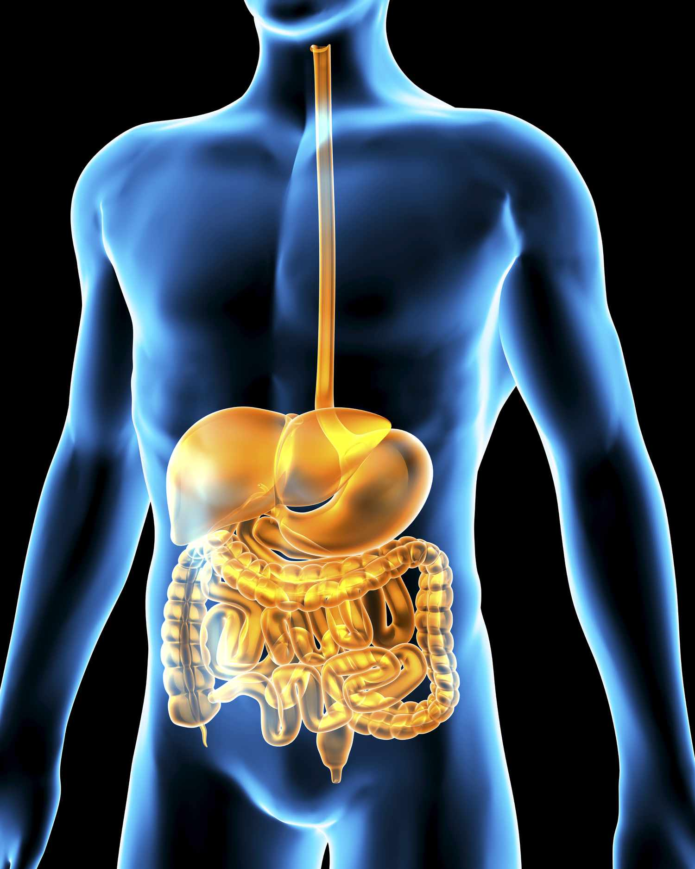
The digestive system
The digestive system contributes to homeostasis by transferring nutrients, water, and electrolytes from the external environment to the internal environment.
Ingested food is essential as an energy source, or fuel, from which the cells can generate adenosine triphosphate (ATP) to carry out their particular energy-dependent activities, such as active transport, contraction, synthesis, and secretion.

Slide 3
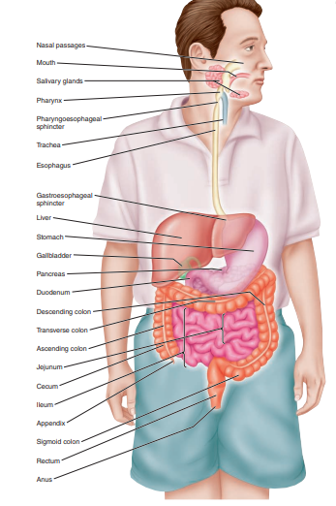
Component of digestive system
The digestive system consists of the gastrointestinal tract (GIT) or (Alimentary canal) and accessory organ.
Alimentary canal: include mouth, pharynx, esophagus, stomach, small intestine, and large intestine.
Accessory digestive organs: teeth, tongue, gallbladder, salivary glands, liver, and pancreas.
Digestion: Refer to All those processes involved in breaking down large, complex, insoluble molecules into simple, soluble so that these substances can be absorbed quickly into the blood for transport to the cells that utilize them.

Slide 4
Functions of Digestive System
The primary function of the digestive (gastrointestinal or GI) system (gastro means “stomach”) is to transfer nutrients, water, and electrolytes from the food we eat into the body’s internal environment.
There are six basic digestive processes:
Ingestion (Motility): taking food into the digestive tract.
Secretion: The digestive system produces both exocrine and endocrine secretions.
Propulsion : swallowing and peristalsis movement.
Digestion: Mechanical, chewing, mixing, and churning food. Chemical, catabolic breakdown of food.
Absorption: In the small intestine, digestion is completed and most absorption occurs.
Defecation: elimination of indigestible solid wastes.

Slide 5
Histology of the Alimentary Canal
From the esophagus to the anal canal, the walls of the GI tract have the same four compositions:
Mucosa: which secretes gastric juices, absorbs nutrients, and protects the tissue through mucus production. It consists of a single layer of epithelial tissue attached to the lamina propria (a layer of connective tissue).it consist from three layers (mucous membrane, lamina propria , muscularis mucosa).
Submucosa: holds blood, lymphatic, and nervous tissues that serve to nourish, protect, and communicate.
Muscularis layer: consists of circular and longitudinal muscle that contract and relax and make a wavelike movement termed peristalsis.
Serosa: is the outermost layer, which consists of connective tissue covered by squamous epithelium.

Slide 6
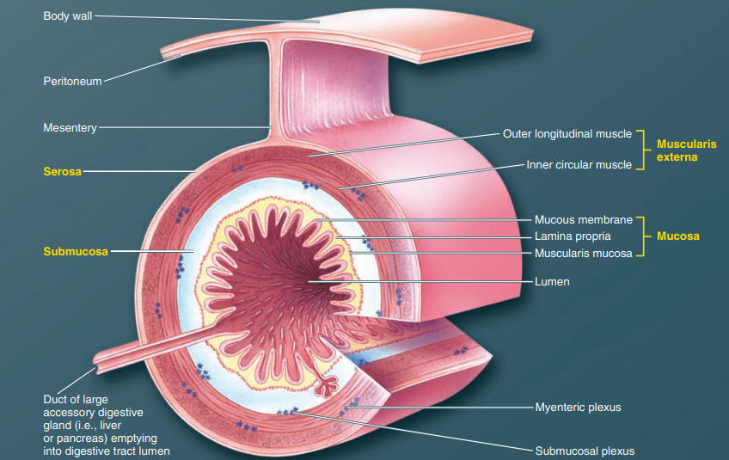
Histology of the Alimentary Canal

Slide 7
Mouth
Digestion in the mouth is minimal; no absorption of nutrients occurs.
The oral cavity is the entrance to the digestive tract.
The opening is formed by the muscular lips, which help in guide and contain the food in the mouth.
The first step in the digestive process is chewing, the mouth motility that involves the slicing, tearing and mixing of ingested food by the teeth.
The tongue, which forms the floor of the oral cavity, is composed of voluntarily controlled skeletal muscle. The tongue guides food within the mouth during chewing and swallowing and also plays an important role in speech.
The saliva, the secretion associated with the mouth, is produced largely by three major pairs of salivary glands that lie outside the oral cavity and discharge saliva through short ducts into the mouth.

Slide 8
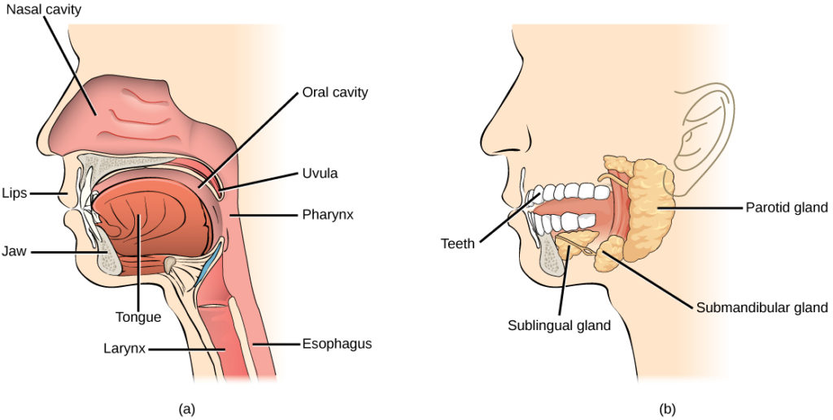
Mouth

Slide 9
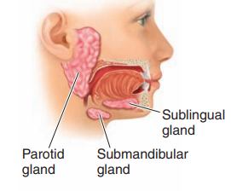
Salivary glands
Three pairs of salivary glands empty their secretions into the mouth:
The parotid glands (large glands lies anterior to the ear).
The submandibular gland.
Small sublingual gland.
The function of salivary glands is to secrete saliva into the floor of the mouth. 1.0 - 1.5 liters of saliva secreted per day:
25% by parotid glands,
5% by sublingual glands, and
70% by submandibular glands.
The salivary glands are controlled by the two divisions of the autonomic nervous system, the sympathetic and the parasympathetic.

Slide 10
Function of saliva
Contain bactericidal agents to cleanses the mouth.
Facilitate swallowing.
Contains amylase enzymes that break down starch.
Aid speech by facilitating the movement of the lips and tongue.
The saliva PH ranges between 6-7, which helps neutralize gastric acid and relieve heartburn when regurgitation from the stomach to the esophagus.

Slide 11
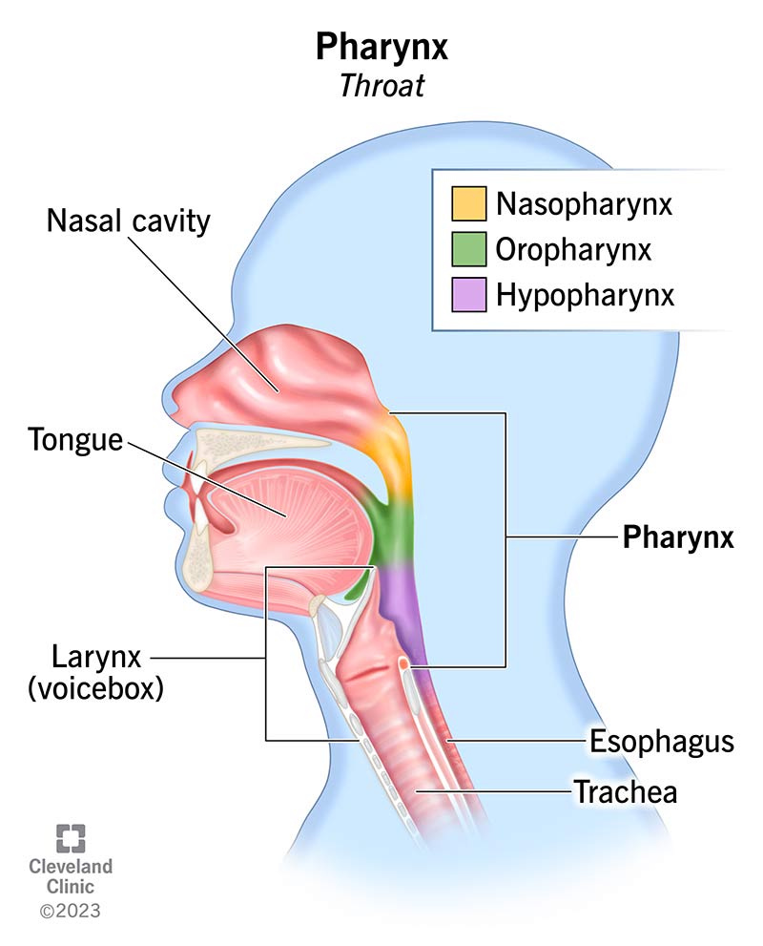
Pharynx
The pharynx is the cavity at the rear of the throat. It acts as a common passageway for both the digestive system (by serving as the link between the mouth and esophagus, for food) and the respiratory system (by providing access between the nasal passages and trachea, for air).
It can be divided into three main parts:
The nasopharynx.
The oropharynx.
The hypopharynx.
The pharynx has two skeletal muscle layers lined with stratified squamous epithelium and allows passage of food and fluids to the esophagus and air to the trachea.

Slide 12
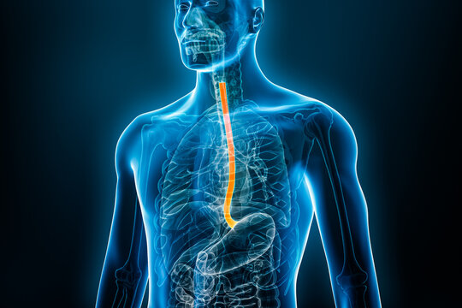
Esophagus
The esophagus is a muscular tube going from the laryngopharynx to the stomach. Travels through the diaphragm, join the stomach at the cardiac orifice, guarded by the gastro-esophageal sphincter or the cardiac sphincter. It transports food to the stomach.

Slide 13
The stomach
The stomach is a J-shaped saclike chamber lying between the esophagus and the small intestine.
The stomach lies below the diaphragm in the upper left region of the abdominal cavity.
It is divided into four sections based on structural and functional distinctions:
Cardia is beginning portion of the stomach that is attached to the esophagus.
The fundus is the part of the stomach that lies above the esophageal opening.
The middle or main part of the stomach is the body.
The narrow portion that is connected to the small intestine is called the pyloric region or pylorus
A sphincter called the pyloric sphincter controls substances from the pyloric region of the stomach into the small intestine.

Slide 14
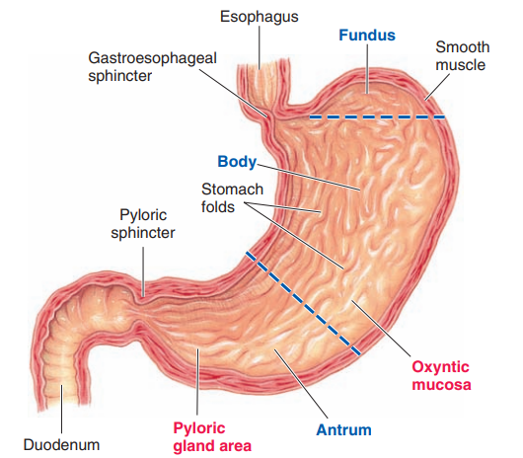
The stomach

Slide 15
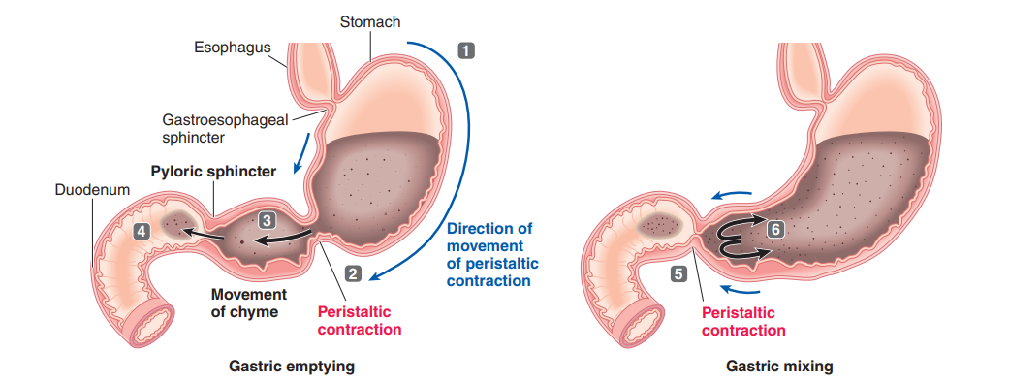
Functions of the stomach
Receive food from the esophagus, mix food with gastric juice.
The stomach’s most important function is to store ingested food until it can be emptied into the small intestine at a rate appropriate for optimal digestion and absorption.
The stomach secretes hydrochloric acid (HCl) and enzymes that begin protein digestion.
Move food into the small intestine.

Slide 16
Small Intestine
The small intestine is the site where most digestion and absorption takes place.
The small intestine lies coiled within the abdominal cavity, extending between the stomach and the large intestine.
Receives bile and pancreatic juice through the pancreatic duct to aid in digestion
It is divided into three segments—the duodenum, the jejunum, and the ileum.
The duodenum, the shortest part, is where preparation for absorption through small finger-like lumps called villi.
The jejunum is specialized for the absorption of small nutrient particles previously digested by enzymes in the duodenum through its lining by enterocytes.
The primary function of the ileum is to absorb vitamin B12, bile salts, and whatever products of digestion were not absorbed by the jejunum.

Slide 17
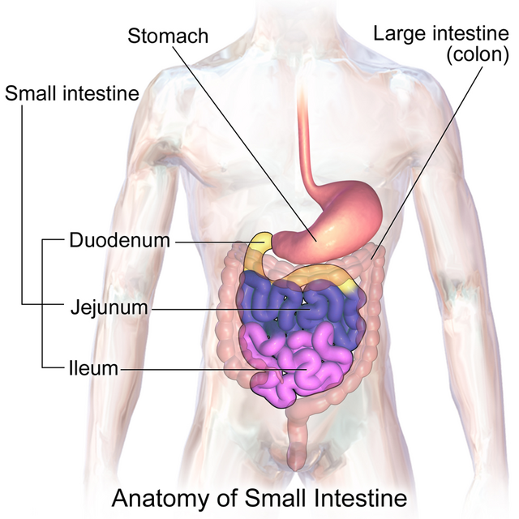
Small Intestine

Slide 18
Large Intestine
The large intestine, also known as the large bowel, is the last part of the gastrointestinal tract and the digestive system in humans. Water is absorbed here, and the remaining waste material is stored as feces before being removed by defecation.
The large intestine consists of the colon, cecum, appendix, and rectum.
The colon is the largest portion of the large intestine. The colon composition of the ascending colon, transverse colon, and then descending to the rectum and its endpoint at the anal canal.

Slide 19
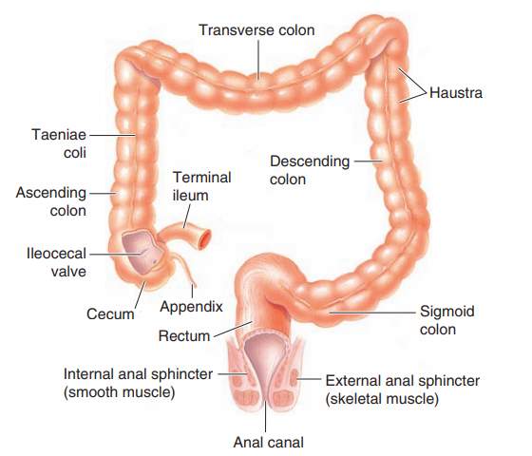
Large Intestine

Slide 20
Functions of Large Intestine
Absorptions of less than 10% of the nutrients in the large intestine.
Large intestine prepares fecal material for ejection from the body.
Reabsorption of water and other substances such as bile salts, vitamins, toxins of bacteria.
Bacteria in the colon produce three vitamins:
Vitamin K.
Biotin.
Vitamin B5..

Slide 21
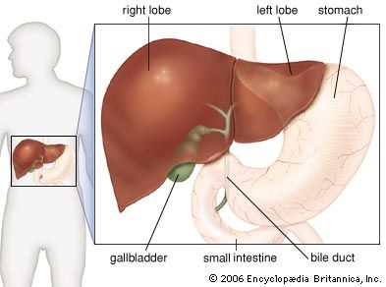
Liver
The biliary system includes the liver, the gallbladder, and associated ducts.
Liver Functions The liver is the largest and most important metabolic organ in the body; it can be viewed as the body’s major biochemical factory. Its functions include the following:
Formation and secreted of bile.
Nutrients and vitamin metabolism.
Inactivated some substances (toxins, steroid, and other hormones).
Synthesis of plasma proteins.
Contributes with immunity.

Slide 22
Gall bladder
The gall bladder is a small sac.
The function of gall bladder:
Storage of bile.
Produces bile that leaves the liver through the common hepatic duct and enters the duodenum through the common bile duct.
Bile is a yellow-to-green watery solution containing bile salts, bile pigments, cholesterol, phospholipids, and various electrolytes.
Bile Functions: Bile secretion contain bile salts and phospholipids, which break the fat, in the process called "Emulsification."

Slide 23
Pancreas
The pancreas is an organ of the digestive system and endocrine system. The pancreas has both an endocrine and an exocrine digestive function. It mainly regulates blood sugar levels as an endocrine gland, secreting the hormones insulin, glucagon, somatostatin, and pancreatic polypeptide.
Exocrine tissue (pancreatic acini):
Secrete pancreatic digestive enzymes.
The pancreatic enzymes secreted into the duodenum are alkaline fluid (pH 8), which neutralizes the acidic chyme coming from the stomach.
The acini glands of the exocrine pancreas produce 1-1.5 L of pancreatic juice daily.
Pancreatic juice consists of the following enzymes:
Amylase: which digests carbohydrates.
Lipase: which digests of fat.
Trypsin, chymotrypsin, digests protein

Slide 24
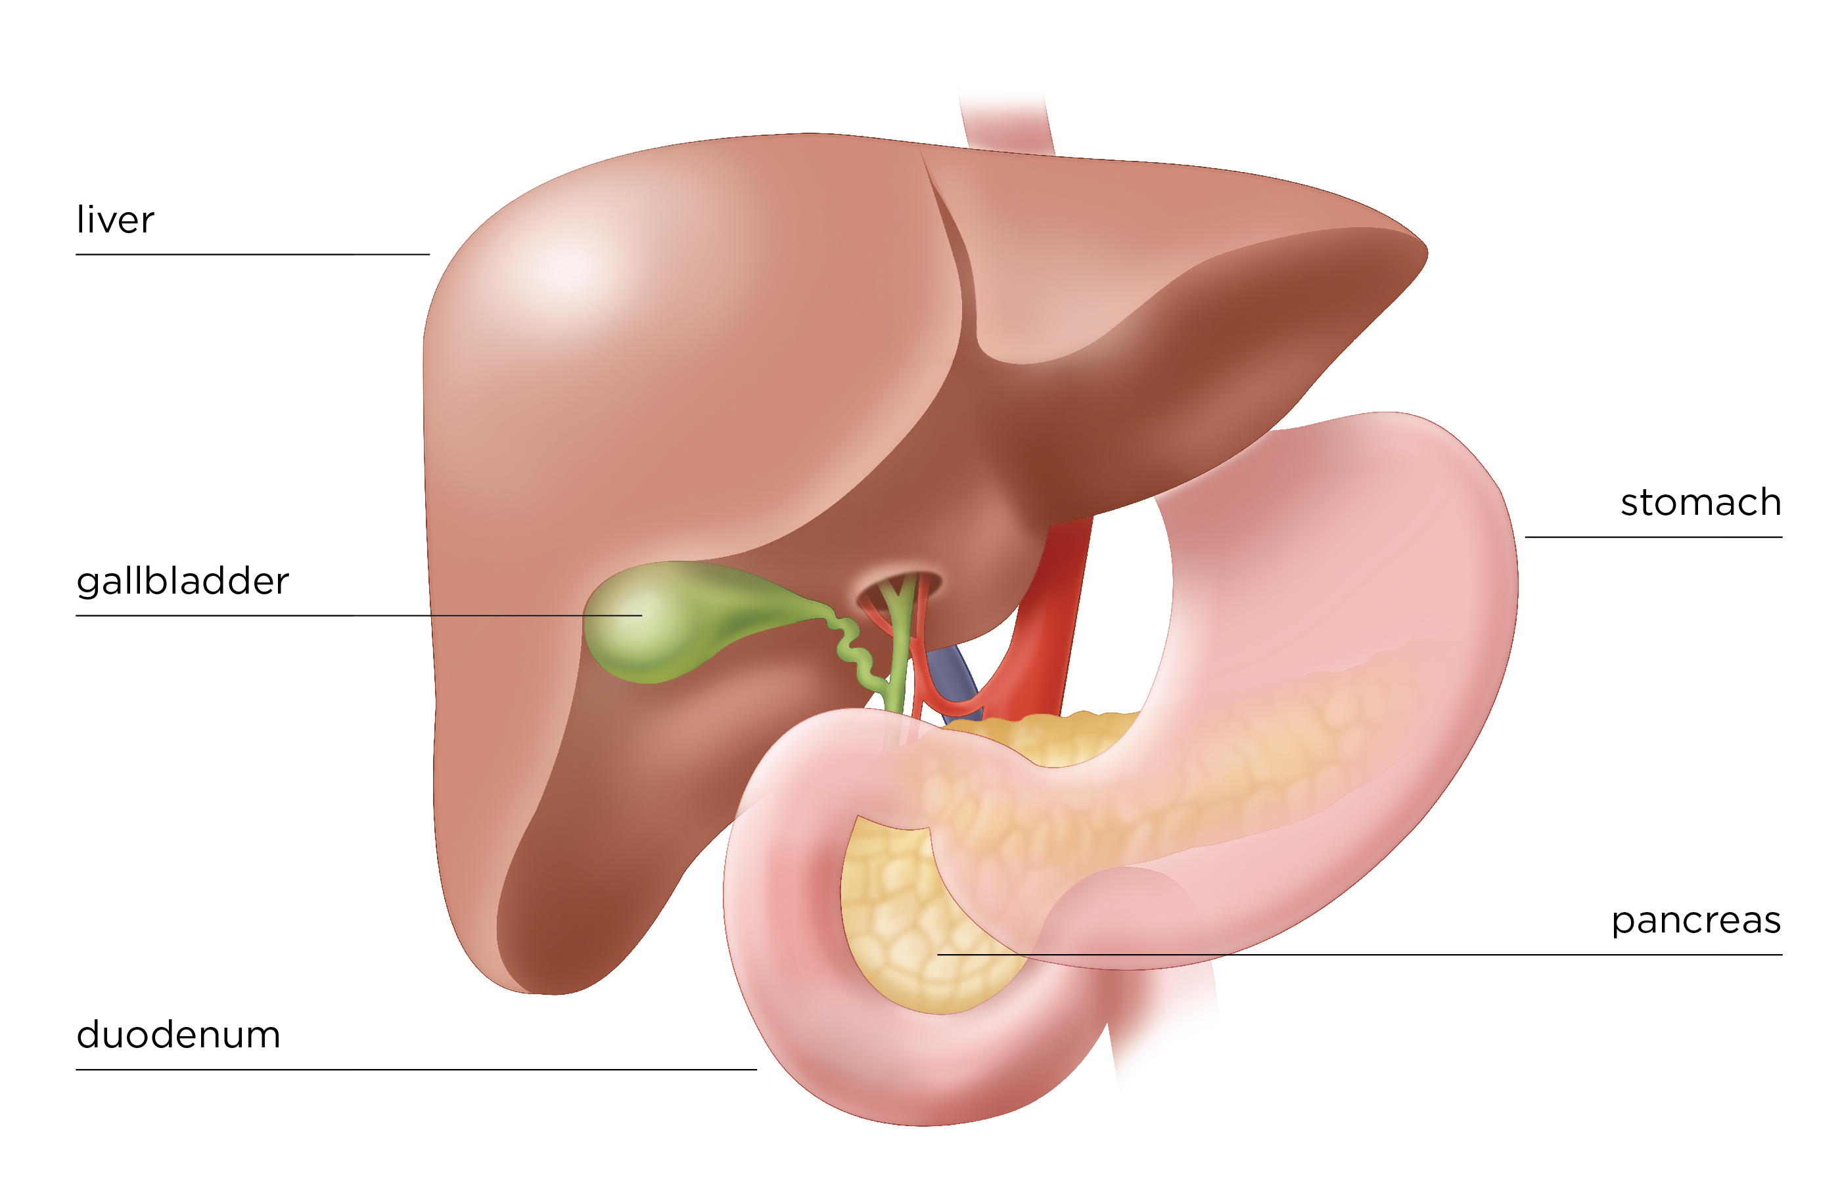
Pancreas

Slide 25


