Slide 1
Al-Mustaqbal University
Biomedical Engineering Department
Class: 4th
Subject: Clinical issues of BME
Lecturer: M.SC. ZAINAB SATTAR JABBAR
1st term – Lect. 7: Medical imaging
Email: zainab.sattar.jabbar@uomus.edu.iq

Slide 2
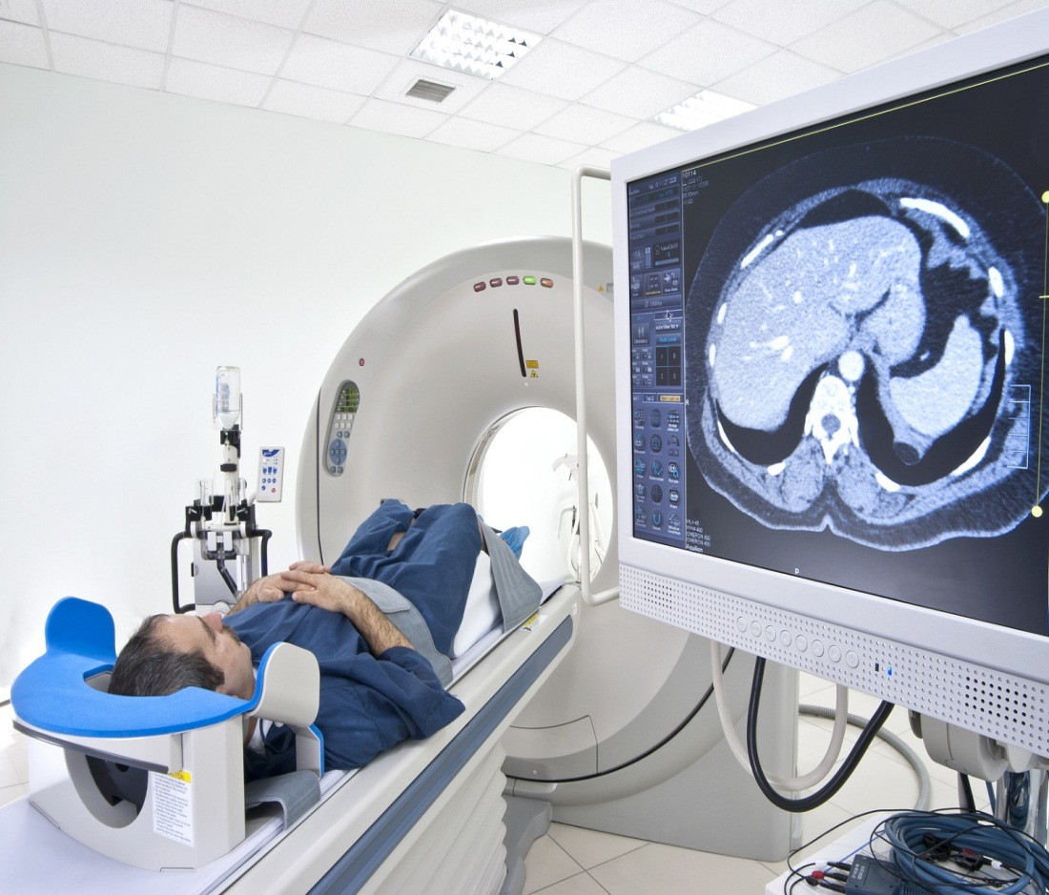
Medical imaging
Medical imaging is the technique and process of imaging the interior of a body for clinical analysis and medical intervention, as well as visual representation of the function of some organs or tissues.

Slide 3
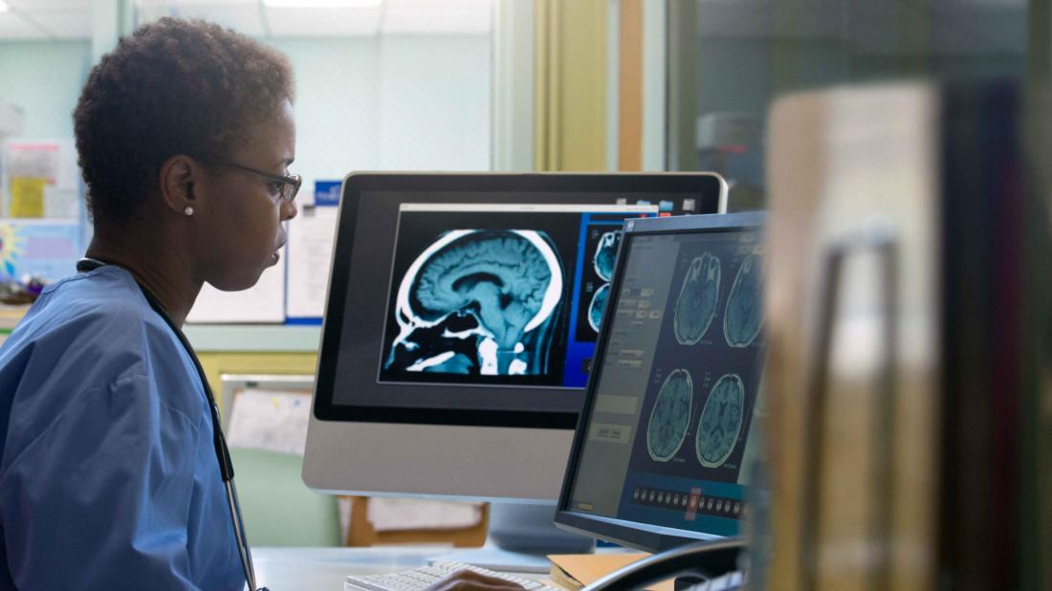
Radiologist
Radiologists are medical doctors that specialize in diagnosing and treating injuries and diseases using medical imaging (radiology) procedures (exams/tests) such as X-rays, computed tomography (CT), magnetic resonance imaging (MRI), nuclear medicine, positron emission tomography (PET) and ultrasound

Slide 4
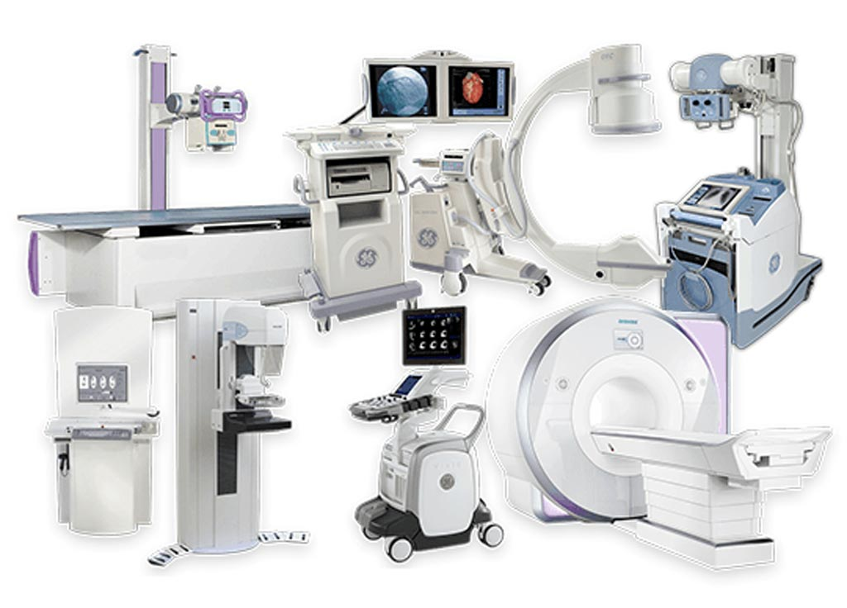
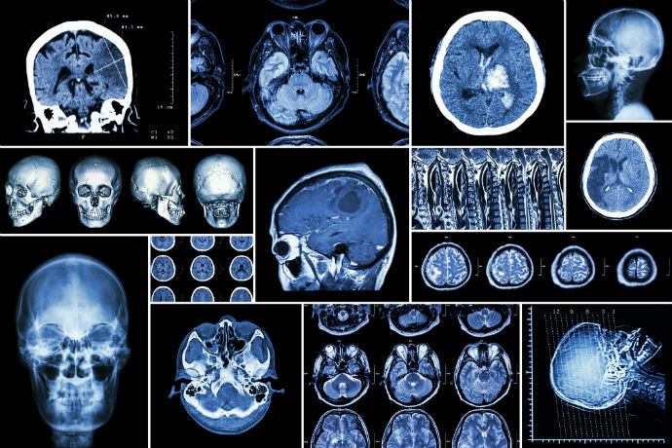
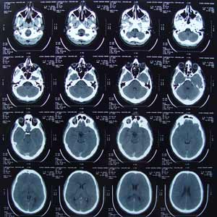
Medical imaging
OUTPUT
GE heaithcare
Simense
Philps
Etc…

Slide 5
Digital Imaging and Communications in Medicine (DICOM)
What is DICOM?
DICOM (Digital Imaging and Communications in Medicine) is an international standard protocol for all medical data exchanges. It also defines the file format, which is mostly either a DCM or DCM30 (DCM3.0) file extension.
DICOM ensures that all the medical equipment installed in clinics, medical imaging center, and hospitals will work together and distribute the medical images correctly.

Slide 6
Digital Imaging and Communications in Medicine (DICOM)
DICOM (Digital Imaging and Communications in Medicine) is use for transmitting, storing, and sharing medical imaging data.
For biomedical engineers, DICOM is fundamental in ensuring seamless communication between various medical imaging modalities (CT, MRI, X-ray, ultrasound, PET, etc.) and other healthcare systems. Understanding DICOM is crucial for the development, implementation, and optimization of medical imaging systems.

Slide 7
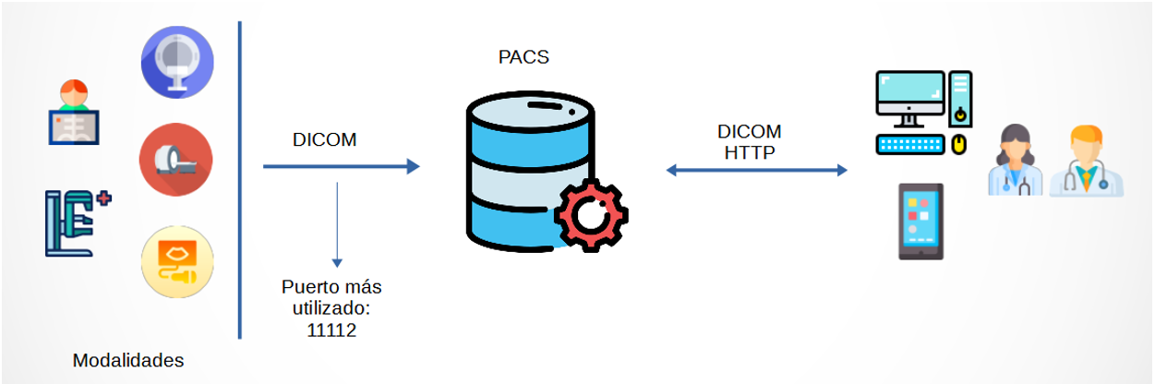

Slide 8
DICOM
DICOM has been implemented in almost every medical imaging modality like MRI, CT, X-ray, Ultrasound, etc.
DICOM has become the standard in medical imaging: today, the vast majority of digital medical imaging systems of all major vendors (including acquisition devices, diagnostic workstations, archives, servers, medical printers, etc.) support and comply with portions of the DICOM standard, depending on the services they implement. Also, DICOM has been widely accepted and adopted by medical institutions, including public and private hospitals, diagnostic centers and analysis laboratories of different sizes.

Slide 9
DICOM enables the connectivity and exchange of data between:
Image Acquisition Devices / Modalities: X-Ray, CT, MR, etc.
Diagnostic Workstations
Image Management Systems (PACS)
Storage and Archive Products
Radiology Information Systems (RIS)
Cardiology Information Systems (CIS)
Radiation Therapy Planning Systems

Slide 10
The DICOM devices
A medical device supporting and implementing the DICOM standard is defined as: a DICOM-compliant device. A “DICOM-compliant” device may be an acquisition device (e.g., CR equipment, CT equipment, MR equipment, etc.), or a workstation, or a server, or any other kind of device able to connect to the DICOM network exchange data with other nodes using the DICOM protocol. For this reason, almost all DICOM devices need to have a network interface.
DICOM devices attached to a DICOM network are often referred to also as DICOM nodes or DICOM peers.

Slide 11
Key Components of DICOM
1-DICOM Data Format
DICOM File:
A DICOM file is an image saved in DICOM format. The DICOM standard covers both the formats to be used for storage of digital medical images and related digital data, and the protocols to be adopted to implement several communication services which are useful in the medical imaging workflow.

Slide 12
DICOM file
A DICOM file consists of two main parts:
Header: Contains metadata, such as patient information, study details, and image acquisition parameters.
Pixel Data: The actual image data, which can be a 2D or 3D array depending on the imaging modality.
Attributes in Header: The header includes a wide range of attributes, such as patient ID, study date, image type, modality (e.g., CT, MRI), and spatial resolution.
Data Elements: Each data element in the header consists of a tag (a unique identifier), a value representation (the data type), and the value itself.

Slide 13
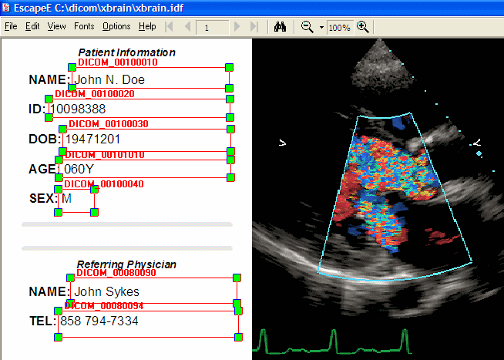
DICOM file

Slide 14
Key Components of DICOM
2-DICOM Communication Protocols
DICOM Services: DICOM supports various services that allow devices to exchange information. These include:
Storage Service (C-STORE): Transmitting images from one system to another.
Retrieve Service (C-FIND, C-MOVE): Retrieving the database and retrieving specific images or records.
Print Service (C-PRINT): Printing images on paper or other media.
Worklist Service (C-WORKLIST): Managing imaging studies and procedures.
Modality Worklist: A predefined list of imaging exams for a patient, including details such as examination instructions.

Slide 15
Key Components of DICOM
3-The DICOM network
Is the data network connecting DICOM-compliant devices within a medical institution or department. Normally, the DICOM network is a standard Local Area Network (LAN). Hence, the typical network interface of DICOM-compliant devices is a common Ethernet interface. This makes it particularly convenient to connect common PCs with dedicated DICOM-compliant software to a DICOM network.
The performance and safety of a DICOM network are quite critical, considering the kind and volume of data which are transferred through it. In fact, these data may include large and numerous diagnostic images, patient and exam information, diagnostic reports, etc.
For this reason, many medical institutions choose to build a dedicated, isolated and high-performance network as their DICOM network, separating it from the usual internal Local Area Network used for instance to exchange administrative data and files.

Slide 16
Key Components of DICOM
4-DICOM Conformance
DICOM Conformance Statement: Each vendor marketing a DICOM-compliant device is required to provide a for that device. the DICOM Conformance Statement is a document having a well-defined format (which is also specified by the DICOM standard itself) describing which DICOM services the device implements, which optional portions of those services are supported by the device, plus some details about the specific implementation of those services by the vendor. Each DICOM-compliant device or software includes a conformance statement that outlines the supported services, data formats, and protocols.
DICOM Versions: Over time, the DICOM standard has evolved with multiple versions. It is important to ensure that all devices are using compatible versions to prevent communication issues.

Slide 17

DICOM viewer
What is a DICOM viewer?
DICOM viewing software allows radiology trainees and consultants to view and manipulate medical images (such as radiographs or MRI scans) on their own PC, laptop or tablet.
MicroDicom is a free DICOM viewer and editor for Windows. It can open DICOM images produced by medical equipment (MRI, PET, CT, ...). It can also possible to open other image formats - BMP, GIF, JPEG, PNG, TIFF, etc.
This program is available for Windows free and can be downloaded directly to the computer.

Slide 18
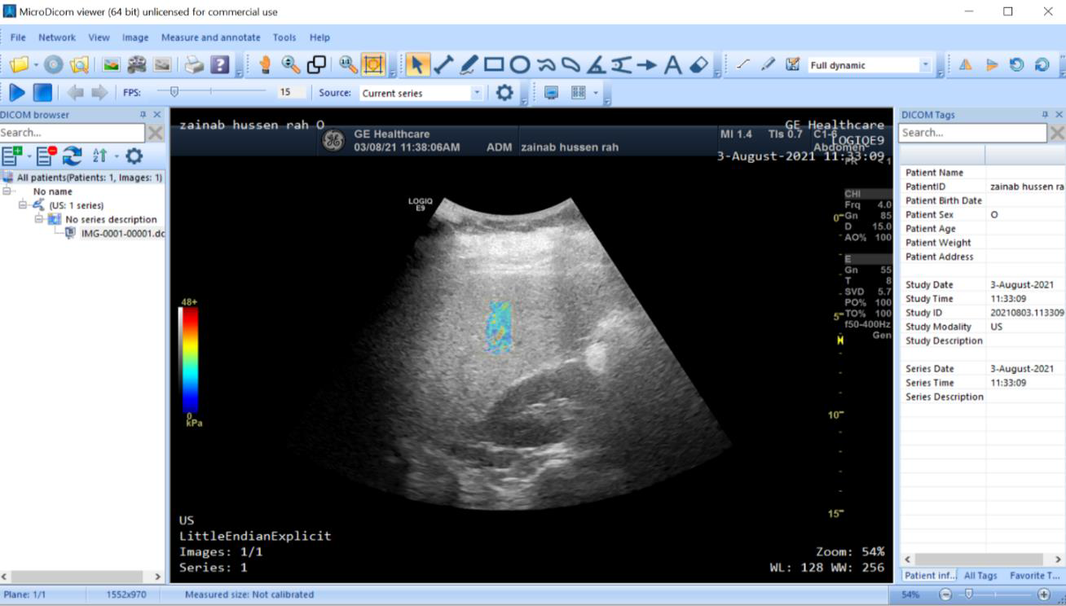
Microdicom viewer

Slide 19
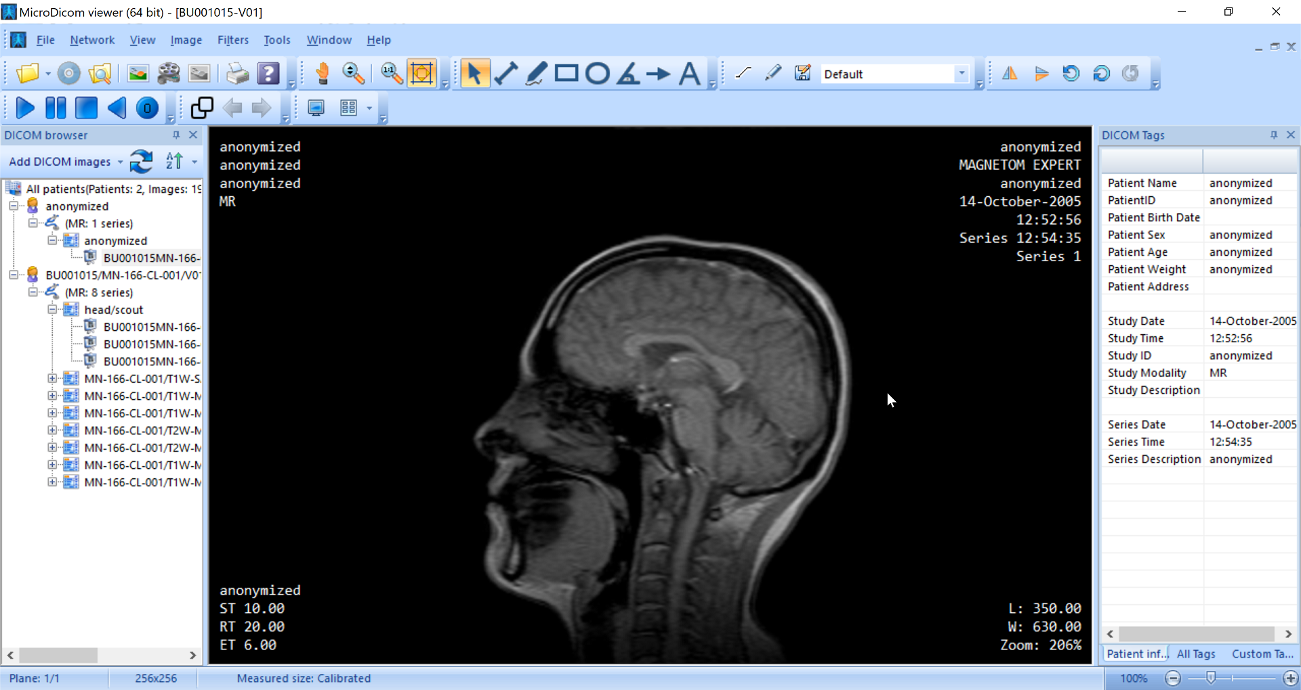
Microdicom viewer

Slide 20
DICOM for Biomedical Engineering
Biomedical engineers work at the intersection of medical imaging technology and healthcare, and understanding DICOM is essential for designing, maintaining, and optimizing imaging systems. Here’s how DICOM applies to biomedical engineering:
System Integration:
Biomedical engineers often integrate multiple imaging devices (e.g., CT, MRI, ultrasound) into a single network. DICOM enables this by providing a common language that all devices can understand, making it easier to link different modalities to hospital information systems (HIS) and picture archiving communication systems (PACS).
Integration of DICOM with Radiology Information Systems (RIS) and Electronic Health Records (EHR) is key to ensuring patient data flows seamlessly across the healthcare ecosystem.

Slide 21
DICOM for Biomedical Engineering
Quality Control and Validation:
Biomedical engineers are responsible for ensuring that medical imaging systems perform optimally and safely. DICOM plays a role in this by allowing engineers to monitor the integrity of image data, validate image quality, and ensure that DICOM communication protocols are working correctly.
DICOM compliance testing is an ongoing task, particularly when new devices are added to a network. Engineers often need to verify that devices comply with DICOM standards and communicate effectively with each other.

Slide 22
DICOM for Biomedical Engineering
Data Analysis and Processing:
DICOM provides a framework for storing and sharing complex medical image data, which can be processed and analyzed. Biomedical engineers often work with image processing software to manipulate or enhance DICOM images for diagnostic purposes.
DICOM tags are critical in this context, as they allow engineers and clinicians to identify crucial metadata such as acquisition parameters (e.g., scan type, slice thickness) that influence how images should be processed or interpreted.

Slide 23
DICOM for Biomedical Engineering
Customization and Development:
Biomedical engineers working in research and development may need to build custom applications that interact with DICOM-compliant imaging systems. This could involve designing software for specific image processing tasks, developing interfaces to DICOM servers, or implementing new DICOM services.
The open nature of the DICOM standard means engineers can extend its capabilities, including developing new modules for handling non-standard data or creating custom views of medical images for specialized applications..

Slide 24
Challenges and Opportunities in DICOM for Biomedical Engineers
1-Interoperability: While DICOM is a standard, various devices and systems may interpret or implement it differently. Biomedical engineers often face challenges in ensuring that different manufacturers' equipment can communicate seamlessly. This can require additional effort in configuration, testing, and troubleshooting.
2-Big Data and Imaging: Medical imaging produces large volumes of data, especially with high-resolution images and 3D/4D datasets. Biomedical engineers need to handle data storage, management, and transfer efficiently, ensuring that DICOM systems are optimized for scalability and fast data retrieval.

Slide 25
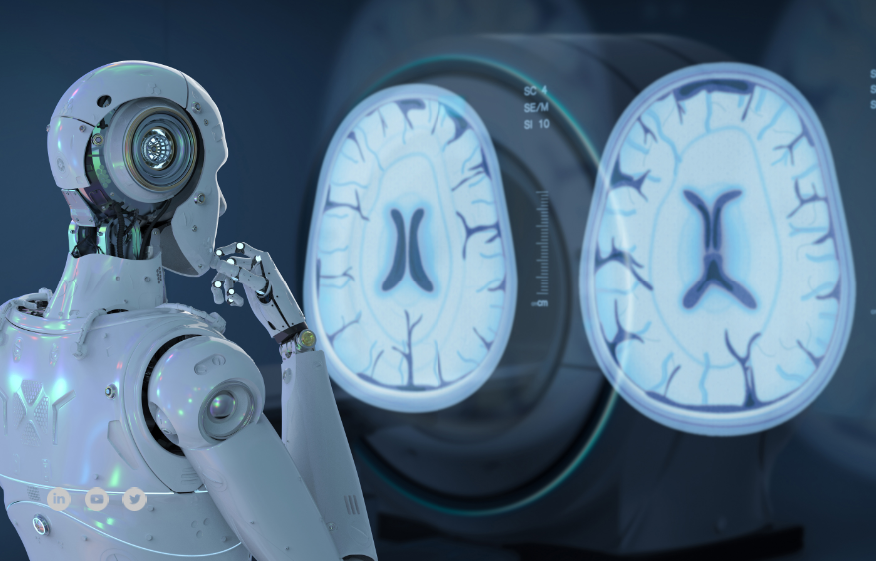
Challenges and Opportunities in DICOM for Biomedical Engineers
3-Artificial Intelligence in Imaging:
With AI and machine learning playing a larger role in medical imaging, biomedical engineers may be tasked with integrating AI algorithms into DICOM-compliant systems, ensuring that image data can be processed, analyzed, and shared using the DICOM standard.

Slide 26

Challenges and Opportunities in DICOM for Biomedical Engineers
DICOM is an essential component in modern medical imaging systems. Biomedical engineers who understand the DICOM standard can contribute to improving interoperability, enhancing image quality, developing innovative imaging solutions, and ensuring data security in healthcare environments. As medical imaging technologies continue to evolve, so too will the role of DICOM in facilitating communication and data management across the healthcare landscape.

Slide 27


