Slide 1


Al-Mustaqbal University.
College of Engineering and Engineering Technologies.
Biomedical Engineering Department.
Subject: Biomedical Instrumentation Lab.
Class (code): 5th
Lecture: 1
By: M.SC. Zainab Sattar Jabbar
BME

Slide 2
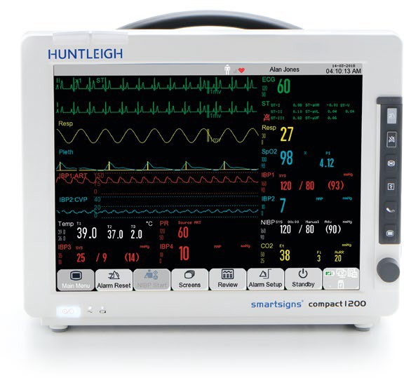
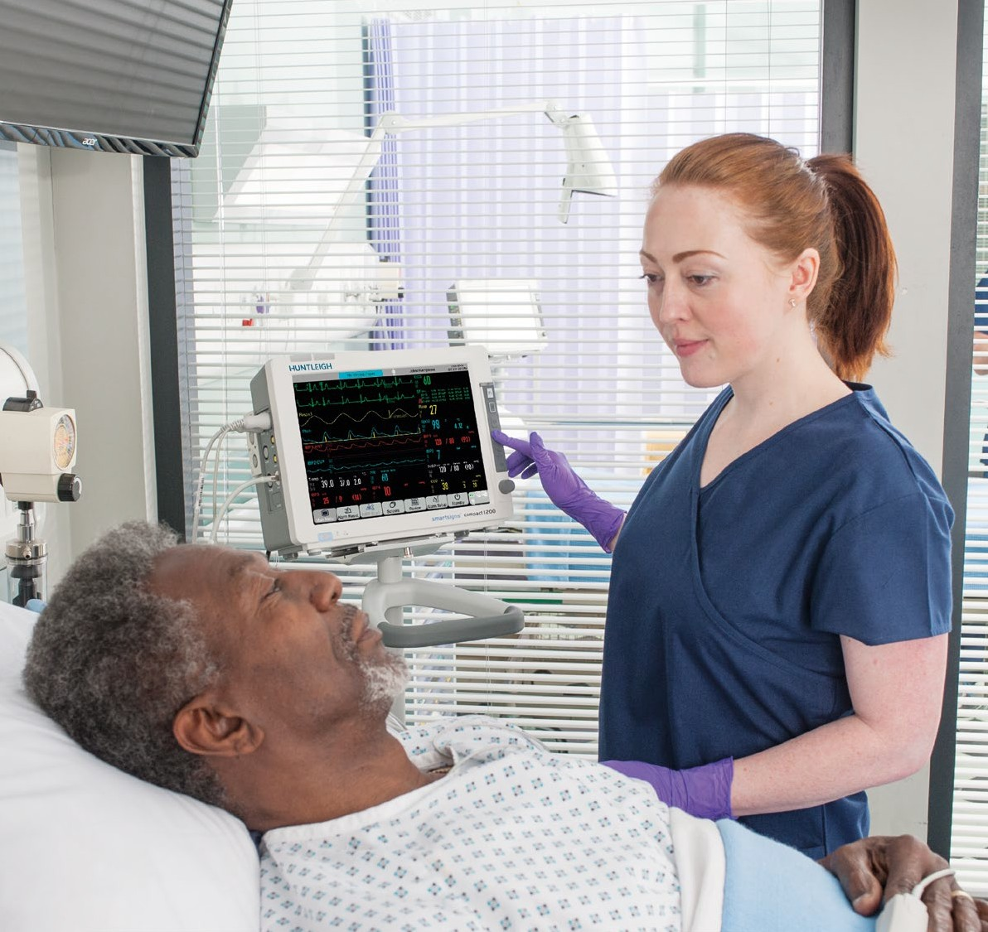
Patient monitoring systems

Slide 3
Overview
Patient monitor is a very critical monitoring system, it is used for monitoring physiological signals including electrocardiogram, respiration, blood pressure, oxygen saturation in human blood, body temperature.
Multiple sensor and electrodes is used for receiving physiological signals like as ECG electrodes, SPO2 finger sensor, blood pressure cuff and temperature probe to measure the physiological signals.

Slide 4
purpose
The patient monitor is one of the most popular medical instruments in clinical applications, and it is the necessary equipment for the emergency department, operating room, and ICU.
In addition to measuring and monitoring the patient’s physiological parameters, the patient monitor can also monitor and deal with the patient’s medication and condition before and after the operation.
The use of patient monitors provides a basis for doctors to make the correct diagnosis and formulate medical plans and greatly reduces the mortality rate of critically ill patients.

Slide 5
Patient Monitor Working Principle
A conventional patient monitoring system is a bedside unit with various sensors connected to the patient to detect and process various physiological phenomena, especially cardiac activity.
The devices in the system are usually configured per patient and provided at the bedside.
The central monitoring system combines these independent systems into an integrated module and allows for remote monitoring and management of information from several patients at a time.

Slide 6
Patient Monitor Working Principle
The central monitoring systems enable the remote monitoring of many patients.
They are typically made up of networked machines that consist of one or more sensors, display devices, processing components, and communication links for displaying or recording the results elsewhere through the monitoring network.

Slide 7
Classes of patient monitor
1- Signal –parameters monitoring system: It is available for measuring blood pressure of a human body, ECG monitor, SPO2 monitor etc…
2- A multi - parameters monitoring systems (PMS) is used for multiple critical physiological sign of the patient to transmit the vital information like Electro cardiograph, Respiration rate, blood pressures etc… so PMS has always been occupying a very significant position in the field of medical devices.

Slide 8
Stages
Electrode or transducer stage for signal acquisition.
An amplification stage.
Conversion stage for analog‐to‐digital conversion.
Data processing stage.
Data display unit for viewing.
Central processing stage for overall control of power.
Various operations of the system.

Slide 9
Types of Patient Monitor
Bedside Monitor.
Wearable monitors.
Noncontact monitors.

Slide 10
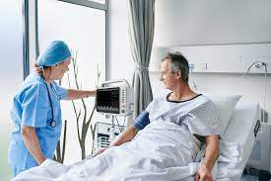
Bedside Monitor
Sensors attached to the patient are connected via cables/leads to a display unit near the patient’s bed.
Vital signs data can be viewed on these display units, at a central station, or on a remote display.

Slide 11
Wearable monitors
In the patient-worn devices, the sensors are attached to the patient and connected to small, lightweight display units.
These monitors can display vital signs data on their small screens and wirelessly transmit the data to a central station.
The absence of a wire‐connected bedside unit allows the patient to move more freely.
These devices are compact and lightweight and have a built‐in color display, alarm messages, and rechargeable battery.
The devices are based on industry‐standard Wi‐Fi technology and provide continuous standalone monitoring.

Slide 12
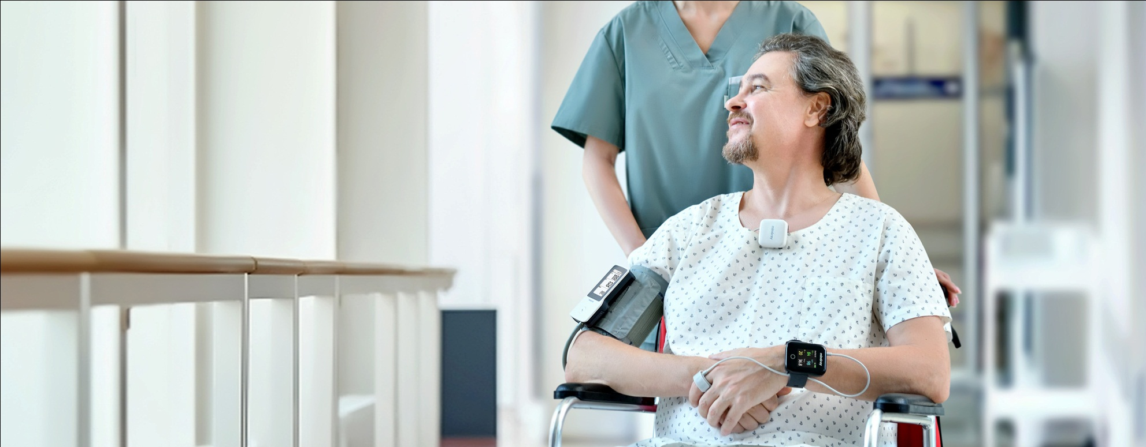
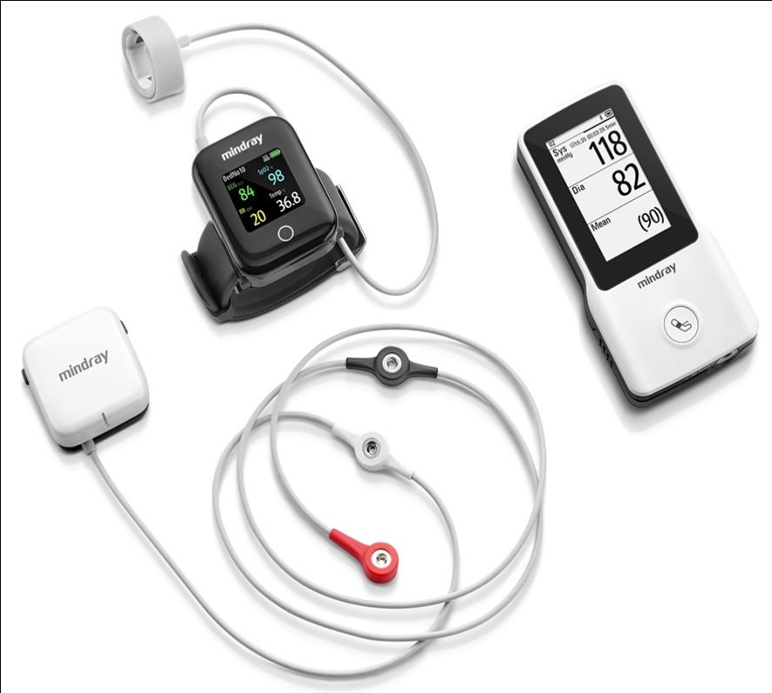
Wearable monitors

Slide 13
Noncontact monitors
These devices are designed to monitor certain vital signs such as, heart rate and respiratory rate, without the sensor having any physical connection to the patient.
The sensors are placed beneath the mattress or bed sheet on which the patient lies.
As long as the patient is in bed, the device can monitor vital signs and display the data on a unit situated near the patient’s bed and/or at a central station.
The patient is not required to be in direct contact with the sensor; however, if the patient leaves the bed, vital signs monitoring will cease until the patient returns.

Slide 14
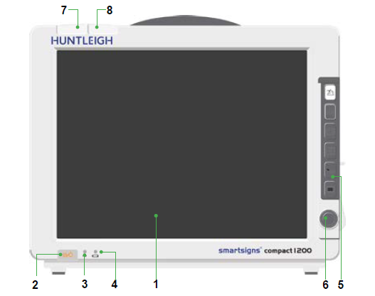
Identification of patient monitor
Front Panel
  1-Front Panel

Slide 15
Identification of patient monitor
Front Panel
1 | Touchscreen | 5 | Function keys
2 | On/Off Button | 6 | Jog Dial
3 | AC supply / Battery status LED | 7 | Physiological Alarm Indicator
4 | Battery charging LED | 8 | Technical Alarm Indicator

Slide 16
Identification of patient monitor
Function Keys
Symbol Explanation
 | Acknowledge Alarm |  | Pause Alarm
 | Freeze / Unfreeze Waveform |  | Record Start / Stop
 | BP Start / Stop |  | Main Menu

Slide 17
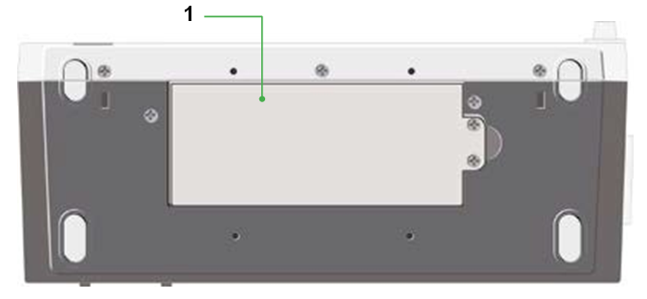
  Identification of patient monitor
  Base
2- Base
1
Battery Compartment

Slide 18
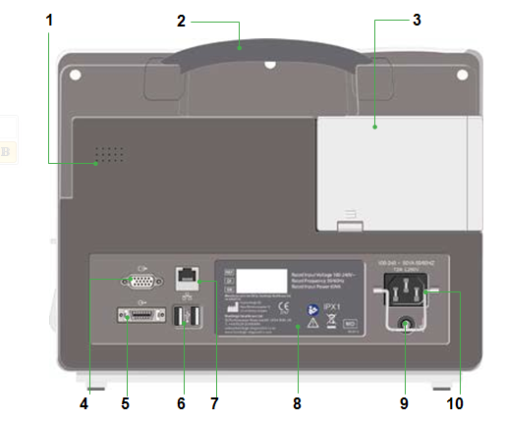
  Identification of patient monitor
  Rear Panel
  3-Rear Panel

Slide 19
Identification of patient monitor
Rear Panel
1 | Loudspeaker | 6 | USB Port x 2
2 | Carry Handle | 7 | Ethernet Port
3 | Expansion module | 8 | Rating Label
4 | VGA Port | 9 | Equipotential earth point
5 | Multifunctional Interface | 10 | Mains Socket

Slide 20
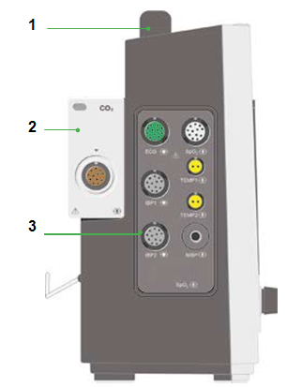
Identification of patient monitor
Left Side Panel
4-Left Side Panel
1 | Carry Handle
2 | Expansion module
3 | Sensor connections

Slide 21
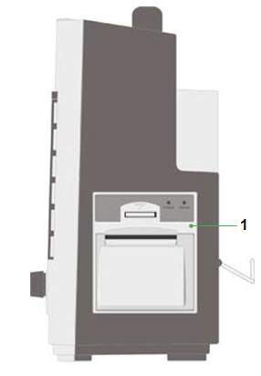
  Identification of patient monitor
  Right Side Panel
  5-Right Side Panel
1
Printer

Slide 22
Measurement Capabilities
Heart/Pulse Rate.
Electrocardiography (ECG).
Oximetry (SpO2).
Non-invasive Blood Pressure (NIBP).
Respiration Rate (RR).
Temperature (TEMP).

Slide 23
  Display
Patient monitor uses a backlit colour LCD display with integrated touch screen.
Physiological parameters, waveforms, alarm messages, date and time, network connection status, battery level and other messages are displayed.
The screen is divided into four areas:
    Waveform area
    Parameter area
    Upper menu bar
    Lower menu bar

Slide 24
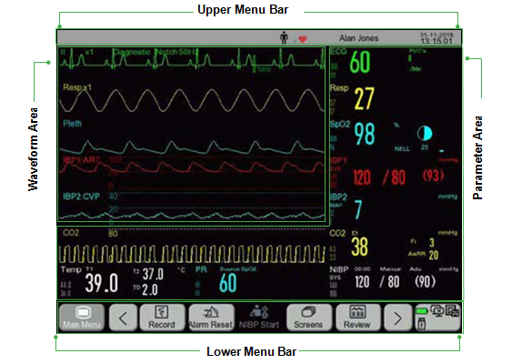
Display

Slide 25
Display
    1-Waveform Area
    - 8 waveforms can be displayed, along with the respective identification
    - Touch a waveform to display the corresponding setup menu.
    2-Parameter Area
    - Displays measured parameters
    - Parameter is displayed in the same colour as the waveform
    - Touch a parameter to display the corresponding setup menu

Slide 26
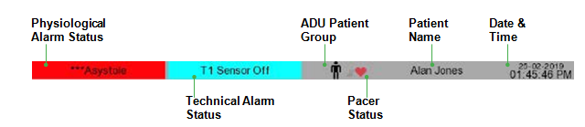
Display
    3-Upper Menu Bar

Slide 27
Display
    3-Upper Menu Bar
This area includes the following sections from left to right:
Physiological alarm message: Displays the alarm messages.
Technical alarm message: Displays technical alarm messages. If there are multiple alarms, each one
will be displayed in turn.
Patient data - Displays the patient name, type, and pacemaker status.
Time and date.

Slide 28



Display
    Lower menu bar
    This menu contains the shortcut keys or smart keys
1 | Scroll left/right to show more shortcut keys
2 | Monitor setup area: Central Monitoring System (CMS) status, SD card status, battery status, USB drive status

Slide 29
THANK YOU

