Slide 1


Al-Mustaqbal University.
College of Engineering and Engineering Technologies.
Biomedical Engineering Department.
Subject: Biomedical Instrumentation Lab.
Class (code): 5th
Lecture: 3
By: Zainab Sattar Jabbar M.SC. IN BME
BME

Slide 2
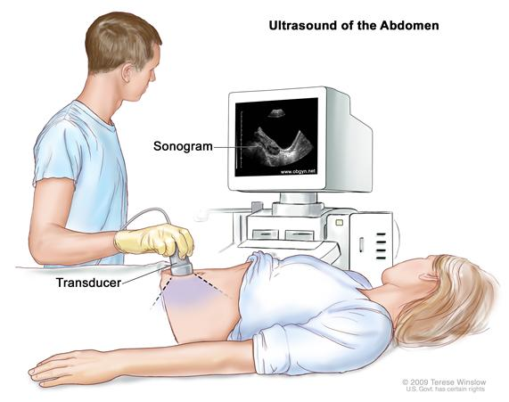
Ultrasound machine
An ultrasound is an imaging test that uses sound waves to make pictures of organs, tissues, and other structures inside your body. It allows your health care provider to see into your body without surgery.

Slide 3
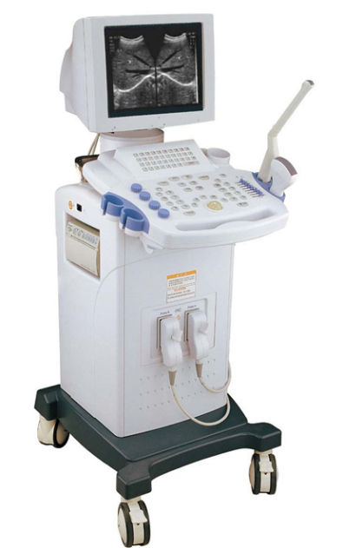
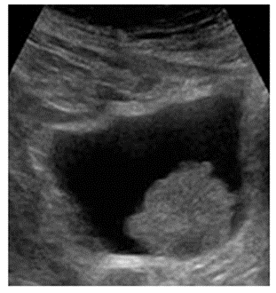
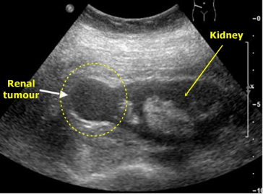
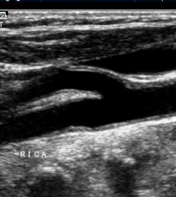
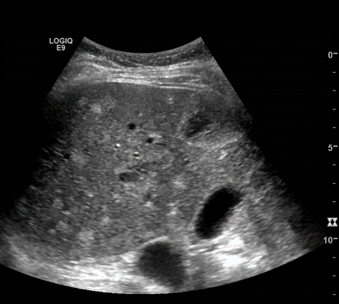
Ultrasound applications
Gynaecology and neonatology
Cardiology, to detect ventricular size and heart valve anomalies
Neurology for blood flow assessment
Nephrology (kidney, bladder)
Ultrasound systems can deliver static or dynamic images (e.g. heart valves)
liver with cirrhosis
(too much alcohol)
bladder with
cancer
kidney with cancer
blood vessels

Slide 4
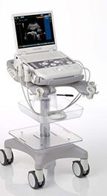
Ultrasound machine
  Advantages include:
  It provides images in real-time (still and video).
  it is portable and can be brought to the bedside.
  it is substantially lower in cost.
  it does not use harmful ionizing radiation.
Drawbacks include:
  various limits on its field of view including
    patient cooperation and physique (obese).
    difficulty imaging structures behind bone.
  and its dependence on a skilled operator

Slide 5
Ultrasound Systems
Specialized ultrasound systems are available per application domain, e.g. cardiovascular.
General purpose ultrasound systems may differ in:
different transducers
color Doppler ultrasound
3D-imaging capability
portability

Slide 6
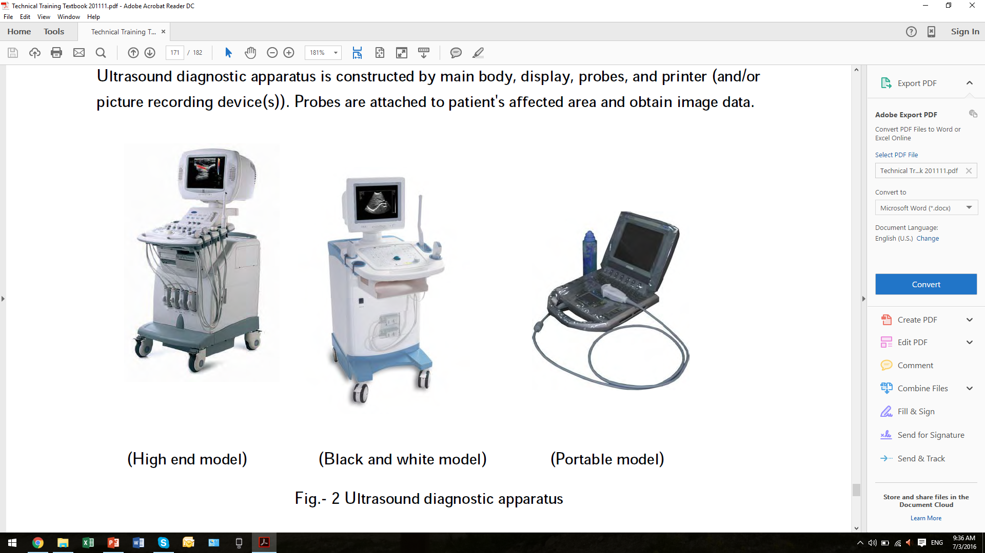
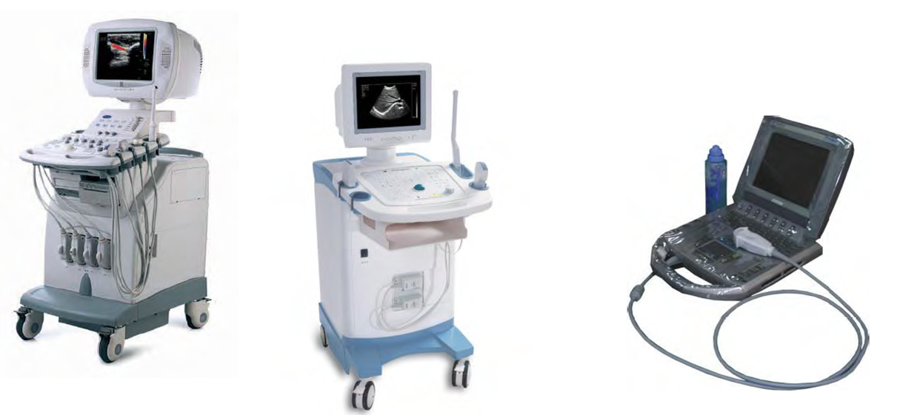
Ultrasound Systems
High end model
Black & white model
Portable model

Slide 7
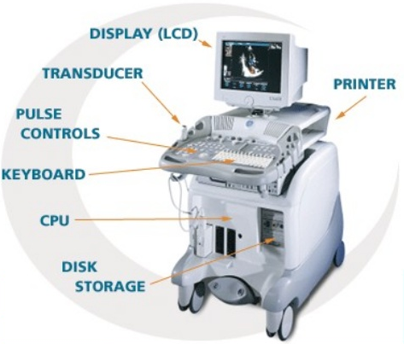
Construction

Slide 8
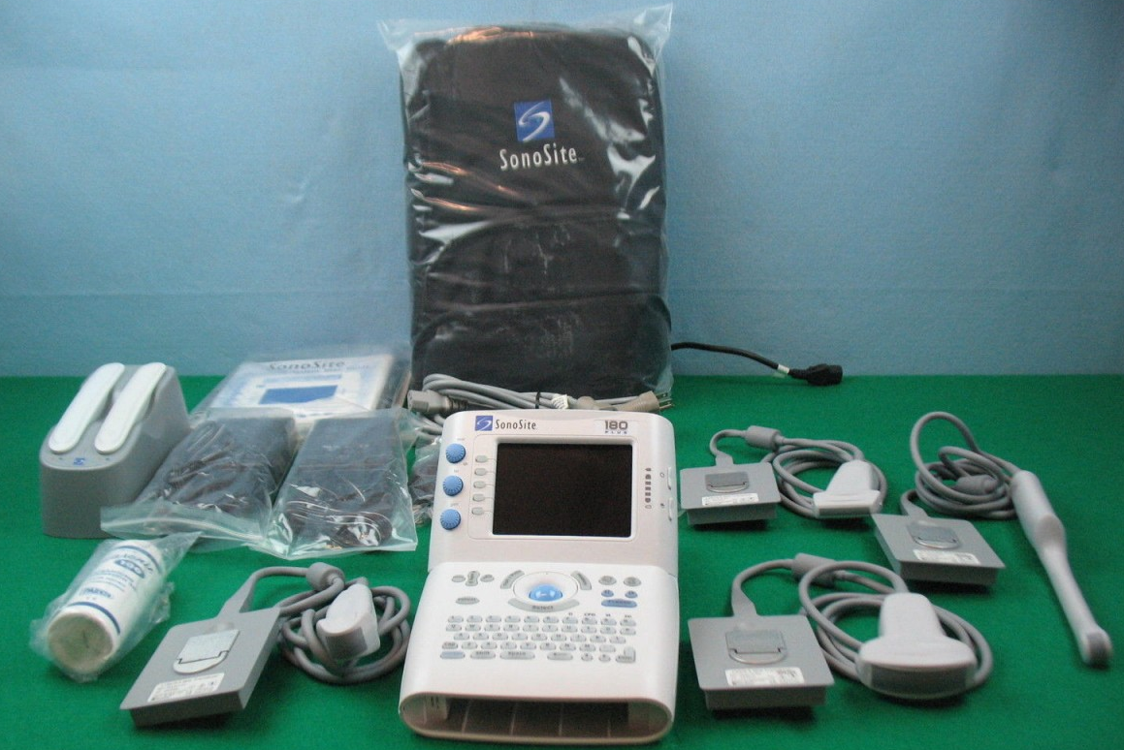
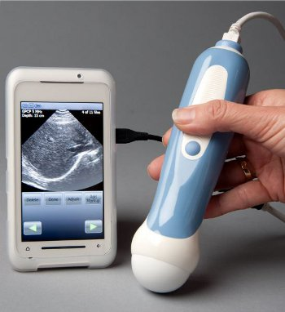
Portable ultrasound system (examples)
portable ultrasound system with four transducers
ultrasound system on smart phone

Slide 9
Construction
A diagnostic ultrasound machine consists of many components, each of which has a separate operation to perform. This starts with transmitting and receiving ultrasound signals which are then processed to form the images that we see on screen.
The internal components that make up a typical ultrasound machine are listed below:
Transducer
Pulser
Beam former
Receiver
Processor
Display
Digital storage
Hard copy printer devices.

Slide 10
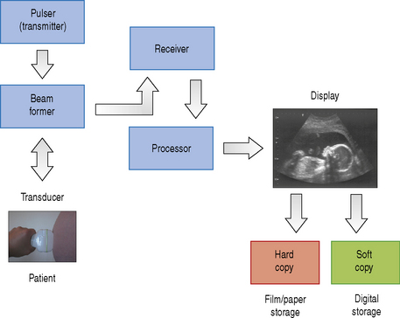
Construction

Slide 11
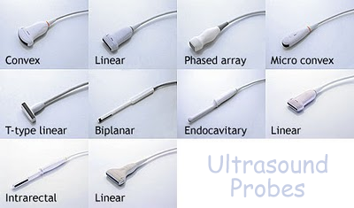
The Transducer
Diagnostic transducers are made from piezoelectric materials and are able to convert electrical energy into ultrasound energy. As a consequence of this they can act as a transmitter and receiver of ultrasound. They are able to produce beams which can be directed in various ways which are controlled by the ultrasound machine to improve image quality.

Slide 12
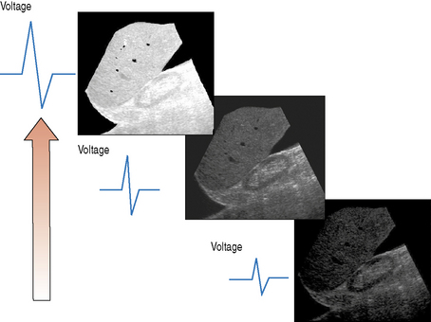
The pulser
The pulser produces the electric voltage that drives the transducer. This driving voltage governs the output power of the ultrasound machine and can be adjusted by the operator through the power or output control

Slide 13
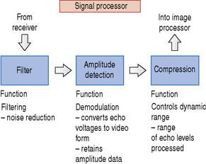
Beam Former, Receiver and Processor
The beam former controls the shape and direction of the ultrasound beam and the scanning patterns used to form the images that we see.
The job of the receiver is to combat attenuation.
The processor can be divided into two individual parts:
• A signal processor – converts echo voltages to video signals
• An image processor – formats the many scan line data into image form.

Slide 14
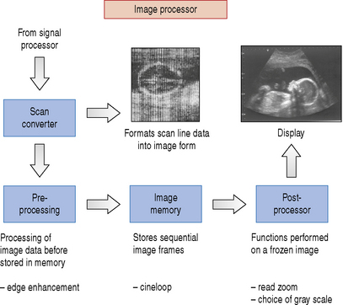
Block diagram of the signal processor

Slide 15
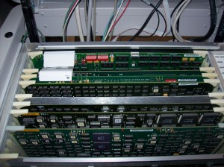
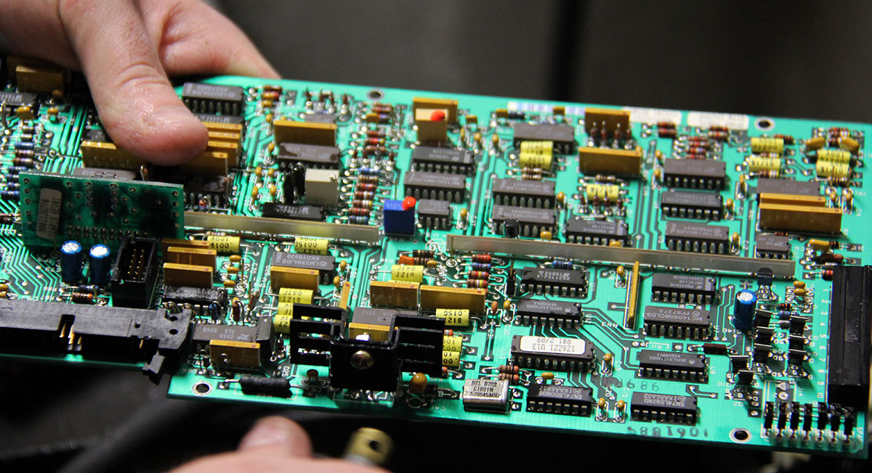
Construction
A high end ultrasound system contains a lot of electronics. Repair cannot be undertaken without guidance of a service manual. The most common problem, next to user and power issues, is poor connections of the PCBs in their connectors/slots.

Slide 16
Corrective Maintenance Highlights
User Error Is enough of the proper ultrasound gel used?
Are the controls set correctly? In particular the contrast and brightness buttons!
Transducer Ensure that the transducer is properly connected and undamaged
The transducer is sensitive to shocks! If there is defective element, you often see a black line on the image. Transducer cracks cannot be repaired: exchange the transducer. Gently pull on the cable at different points to see when the image flickers. This is where the cable is broken. If cable/connections are broken: fix by soldering
Dials/buttons If buttons don’t function properly: replace or use anti-corrosive contact spray on dials.
Deteriorating Check mains voltage, check pre-amplifiers, check probe connection, fuses.
image quality Is the machine calibrated correctly?
the CRT (Cathode Ray Tube) monitor may be worn out after a few years. Replace! A voltage stabilizer may be required in case of varying mains voltage (more than 10%)
Electric contact Poor electric contacts is a major problem in all electronics devices.

Slide 17
Preventive Maintenance: Daily & Weekly care
Daily Care:
Clean Wipe dust of exterior and cover wipe probe with alcohol-free tissue or cloth
Visual Check Check all fittings and accessories are mounted correctly. Check that cables are not twisted and the probe is safely stored.
Function Check If in use that day, run a brief function check before patients arrive.
Weekly Care:
Clean Unplug, clean outside / wheels / rear with damp cloth, dry off
Visual Check Check that mains plug screws are tight. Check that mains cable has no bare wire and is not damaged.
Function Check If machine has not been in use, run and test briefly.
Do not soak the cable with gel!

Slide 18
Preventive Maintenance Checklist: BMET
Preventive maintenance (BMET, every six months):
Clean outside (if necessary)
Visual Check Check if all accessories are mounted correctly. Check cables, power & connections. Open system and perform visual check inside the system.
Grease & filters Clean grease wheels, replace air filters.
Function Check Check imaging quality with
different transducers Calibrate system with phantoms
Safety Check Check electrical safety

Slide 19
Calibration
Calibration is performed by means of phantoms. Different phantoms are used to test different performance features such as lateral and axial resolution, and correctness of distance measurements. Based of the ultrasound image of the phantom, the good performance of the system can be confirmed. Transducers cannot be adjusted with respect to their image accuracy. If the test result is not acceptable, the transducer should be replaced.
The white dots in the image indicate reflectors at these locations in the phantom.
If the reflections do not show up at the correct locations in the image, something is probably wrong with the transducer.
Full calibration requires using a range of phantoms to test different aspects of the equipment.
Follow the instructions in the service manual.
Phantom (example)
Example of ultrasound image of phantom

Slide 20
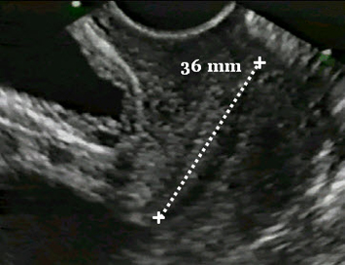
Safety
Ultrasound diagnostic imaging appears to be risk-free when used properly.
Ultrasound transducers should be handled carefully to avoid damage. Electromechanical problems, such as cracks in piezoelectric elements, can alter beam width or sound pulses, thereby affecting resolution. Errors in distance measurements from the images can cause incorrect calculations and thus an incorrect diagnosis.

Slide 21
THANK YOU

