Slide 1


Al-Mustaqbal University.
College of Engineering and Engineering Technologies.
Biomedical Engineering Department.
Subject: Biomedical Instrumentation Lab.
Class (code): 5th
Lecture: 8
By: Zainab Sattar Jabbar M.SC. IN BME
BME

Slide 2
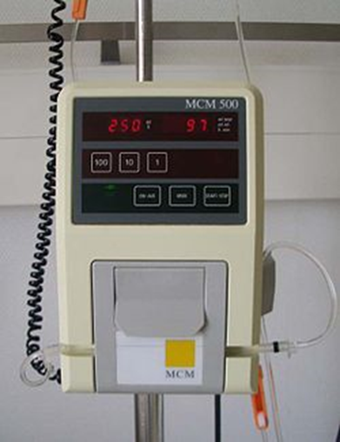
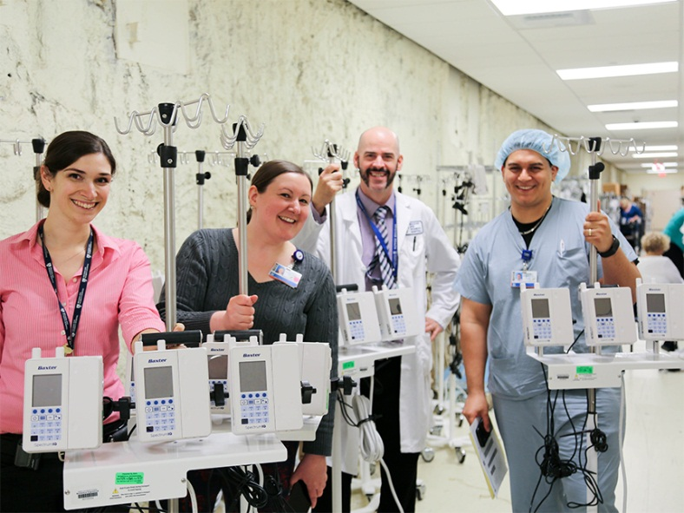
Infusion pumps

Slide 3
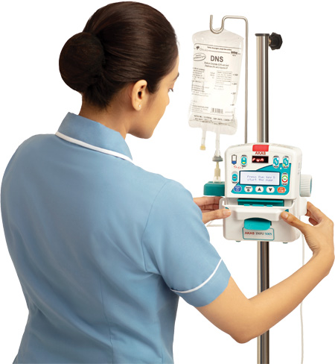
Infusion pumps
An infusion pump is a medical device that delivers fluids, such as nutrients and medications, into a patient's body in controlled amounts.

Slide 4
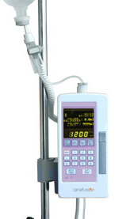
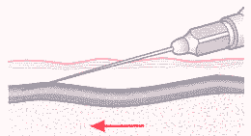
Function: infuse fluids
What is the function of an Infusion pump ?
An infusion pump infuses fluids, medication (antibiotics, pain medication) or nutrients into a patient’s circulatory system. It is generally used intravenously, although arterial and subcutaneous infusions are occasionally used.

Slide 5
Function: infuse fluids
Why is it important ?
Infusion pumps can administer fluids in ways that would be impractically expensive or unreliable if performed manually by nursing staff. For example, they can administer as little as 0.1 mL per hour injections (too small for a drip), injections every minute, injections with repeated boluses, or fluids whose volumes vary by the time of day.

Slide 6
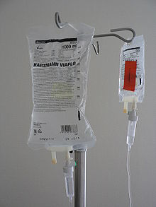
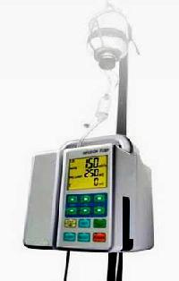
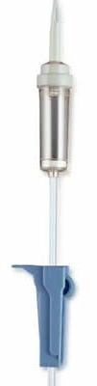
Use
Use: general nursing, intensive care, surgery, recovery .
The difference between drip chamber and infusion pump
Drip chamber
Clamp
Infusion pump

Slide 7
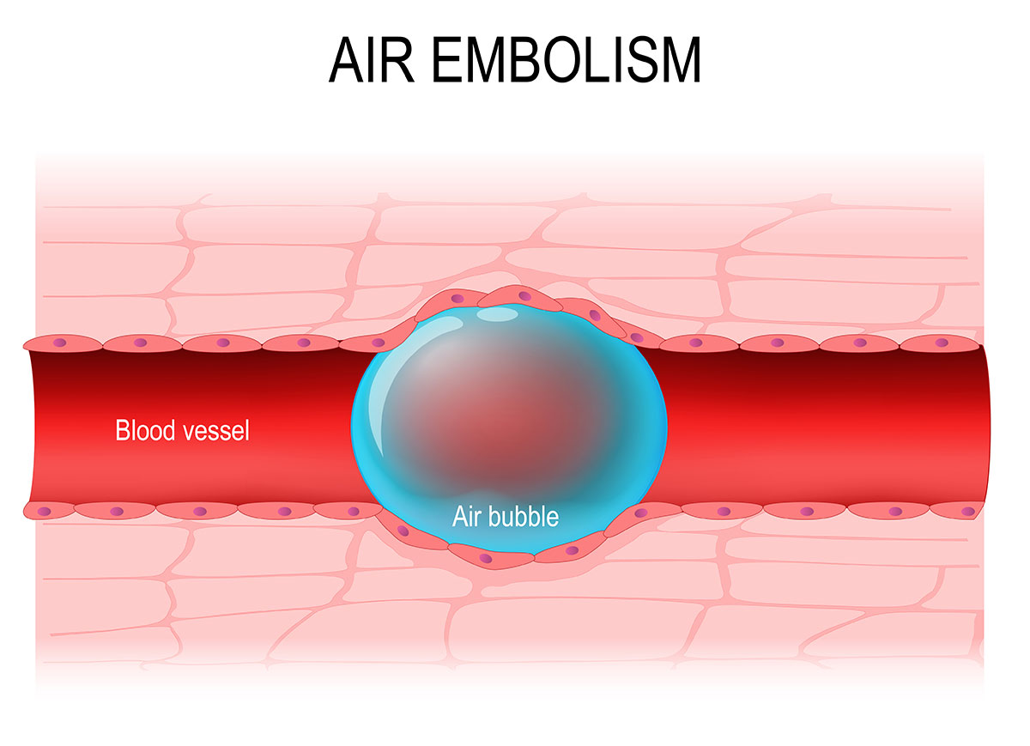
Use
A drip chamber is a device used to allow air to rise out from a fluid so that it is not passed downstream. These are commonly employed in delivery systems of intravenous therapy and act to prevent air embolism.
The use of a drip chamber allows an estimate of the rate at which fluid is administered. For a fluid of a given viscosity, drips from a hole of known size will be of nearly identical volume and the number of drips in a minute can be counted. The rate of flow is controlled by a clamp on the infusion tubing; this affects the resistance to flow.

Slide 8
Use
However, other sources of resistance (such as whether the vein is kinked or compressed by the patients position) cannot be directly controlled and a change in position may change the rate of flow leading to inadvertently rapid or slow infusion.
Where this might be problematic an infusion pump can be used which gives a more accurate measurement of flow rate.
The positive pressure generated by the various manufacturers’ pumps can widely vary. All pumps should be able to overcome arterial pressures of a patient (150-200 mmHg). Most pumps have a pressure limit of 500 mmHg. If the limit is reached, an occlusion alarm should sound. Pumps with lowered pressure limits are often labelled as paediatric.

Slide 9
Types of pumps
On many pumps the output pressure also has a low limit. If the pressure in the fluid line is below the lower limit, an alarm should indicate a possible loss of connection to the patient or artery (an infiltration alarm, when the catheter is no longer in the blood vessel but infusing fluid into the surrounding tissue).
There are two basic classes of pumps:
Large volume pumps can pump nutrient solutions large enough to feed a patient.
Small-volume pumps infuse hormones, such as insulin, or other medicines, such as opiates.

Slide 10
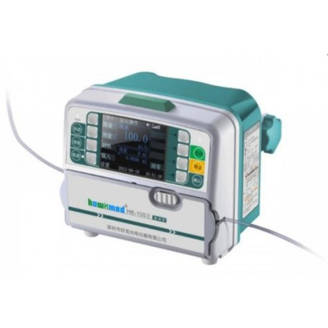
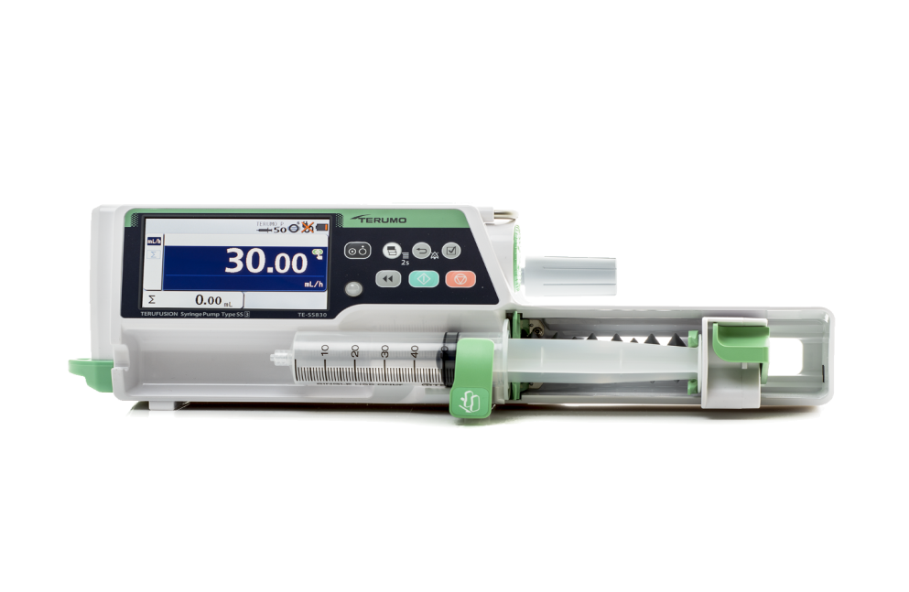
Infusion pump vs Syringe pump
An infusion pump will provide the patient with a more substantial capacity, while a syringe pump will provide a small dose with precision.
Syringe pumps are more compact and take up less space than infusion pumps. This becomes important when the patient is on many different infusions.
Infusion pump
Syringe pump

Slide 11

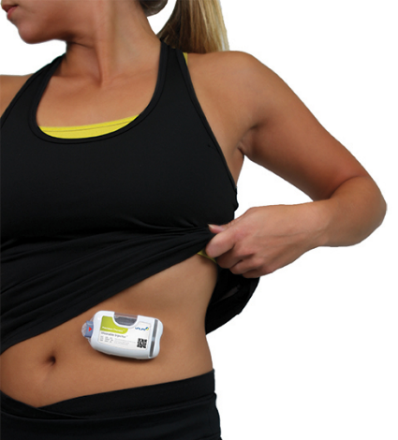
Infusion pump design
Some infusion pumps are designed mainly for stationary use at a patient’s bedside.
Others, called ambulatory infusion pumps, are designed to be portable or wearable.
Wearable injector
Bedside injector

Slide 12
Construction
All fluid pumps work on one of three principles:
Volume displacement .
Roller peristaltic .

Slide 13
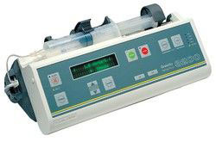
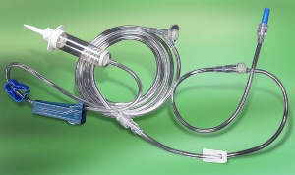
Volume Displacement Pump
The volume displacement pump operates by filling a cavity (syringe) and then displacing a given volume of liquid. The positive displacement pump delivers a constant volume of liquid independent of the discharge pressure.
A volume displacement pump can require a dedicated (meaning: applicable to only one type of pump) IV (intravenous) administration set, available only from the manufacturer.
Small-volume pumps usually use a computer-controlled motor turning a screw that pushes the plunger on a syringe.

Slide 14
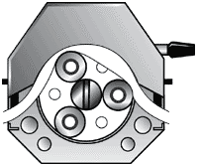
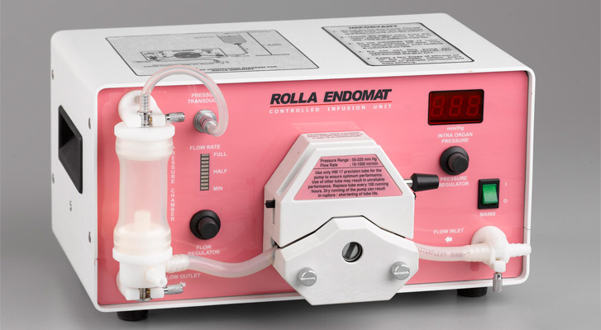

Roller Peristaltic Pump
Large-volume pumps usually use some form of peristaltic pump.
Classically, they use computer-controlled rollers compressing a silicone-rubber tube through which the medicine flows.

Slide 15
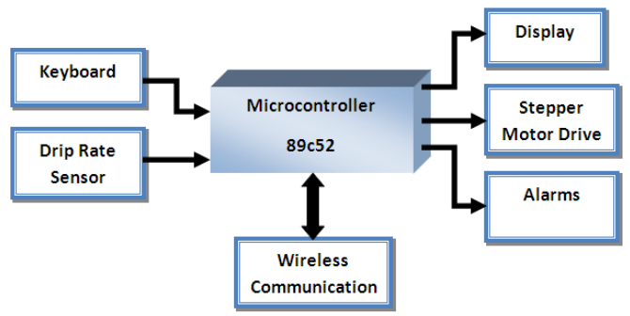
Functional Block Diagram

Slide 16
Trouble shooting
User error is common with pumps. While only the clinical staff should program the pump, the technician must know the programming procedure so they can troubleshoot or calibrate the units.
Some of the most common problems with syringe pumps are:
  Clutch slipping which causes under infusion of the drug.
  Broken latches so the syringe does not fit securely onto the pump
  Bad batteries.
User abuse is very common as the pumps are dropped on a regular basis.

Slide 17
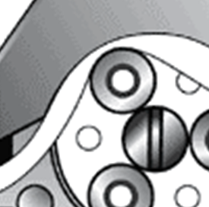
Trouble shooting
With roller pumps, the rollers may need adjustment.
  If the roller is too close to the tube, it causes high friction, low flow rates and premature wear of the tube and motor.
  If the roller is too loose, there will be insufficient occlusion to move the required volume of liquid. Flow rates may drop as well, despite rapid motion of the rollers.

Slide 18
Safety and Testing considerations
Pumps should be tested for their delivered volume with time, or flow rate.
The occlusion (or high pressure) limit should be tested.
If the pump has batteries, it is usually sufficient to simply test that the device runs on the batteries for a few minutes
An air filter is an essential safety device in a pressure infuser, to keep air out of the patients' veins. The air filter is just a membrane that passes gas but not fluid or pathogens. When a large air bubble reaches it, it bleeds off.

Slide 19
Safety and Testing considerations
In summary, the infusion-related safety risks are:
  Uncontrolled flow causing an overdose,
  Uncontrolled lack of flow, causing an under-dose,
  Reverse flow, which can siphon blood from a patient,
  Air in the line, which can cause an air embolism

Slide 20
THANK YOU

