Slide 1


Al-Mustaqbal University.
College of Engineering and Engineering Technologies.
Biomedical Engineering Department.
Subject: Biomedical Instrumentation Lab.
Class (code): 5th
Lecture: 2
By: M.SC. Zainab Sattar Jabbar
BME

Slide 2

Troubleshooting
How to diagnose and correct monitor problems?
how to troubleshoot a monitor that is not operating correctly?

Slide 3
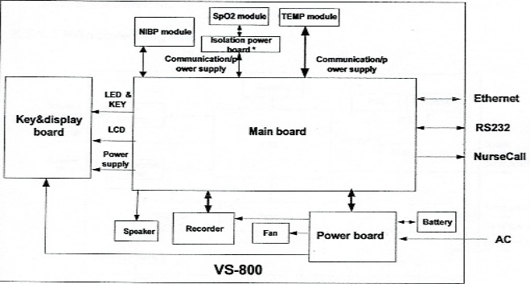
Hardware structure
Main board
Power board
Key & display
Parameter board
Recorder board
Barcode scanner

Slide 4
Troubleshooting
You can repair the monitor in either of two ways:
Return the monitor to a company authorized service center for repair.
Purchase spare parts from a company authorized service center.
Repairs should be made by qualified service personnel only.
Repairs should be made only with the recommended parts. Use of incorrect parts can cause damage to the monitor or incorrect measurements.

Slide 5
Diagnosing a Problem
Before you begin to troubleshoot a problem or open the monitor for repair, check the following basics:
1. Is the power switch turned on?
2. Is the battery adequately charged?
3. Is the AC power cord connected to the monitor and plugged into a functional AC outlet?
4. Is the monitor's display functioning?
5. Are the LEDs on the front of the monitor lit as you expect?

Slide 6
Diagnosing a Problem
Monitor problems are categorized as follows:
Power
Display
Alarms
Measurements, including:
NBP
Temperature
SpO2
ECG/Respiration

Slide 7
Repairing the Monitor
The procedures for disassembling the monitor to replace
defective assemblies or components.
The monitor has three main assemblies:
Rear case
Chassis
Front panel

Slide 8
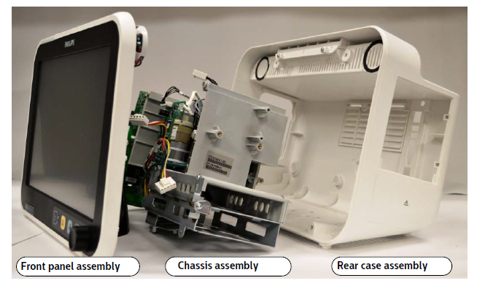
Repairing the Monitor

Slide 9
Power Problems
The monitor turns on with battery power, but does not with AC power:
Possible Cause:
The power cord is unplugged/Ensure that the AC power cord is plugged into an outlet.
The power cord is broken/Replace the AC power cord.
The fuse is blown/Replace the fuse.
The power supply cable malfunctioned/Replace the power supply module.
The power supply malfunctioned/Check output voltage on power supply. If you do not measure 15 V, replace the power supply.
The AC power connector malfunctioned/Replace the AC connector.
The main board malfunctioned/Replace the main board.

Slide 10
Power Problems
The monitor turns on with AC power, but does not with battery power.
Possible Cause:
A battery is not present/Ensure that a battery or batteries are installed.
The battery is not charged/Charge the battery .
The battery or connector is loose/Reseat the battery and the battery cable.
The main board malfunctioned/Replace the main board.

Slide 11
Action to solve Power Problems
To replace the battery
Shut down the monitor.
Remove the AC power cord from the back of the monitor.
Insert a slotted screwdriver into the slot in the battery cover.
Rotate the battery retaining clip until it clears the battery.
Remove the battery from the monitor by pulling the attached black ribbon.
Insert the new battery and replace the cover

Slide 12
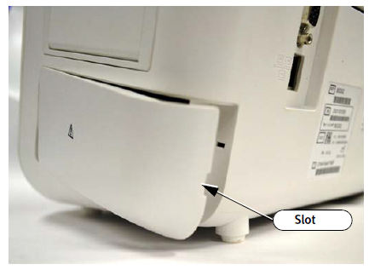
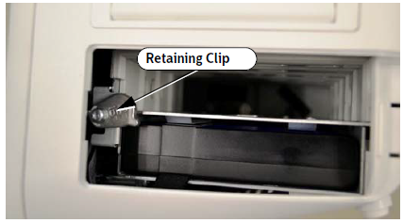
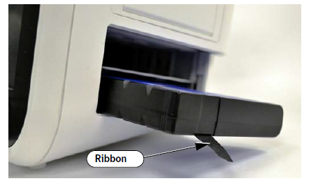
Replacing the battery

Slide 13
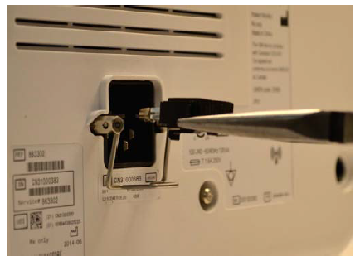
Replacing a fuse
To replace a fuse in the AC power connector use pliers to pull the fuse holder out of the AC power connector, replace the fuse, and then push the fuse holder back into the power connector until it snaps into place.

Slide 14
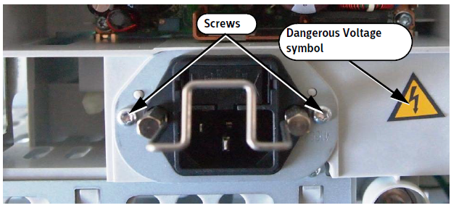
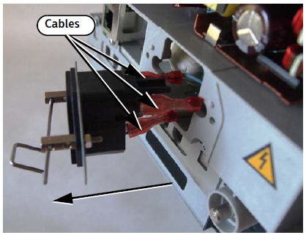
Replacing the power entry module
To replace the power entry module:
Remove the rear case, remove the two screws from the power input module, pull the module out of the chassis and disconnect the three cables from the module.

Slide 15
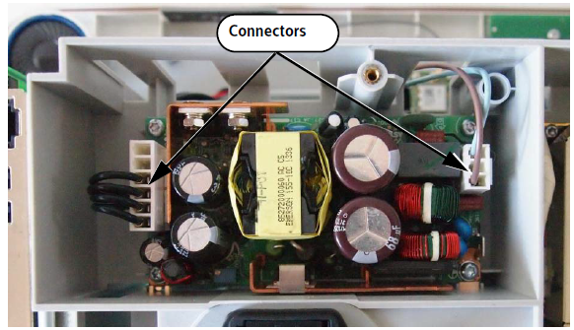
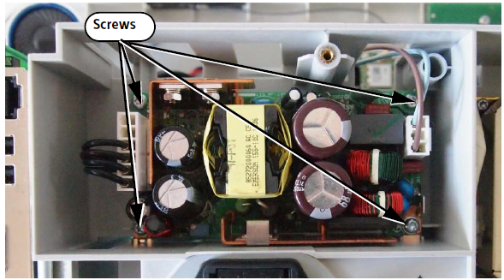
Removing the Power Supply Module
To remove the power supply
Remove the rear case, remove the power supply connectors, remove the four screws and lift the module out of the chassis.

Slide 16
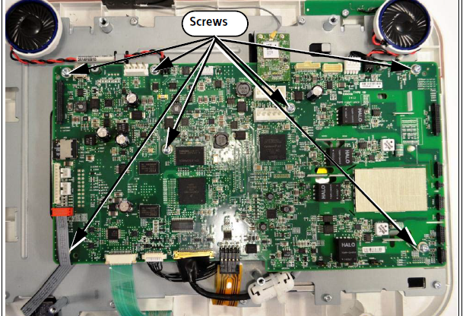
Replacing the Main Board
Remove the rear case, Remove the chassis, Remove the wireless assembly, Disconnect the speaker or speakers from the main board, Disconnect the alarm light, LCD signal, LCD backlight, and touch cables from the main board, Remove the screws from the main board, Lift the main board away from the front panel assembly.

Slide 17
Display Problems
The power is on, but the monitor screen is blank.
The monitor displays random or distorted graphics with a white background.
The monitor turns on and the opening screen and/or color bar starts, but then freezes
Possible Cause:
The connection with the backlight LCD is faulty/ Ensure that there is a proper connection between the cable, LCD, and main board
The LCD is faulty or malfunctioned, the LCD signal cable is not attached correctly/ Replace the LCD or open the monitor and reseat the LCD signal cable.
The main board malfunctioned/ Replace the main board.

Slide 18
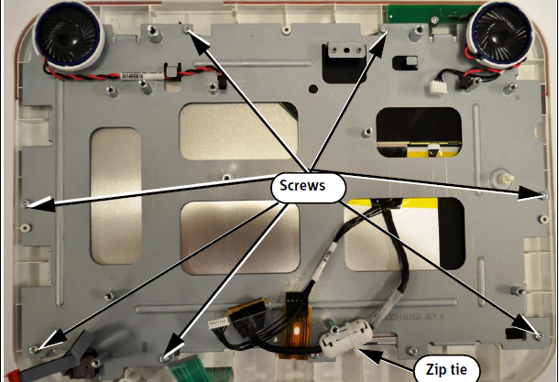
Removing the LCD Assembly
To remove the LCD assembly:
Remove the rear case, Remove the chassis, Remove the main board. Use wire cutters to cut the plastic zip tie and remove it. Remove the screws that attach the LCD assembly to the front panel. Pull the LCD assembly away from the front panel.

Slide 19
Alarm Problems
Alarms do not sound
Alarm LED on the front panel does not light up
The Speaker Malfunc alarm appears in the message pane.
Possible Cause:
The monitor is in Audio Pause mode or Audio Off mode/ Confirm audio alarms are enabled, The speaker or speakers malfunctioned/ Replace the speaker, The connection to the speaker is faulty/ Ensure that the connection to the speaker is correct, The main board malfunctioned/ Replace the main board.
Alarm LED assembly malfunctioned/ Replace the front panel.
A speaker malfunctioned/ Clear the message by performing the speaker test.

Slide 20
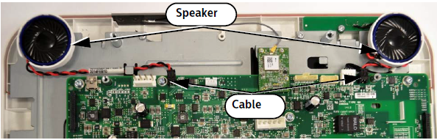
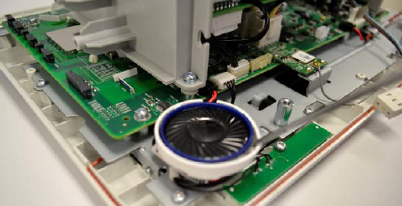
Replacing a Speaker
Remove the rear case, Disconnect the speaker cables from the main board, Insert a small flathead screwdriver under the speaker and remove it by prying it out of the rear case.

Slide 21
NBP Problems
The NBP cuff does not inflate.
NBP measurements are not displayed.
NBP measurements are unreliable.
Possible Cause:
The air tube or cuff is bent or twisted/ Straighten the tube or cuff. Air leak in the air tube or cuff/ Replace the cuff and ensure that there is no air leakage in the tube. The NBP module malfunctioned/ Replace the NBP pump module.
Wrong cuff size, or incorrect cuff placement/ Use proper cuff size, ensure proper cuff placement. Initial pressure setting is incorrect/ Specify the correct initial pressure. The air tube is bent or twisted or there is air leakage in the air tube or cuff/ Ensure that the tube is straight and not kinked. Replace the cuff and ensure that there is no air leakage in tube. External problem. For example, the patient is moving excessively, shivering, or has arrhythmias/ Ensure that all external blood pressure reading requirements are met. NBP module error/ Replace the NBP module.
The NBP module needs to be calibrated/ Recalibrate the NBP module.

Slide 22
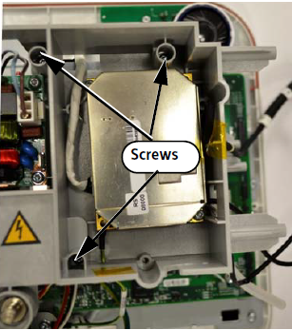
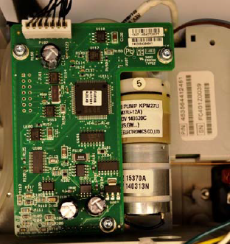
Remove the NBP module
To remove the NBP module:
Remove the rear case. Remove the chassis. Remove the screws from the rear of the NBP module. Tun the chassis over and lift the NBP module out of the chassis.

Slide 23
Temperature Measurement Problems
Temperature measurements are not displayed.
Temperature measurements are unreliable.
Possible Cause:
The probe is disconnected from the monitor/ Ensure that the temperature probe is connected and seated in the probe well. The probe is misplaced/ Ensure that the probe is properly placed in the measurement site. The temperature is over range/ Ensure that the temperature measurements are in the range of 15° – 45°C (59°F – 113°F). The probe malfunctioned/ Replace the probe. Front end malfunction/ Replace the front end board. The main board malfunctioned/ Replace the main board.
The module is not calibrated/ Replace the main board. The front end malfunctioned/ Replace the front end board.

Slide 24
SpO2 Measurement Problems
SpO2 measurements are not displayed.
SpO2 measurements are unreliable
Possible Cause:
The SpO2 sensor malfunctioned/ Replace the SpO2 sensor. The SpO2 board has a faulty connection to the front end board/ Ensure that all connectors to the front end board are seated correctly. The SpO2 board malfunctioned/ Replace the SpO2 board. The main board malfunctioned/ Replace the main board.
External problem. For example, excessive patient movement, excessive ambient light, incorrect sensor placement, sensor is too loose or too tight/Ensure that all external SpO2 reading requirements are met.
Perfusion is low/ Reset the SpO2 function.

Slide 25
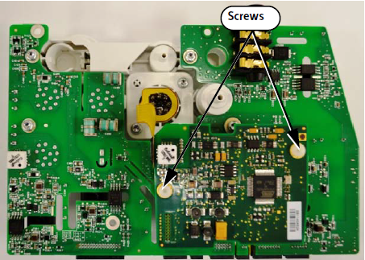
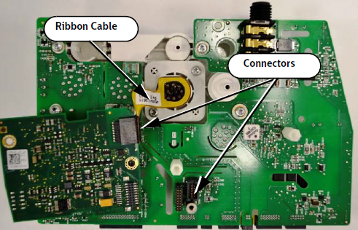
Removing the SpO2 Board
To remove the SpO2 board:
Remove the rear case. Remove the front end assembly. Remove the two white plastic screws. Pull the SpO2 board upward to separate it from the connector on the front end board. Disconnect the ribbon cable.

Slide 26
ECG/Respiration Measurement Problems
ECG measurements are not displayed.
ECG measurements are unreliable.
Respiration measurements are not displayed.
Respiration measurements.
Possible Cause:
The ECG leads are off/Ensure that the leads are connected. The ECG cable is broken/Ensure that the cable is in good working order. The ECG 3/5/10 wire is not configured correctly/ Correct the ECG configuration.
The ECG leads are off/Ensure that the ECG leads are connected. A problem external to the monitor occurred/Ensure that all external ECG reading requirements are met, Check lead placement, Ensure that the skin has been prepared properly. An external interference occurred/Set the default AC power frequency.
The respiration leads are off/Ensure that the respiration leads are connected. External interference/Ensure that all respiration reading requirements are met.

Slide 27
Another problems
Navigation Wheel, Touch Screen, and Key Problems
Recorder Problems
Nurse Call Problems
Full Disclosure SD Card Problems

Slide 28
THANK YOU

