Slide 1


Al-Mustaqbal University.
College of Engineering and Engineering Technologies.
Biomedical Engineering Department.
Subject: Biomedical Instrumentation Lab.
Class (code): 5th
Lecture: 5
By: Zainab Sattar Jabbar M.SC. IN BME
BME

Slide 2
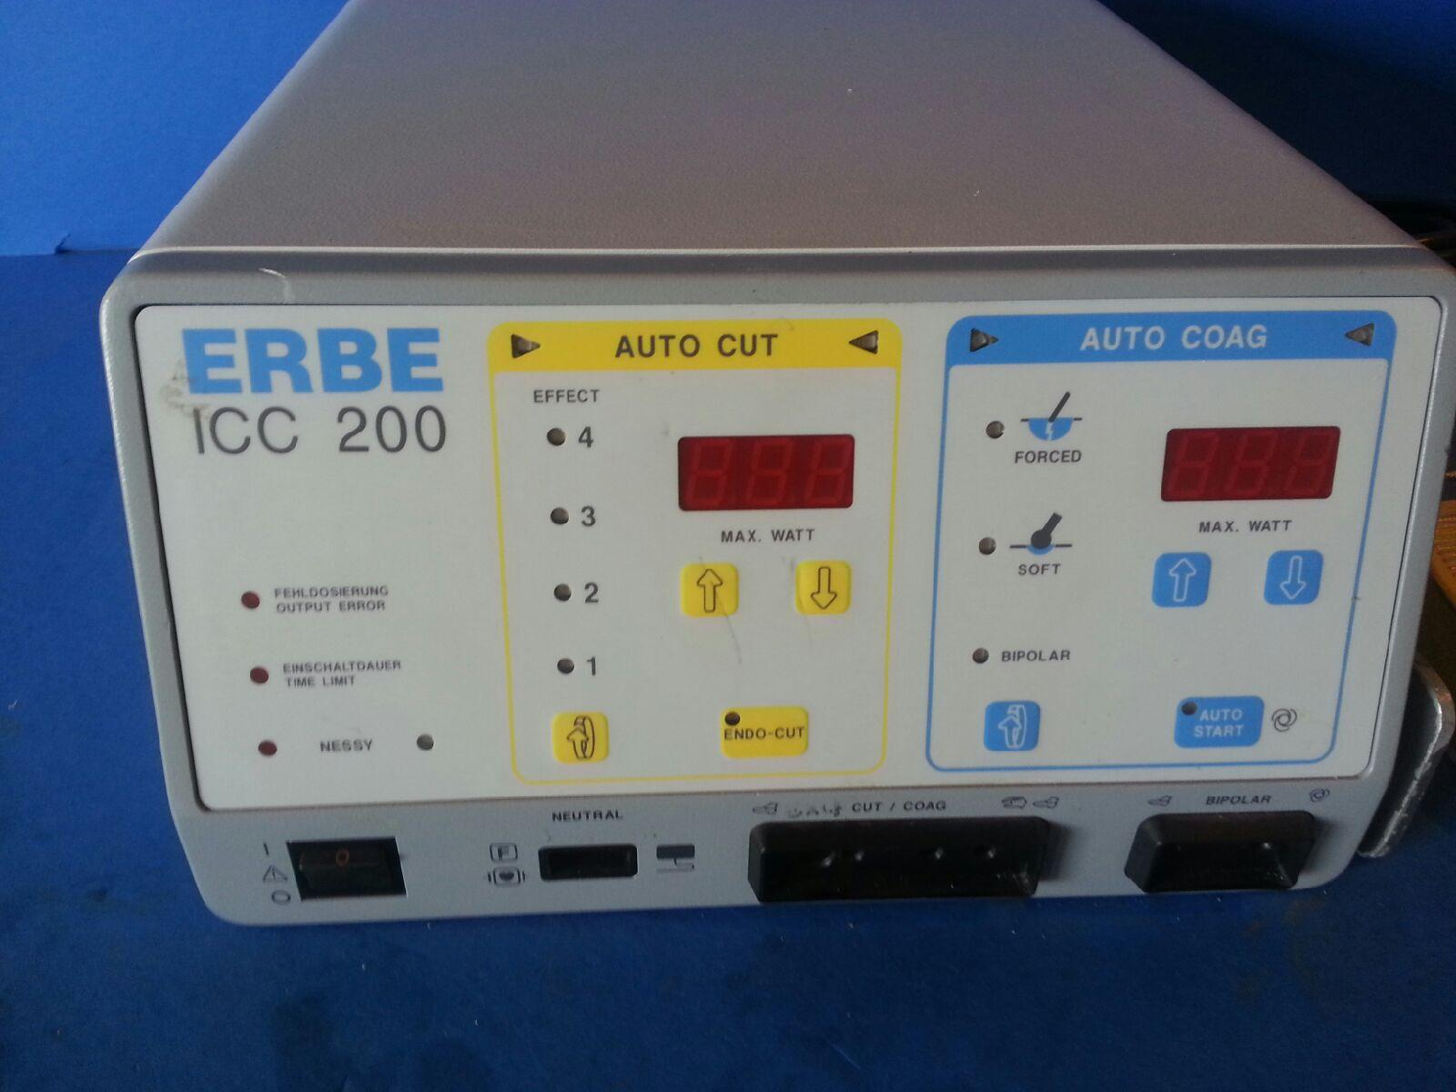
Electrosurgical Machine

Slide 3
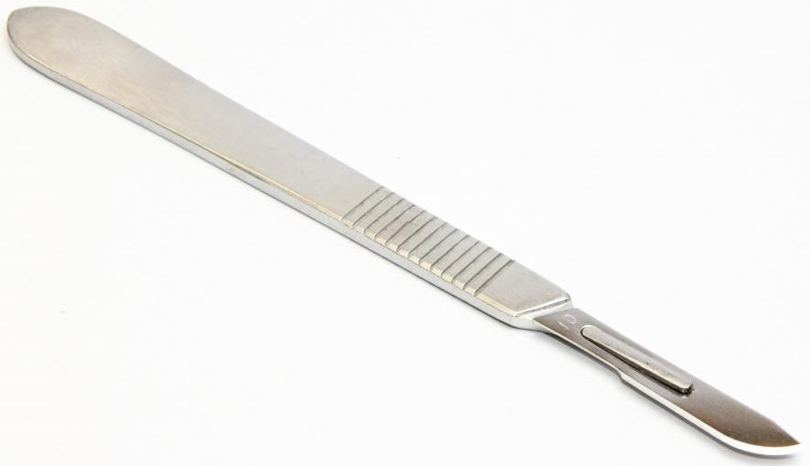

Use Of Electrosurgical Machine
Electro surgery is an alternative approach to cutting a patient. Typically, it is used as an alternative to a scalpel.
Electro surgery can cut like a scalpel, but can also coagulate the blood in small vessels so the surgical field is bloodless.
Electro surgery allows the surgeons to work faster as they do not have to tie off (close) every vessel they cut. The patient recovers better as there is less blood loss and there is more rapid healing.
an Electrosurgical machine is also known as an:
ESU = Electro Surgical Unit

Slide 4
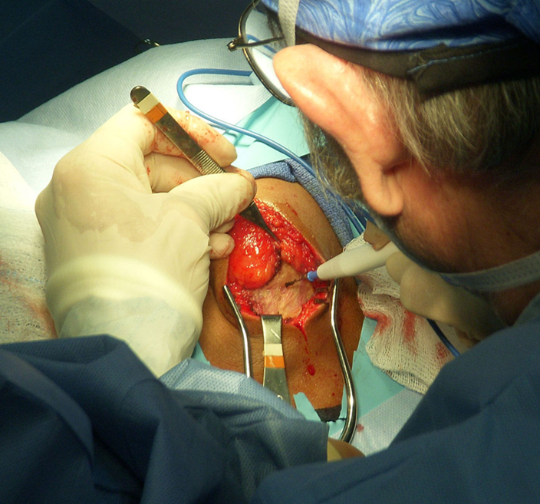
Scientific Principles of Electrosurgical Machine
Electro surgery is accomplished by converting high frequency electrical current into heat, caused by the tissue resistance to the passage of electrical current
As current must pass through the body, at least two electrical connections must be made between the patient and the machine. The power needed is up to 400 watts.

Slide 5
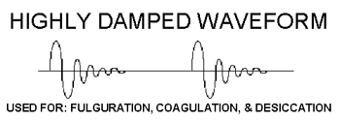
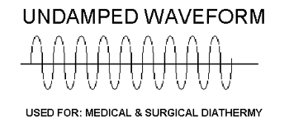
Scientific Principles of Electrosurgical Machine
If the waveform is damped it will coagulate blood and stop bleeding (coag setting).
If the waveform is undamped the tissue is ablated (vaporizing the water content) leaving a void or cut or incision (cut setting).

Slide 6
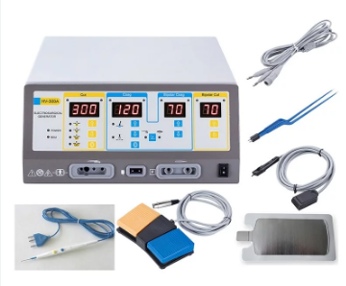
Component of Electrosurgical Machine
An electrosurgical unit (ESU) consists of :
High frequency power producing generator with monitoring function.
Hand piece with electrodes to apply the energy to the surgical site.
Connecting cables.
Foot switch to control output.

Slide 7
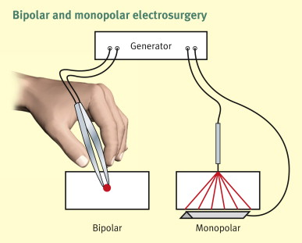
Types of Electrodes
Monopolar electro-surgery
Bipolar electro-surgery

Slide 8
Monopolar electro-surgery
All electrosurgery techniques require two connections to the patient, the active electrode (or pen, or bovie pen) and the reference electrode (or dispersive or ground electrode).
For monopolar electro-surgery, the reference electrode is placed under the patient and the active electrode is held in the surgeon’s hand.

Slide 9
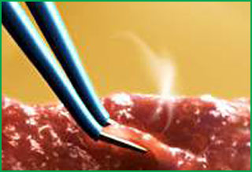
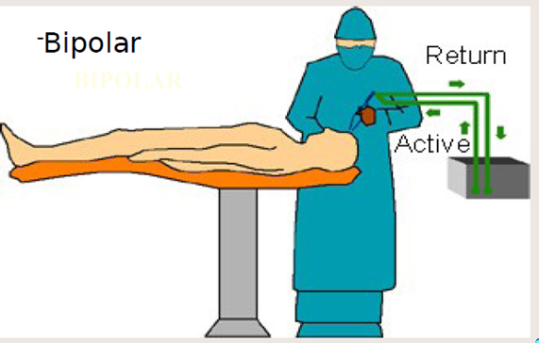
Bipolar electrosurgery
For bipolar electrosurgery, the reference and active electrodes are both held by the surgeon in one combined pen.
Electrosurgical current in the patient is restricted to a small volume of tissue in the immediate region of application of the forceps.
Bipolar is most commonly used with small vessels and for precise tissue destruction.

Slide 10

Electrosurgical machine: use
The Bovie pen (or ESU pen) is held on the patient by the surgeon.
The dispersive electrode can be a metal plate covered with a conductive gel or saline soaked cloths.
Many are now using single use dispersive electrodes. Single use devices are often pre-gelled, conductive adhesive pads that include multiple connections to the machine. The multiple connections are used to allow the device to constantly check for a good contact between the patient and the dispersive electrode.
Poor contact with the dispersive electrode is the most common cause of unintentional patient burns. In modern ESU machines, the dispersive electrode must touch the patient to prevent an alarm.

Slide 11
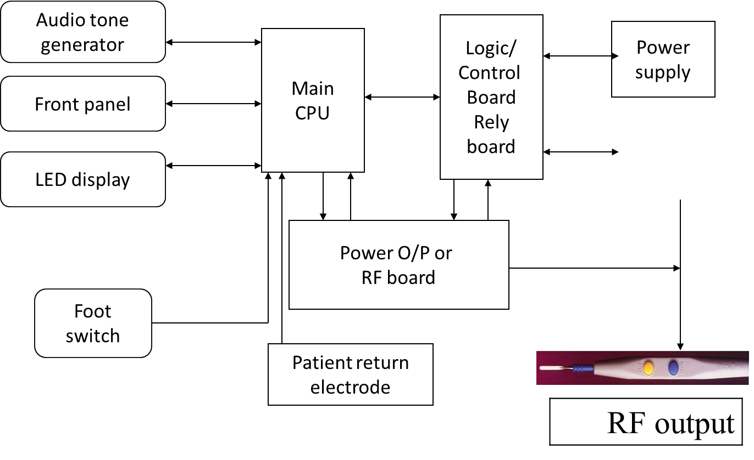
Electrosurgical machine: Construction

Slide 12
Troubleshooting
The most common problems in electrosurgery are:
    burns, excessive tissue damage, damage to alternate
    fires
    interference with other devices.
Skin burns are the most frequently reported of these problems, usually occurring at the return electrode site. Partial or complete detachment of the electrode pad from the patient is the most common cause.
The dispersive electrode should always be placed on an area of the body that has good blood flow and is not subject to high weight concentration. The side of the thigh is a very common location.
If the tip is dirty, there can be little, or no, current passing through the patient

Slide 13
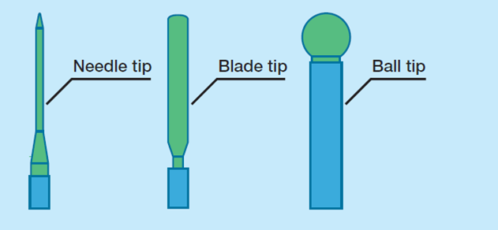
Preventive maintenance
The most important action in preventive maintenance is to keeping the inside and outside of the machine clean. Check the plate electrode, the leads, and the instruments.
If the physician wishes a different tip for a monopolar electrosurgery unit, it is sufficient to connect any metal tip to the existing tip. Insure that the connection is electrically and mechanically sound to the existing tip and pen.

Slide 14
Safety considerations
The ESU is inherently a potentially dangerous device. All members of the surgical team using an ESU must be fully aware of the hazards, understand the principles of operation and safe handling, and be familiar with the abilities and limitations of their particular unit.
The main risks associated with electrical surgery
        Burns
        Electrical interference with the heart muscle
        Explosion/fire caused by sparks and
        Electrical interference with pacemaker and other medical equipment.

Slide 15
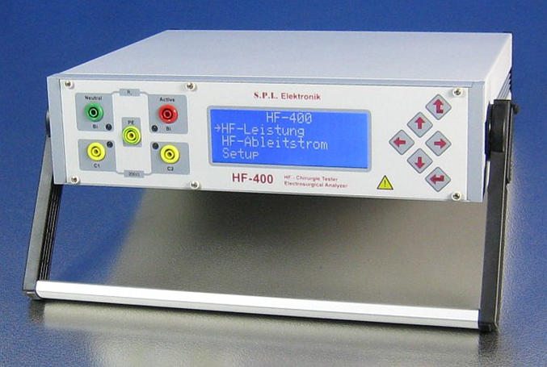
Performance monitoring
The performance and safety of electrosurgical devices must be verified every 3-6 months.
A typical test procedure can consist of the following test steps:
  Visual inspection
  Low-frequency electrical safety test.
  Verification of the contact quality monitoring circuit (Return Electrode Monitoring)
  Testing for high frequency leakage.

Slide 16
THANK YOU

