Slide 1



AL-Mustaqbal University
Microsoft PowerPoint
Lecture 8
Design Tab – Slide Layout
By M.Sc. Alaa khalid
Department of Medical Instrumentation Techniques Engineering

Slide 2

Design Tab – Slide Layout
Design Tab: the "Design" tab on the ribbon provides tools and options to customize your presentation's overall look and feel. The "Design" tab is organized into several groups, each containing specific tools and options for designing and formatting your presentation. Here are the main groups you'll find within the "Design" tab:
Page Setup:
Themes
Background

Slide 3
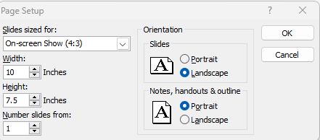

Design Tab – Slide Layout
Page Setup Group: includes options related to the size and orientation of your slides.
Page Setup:
This option allows you to change the dimensions of your slides. You can choose from predefined slide sizes (such as Standard or Widescreen) or set a custom size.

Slide 4
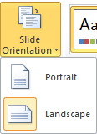
Design Tab – Slide Layout
Page Setup Group: includes options related to the size and orientation of your slides.
Orientation:
The orientation option lets you choose between "Portrait" and "Landscape" modes. "Portrait" means the slide is taller than it is wide, while "Landscape" means the slide is wider than it is tall.

Slide 5
Design Tab – Slide Layout
Themes Group: provides a collection of predefined design elements that you can apply to your entire presentation. Themes in PowerPoint include a combination of colors, fonts, effects, and background styles to give your slides a cohesive and professional look.
Theme: Clicking on the "Theme" button opens a gallery of available themes. These themes determine the overall design style of your presentation, including the color scheme, font styles, and effects.
Colors: The "Colors" button allows you to choose a color scheme for your presentation. The colors within the theme are applied to various elements such as text, background, and shapes.
Fonts: The "Fonts" button lets you select a set of font styles that will be used throughout your presentation. This includes fonts for titles and body text.

Slide 6
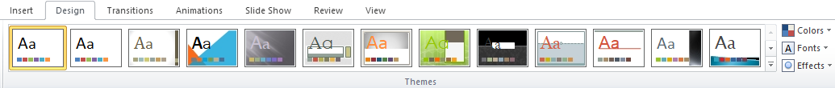
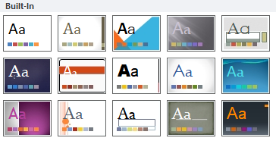
Design Tab – Slide Layout
Effects: The "Effects" button provides options for applying visual effects to elements in your presentation. Effects may include shadows, reflections, and glows.
Colors
Themes
Fonts
Effects

Slide 7
Design Tab – Slide Layout
Background Group: allows you to customize the background of your slides. This group provides options for applying different background styles to enhance the visual appeal of your presentation.
Background Styles: Clicking on "Background Styles" opens a dialog box that provides more detailed options for customizing the background of your slides. In this dialog box, you can choose to fill the background with a solid color, gradient, texture, or picture. You can also adjust transparency, apply background styles, and make other advanced adjustments.

Slide 8

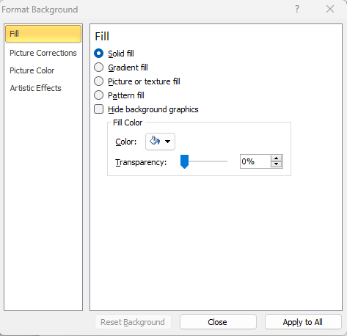
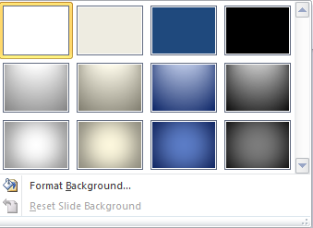
Design Tab – Slide Layout

Slide 9

Design Tab – Slide Layout
Hide Background Graphics: This option allows you to toggle the visibility of background graphics on your slides. If your theme or background includes graphics that you want to temporarily hide, you can use this option.

Slide 10
Thank You

