Slide 1



AL-Mustaqbal University
Microsoft PowerPoint
Lecture 10
Slide Show & Review & View Tabs
By M.Sc. Alaa Khalid
Department of Medical Instrumentation Techniques Engineering

Slide 2

Slide Show & Review & View Tabs
Slide Show Tab: In PowerPoint, the Slide Show tab provides options and features for presenting your slideshows.
Start Slide Show Group:
From Beginning: Start the slideshow from the first slide.
From Current Slide: Start the slideshow from the currently selected slide.
Set Up Group:
Hide Slide: If you don’t want a slide to be included in the final slide show, you can hide it from your audience. It won't show up when you play the slide show, but you will still see it in the normal view so you can bring it back in the future.

Slide 3
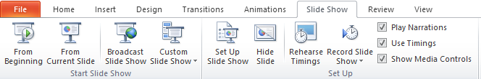
Slide Show & Review & View Tabs
Select the slide you want to hide.
Click the Slide Show tab.
Click Hide Slide.
From Beginning
From Current Slide
Hide Slide

Slide 4
Slide Show & Review & View Tabs
Review Tab: In PowerPoint, The "Review" tab provides tools and features for reviewing and collaborating on presentations.
Comments Group: the "Review" tab, provides tools for adding and managing comments in a presentation.
New Comment: Clicking on "New Comment" allows you to add a comment to a specific slide or a particular element within a slide. This is useful for leaving feedback or notes for collaborators.
Delete: The "Delete" option allows you to remove selected comments. If you have comments in your presentation and you want to get rid of some of them, you can select the comment and then click "Delete."

Slide 5
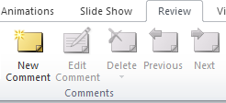
Slide Show & Review & View Tabs
Review Tab
New Comment
Delete
Comments Group

Slide 6
Slide Show & Review & View Tabs
Working with Slides
Add New Slide:
Click on the "Home" tab in the ribbon.
In the Slides group, click on the "New Slide" dropdown, or press the shortcut (Ctrl + M).
Deleting Slides:
In the Slides pane on the left, right-click on the slide you want to delete and Select "Delete Slide.“
Press “Delete” on the keyboard.

Slide 7
Slide Show & Review & View Tabs
Working with Slides
Slide Layout: Microsoft PowerPoint refers to the arrangement of placeholders on a slide. Each layout is designed for a specific purpose, allowing you to easily organize and format the content of your slides.
To apply a new slide layout in PowerPoint, click on the desired slide, go to the "Home" tab, and access layout options in the "Layout" dropdown within the Slides group. Choose a layout that suits your content needs, allowing for easy customization of slide organization and placeholders.
Changing Layout After Adding a Slide: If you've already added a slide and want to change its layout, right-click on the slide in the Slides pane on the left. Choose "Layout" from the context menu and select a new layout.

Slide 8
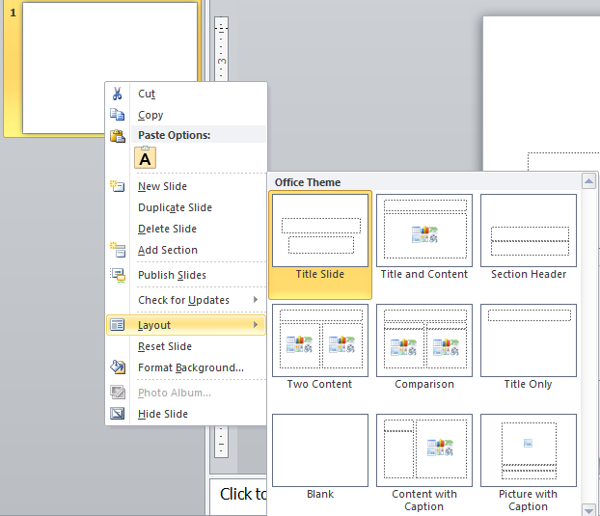
Slide Show & Review & View Tabs
Right-Click on slide
Slide Layouts
Layout

Slide 9
Slide Show & Review & View Tabs
View Tab: This tab is used to set how you want your presentation to be viewed while you are working on it.
Presentation Views Group:
Normal: The default view for editing individual slides.
Slide Sorter: Shows all slides in thumbnail form, allowing you to rearrange or delete slides easily.
Notes Page: This allows you to view and edit speaker notes associated with each slide.
Reading View: Shows your presentation in a full-screen mode, similar to how it would appear during a presentation.

Slide 10

Slide Show & Review & View Tabs
Slide Master
Normal View
Presentation Views Group
Master Views Group

Slide 11
Slide Show & Review & View Tabs
Master Views Group:
Slide Master: The slide master is a simple way of applying changes to the entire slide. Every presentation has at least one slide master, but you can have more than one. Using features like copy/ paste and format painting you can make changes to different sections within the presentation to make them look similar, however, if you want to use a theme and background throughout the slide, using the slide master is a simpler and more graceful way of approaching it.

Slide 12
Slide Show & Review & View Tabs
Accessing Slide Master:
To enter Slide Master view, click on the "View" tab in the Ribbon.
In the "Master Views" group, click on "Slide Master."
Understanding Master Slide:
The Master Slide is the topmost thumbnail in the left pane and represents the overall design of your presentation.
Changes made to the Master Slide will affect all slides in the presentation.

Slide 13
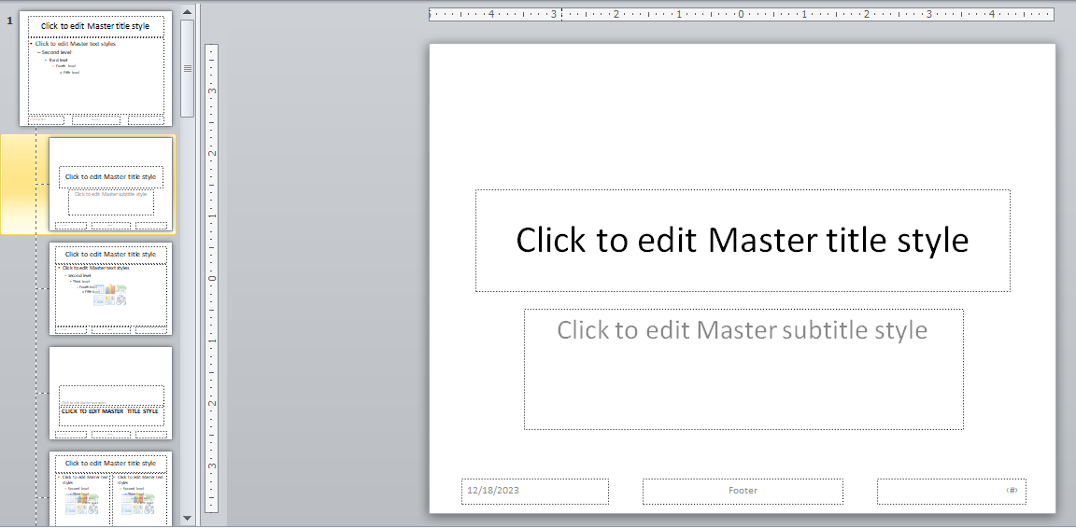
Slide Show & Review & View Tabs
Title
Slide Layouts
Slide number
Date
Footer

Slide 14
Slide Show & Review & View Tabs
Layouts and Placeholder Customization:
Each layout (Title Slide, Title, Content, etc.) is represented by a thumbnail on the right side.
Click on a layout to customize it individually.
Adjust the size and position of placeholders for titles, content, images, etc.
Text Formatting:
Customize the formatting of text globally by changing font styles, sizes, and colors on the Master Slide.
Changes will be applied to all slides using that Master Slide.

Slide 15

Slide Show & Review & View Tabs
Slide Numbering and Date:
Control the appearance and positioning of slide numbers, date, and footer text.
Use the "Insert Slide Number" and "Insert Date & Time" options on the "Insert" tab.
Exiting Slide Master View:
Click the "Close Master View" button or simply click on the "Normal" button in the status bar to return to the normal editing mode.
Saving Changes:
Changes made in the Slide Master view are automatically applied to your presentation.
Save your presentation to preserve these changes.

Slide 16
Thank You

