Slide 1
Indication of infant referal tophthalmolgist
Age |  | Referral Criteria
Newborn to 12 months(infant) |  | do not track well after 3 months of age abnormal red reflex retinoblastoma in a parent or sibling Inspection Structural abnormality Alternate occlusion Failure to object equally to covering each eye Corneal light reflex

Slide 2
Indications for referral of infant to child to ophthalmologist
1) Visual Behavior/Acuity
General Guidelines
• By 3 months of age, babies should exhibit a social smile and make eye contact.
• By 4 months of age, babies’ ocular alignment is stable and can look from near to far and back again.
• Vision testing with a pediatric eye chart is usually beginning age 3-4 years.
Refer when:
► Absence of a social smile or eye contact by 3 months of age should prompt a referral.
► Any misalignment of eyes (intermittent or constant) in children after the age of 4 months or constant misalignment of eyes at any age even before 4 months should be evaluated .

Slide 3
history should include a detailed family history of eye and vision abnormalities and of past and present medical problems. Infants at risk for eye problems because of family history of congenital cataract, congenital glaucoma, retinoblastoma, metabolic or genetic disease baby’s visual interactions, visual abilities, and possible eye or vision problems
examination of the red reflex to detect abnormalities of the ocular media; external inspection to detect ocular abnormalities; visual acuity on an age-appropriate basis; and, after 6 months of age, the corneal light reflex (Hirschberg) test and cover testing both for ocular alignment and motility testing.
e newborn medical examination and is limited to the red reflex and identification of structural abnormalities. If a structural eye problem is detected, the baby should be referred on an urgent basis. [
At 6 months of age all infants should be evaluated for fixation preference, ocular alignment, and the health of ocular structures

Slide 4
3 years (approximately)
20/50 or worse, or 2 lines of difference between the eyes
Corneal light reflex/ cover-uncover Asymmetric/ocular refixation movements
Red reflex Abnormal or asymmetric Inspection Structural abnormalit

Slide 5
Vision testing should be performed for a child at the earliest age that is practical, and it is recommended for all children starting at age( If picture cards )are used approximately age 2. The most sophisticated test that a child is capable of performing should be used to achieve the most accurate testing possible
Adjunctive screening methods include the binocular red reflex (Bruckner) test to detect anisometropia (unequal refractive error in the two eyes) or strabismus and stereovision testing to detect small-angle strabismus.
The binocular red reflex test is performed in a dimly lit room before pupillary dilation takes place
Normally, the reflex should be of the same color and brightness, but with media opacities, strabismus, anisometropia, large vitreoretinal lesions, and anisocoria, the reflex will be unequal. Opacities identified using the retinoscopic reflex.

Slide 6
5 years (approximately)
Visual acuity* (monocular) 20/40 or worse, or 2 lines of difference between the eyes Corneal light reflex/ cover-uncover Asymmetric/ocular refixation movements Red reflex Abnormal or asymmetric Inspection Structural abnormality

Slide 7
after age 5
20/30 or worse, or 2 lines of difference between the eye
Corneal light reflex/ cover-uncover Asymmetric
ocular refixation movements
Red reflex Abnormal or asymmetric
Inspection Structural abnormality
NOTE: pupillary dilation facilitates evaluation of the red reflex.
For infants, a combined weak solution of phenylephrine hydrochloride and cyclopentolate

Slide 8
Abnormalities on the screening evaluations
Detection of a red reflex abnormality or asymmetry
Detection of a structural eye abnormality Detection of an ocular alignment or motility abnormality Unable to perform vision screening at age 3-3 ½ or older
Visual acuity 20/50 or worse, or a 2 line difference in a 3-year-old
Visual acuity 20/40 or worse, or a 2 line difference in a 5-year-old
Visual acuity 20/30 or worse, or a 2 line difference in a 6-year-old or older child

Slide 9
Signs or symptoms of eye problems by history or observations by family members
Defective ocular fixation or visual interactions
Abnormal light reflex (including both the corneal light reflections and the "red" fundus reflection)
Ocular alignment or movement abnormality Nystagmus (shaking of eyes)
Persistent tearing
Persistent ocular discharge
Persistent redness
Persistent light sensitivity
Squinting
Eye closure
Head tilt
Learning disabilities

Slide 10
Diagnoses that may be made during a comprehensive pediatric medical eye examination based on abnormalities detected during eye and vision screening include, but are not limited to the following:

Slide 11
Retinopathy of prematurity
Congenital cataract
Leukocoria
Childhood retinal dystrophy/ degeneration
Conjunctivitis
Nystagmus
Strabismus
Refractive disorder
Retinoblastoma
Congenital glaucoma
Diseases associated with a cloudy cornea
Coloboma (iris or retinal)
Nasolacrimal duct obstruction
Delayed visual maturation
Amblyopia
Ptosis

Slide 12
Family history
(general health problems, systemic disease, or use of medications that are known to be associated with eye disease and visual abnormalities)
Amblyopia
Glasses in early childhood
Sickle cell disease
Systemic syndromes with ocular manifestations

Slide 13
general health problems, systemic disease, or use of medications that are known to be associated with eye disease and visual abnormalities
Prematurity
Perinatal complications (evaluation at birth) and (at 6 months)
Neurological disorders or neurodevelopmental delay (upon diagnosis)
Juvenile rheumatoid arthritis (upon diagnosis)
Diabetes mellitus (5 years after onset, yearly thereafter)
Systemic syndromes with ocular manifestations (at 6 months or upon diagnosis)
Chronic systemic steroid therapy or other medications (e.g., hydroxychloroquine) known to cause eye disease

Slide 14
2) Eyelids
General Guidelines
• Mechanical obstruction of vision can produce severe visual loss .
• Droopiness of Eyelid (ptosis) or Eyelid hemangioma can also cause amblyopia.
Refer when:
► Any child with ptosis or eyelid mass should be referred for evaluation.

Slide 15
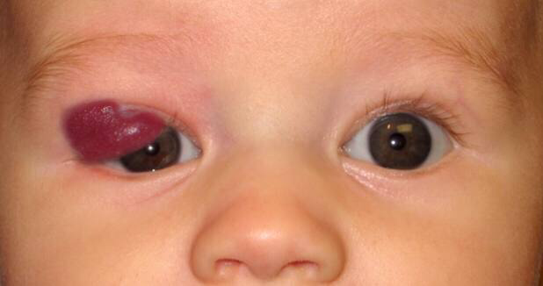
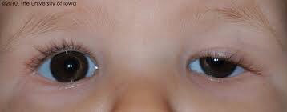
Eyelid hemangioma
ptosis

Slide 16
3) Nasolacrimal System
General Guidelines
Dacryocele / Mucocele
• Often heralded by clinically apparent enlargement of the lacrimal sac and bluish discoloration of the overlying skin in the first weeks of life.
Dacryostenosis (Blocked tear duct)
• Excessive tearing is usually related to nasolacrimal duct obstruction, and often resolves in the first year of life.
Refer when:
► Immediate referral – as there is risk for secondary infection and neonatal sepsis
► If there is recurrent nasolacrimal sac infection (dacryocystitis), earlier referral and treatment is appropriate

Slide 17
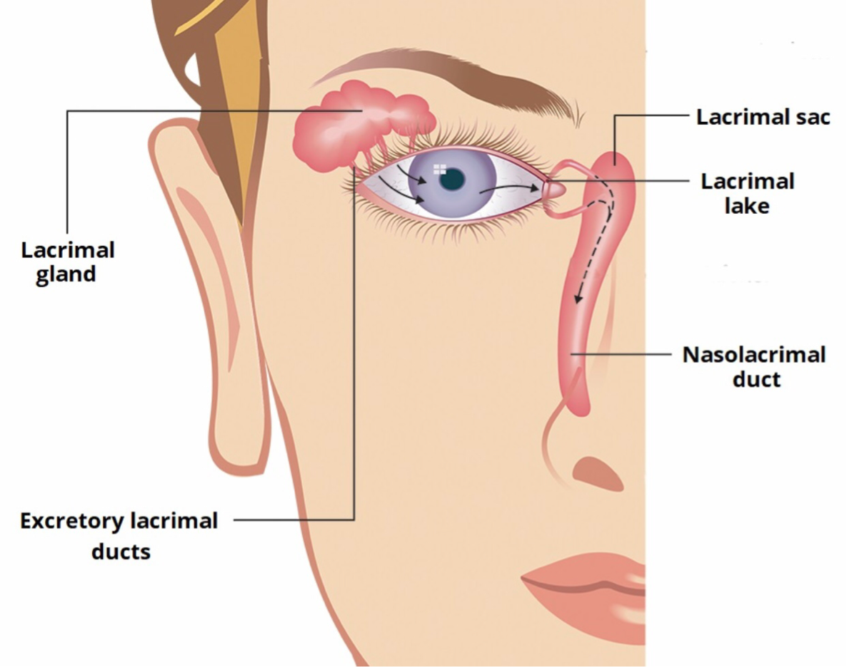

Slide 18
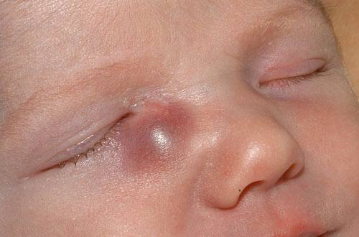
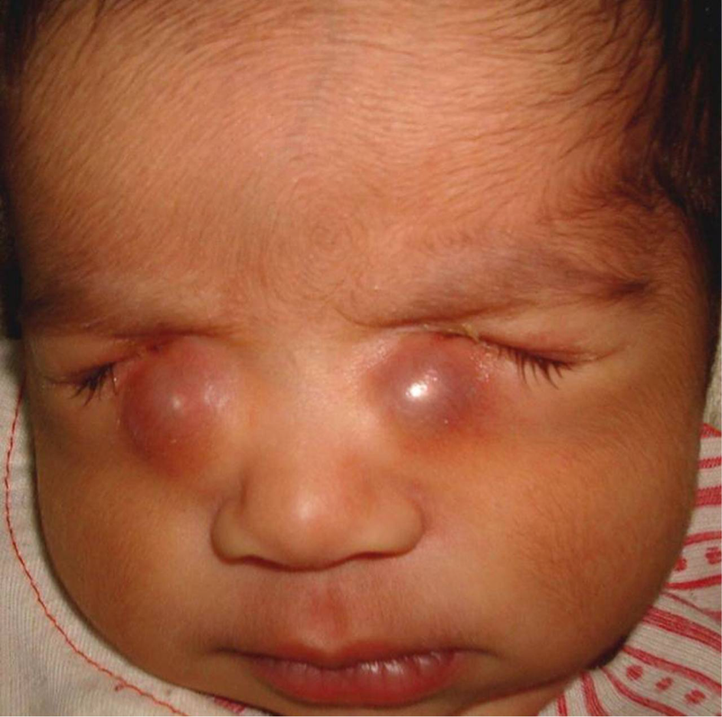
Dacryocele

Slide 19
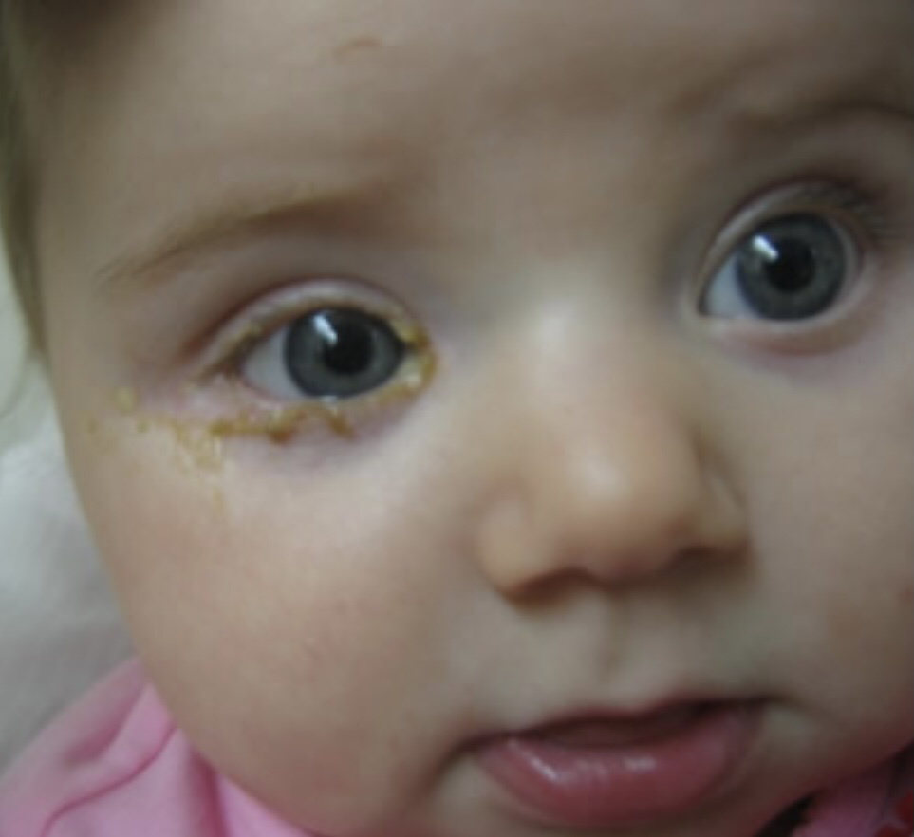
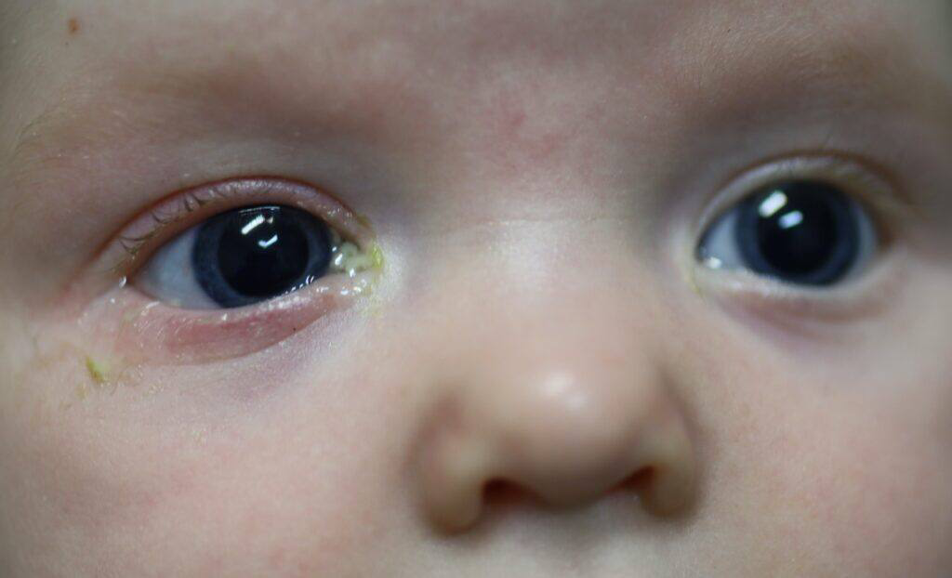
Dacryostenosis

Slide 20
4) Anterior Segment
Congenital Glaucoma
• When excess tearing is associated with photophobia (light aversion), corneal enlargement and clouding, an immediate referral should be made for possible congenital glaucoma.
Chronic Conjunctivitis
• The most common cause is allergic conjunctivitis. However, other (more serious) etiologies should always be considered
► Immediate referral – Delays can cause irreversible optic nerve damage, permanent corneal enlargement, astigmatism and amblyopia.

Slide 21
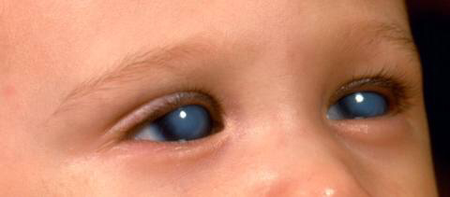
congenital glucoma

Slide 22
5) Ocular Media Opacities
• Examination of the red reflex is an essential part of healthy baby/child visits in nonverbal children.
► Anytime there is a dull or asymmetric reflex a referral should be made.
► If there is a white reflex (leukocoria) an urgent referral should be made to rule out possible retinoblastoma.

Slide 23
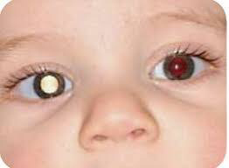
leukocoria

Slide 24
6) Sensorimotor System (pupils and eye movements)
General Guidelines
Difference in Pupil Size
• A difference in pupil size that is less than 1mm in both light and dark is usually benign.
Refer when:
► Any difference in pupil size more than 1mm should be evaluated.
► Association of mild ptosis (droopy eyelid), with a smaller pupil on the same side, more pronounced in the dark, requires evaluation for Horner’s Syndrome and workup for rare cases of neuroblastoma.
► A dilated pupil with limitation of eye movement requires urgent referral for evaluation of a 3rd nerve palsy.

Slide 25
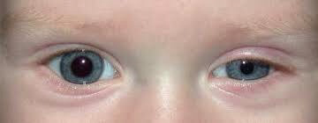
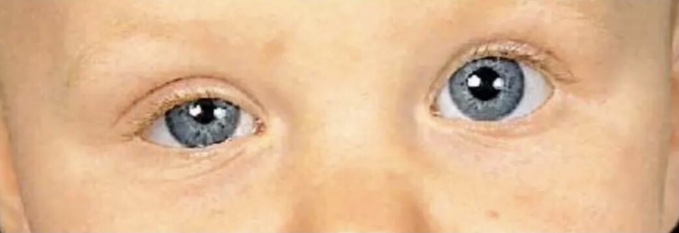
Horner syndrom

Slide 26
Nystagmus
► Any child with nystagmus (oscillating eye movements) should be evaluated.
► New/acute onset nystagmus requires urgent evaluation.
7) Prematurity
General Guidelines
• Very premature infants, <1500g or <32wks, are at risk for development of strabismus and refractive errors – even in the absence of retinopathy of prematurity (ROP).
Refer when:
► These infants should be examined at minimum 3 and 6 months post discharge from the NICU (or more frequently if there is a history of retinopathy of prematurity).

Slide 27
8) Systemic Disorders
General Guidelines
• Children with autoimmune disorders are at risk for uveitis.
Appropriate referral for screening should be made (e.g. Lupus . JRA,)
• Children with Type I or II Diabetes are at risk for development of retinopathy.
• Children with Sickle Cell disease, Albinism, Hypertension, thyroid malfunction, sturge-weber syndrome.
Refer when:
► Baseline evaluation followed by appropriate examinations for children with diabetes is recommended.
► Baseline evaluation followed by appropriate eye examinations based on ocular findings.

Slide 28

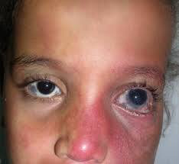
albinism
sturge weber syndrom

Slide 29
Congenital syndrome
▪ Subtle abnormalities of the anterior segment may be associated with significant underlying ocular maldevelopment (e.g. small iris coloboma – “key hole pupil” – with possible associated chorioretinal and optic nerve coloboma) ✓
. ✓ Children with Down syndrome are at higher risk for cataracts and high refractive errors.
✓ Ocular examination can aid in diagnosis of certain syndromes (e.g. Iris Lisch nodules is NF-1|, lens subluxation in Marfan’s). .
✓ Any child with a history of gestational drug exposure/alcohol should be evaluated for associated ocular abnormalities.
✓ Any child with craniosynostosis should be evaluation for optic neuropathy and strabismus

Slide 30
NON-ACCIDENTAL INJURY
▪ Retinal hemorrhages may be an important clue to possible “shaken baby syndrome” and are more common before age 3 months – due to poor neck control ✓ Any child with suspected non-accidental injury should have a dilated fundus examination.
HEADACHES ▪ Headaches can be secondary to refractive errors (need for glasses) or ocular motility issues like convergence insufficiency ✓
Any child with chronic headaches or complaining of headache after prolonged reading should have a comprehensive eye examination.

