Slide 1
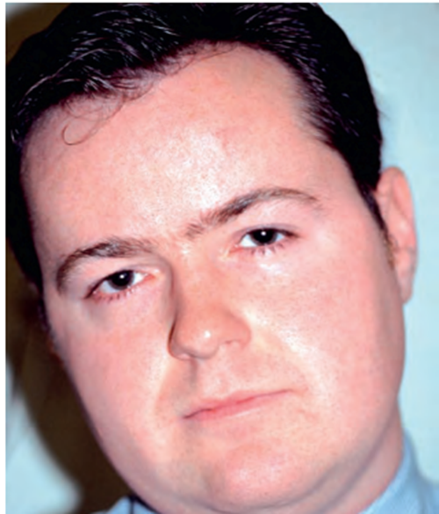
History
Both strabismus and torticollis are common presenting conditions in pediatric ophthalmology. Torticollis is an abnormal head position (AHP), such as a head turn or tilt. Torticollis is a common presenting sign of strabismus but can be caused by a wide variety of other ocular and nonocular conditions.
There is broad overlap in the diagnostic assessment of
strabismus and
torticollis.
Key questions for the clinician to ask when obtaining
a strabismus or torticollis history include the following:
• At what age did the deviation or AHP appear?
(Reviewing old photo graphs may be helpful.) •
Did onset coincide with trauma or illness?
• Is the deviation or AHP constant or intermittent
• Is it present for distance or near vision or both?
• Is it present only when the patient is inattentive or fatigued?
• Is it associated with double vision or eyestrain?
• If a deviation is noted, is it present in all positions of gaze?
• If a deviation is noted, is it unilateral or alternating?
• Does the patient close 1 eye blepharoptosis, ?
• Is there a history of other ocular disease or ocular surgery?
It is important to review any previous treatment,
such as amblyopia therapy, spectacle correction, and eye muscle surgery.

Slide 2
the acquired condition with the sudden onset of diplopia. (horizontal, cyclovertical) should be established, the direction of gaze in which it predominates and whether any BSV is retained
• It is not unusual for patients to present with spurious symptoms which mask embarrassment over a cosmetically noticeable squint.
General health or developmental problems (e.g, children with cerebral palsy have an increased incidence of strabismus).
.patients may report associations or causal factors (trauma, neurological disease, diabetes etc).
. Birth history, including period of gestation, birth weight and any problems in utero, with delivery or in the neonatal period.
.previous surgery or prisms is important to future treatment options and prognosis
Clinical features of acquired muscle palsy can result from various causes such as trauma, vascular disease, intracranial tumours, or aneurysm, and, or ocular motor restriction, previous medical history, especially the presence of vascular risk factors noted
.the presence of other related ophthalmic or neurological signs

Slide 3
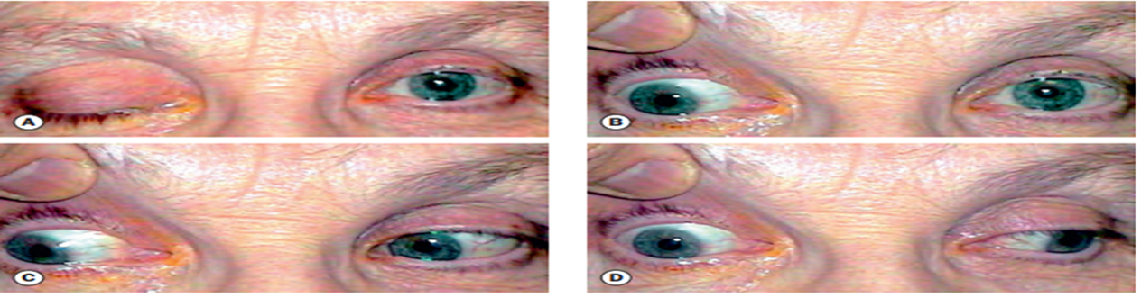
Cranial Nerve III Palsy In children,
CN III palsy can be a) Congenital b) Acquired: acquired cases can be caused by i. trauma ii. Inflammation iii. viral infection iv. mass lesion. v. It can result from a steroid- responsive condition known as ophthalmoplegic migraine, vi. CN III palsy in children can also occur after vaccination Clinical features ✓ limited adduction, elevation, and depression of the eye, with exotropia and hypotropia ✓ Upper eyelid ptosis
Fourth cranial nerve palsy Fourth nerve palsy is the most common form of paralytic vertical strabismus. The diagnostic criteria include a ▪ hypertropia of the affected eye that increases on adduction and ipsilateral head tilt ▪ Limitation of depression, most marked in adduction, that’s why patient has problem in reading ▪ A compensatory head posture to contralateral side to avoids diplopia

Slide 4
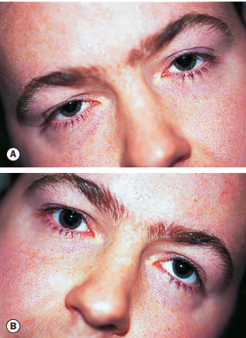
signs of congenital palsy
history of head tilt dating back to infancy, definite facial asymmetry, amblyopia in the palsied eye, large vertical fusional amplitudes more than 10 prism dioptres (PD)
Superior oblique
(fourth nerve) palsy patient, a disappearance or decrease in the vertical deviation angle exaggerated with the head tilt test was used is the most common form of paralytic vertical strabismus.
The diagnostic criteria include
a ▪ hypertropia of the affected eye that increases on adduction and ipsilateral head tilt ▪ Limitation of depression, most marked in adduction, that’s why patient has problem in reading ▪ A compensatory head posture to contralateral side to avoids diplopia
Causes of isolated fourth nerve palsy
➢ Idiopathic (congenital ) cause
▪ symptoms may not develop until decompensation occurs in adult life due to reduced fusional ability. ▪ In contrast to acquired lesions patients are not usually aware of the torsional aspect, but may develop vertical double vision that is often appreciated as of sudden or subacute onset. ▪ Most patients maintain a chronic head tilt.
The long- standing nature of the head tilt may cause
facial asymmetry and can often be confirmed by reviewing
old photo graphs
➢ Traumatic cause:
frequently causes bilateral fourth nerve palsy.
Care must be taken not to mistake a bilateral palsy
for a unilateral lesion, particularly when corrective surgery is
contemplated

Slide 5
Cranial Nerve VI Palsy
General considerations and differential diagnoses
▪ Weakness of the lateral rectus muscle due to palsy of the abducens nerve results in Incomitant esotropia.
▪ CN VI palsy occurring in the neonatal period is rare and usually transient. Pathogenesis ▪ Congenital CN VI palsy is usually benign and transient and may be caused by ▪ Increased intracranial pressure associated with the birth process. ▪ CN VI palsy in older children is associated with intracranial lesions ▪ infectious agents: mostly due to virus
Clinical features
▪ Esotropia and in older children may report diplopia. If a child presents soon after the onset of the deviation, vision in the eyes is usually equal.
Evaluation
✓ It is important to take a careful history that includes antecedent infections, head trauma, and hydrocephalus,
✓ high prevalence of associated intracranial lesions in children with CN VI palsy, neurologic evaluation and magnetic resonance imaging of the head and orbit are usually indicated, even in the absence of other focal neurologic findings

