Slide 1
NYSTAGMUS
is an involuntary oscillation of the eyes that can be a physiological (e.g. following the rotation of an optokinetic drum) or pathological phenomenon. In pathological nystagmus, each cycle of movement is usually initiated by an involuntary, defoveating drift of the eye away from the target, followed by a refixating saccadic movement.
• Plane may be horizontal, vertical, or torsional.
• Amplitude refers to the extent of excursion: fine or coarse.
• Frequency describes how rapidly the eyes oscillate: high, moderate or low

Slide 2
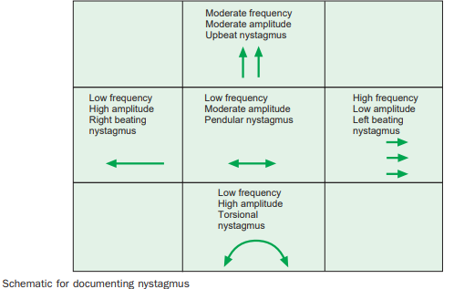
• Jerk nystagmus is saccadic with a slow defoveating ‘drift’ movement and a fast corrective refoveating saccadic movement. The direction of nystagmus is described in terms of the direction of the fast component: right, left, up, down or rotatory.
• Pendular nystagmus is non-saccadic in that both the foveating and defoveating movements are slow (i.e. the velocity of nystagmus is equal in both directions).
• Mixed nystagmus consists of pendular nystagmus in the primary position and jerk nystagmus on lateral gaze.
.

Slide 3
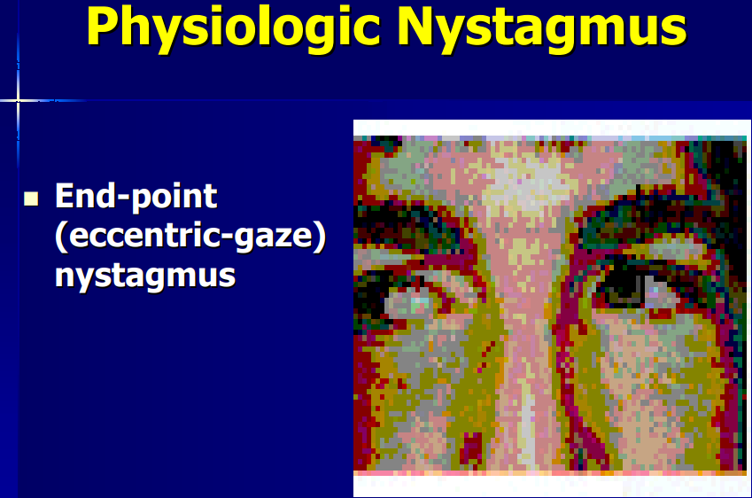
Optokinetic Nystagmus Test ( OKN )
: drum has been proposed as a method of measuring visual acuity in children.
• It has been used for assessing visual function in infants, hysterical patients, and malingerers. It is also of value in the diagnosis of disorders of the central nervous system.
• In this test, nystagmus is elicited by passing a succession of black and white stripes through patient's field of vision
. • When the subject views rotating strip drum his/her eyes involuntarily follow a strip which slow eye movement (pursuit movement) then return with fast eye movement (saccade movement) to fixate the new strip
○ OKN nystagmus is useful for detecting functional (non-physiological) blindness and for testing visual acuity in the very young. It can be helpful in the assessment of an isolated homonymous hemianopia

Slide 4
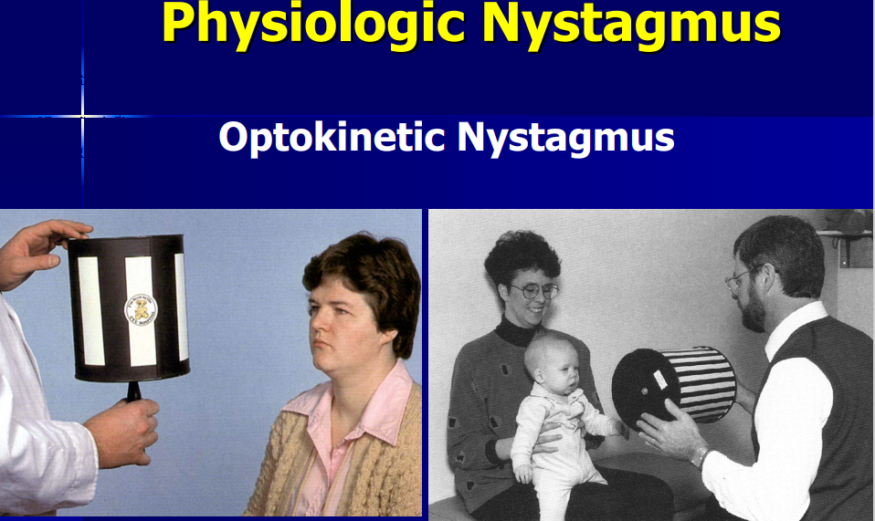

Slide 5
Vestibular nystagmus
• Physiological vestibular nystagmus is a jerk nystagmus caused by altered input from the vestibular nuclei to the horizontal gaze centres.
elicited by caloric stimulation as follows:
○ When cold water is poured into the right ear the patient will develop left jerk nystagmus (i.e. fast phase to the left).
○ When warm water is poured into the right ear the patient will develop right jerk nystagmus (i.e. fast phase to the right). A useful mnemonic is ‘COWS’ (cold-opposite, warm-same) indicating the direction of the nystagmus. ○ When cold water is poured into both ears simultaneously, a jerk nystagmus with the fast phase upwards develops; warm water in both ears elicits nystagmus with the fast phase downwards (cold ‘slows things down’). ○ An abnormal test indicates the presence of peripheral vestibular disease.

Slide 6
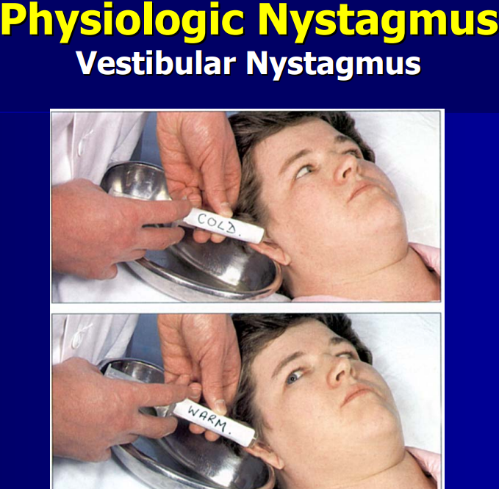

Slide 7
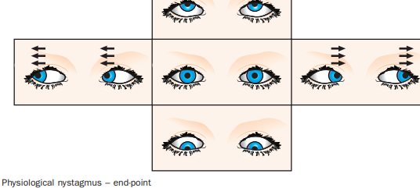
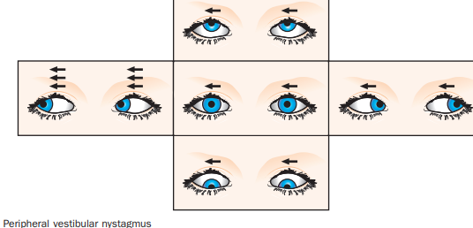
Pathological peripheral vestibular nystagmus (Fig. 19.81) is caused by disease affecting the ear such as labyrynthitis, Ménière disease and middle or inner ear infections. It tends to be solely horizontal, vertical or torsional, increases in intensity with gaze in the direction of the fast phase, and is dampened by fixation. It is typically of fine amplitude.

Slide 8
Infantile (congenital) nystagmus
Sensory deficit (afferent) Sensory deprivation nystagmus is the more common form of infantile nystagmus and is caused by impairment of central vision in early life (e.g. congenital cataract, macular hypoplasia, albinism, Leber congenital amaurosis, optic nerve hypoplasiaachromatopsia). In general, children with bilateral poor vision under 2 years of age develop nystagmus, the severity of which is associated with the degree of visual loss.
Introduction
Early-onset (usually the first few months of life rather than truly congenital) commonly pendular, horizontal and uniplanar (direction of oscillation remains constant regardless of direction of gaze). In contrast to adults with acquired nystagmus, oscillopsia is not experienced even by adults with congenital nystagmus. dampened by convergence and is not present during sleep. There is usually a null point – a position of gaze in which nystagmus is minimal – and a compensatory head posture may develop to favour this. Investigation should seek to detect ocular and systemic association
A family history is common, with X-linked (dominant or recessive) inheritance the common mode. persists throughout life. VA is generally better than with sensory deficit nystagmus, at 6/12–6/36. may convert to jerk nystagmus on side gaze (

Slide 9
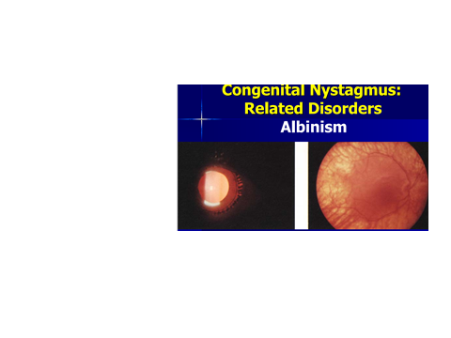
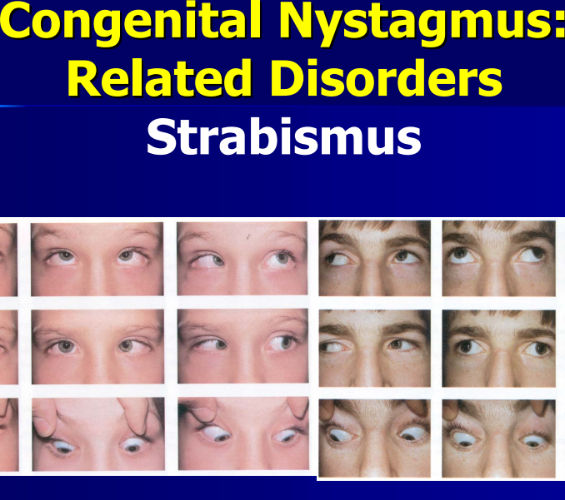
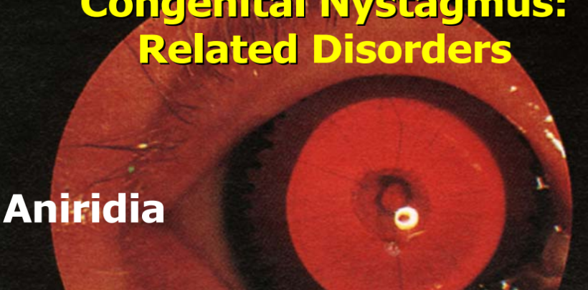
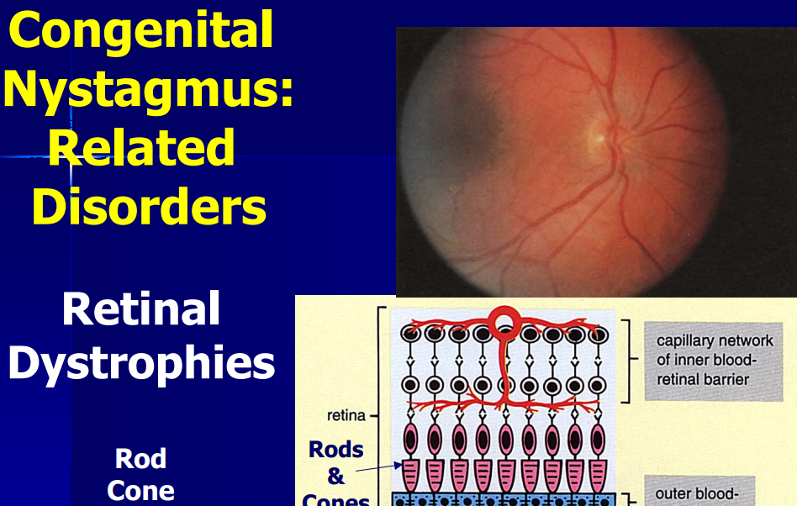
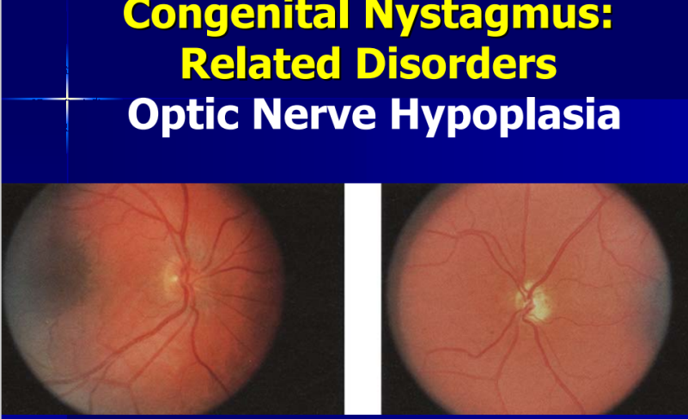

Slide 10
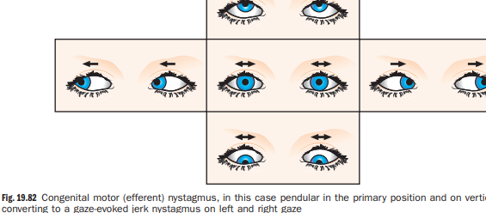
Infantile (congenital) nystagmus
Spasmus nutans
Presentation of this rare condition is between 3 and 18 months with unilateral or bilateral small-amplitude high-frequency horizontal nystagmus (Fig. 19.83) associated with head nodding. It is frequently asymmetrical, with increased amplitude in abduction. Vertical and torsional components may be present. An idiopathic form spontaneously resolves by age 3 years, but tumor of the anterior visual pathway, can also be causative

Slide 11
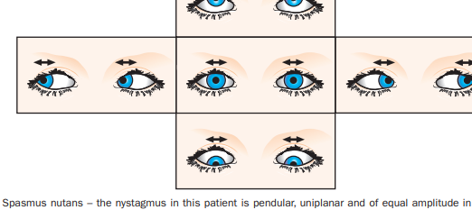
Acquired nystagmus
Latent nystagmus
is associated with infantile esotropia and dissociated vertical deviation With both eyes open there is no nystagmus, but horizontal nystagmus becomes apparent on covering one eye; the fast phase is in the direction of the uncovered fixating eye. Occasionally an element of latency may be superimposed on a manifest nystagmus so that when one eye is covered the amplitude of nystagmus increases (manifest-latent nystagmus)
Periodic alternating
nystagmus Periodic alternating nystagmus (PAN) is a conjugate horizontal jerk nystagmus that periodically reverses direction. During the active phase, the amplitude and frequency of nystagmus first progressively increase then decrease. This is followed by an interlude lasting 4–20 s during which time the eyes are steady and may show low-intensity, often pendular movements. A similar sequence in the opposite direction occurs thereafter, the whole cycle lasting between 1 and 3 minutes. PAN can be congenital or due to cerebellar disease, ataxia telangiectasia and drugs such as phenytoin

Slide 12
Upbeat nystagmus is a vertical nystagmus with the fast phase beating upwards in all positions (Fig. 19.85); causes include posterior fossa lesions, drugs and encephalopathy.
Convergence–retraction nystagmus
is a jerk nystagmus due to the co-contraction of extraocular muscles, often the medial recti. It can be induced by rotating an OKN drum downwards; the upward refixation saccade brings the two eyes towards each other in a convergence movement. There is classically associated retraction of the globe into the orbit. It is a component of lesions, and vascular accidents.
Downbeat nystagmus
This is a vertical nystagmus with the fast phase beating downwards (Fig. 19.84), more easily elicited in lateral gaze and downgaze. It can be caused by lesions at the foramen magnum drugs such as lithium and phenytoin, and a range of other conditions
See-saw nystagmus
A pendular nystagmus, in which one eye elevates and intorts while the other depresses and extorts. It can be due to tumours stroke
Ataxic nystagmus
is a horizontal jerk nystagmus that occurs in the abducting eye
Bruns nystagmus
This consists of a coarse cerebellar horizontal jerk nystagmus in one eye and fine high frequency vestibular nystagmus in the other, and can be caused by tumours

Slide 13
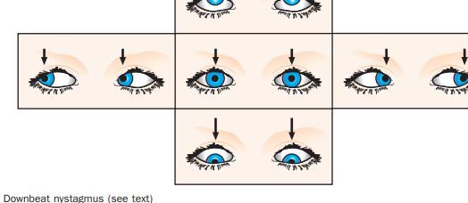
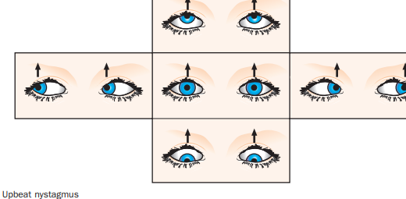
Treatment of nystagmus
• Amblyopia and refractive error should be managed as appropriate. Contact lenses and other refractive measures such as the combination of high minus contact lenses and high plus spectacle lenses may be helpful. • Medication
. • Botulinum toxin injection into the extraocular muscles has had some success but can be unpredictable and long-term treatment is required.
• Surgery for nystagmus with a null point is aimed at moving muscles in order to mimic muscle tension while the eyes and face are straight and may be performed to address a compensatory head posture. Recession of all horizontal recti has been successful in reducing the amplitude of ny ystagmus in some patients without a significant null point

