Slide 1
College of Administrative Sciences
Department of Business Administration
Almustaqbal University
1st lecture (Greeting people)
اعداد :م.م.التفات عليوي محمد
Iltifat.Aliwi.Mohemmed@uomus.edu.iq
First stage students in the Department of Business Administration

Slide 2

Week 1, Lesson 1.1
Review of Names and Numbers

Slide 3
“The verb ‘to be’ means ‘am,’ ‘is,’ or ‘are.’
We use it to talk about names, countries, and jobs.
For example:
Positive: ‘I am a student.’
Negative: ‘I am not a teacher.’
Question: ‘Are you a student? Yes, I am.’ or ‘No, I’m not.’
Personal Activity
Write 4–5 sentences introducing yourself (name, country, age, job).

Slide 4

By the end of this lesson, students will be able to:
1- Greet others and introduce themselves using simple phrases.
2- Use the verb "to be" in positive, negative, and question forms (e.g., "I am," "He isn’t," "Are you?").
3- Understand and use basic personal information vocabulary (e.g., name, age, country).
4- Respond appropriately in simple conversations.
Behavioral Objectives

Slide 5
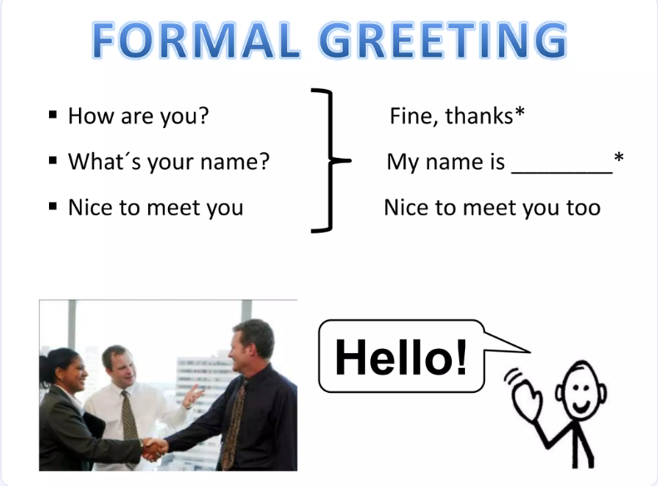

Slide 6
"Hello"
"Hi"
"Good morning"
"How are you?"
"I’m fine, thank you.“
Demonstrate a short greeting dialogue with a student:
Teacher: "Hello! What’s your name?"
Student: "My name is [Name]."
Ask students to practice with a partner.
B. Vocabulary: Greetings and Personal Information
"What’s your name?" → "My name is..."
"Where are you from?" → "I’m from..."
"How are you?" → "I’m fine, thank you."

Slide 7
Dialog
A. Hello. My name is ____. What is your name?
B. Hi, _____. My name is ___.
What is your last name?
A. My last name is ____________.
B. My telephone number is ____________. What is your telephone number?
A. My telephone number is ____________.
B. Thank you. I’m happy to meet you.
A. I’m happy to meet you, too. Good-bye---------
B. Good-bye, ____________

Slide 8
The verb "to be" is used in a variety of ways in English.
Here are its primary functions:
Linking verb: It connects the subject of a sentence with a subject complement (adjective, noun, or pronoun).
  Example: She is a teacher.
  Example: The sky is blue.
Auxiliary verb (helping verb): It is used with the main verb to form different tenses, passive voice, and continuous aspects.
  Example (passive voice): The cake is baked by my mom.
  Example (continuous aspect): I am running.
Indicating existence: It is used to express the existence or presence of something or someone.
  Example: There is a book on the table.
  Example: There are many people here.
.

Slide 9
Verb to be
Forming questions: The verb "to be" is used at the beginning of a question to inquire about identity, condition, or existence.
  Example: Are you coming to the party?
  Example: Is she happy?
Expressing identity, condition, or location: It is used to describe or give information about the subject's state, characteristics, or location.
  Example (identity): He is my brother.
  Example (condition): They are tired.
  Example (location): The library is on Main Street

Slide 10
Use basic countries (e.g., the USA, Brazil, Japan) and their nationalities (e.g., American, Brazilian, Japanese).
Explain the Verb "To Be":
Positive:
"I am" → "I’m"
"You are" → "You’re"
"He/She/It is" → "He’s/She’s/It’s"
Negative:
"I am not" → "I’m not"
"You are not" → "You’re not" / "You aren’t"
Questions:
"Am I?"
"Are you?"
"Is he/she/it?"
Positive: "I am a teacher." / "He is from Brazil."
Negative: "I am not a student." / "She is not from Japan."
Questions: "Are you a teacher?" → "Yes, I am." / "No, I’m not."

Slide 11
"Practice Activity:
Fill in the blanks:
"I ___ a student." (am)
"She ___ from China." (is)
"We ___ not from Italy." (are)
D. Listening and Speaking Practice (20 minutes)
Listening Activity:
Play a dialogue between two people introducing themselves.
Example:
A: "Hello! My name is Anna. What’s your name?"
B: "Hi, I’m John. Nice to meet you!"
A: "Where are you from?"
B: "I’m from Canada."
Ask comprehension questions (e.g., “What’s Anna’s name?”).

Slide 12
Activity 3 – Numbers, counting
1. Point to the list of numbers on the board, say “numbers,” and read the numbers from 1 to 20. “everyone” or “class” count and repeat.
2. Ask “How many students are here?” write on the board: [number] Ask my students to count with you and repeat, and then ask them write the spelled number (e.g., eight students) on the board.

Slide 13
20 Multiple Choice Questions (MCQs)
The verb "to be" is used to:
a) Express actions b) Describe states of being c) Show possession d) Indicate direction
2. Which of the following is the correct contraction for "I am"?
a) I'm b) Am c) 'm d) I'
3. How do you form the negative of "He is a doctor"?
a) He is not a doctor. b) He isn't a doctor. c) He not is a doctor. d) Both a) and b) are correct.
4. What is the question form of "She is from Spain"?
a) Is she from Spain? b) Are she from Spain? c) From Spain is she? d) She is from Spain?
5. Which of the following sentences uses "to be" correctly?
a) I am a student. b) You are from France. c) He is a teacher. d) All of the above.

Slide 14
6. In the sentence "We are not late," "are not" is the:
a) Positive form b) Negative form c) Question form d) Contraction
7. What is the purpose of the Listening Activity?
a) To practice grammar b) To improve pronunciation c) To develop listening comprehension d) To learn new vocabulary
8. In the Speaking Activity, students practice:
a) Introducing themselves b) Asking and answering questions c) Role-playing d) All of the above
10. The Homework Assignment includes:
a) Writing sentences about yourself b) Practicing workbook exercises c) Memorizing the verb "to be" d) Both a) and b)
11. What is the contraction for "You are"?
a) You're b) Your c) Y're d) Are

Slide 15
12. How do you form the question form of "I am a student"?
a) I am a student? b) Am I a student? c) Are I a student? d) Is I a student?
13. Which sentence is in the negative form?
a) He is a doctor. b) Are you from Mexico? c) She is not a teacher. d) I am happy.
14. What is the purpose of the Practice Activity with fill-in-the-blanks?
a) To assess student understanding b) To provide practice with sentence structure c) To introduce new vocabulary d) To improve pronunciation
15. In the Listening Activity, students listen to:
a) A song b) A story c) A dialogue d) A lecture

Slide 16
16. What is the main purpose of the Speaking Activity?
a) To improve fluency b) To practice pronunciation c) To build confidence d) To learn new vocabulary
17. Which of the following is NOT mentioned as a use of the verb "to be"?
a) Describing nationality b) Describing occupation c) Describing age d) Describing likes and dislikes
19. How does the teacher introduce the verb "to be"?
a) By giving a lecture b) By showing a video c) By providing examples and explanations d) By having students read a text
20. What is the role of the teacher in the Speaking Activity?
a) To observe and provide feedback b) To correct every mistake c) To demonstrate the activity d) To choose partners for students

Slide 17

شكرا جزيلا لإصغائكم

