Slide 1

وزارة التعليم العالي والبحث العلمي
قسم هندسة الحاسبات\كلية الهندسة\جامعة المستقبل
Information Theory and coding
lecture 13 :-
Independent Transmission

Slide 2

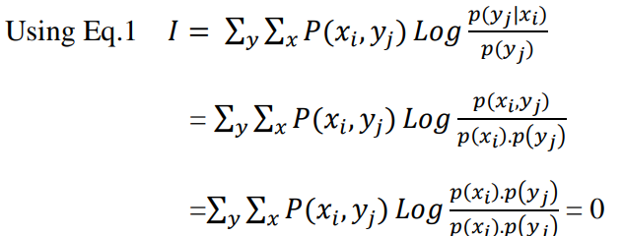
Independent Transmission
This is the opposite case of the noiseless channel, where the symbols {𝑥𝑖} are independent of the symbols { 𝑦𝑗 }, for all i and j. Thus,
note: if we have independent transmission then the average mutual information is zero, also (using the relations between entropies and average mutual information)

Slide 3
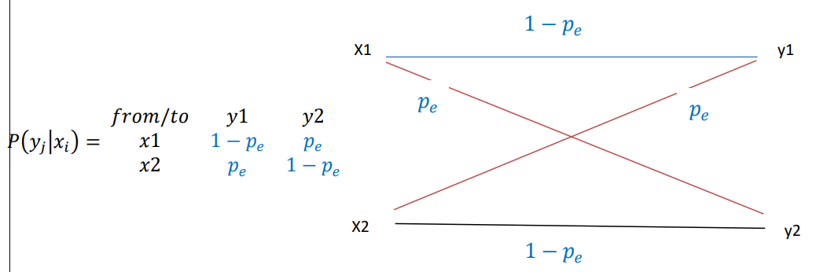
Symmetric Channels
The symmetric channels are those channels that have identical correct transition probabilities for all symbols and similarly for the incorrect transmission probability.
Example:- Binary Symmetric Channel (BSC)
its general form is given by:

Slide 4
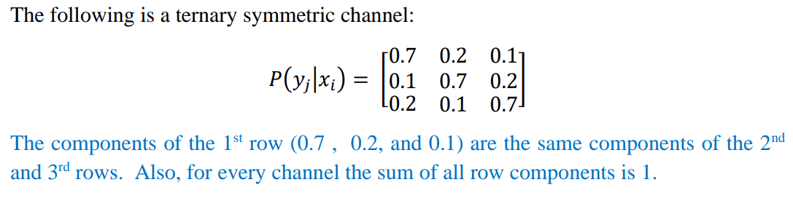
Symmetric Channels
Example:-Ternary Symmetric Channel (TSC)

Slide 5
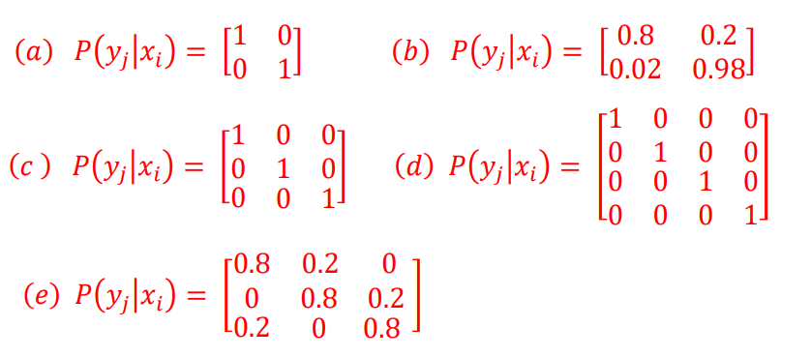
Question
Specify the type of the following channels (noiseless or/and symmetric) and then draw the model of each channel:

