Slide 1

وزارة التعليم العالي والبحث العلمي
قسم هندسة الحاسبات\كلية الهندسة\جامعة المستقبل
Information Theory and coding
lecture 12 :-
Discrete Channel Representation

Slide 2
Introduction
The discrete channel is usually described by the conditional probability 𝑃(𝑦𝑗 |𝑥𝑖). But other probabilities also used since there are different relations to determine this conditional probability. Since 𝑃(𝑦𝑗 |𝑥𝑖) is two dimensional values then it also can be given in the form of matrix with rows indicating the values of xi while yj represents its columns. The summation of each row elements of 𝑃(𝑦𝑗 |𝑥𝑖) matrix is unity (1) as in the next example.

Slide 3
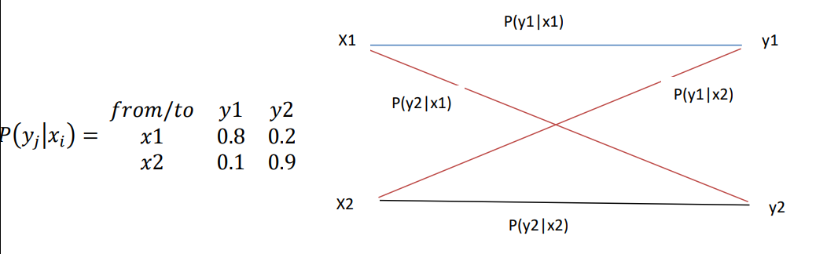
Binary Channel
The channel is called binary because its source produces binary values. The source output actually is binary “0” or “1”, but here we used x1 and x2 instead. The channel matrix and channel model of an example binary channel is given by:

Slide 4
Binary Channel
in the above model in the above slide the red transitions are the erroneous or incorrect transitions. For example: P(y1|x1) =0.8 means that 80% of x1 are received correct, while P(y2|x1) =0.2 means that 20% of the x1 are received incorrect. Similarly, for x2 90% are received correct, while 10% are received incorrect
In the above slide Assuming that p(x1)=0.6 and p(x2)=0.4, then how it is possible to calculate all entropies and the average mutual information I?

Slide 5
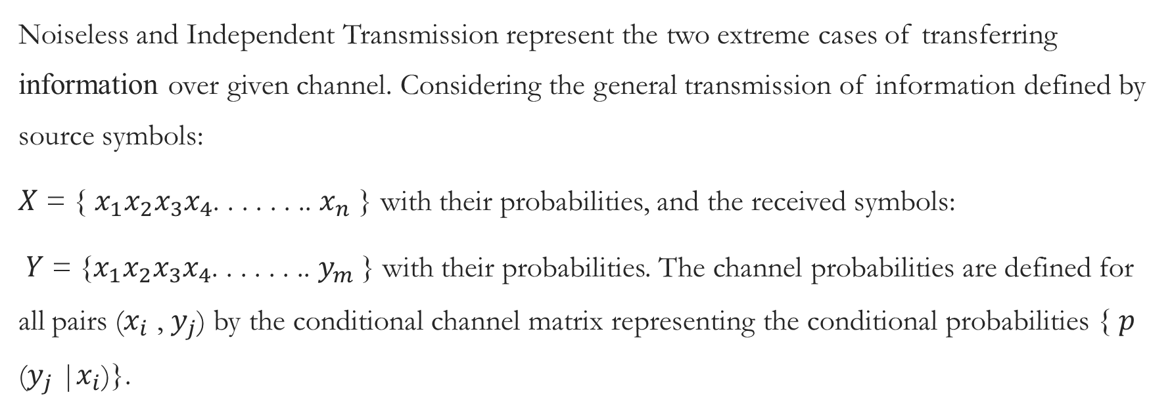
Noiseless and Independent Transmission
Noiseless and Independent Transmission represent the two extreme cases of transferring information over given channel. Considering the general transmission of information defined by source symbols:
𝑋 = { $x_{1}x_{2}x_{3}x_{4}$. . . . . . .. $x_{n}$ } with their probabilities, and the received symbols:
𝑌 = {$x_{1}x_{2}x_{3}x_{4}$. . . . . . .. $y_{m}$} with their probabilities. The channel probabilities are defined for all pairs ($x_{i}$ , $y_{j}$) by the conditional channel matrix representing the conditional probabilities { 𝑝($y_{j}$ |$x_{i}$)}.

Slide 6
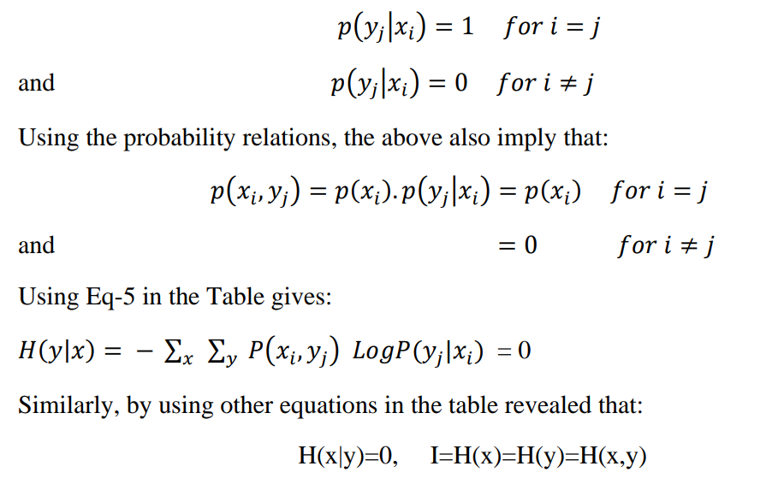
Noiseless Channel
Here the number of source symbols must equal the received symbols (N=M). The channel is called noiseless if the channel conditional probabilities are given by:

Slide 7
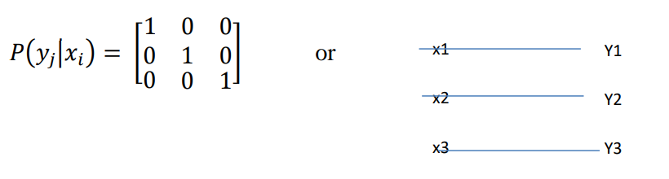
Noiseless Channel
Example:- Ternary Noiseless Channel

