Slide 1


Information Theory and coding
lecture 11:-
The Average Mutual Information

Slide 2

Introduction
The average mutual information (I) is the overall useful information transferred to the receiver from the source. The self-information of the source and the receiver symbols are given by:
Define the channel conditional information in two different ways according to the conditional probability:
The mutual information 𝐼𝑥:𝑦 is the useful information transferred from the source to the destination can be determined by:

Slide 3
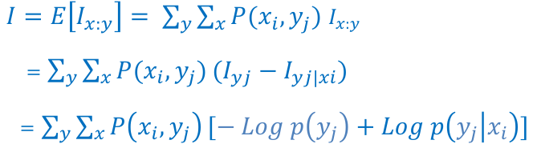


The Average Mutual Information
Taking the average (or expectation) of the mutual information gives the average mutual information (I):
The final equation can be written as :
Using the other mutual information gives:

Slide 4
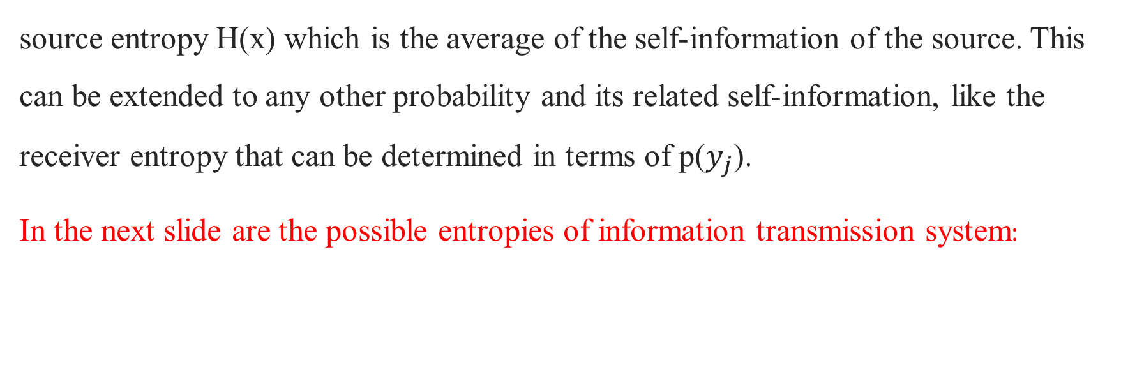
Entropies and Average Mutual Information
source entropy H(x) which is the average of the self-information of the source. This can be extended to any other probability and its related self-information, like the receiver entropy that can be determined in terms of p($y_{j}$).
In the next slide are the possible entropies of information transmission system:

Slide 5
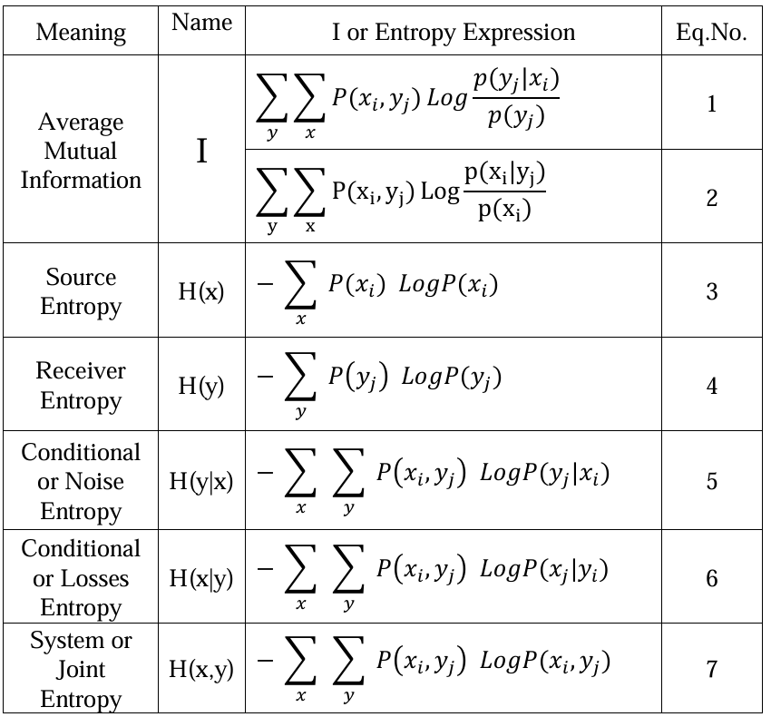

Slide 6
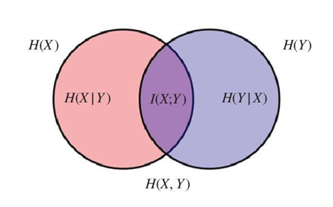
Examples
Show that
I = H(x) – H(x|y)
1- I=H(y)-H(y|x)
H(x,y) = H(y) + H(x|y)
H(x,y) = H(x) + H(y|x)
H(x,y) = H(x) + H(y) – I
H(x,y) =I + H(y|x) + H(x|y)

