Slide 1


Information Theory and coding
lecture 6 :-
Important Probability Distributions part2

Slide 2
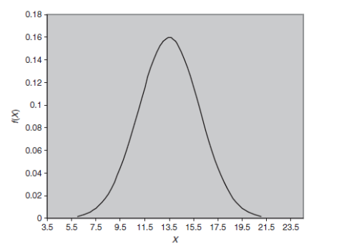
Normal or Gaussian Distribution
The following is a plot of normal pdf f(x) with mean 𝑥 = 13.5 and standard deviation 𝜎 = 2.5 as an example:

Slide 3
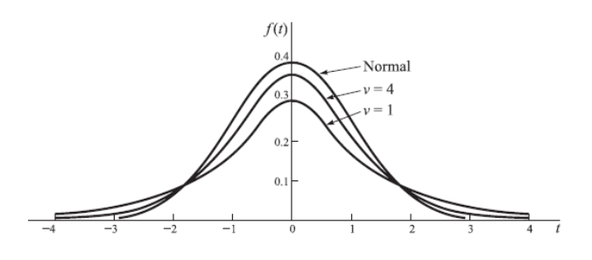
Normal or Gaussian Distribution
The change in the mean affect the positioning of the mean (shift of the curve to the left or right). The peak value in f(x)-axis of the distribution is determined by 1 𝜎 √2𝜋 while the center of the peak in the x-axis is at the mean 𝑥 (𝑖. 𝑒 𝑎𝑡 𝑥 = 𝑥). The following Normal curves with different 𝜎 and the mean is fixed at 𝑥 = 0.

Slide 4
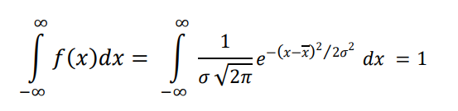
The Poisson Distribution
In any case (of the mean or the variance) the total area under normal curve is unity since it is a pdf, so:

Slide 5

The Exponential Distribution
A discrete random variable taking unbounded positive values obeys a Poisson law with parameter A if its distribution is given by:
The main application of Poisson distribution is related to queuing applications as in network access trials and cell phone calls (k is the number of users asking for the connection service. It is also an accurate approximation of binomial distribution for the case where 𝑃𝑆 𝑜𝑟 𝑃𝐹 become very small and 𝑛 very large.

