Slide 1


Information Theory and coding
lecture 2 :-
Modeling of Information Transmission System part2

Slide 2
Measuring of Information
Consider the block diagram of information transmission system model.
Source or
Transmitter
x_{i}
Channel or
Transmission Path
y_{i}
Destination or
Receiver
x_{i} = the transmitted symbol
y_{i} = the received symbol

Slide 3
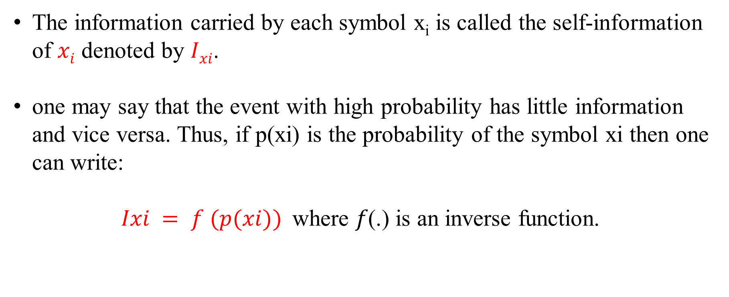
Measuring of Information
The information carried by each symbol x_{i} is called the self-information of $xi$ denoted by $Ixi$.
one may say that the event with high probability has little information and vice versa. Thus, if p(xi) is the probability of the symbol xi then one can write:
$Ixi = f (p(xi))$where 𝑓(.) is an inverse function.

Slide 4
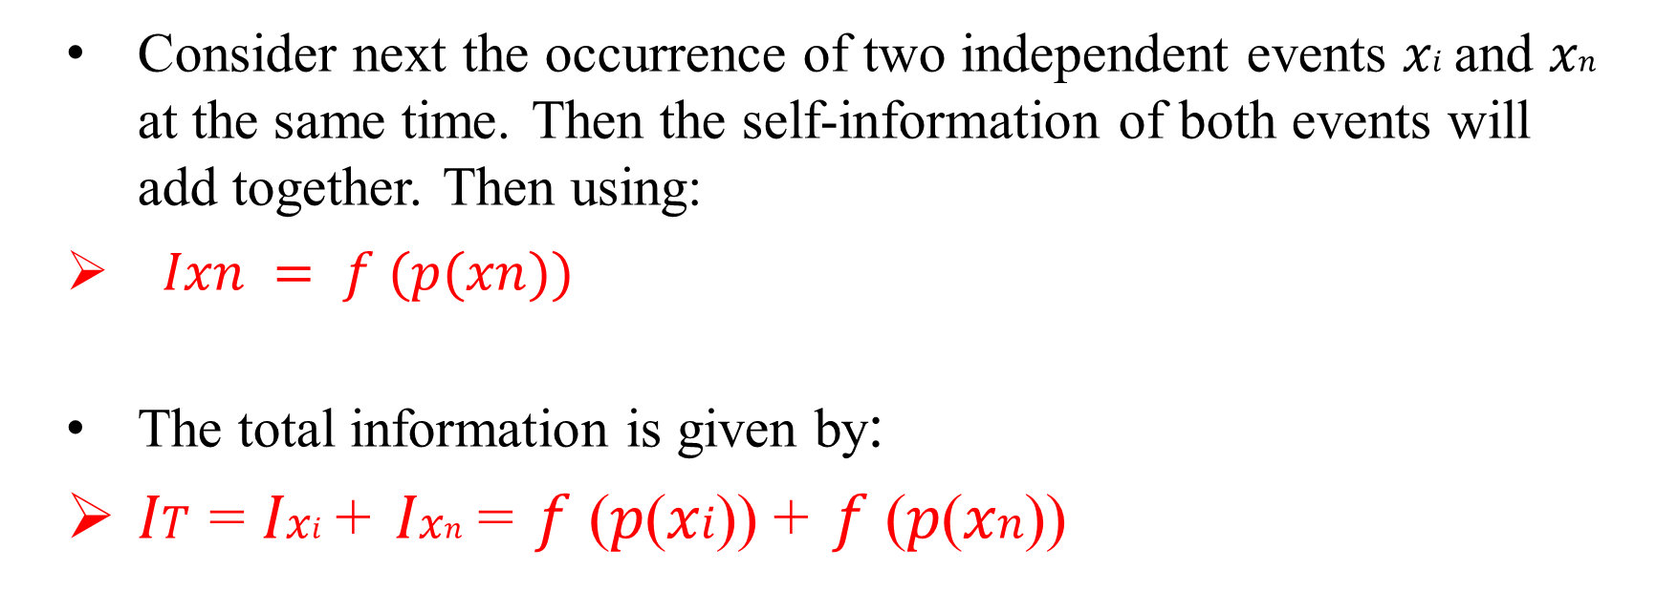
Measuring of Information
Consider next the occurrence of two independent events 𝑥𝑖 and 𝑥𝑛 at the same time. Then the self-information of both events will add together. Then using:
$Ixn = f (p(xn))$
The total information is given by:
𝐼𝑇 = 𝐼𝑥𝑖 + 𝐼𝑥𝑛 = 𝑓 (𝑝(𝑥𝑖)) + 𝑓 (𝑝(𝑥𝑛))

Slide 5
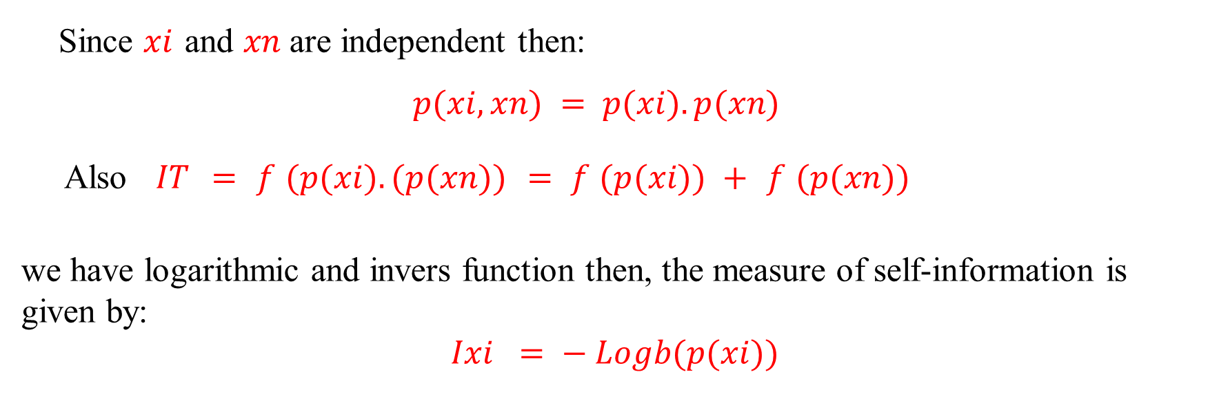
Measuring of Information
Since $xi$ and $xn$ are independent then:
$$p(xi, xn) = p(xi). p(xn)$$
Also $IT = f (p(xi). (p(xn)) = f (p(xi)) + f (p(xn))$
we have logarithmic and invers function then, the measure of self-information is given by:
$$Ixi = − Logb(p(xi))$$

Slide 6
Example-1
A bag lock consists of 3 decimal digits, find the information required to open such lock in Hartley units and in Bits.
Thank you

