Slide 1


Information Theory and coding
lecture 4 :-
Review of Probability Theory and Random Variables part2

Slide 2
Binary Symmetric Channel
Noiseless Channel:
P(0R ) = P(0T) and P(1R ) = P(1T)
P(0R | 1T ) = P(1R | 0T ) = 0 (no transition error )
Also P(0R | 0T ) = P(1R | 1T ) = 1 (totally correct transition)
Note:-in practice the channel is not noiseless (i.e. noisy).

Slide 3
Binary Symmetric Channel
Noisy Channel:
P(0R ) ≠ P(0T) and P(1R ) ≠ P(1T)
P(0R | 1T ) = P(1R | 0T ) ≠ 0 (there is transition error )
Also P(0R | 0T ) = P(1R | 1T ) ≠ 1 (partially correct transition)

Slide 4
Example
Given: P(0T) =0.6 , P(1T ) = 0.4 and P(0R | 1T ) = P(1R | 0T ) = 0.1
Find: P(0R | 0T ) , P(1R | 1T ) , all p(T∩R) , P(0R) and P(1R )

Slide 5
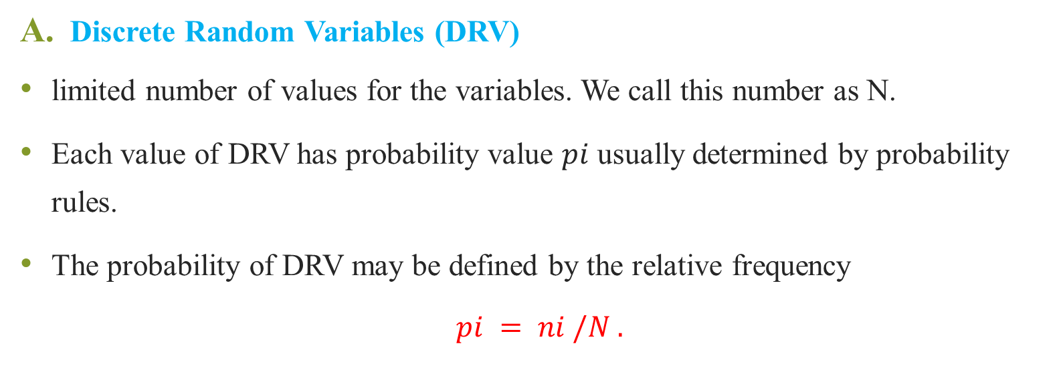
Types of Random Variables
Discrete Random Variables (DRV)
limited number of values for the variables. We call this number as N.
Each value of DRV has probability value 𝑝𝑖 usually determined by probability rules.
The probability of DRV may be defined by the relative frequency
$$pi = ni /N .$$

Slide 6
Example
In die experiment the output number is DRV. The number of variables is limited to 6, thus it is discrete random variable.

Slide 7
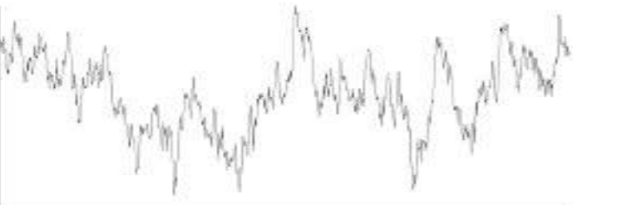
Types of Random Variables
Continues Random Variables (CRV)
In CRV, the random variable has unlimited values (N → ∞). Thus 𝑝𝑖 is undefined this case.
Example: Noise waveform

Slide 8
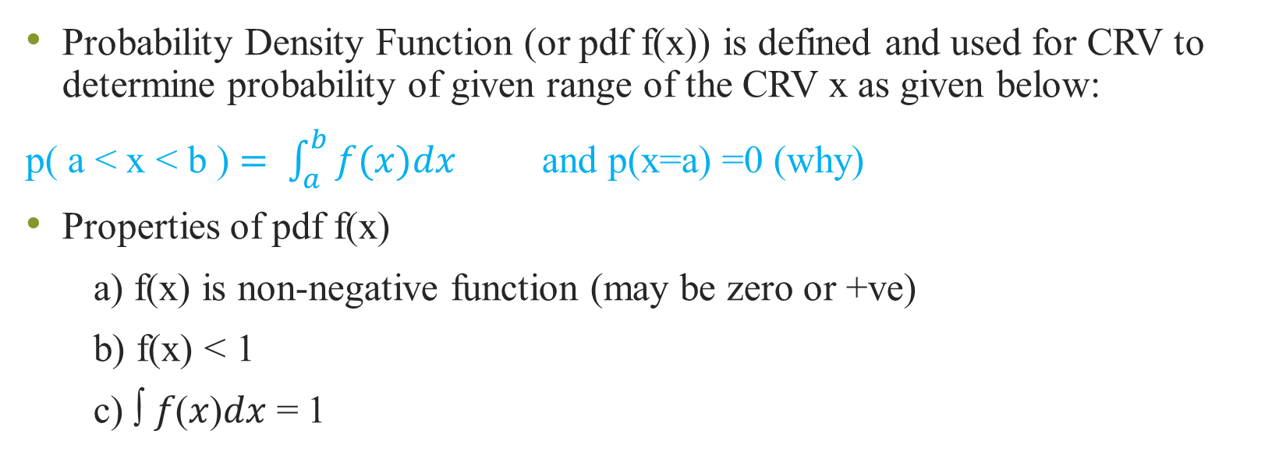
Probability Density Function (pdf) of CRV
Probability Density Function (or pdf f(x)) is defined and used for CRV to determine probability of given range of the CRV x as given below:
p( a < x < b ) $= \int_{a}^{b}{f(x)dx}$and p(x=a) =0 (why)
Properties of pdf f(x)
a) f(x) is non-negative function (may be zero or +ve)
b) f(x) < 1
c) ∫ 𝑓(𝑥)𝑑𝑥 = 1

