Slide 1

Computer Applications Lab
م م علي كريم عبيد
م آمال كريم رزاق

Slide 2
In computing, a window is a graphical control element. It consists of a visual area containing some of the graphical user interface of the program it belongs to and is framed by a window decoration. It usually has a rectangular shape that can overlap with the area of other windows. It displays the output of and may allow input to one or more processes.
Windows are primarily associated with graphical displays, where they can be manipulated with a pointer by employing some kind of pointing device. Text-only displays can also support windowing, as a way to maintain multiple independent display areas, such as multiple buffers in Emacs. Text windows are usually controlled by keyboard, though some also respond to the mouse.
A graphical user interface (GUI) using windows as one of its main "metaphors" is called a windowing system, whose main components are the display server and the window manager

Slide 3
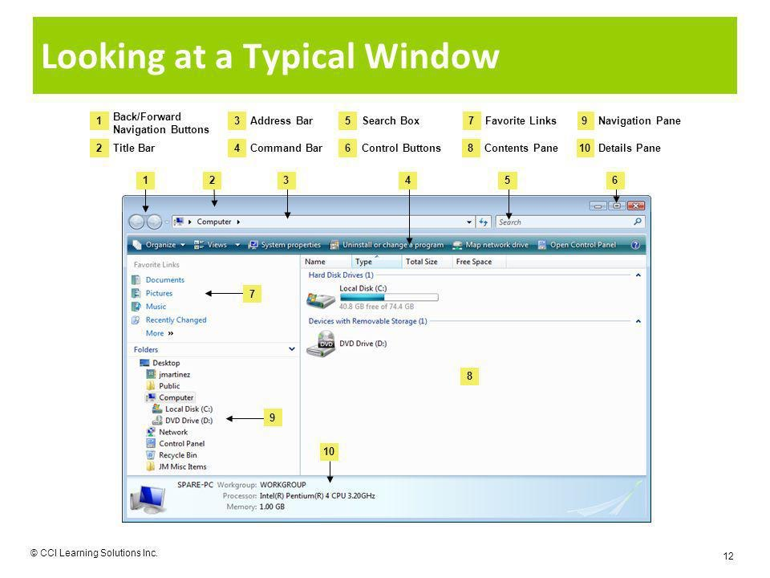
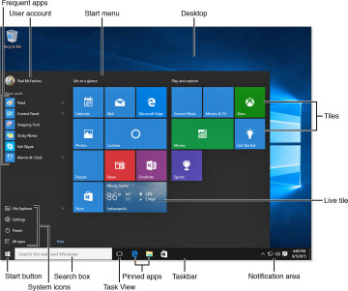
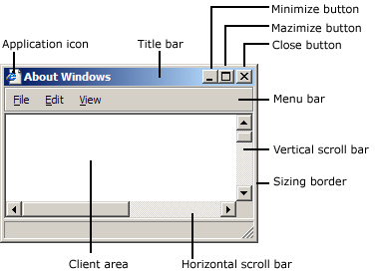

Slide 4
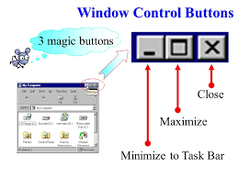
Windows Control Buttons
Minimize (Windows+D)
Maximize (Windows+ Up)
Restore (Windows + Down)
Close (Alt + F4)

Slide 5
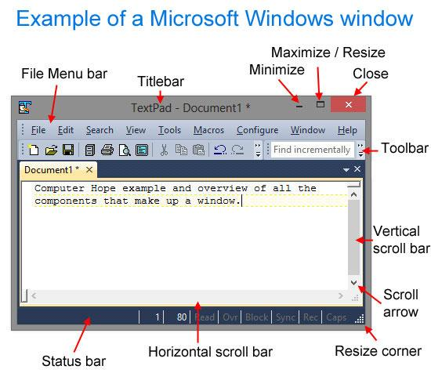
Move, Resize window
Before a window can be moved, make sure it is not maximized. A maximized window cannot be resized. If the window is maximized, click the maximize or resize button, as shown in the example below. Also, realize that not every window can be resized.
To move the window, first click and hold the left mouse button down at the top. While continuing to hold down the mouse button, move the window to where you want it to be positioned.

Slide 6
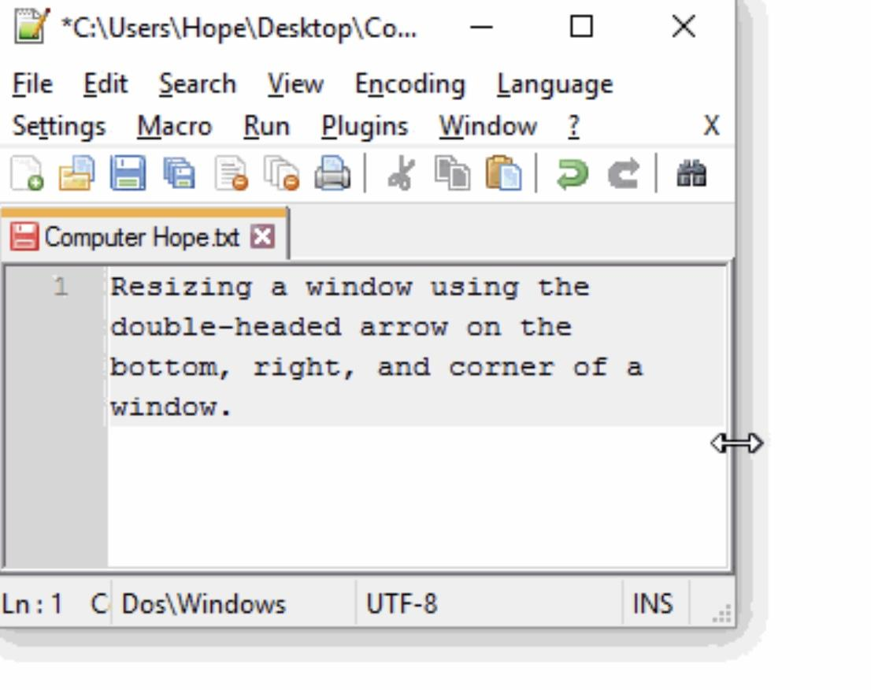
Resizing a window can be helpful in many situations. For example, you can resize a DOS command window or resize two program windows to fit both windows on the same screen. The following sections show you how to resize a window in Windows and macOS.

Slide 7
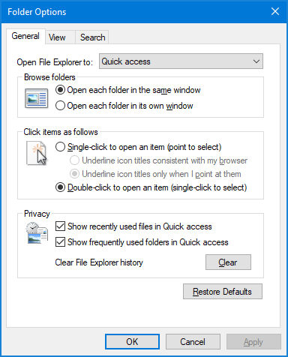
view option in window

Slide 8
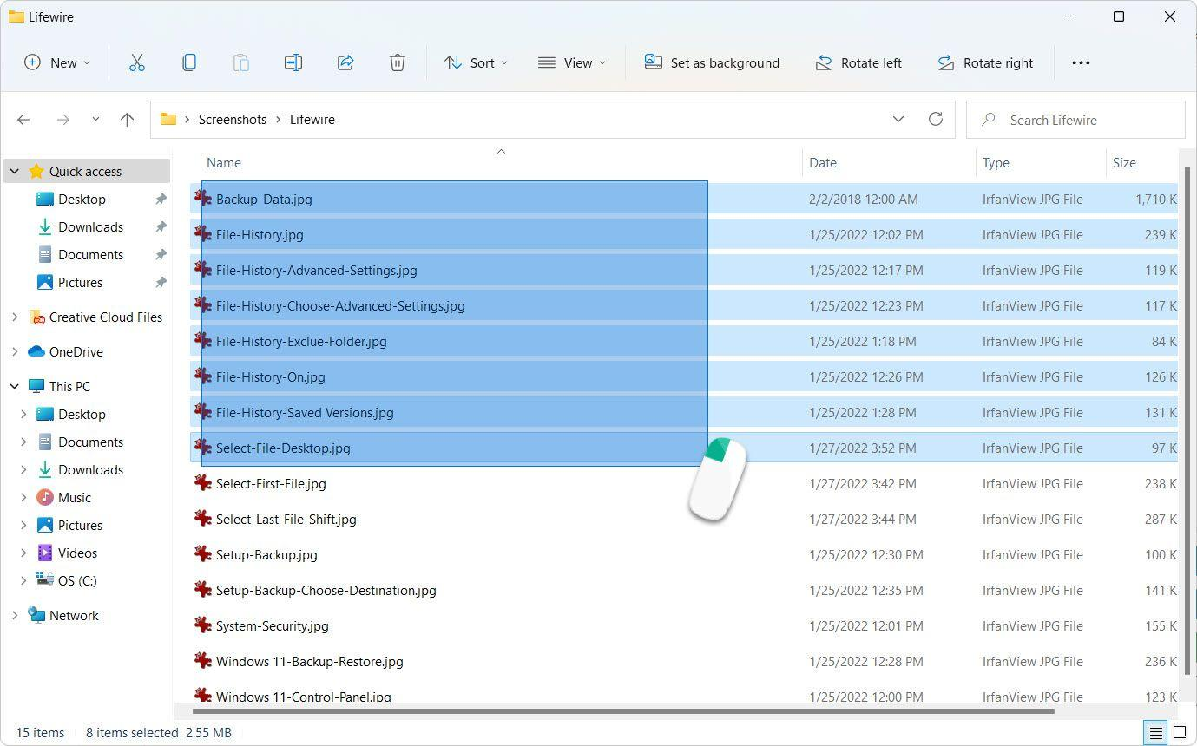
Click on one of the files or folders you want to select.
Hold down the control key (Ctrl).
Click on the other files or folders that you want to select while holding the control key.
Continue to hold down the control key until you select all the files you want.

Slide 9
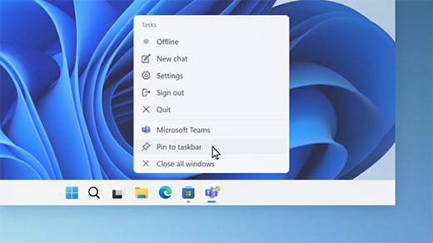
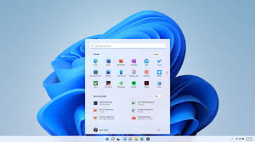
Use the taskbar to show the desktop
Press and hold (or right-click) any empty space on the taskbar, select Taskbar settings, select Taskbar behaviors, then choose Select the far corner of the taskbar to show the desktop. ...
Move the mouse over, or press, the far-right edge of the taskbar to see the desktop.

Slide 10
Thank You

