Slide 1
AL- Mustaqbal University College
Pharmacy Department
Principles of Pharmacy Practice
Lectuer: 2
Prof. Dr. Jabar Faraj AL-Wakeel
Assist. Lecturer. Mustafa Ewad

Slide 2
Abbreviations and Symbols of Prescription

Slide 3
Use of Roman Numerals on Prescriptions
Roman numerals are a numeral system that originated in ancient Rome, and are commonly used in prescription writing to designate quantities.
There are eight letters of fixed values used in the Roman system:

Slide 4
Use of Roman Numerals on Prescriptions
The student also may recall that the following rules apply in the use of Roman numerals:
A letter repeated once or more, repeats its value (e.g., xx = 20; xxx = 30).
One or more letters placed after a letter of greater value increases the value of the greater letter (e.g., vi = 6; xij =12; lx = 60).
A letter placed before a letter of greater value decreases the value of the greater letter (e.g., iv = 4; xl = 40).

Slide 5
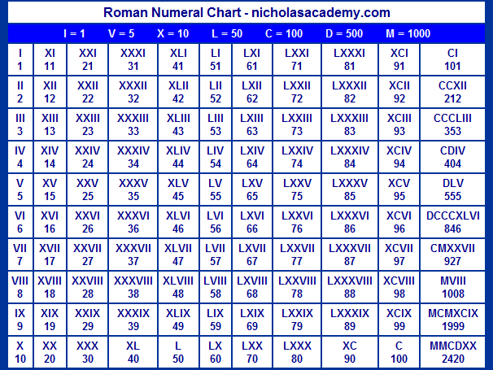

Slide 6
Use of abbreviations in prescriptions and medication orders
Standard abbreviations set to help reduce medication errors
Used to write dispensing or compounding instructions for the pharmacist (subscription) or instructions for the patient (Signa)
It is highly recommended to avoid using any abbreviations
For the purposes of this course, you need to know
Prescription filling directions
Quantity and measurements
Signa/patient instructions
Routs of administration
Dosage forms/vehicles
The correct interpretation of
these abbreviations and
prescription notations plays an important part in
pharmaceutical calculations and thus in the accurate filling and dispensing of medication.

Slide 7
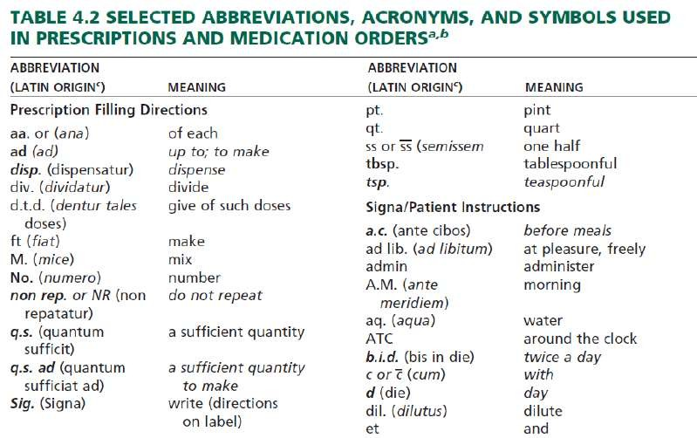

Slide 8
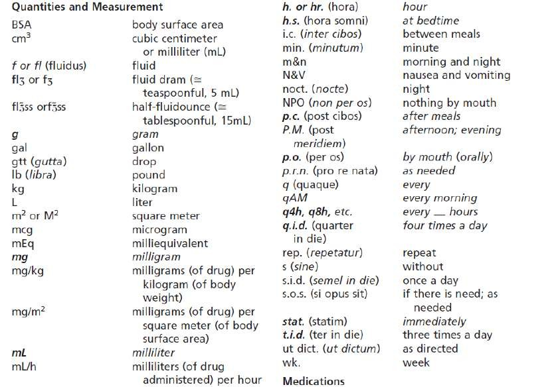

Slide 9
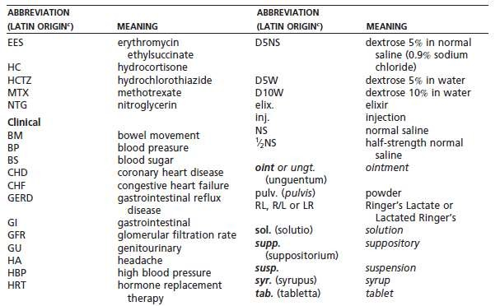

Slide 10
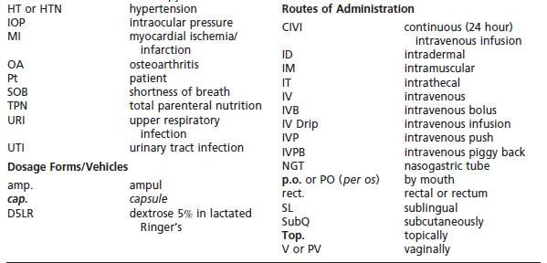

Slide 11
Use of abbreviations in prescriptions and medication orders
Examples of prescription directions to the pharmacist:
M. ft. ung.
Mix and make an ointment.
Ft. sup. no xii
Make 12 suppositories.
M. ft. cap. d.t.d. no. xxiv
Mix and make capsules. Give 24 such doses.
Examples of prescription directions to the patient:
Caps. i. q.i.d. p.c. et h.s.
Take one (1) capsule four (4) times a day after each meal and at bedtime.
gtt. ii rt.eye every a.m.
Instill two (2) drops in the right eye every morning.
tab. ii stat tab. 1 q. 6 h. 7 d.
Take two (2) tablets immediately, then take one (1) tablet every 6 hours for 7
days

Slide 12
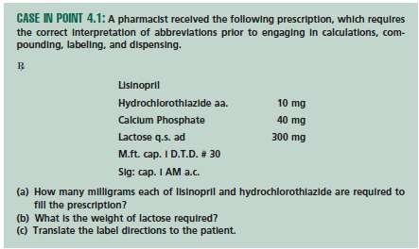

Slide 13
Solution of Case In Point 4.1
aa. means ‘‘of each,’ i.e. 10 mg of each lisinopril and HCT needed for each cap.
q.s. ad means ‘‘a sufficient quantity to make,’’ That mean sufficient quantify
of lactose to make the total weight of each cap 300 mg
wt. lactose = 300 mg – (wt. lisinopril + wt. HCT+ wt. calcium phosphate) =
= 300 – ( 10+10+40)
= 240 mg
M.ft. cap. I : means Mix and make one capsule
D.T.D. # 30 : means Give of such 300 mg cap doses,’’ 30 capsules
So weight of each drug in the prescription will multiplied by 30
Lisinopril = 10 * 30 = 300 mg
HCT = 10 * 30 = 300 mg
Calcium phosphate = 40 * 30 = 1200 mg
Lactose = 240 * 30 = 7200 mg
C) Sig: Cap I AM ac : Take one (1) capsule in the morning before breakfast.

Slide 14
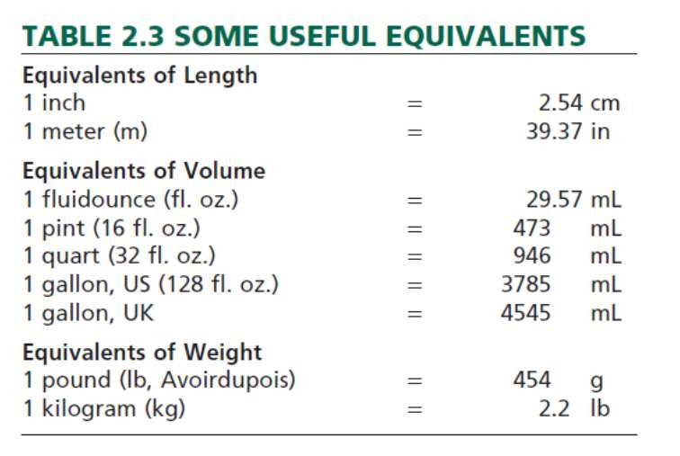
SI (International System) Metric Units of Weight and Measurement vs The Apothecaries’ System

Slide 15
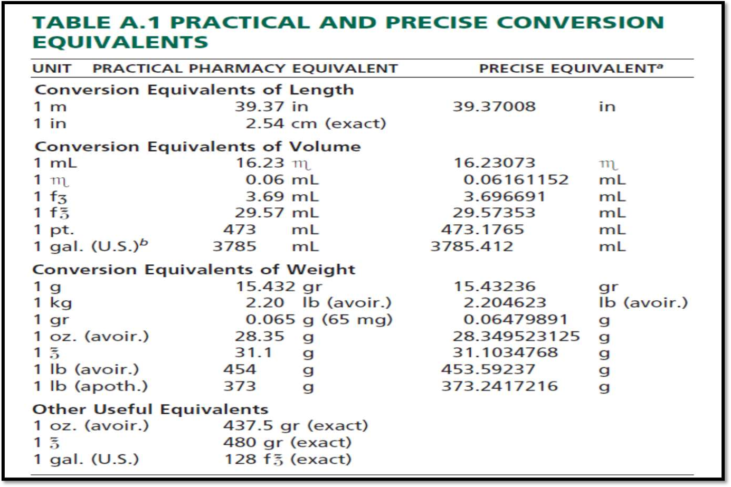

Slide 16
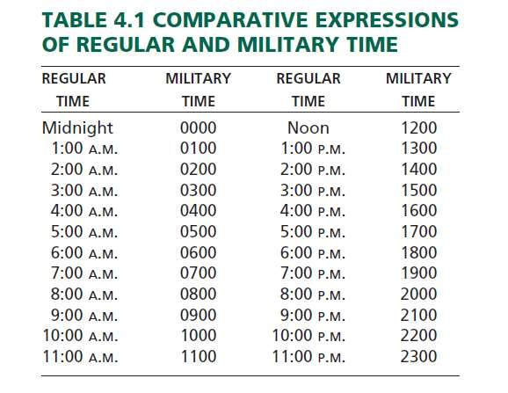
Military Time
Its use provides a clear expression of time.
In health care institutions, military time may be used to record the time of a patient’s admission, when a medication was administered, the time of surgery, and so forth.

Slide 17
Medication Scheduling & Patient Compliance
Medication scheduling may be defined as the frequency (i.e., times per day) and duration (i.e., length of treatment) of a drug’s prescribed or recommended use.
Patient compliance: patient understanding and adherence to the
directions for use.
Compliance includes taking medication
at the desired strength
in the proper dosage form
at the appropriate time of day and night
at the proper interval for the duration of the treatment
with proper regard to food and drink and consideration of other concomitant medications

Slide 18
Medication Scheduling & Patient Compliance
Patient noncompliance: failure to comply with a practitioner’s or labelled direction in the self-administration of any medication.
Noncompliance may involve underdosage or overdosage
Inconsistent or sporadic dosing
Incorrect duration of treatment
Drug abuse or mis-adventuring with medications

Slide 19
℞ Hydrochlorothiazide
Example 1:
50 mg
No. XC
Sig. i q AM for HBP
If the prescription was filled initially on April 15, on about what date should the
patient return to have the prescription refilled?
Prescription is for 90 tablets (XC means: 100 (C) – 10 (X) = 90)
Patient should come back for refill in about 90 days or 3 months which is around July 15 because he should take one every day

Slide 20
℞ Penicillin V Potassium Oral Solution
Example 2:
125 mg/5 mL
Disp. mL
Sig. 5 mL q 6h ATC 10 d
Q.1: How many millilitres of medicine should be dispensed? Answer:
5 mL times 4 (doses per day) equals 20 mL times 10 (days) equals 200 mL.
Q.2: What is the percent compliance rate if a patient received a 30-day supply of medicine and returned in 45 days for a refill?

